Slide 1
Git & Instructions for test!

Slide 2
Using branches in git!
What is a branch?

Slide 3
Branches
In git, we have a master branch, where our main code is going to go.
If we are working in a big company, it doesn’t make sense for all developers to work on the master at the same time. It will cause a lot of confusion and conflicts. So, we use branches!

Slide 4
Master REPO
Commit
Make a branch
Branch
Commit
Merge with master
Commit
Commit

Slide 5
Branches allow us to work on smaller features which will then be merged with the master branch.
This lets developers work without affecting the master.

Slide 6
In order to merge, we sometimes make a pull request. A pull request asks for the changes to be pulled into the master branch. We can make a pull request on github.

Slide 7
Instructions for test

Slide 8
Go to *link will be given later*

Slide 9
Clone the repository in your terminal.
git clone <https link>

Slide 10
Make a new branch!
git checkout -b name-branch

Slide 11
Open the directory that you just cloned.
Inside you will find the test!

Slide 12
Copy the test folder and rename it to “answers_yourname”
PLEASE work from this new folder “answers_yourname”.
Eg. “answers_fran”

Slide 13
When you’re finished with your test, go to the command line and add your folder named “answers_yournamme”
git add answers_yourname

Slide 14
Then, commit your folder.
git commit -m “test answers -fran”

Slide 15
Then, push your folder.
git push
git push --set-upstream origin branch-name

Slide 16
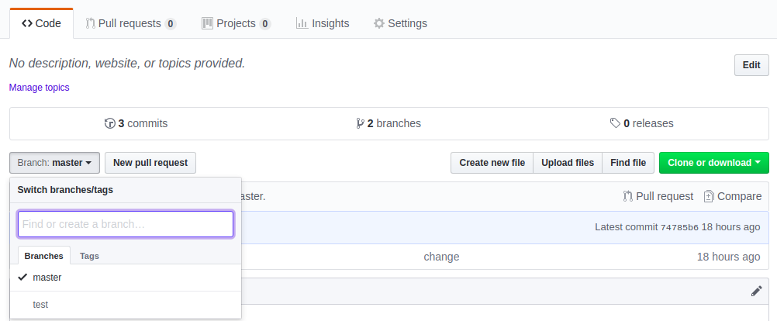
Then, go to github to make a pull request.
Find the repo, and go to your branch.

Slide 17
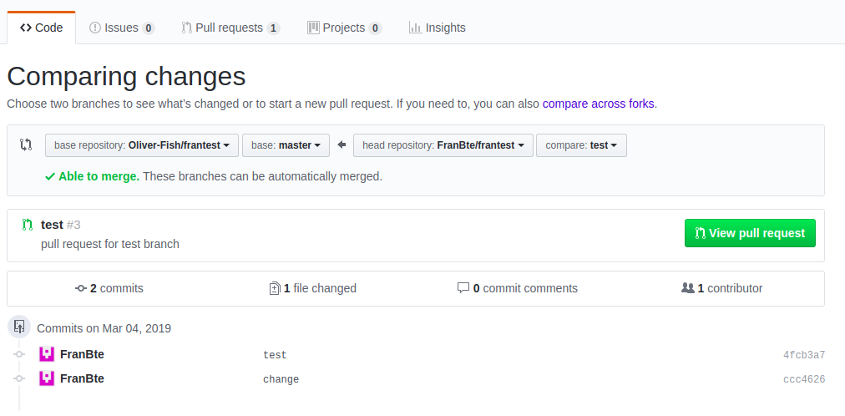

Slide 18
That’s it!
Do not merge the pull request, we will look over your test answers.

