Slide 1
Object Detection
We ai training
Bassam ashraf

Slide 2
Description
In this project we need to try to detect object like: cars, bags and people.
Using website roboflow to help us to create a dataset.
Run our code in google colab.

Slide 3
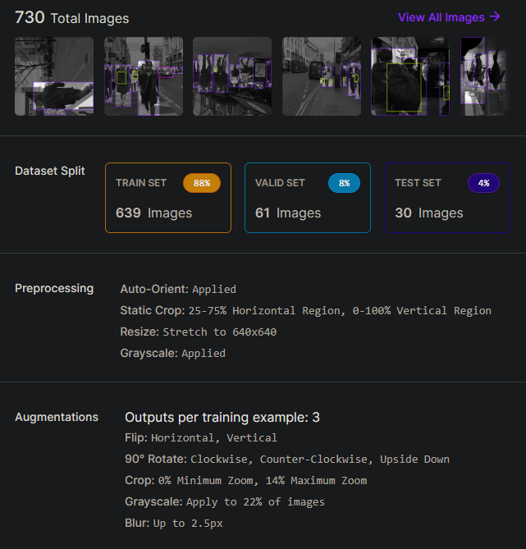
dataset
This our dataset that we tried to work on it.
Dataset contain 730 images.
We spilt our dataset to:
Training set 88%
Valid set 8%
Test set 4%

Slide 4
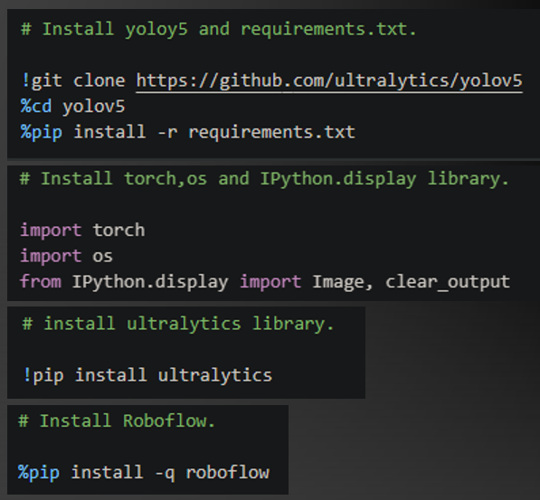
Code: Libraries
In this section of code we import and install the libraries that we will use like:
Yolov5
Requirements.txt
Torch
OS
Ipython display
Ultralytics
Roboflow

Slide 5
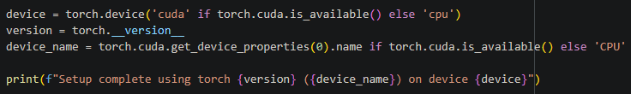
Hardware
Here we check if code can run on GPU rather than CPU.

Slide 6
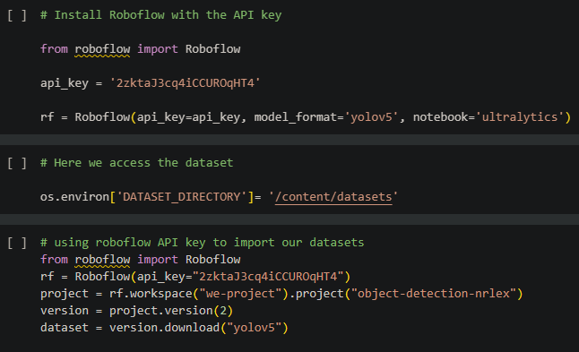
Import datasets from roboflow using API key
Now its time to import our dataset that we manage to make it from Roboflow website.
First: we will install Roboflow with API key that belong to our dataset.
Second: Accessing and downloading the dataset using API key.

Slide 7
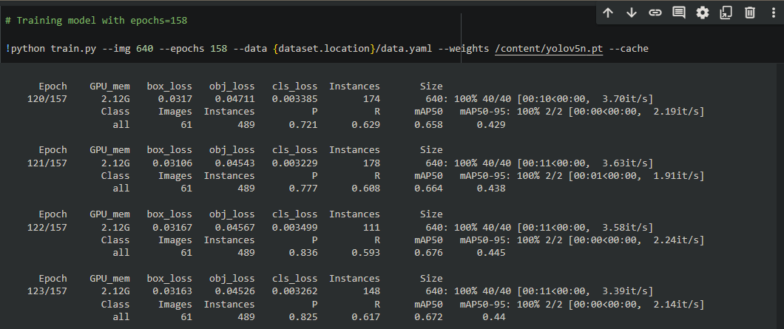
Training model
This part of training model.
Images size 640x640
Epochs 158

Slide 8
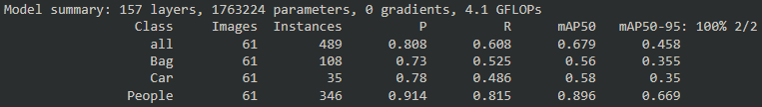
Result of model
Bag:
Precision: 73%
Recall: 52.5%
mAP: 56%
Car:
Precision: 78%
Recall: 48.6%
mAP: 58%
People:
Precision: 91.4%
Recall: 81.5%
mAP: 89.6%

Slide 9
Result of model
Total:
Precision: 80.8%
Recall: 60.8%
mAP: 67.9%

Slide 10
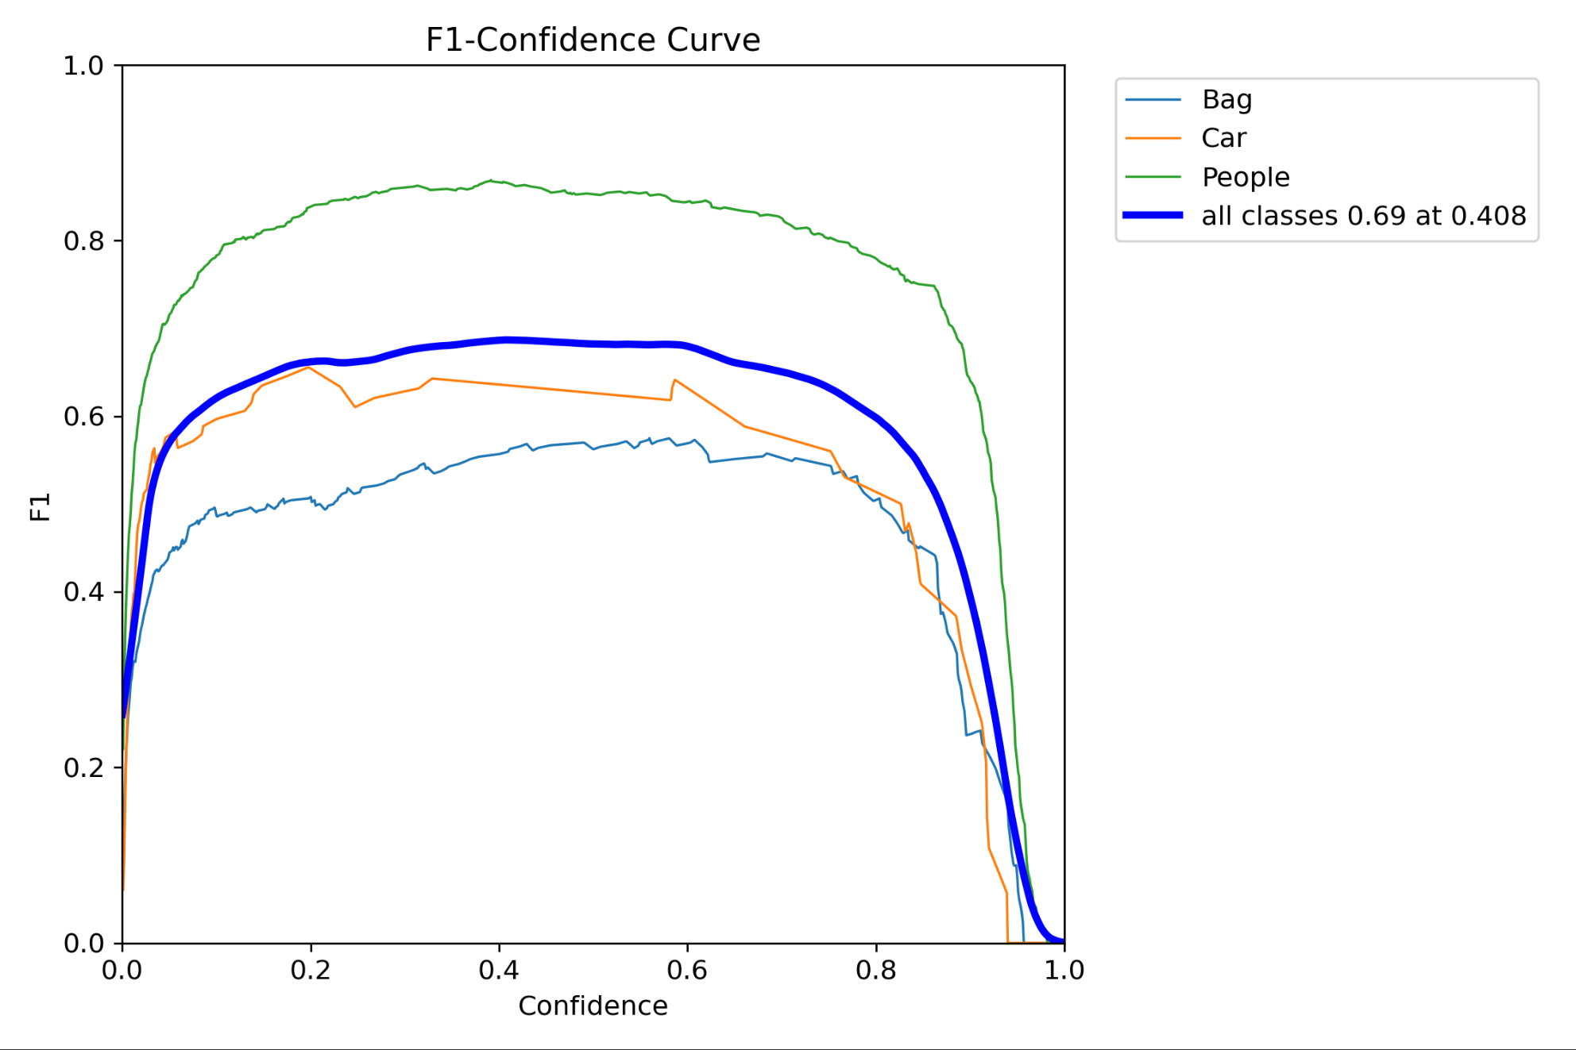
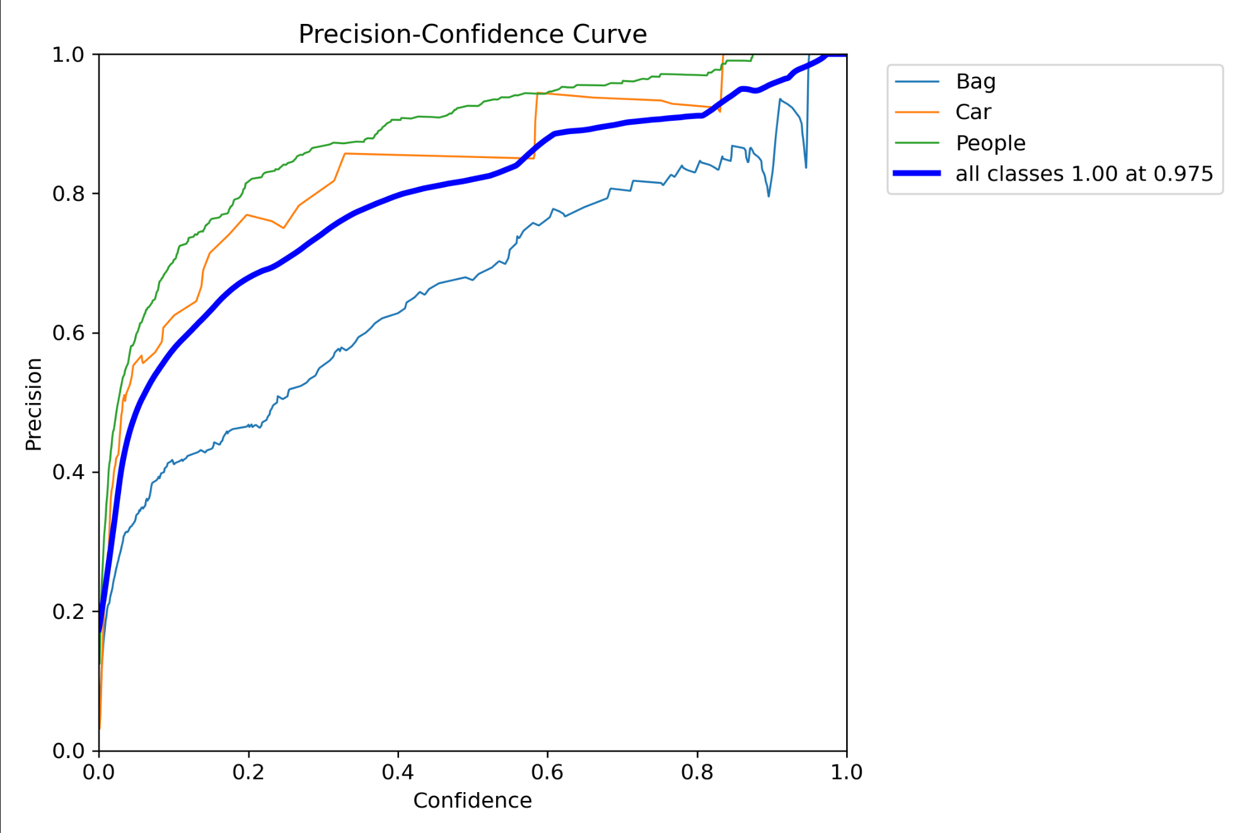
F1 & P curves

Slide 11
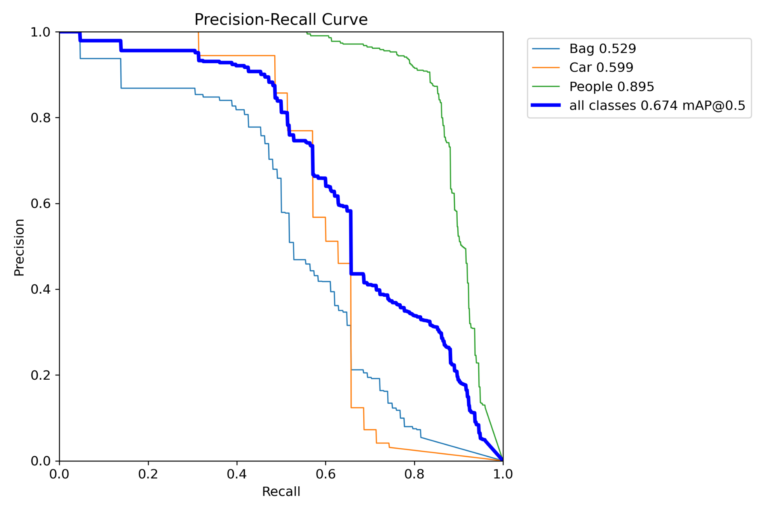
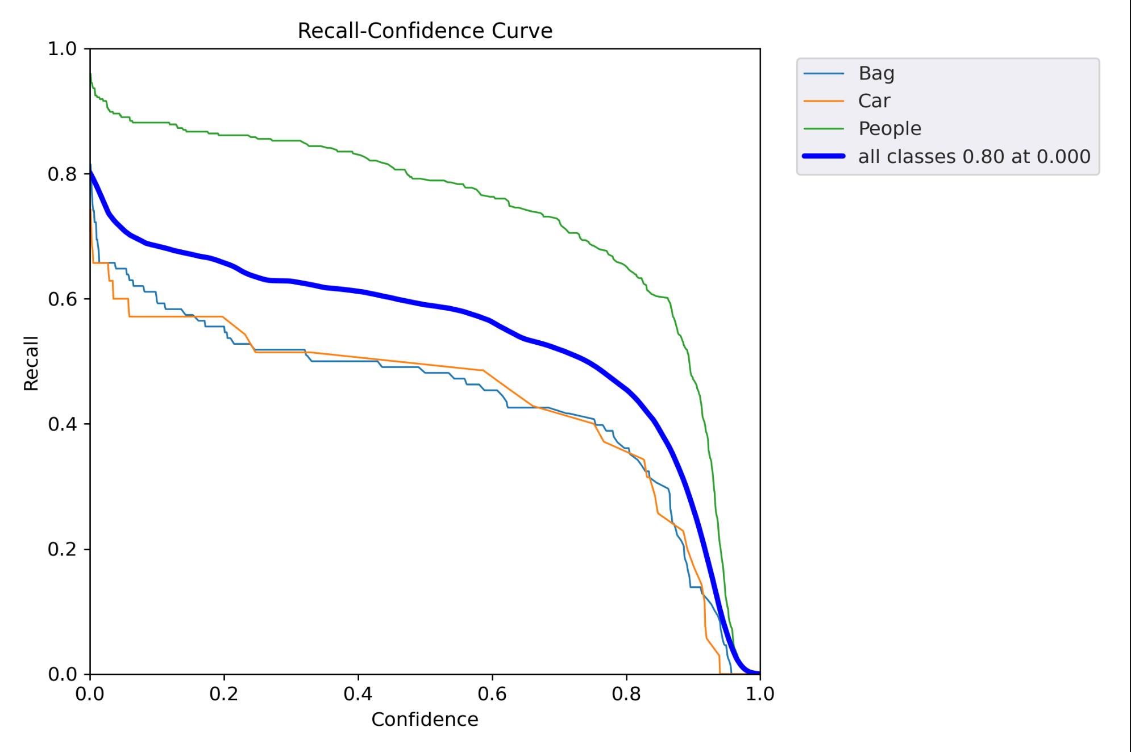
Precision & Recall Curves

Slide 12
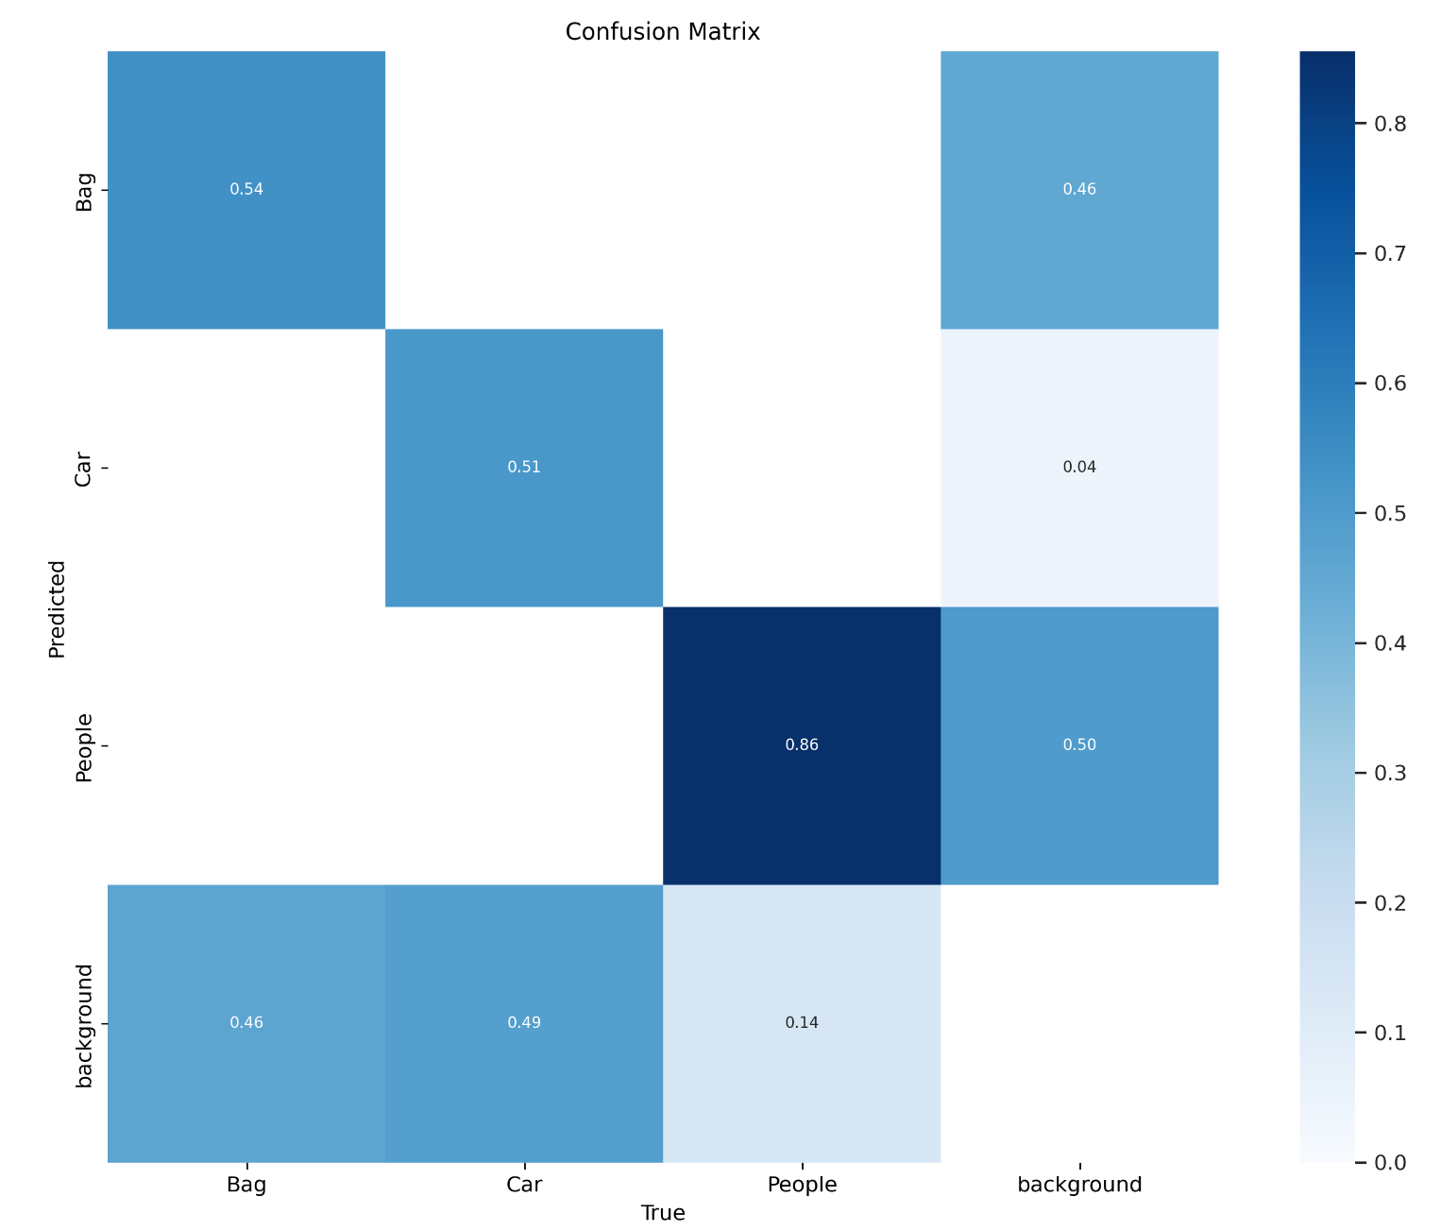
Confusion Matrix

Slide 13
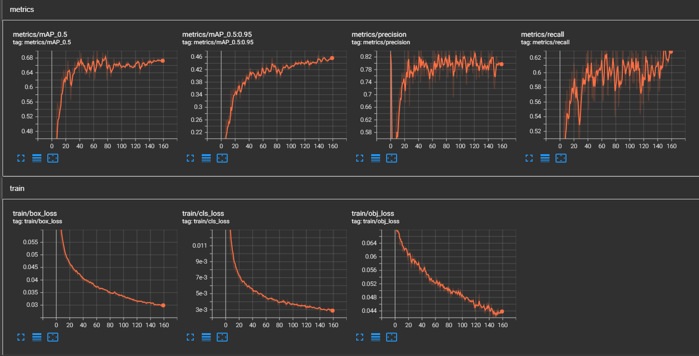
Metrics & train

Slide 14
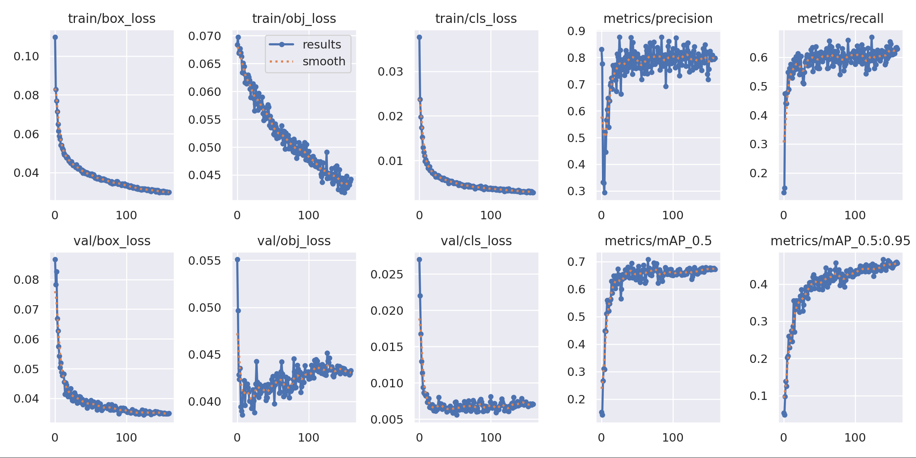
Results

Slide 15
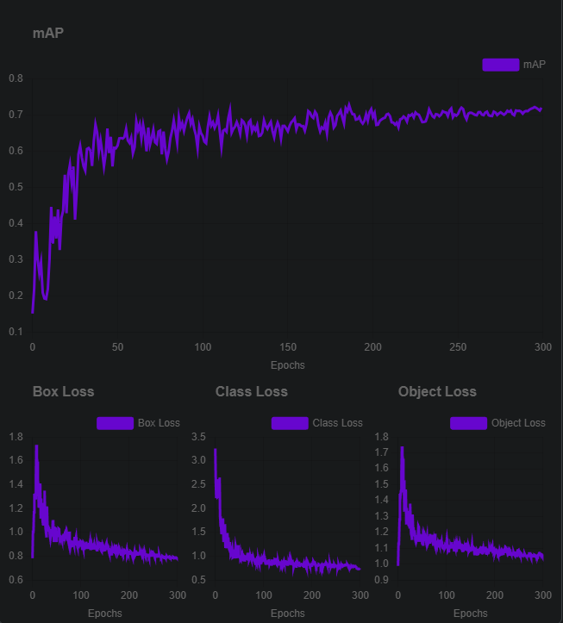

Roboflow result

