Slide 1
Analyzing nba statistics with MACHINE LEARNING.
Bassam Aziz

Slide 2
ABSTRACT:
Basketball Analytics has experienced a major revolution within the past 10 years. Today many Basketball teams use Analytics in order to optimize their teams. The result has been a major impact on how the game is played, particularly offense. Teams are more focused then ever on maximizing efficiency and assessing talent/value. Many advanced offensive stats are used to model and predict the success of an NBA team/ player. Whereas some metrics seem to convey the value of a player or a team with great accuracy we should still be cautious about how much faith we place in certain metrics. At the end of the day they are not necessarily objective. The two stats we will be looking at are Offensive Rating(ORTG) and Player Efficiency Rating(PER)

Slide 3
Libraries and sources used
SKLEARN(regression, randomforrestclassifier), PANDAS, MATPLOTLIB.
Basketballreference.com

Slide 4
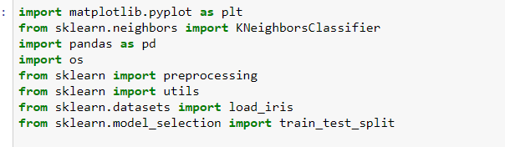
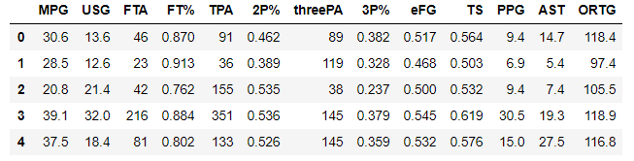
OFFENSIVE RATING (ORTG)
A metric that estimates how many points an individual player produces per 100 team possessions. We are going to use machine learning to see in order to show shooting stats such as FG%, 3P%, PPG, APG to see the correlation between offensive efficiency.

Slide 5
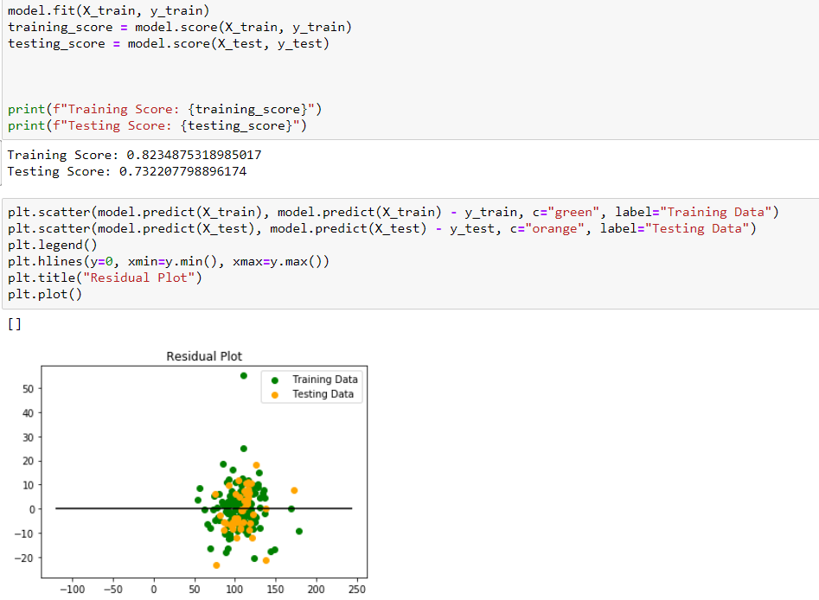
The next part of this analysis entails looking at the data and finding a correlation with other X
Values and Offensive Rating (ORTG) to see if is a valuable metric. Offensive stats such as FG%, 3PT% and PPG were taken into account. The linear regression model shows predicts a strong correlation between these states and ORTG considering all these factors are related to offensive production and efficiency.

Slide 6
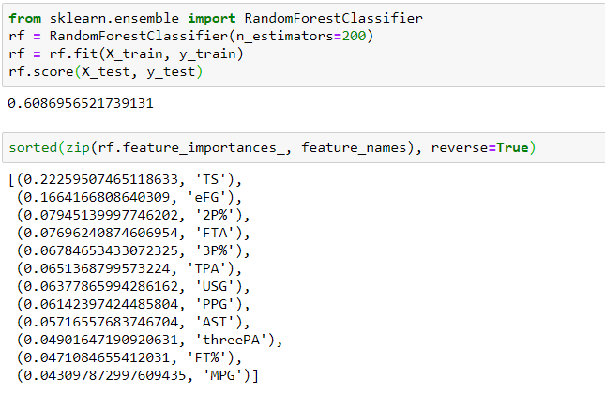
Using RandomForrestClassifier to uncover significant factors
In order for me to examine significant factors individually when it came to ORTG I had to classify ORTG into different categories with 108.5 being the league average. By classifying ORTG values into brackets I was able to find significant factors.
This shows a strong correlation between ORTG and shooting efficiency and Offensive Production.

Slide 7
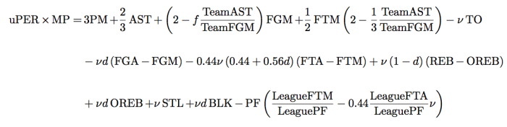
Player Efficiency Rating(PER)
“The player efficiency rating (PER) is John Hollinger's all-in-one basketball rating, which attempts to boil down all of a player's contributions into one number. Using a detailed formula, Hollinger developed a system that rates every player's statistical performance.”

Slide 8
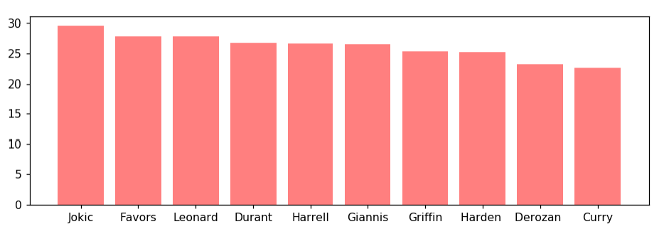
Player “Efficiency” Rating
Before I examined the factors related to PER I decided to see who the leaders of this
Statistic where. What I found where certain placements within the rank despite not many of the leaders not being seen as better by people ranked below them.
Below are the 2018-2019 leaders in PER

Slide 9
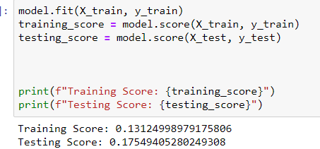
Given this information I wanted to see if those same metrics used in the ORTG would reflect as strongly in a Linear Regression model. That although many of the leagues best players have high a PER many role players and even inefficient scorers are above them.

Slide 10
OFFENSIVE RATING(ORTG) vs. PLAYER EFFICIENCY RATING(RTG)
-ORTG is a simple but effective metric that clearly examines points production
-PER is an all in one stat which makes it difficult to pinpoint exactly what it describes
-ORTG favors efficient scoring especially in high volume, making it useful for understanding the pace of an offense
-The All in One nature (and misleading name) of PER seeks to make an overall rating but fails to take the most important aspect of the game into a great enough account.
-ORTG is dictated by the pace at a certain player or team plays in but is useful for determining many things suchs as play style, efficiency and possibly even defense.

