Slide 1
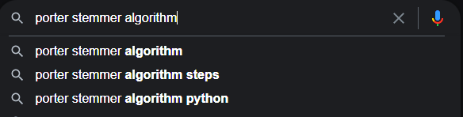
INFORMATION RETRIEVAL SYSTEM
PREPARED BY:
BASSAM NAEEM (12)
SARIA AHMED (63)

Slide 2
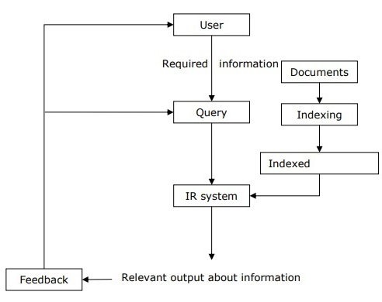
Description:
IRS is a method used to extract chunks of required information to a user through a series of different tasks.
The first task of an IR system is to preprocess documents. In this context, we consider the following steps: document granularity, tokenization, stemming and text normalization etc.

Slide 3
Tokenization: splitting up a larger body of text into smaller lines, words or even creating words for a non-English language.
Boolean operations: Boolean Operators are simple words (AND, OR, NOT or AND NOT). Boolean operators are useful in saving time by focusing searches for more 'on-target' results that are more appropriate to your needs, eliminating unsuitable or inappropriate.
Nltk: Natural Language toolkit is used for building up Python programs to work with human language data. In here nltk is being used for tokenization and stemming.
Tkinter: Tkinter is the standard GUI library for Python. Python when combined with Tkinter provides a fast and easy way to create GUI applications.
Porter stemmer: Stemming is the process of reducing a word to its word stem that affixes to suffixes and prefixes or to the roots of words it was introduced by Martin Porter in 1980.
Exception: Exception handling is been implied to reduce run time errors

Slide 4
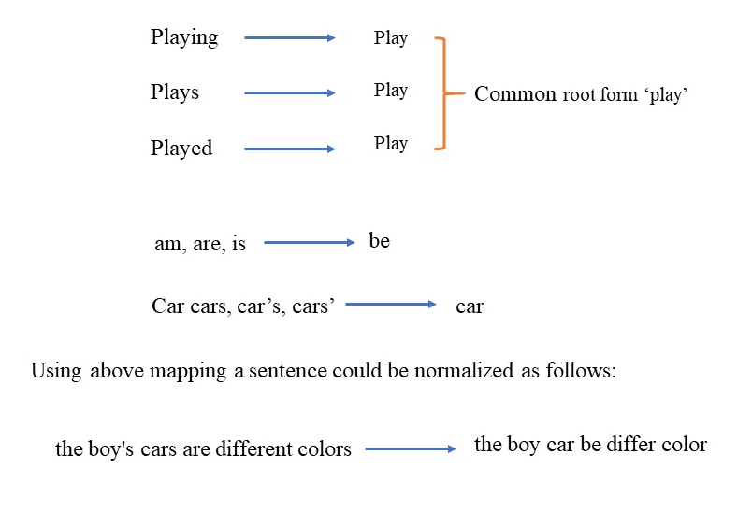
Porter Stemming

Slide 5
Indexing System : Indexing and searching methods and procedures (an indexing system can be human or automated);
Collection of documents : Text, image or multimedia documents, or document surrogates (for example bibliographic records).
Defined set of queries: Which are input into the system, with or without the involvement of a human searcher; and
Evaluation criteria: Specified measures by which each system is evaluated.

Slide 6
تخلیَہ

