Slide 1
ACME POC
API Enablement & Orchestration using Mule ESB

Slide 2
Agenda
Problem Statement
Business Opportunities.
Design Decisions
POC

Slide 3
Problem Statement
ACME Airline looking For
Exposing their business to external or internal customers.
Query their flight data resources warehouse by different criteria.
More readable data format between consumers and providers.
Verbal Communications between consumers and providers.
Flexible configurations to switch between environments.
Shared Configuration module to fasilite deployment process and avoid duplicate components.
Contract First API enablement.

Slide 4
Business Opportunities
Mule supports seamless business integration by connecting with customer and understand their requirements, this can be done in mule through API Design phase, this phase will resolve ACME concerns with contract first design, Using RAML core and advanced components will add a lot of powerful and ready tools without adding more tasks over development phase like validation of user inputs, federation of request, mocking the request, etc.….
Deployment process with mule is straight forward, Mule applications based on Maven which can be easily integrate with any CICD process pipeline.
Like any secure, scalable, configurable application, mule applications can be configured based on environment like dev, test and prod, configuration can be based on YAML or JSON format.
Since Mule applications based on Maven, it’s easy to leverage any module by adding dependencies to POM, dependencies can be domain module or connector modules or any Maven module

Slide 5
Business Opportunities-Cont
Exposing ,manage life-cycle, document, mocking and federate Client API can be easily managed by Mule API manager.
Mule has huge repository of connectors; we can leverage them to speed up development phase.

Slide 6
Design Decisions
Exposing Client API should be handled by another management layer than ESB, ESB should only concentrate on implementation and resolving business concerns, this can be handled by API Manager.
REST architecture allows API providers to deliver data in multiple formats such as plain text, HTML, XML, YAML, and JSON, the lightweight and human-readable JSON format has also quickly gained traction, as it’s super suitable for quick and painless data exchange.
HTTP Verbs: during POC we will use GET,POST and Patch, Choosing Patch over Put for example because some use cases asked for only one change in resource.
POC extensively using Mule core and advanced components like RAML[ traits , resource types and complex data Types Schemas], Mule [http connector, database connector, APIKIT router, errorHandling, Dataweaver, flow controls, flow references, properties and scopes]

Slide 7
POC
The POC has two modules
Domain Module
Mule Application

Slide 8
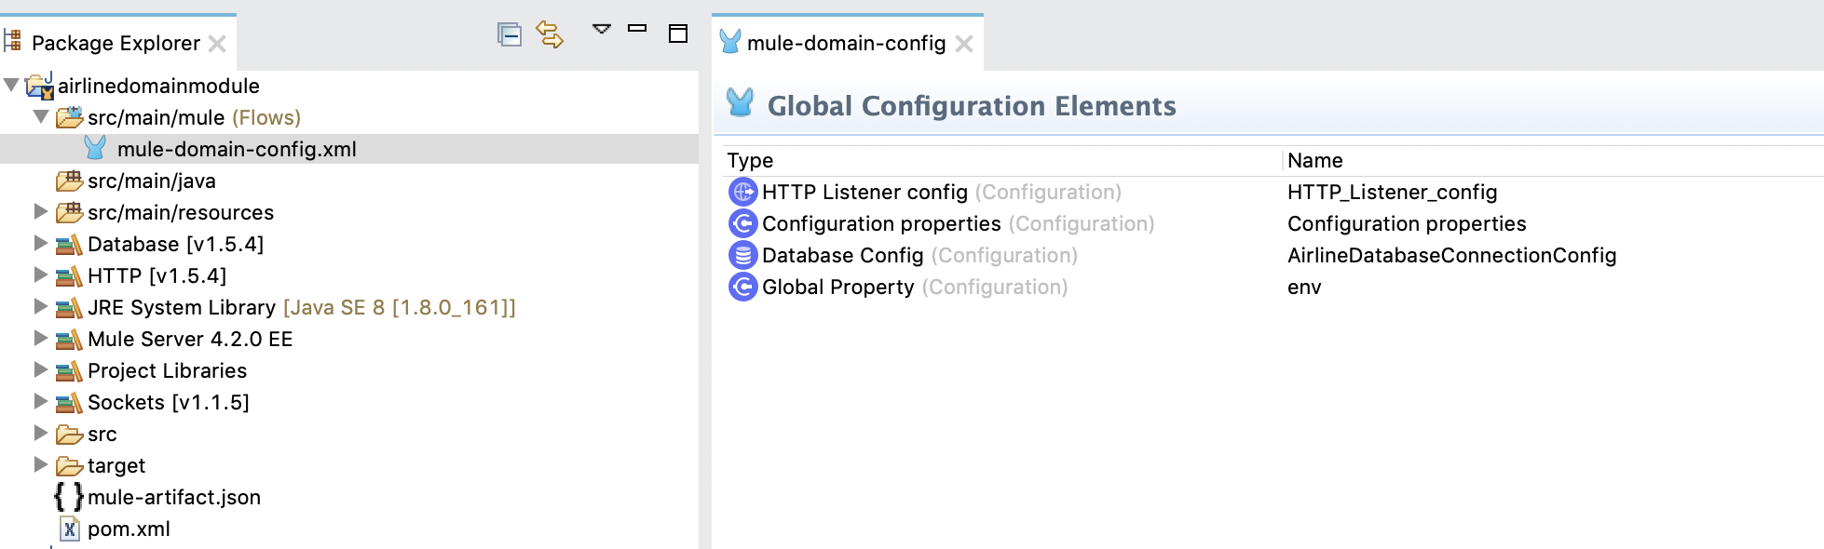
POC- Domain Module
Domain module contains all required configuration for POC plus all the dependencies required

Slide 9
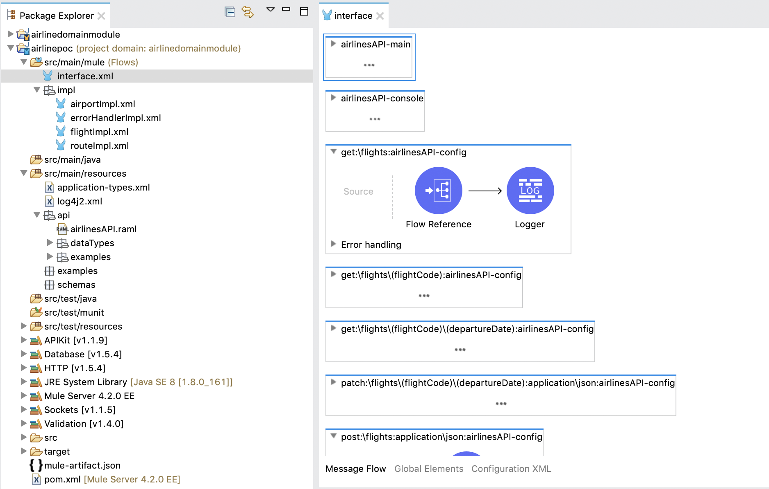
POC- Mule Application
The application leverages domain module
Interface represents APIKIT router implementation.
Impl: represents all implementation categorized by resource Type

Slide 10
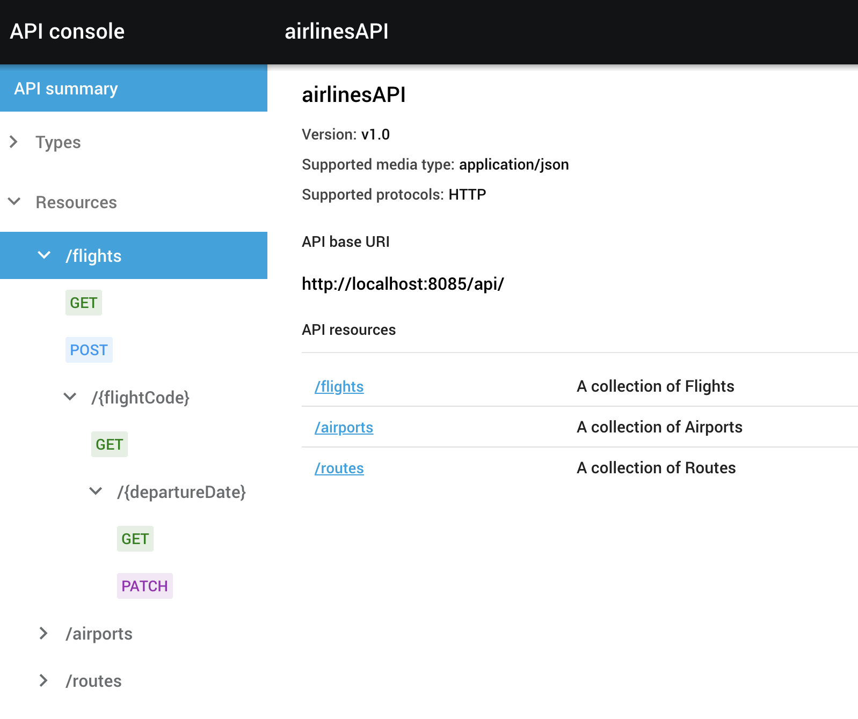
POC- Testing
POC can be tested using file attached to Git ‘ACME Airline.postman_collection.json’ its postman project.
It can be tested from mule console as well

Slide 11
POC- resources
Projects are available under
https://github.com/BassemElsodany84/mule4-AcmeTravel

