Slide 1
Pair Sum search
(instance simplification)
Bassem Osama

Slide 2
Definition
Implementation
The solution is to find the sum of addition between pairs in the given array that equal the target sum, First we iterate over the array elements then add each element once into the hash table and check if the (target sum - i th element) equal to an element in the given array if so then those pair satisfy the condition and should be returned.
Pair Sum Search algorithm is an algorithm designed to find two elements in a given set or array whose sum equals a specified target Sum.

Slide 3
Example
X = [ 5 , 1 , 8 , 5 , 3 , 4 , -2 , 1 , 6 , 0]
Sum = 6
Hash
If Sum - element [i] = K element that exists in the table then the pair satisfies the goal
6 - 5 = 1 —> exists , pair ( 5 , 1 )
6 - 8 = -2 —> exists , pair ( 8 , -2 )
6 - 3 = 3 —> doesn’t exist , not a pair
6 - 4 = 2 —> doesn’t exist , not a pair
6 - 6 = 0 —>exists , pair ( 6 , 0 )
Pairs are ( 5 , 1 ) , ( 8 , -2 ) , ( 6 , 0 )
5 | 1 | 8 | 3 | 4 | -2 | 6 | 0

Slide 4
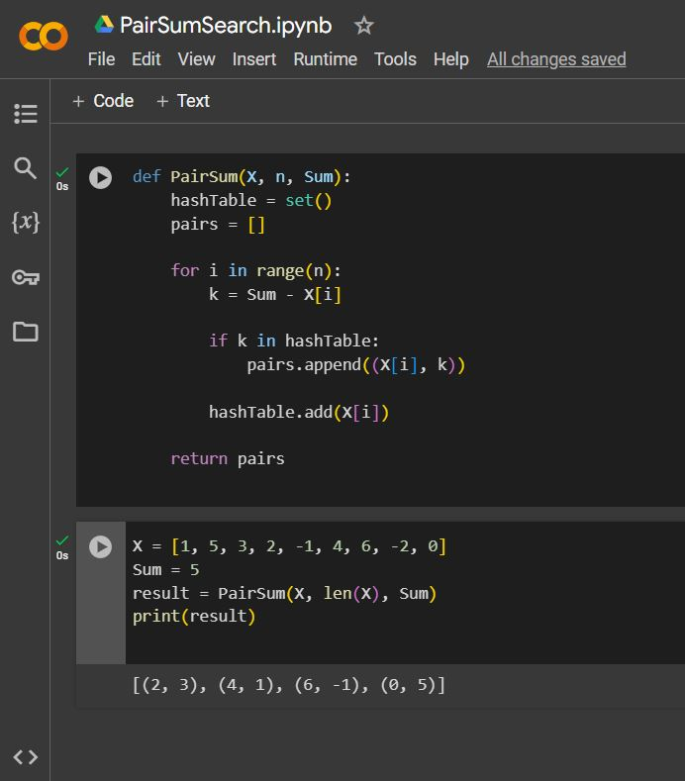
CODE
With Example

Slide 5
Analysis
Time complexity =
Time of inserting elements into the hash table + Time of searching the target sum - X[i] into the hash table
= n * O(1) + n * O(1) = O(n) + O(n) = O(n).
Space complexity = O(n)+O(1) = O(n), as the hash table is of size O(n).

