Slide 1

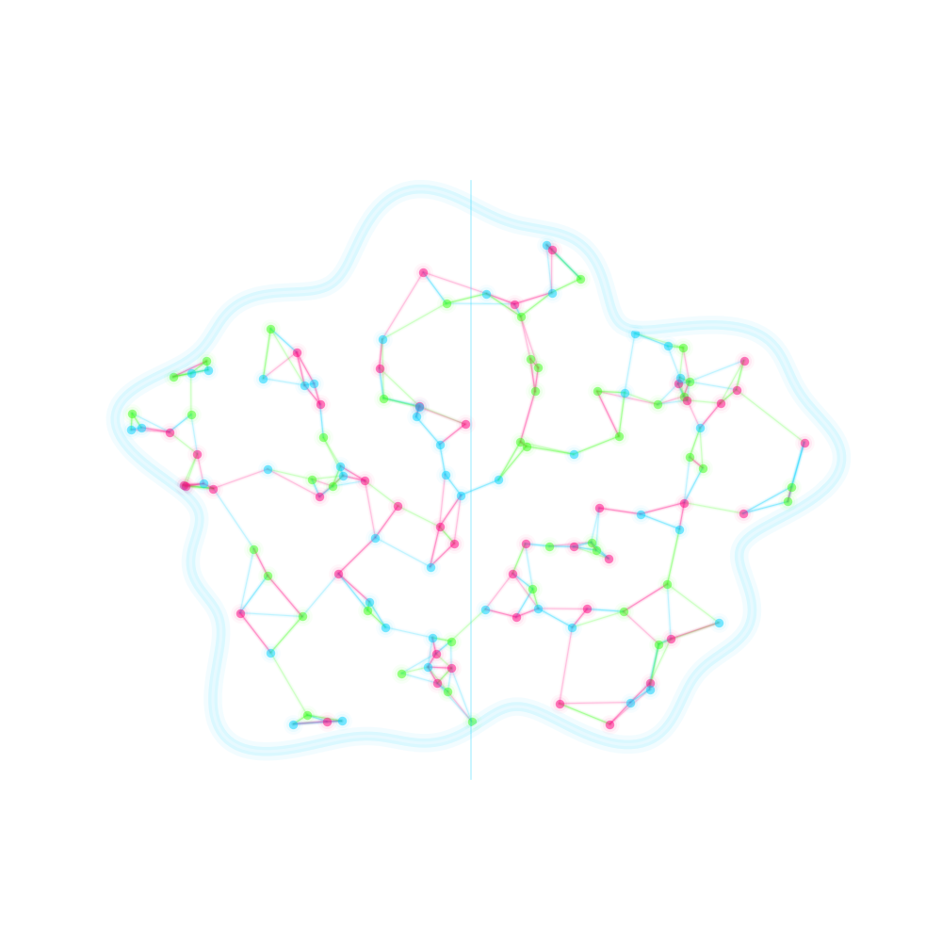
MACHINE LEARNING · END-TO-END PROJECT
AI STUDENT
IMPACT ANALYSIS
Exploring the intersection of Generative AI, Academic Performance, and Student Well-being.
Regression · Classification · Clustering
XGBoost · K-Means · Streamlit Dashboard
Notes:
Welcome the audience. This project is an end-to-end machine learning case study exploring how Generative AI tools like ChatGPT and Claude are reshaping student life. We'll walk through the problem, the data, the models we built (regression, classification, clustering), and the final interactive dashboard. Set the tone: this is a data-driven investigation, not speculation — every claim on later slides is backed by a model or a statistic.

Slide 2





01 · THE PROBLEM STATEMENT
An Unanswered Question in Modern Education
As Generative AI becomes mainstream on campus, we lack rigorous, data-driven answers about its real effect on students — only assumptions.
Academic Performance
Foundational Skills
Psychological Burnout
Does daily GenAI use genuinely move the needle on GPA — up or down?
Is core skill retention quietly eroding beneath AI-assisted convenience?
Is AI dependency correlated with rising anxiety and academic burnout?
AI STUDENT IMPACT ANALYSIS
02 / 10
Notes:
Frame the core research problem. Generative AI tools like ChatGPT and Claude have become part of daily student life almost overnight, but our understanding of their impact is still built on anecdotes and assumptions rather than evidence. This project asks three concrete questions: (1) how does GenAI usage genuinely affect GPA, (2) does it erode foundational skill retention as students offload cognitive effort, and (3) is there a measurable link between AI dependency, anxiety, and burnout. Emphasize that the rest of the deck systematically answers these three questions using real modeling techniques, not opinion.

Slide 3

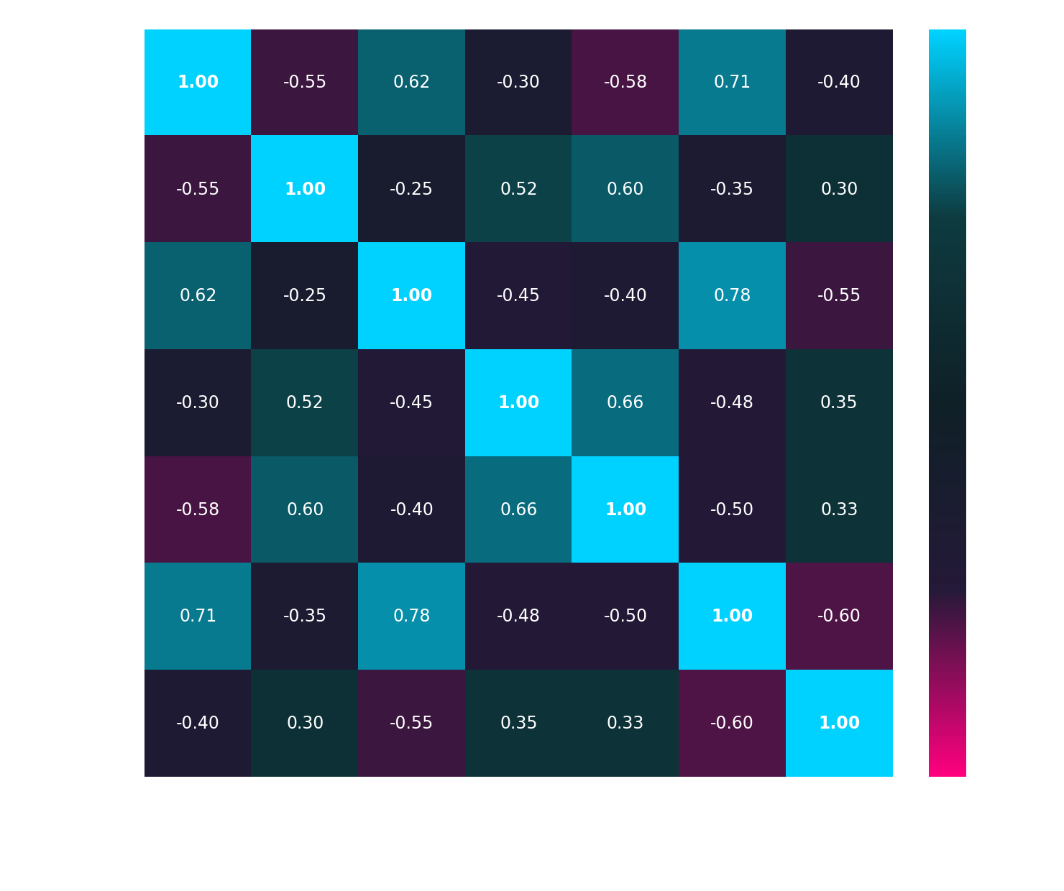
02 · EXPLORATORY DATA ANALYSIS
Getting to Know the Dataset
Glowing Correlation Heatmap
Dataset Snapshot
Diverse student features across majors & year levels
Traditional Study Hours per week
Weekly GenAI Hours (ChatGPT, Claude, etc.)
Self-reported Anxiety Levels (1–10 scale)
GPA, skill assessments & sleep patterns
AI STUDENT IMPACT ANALYSIS
03 / 10
Notes:
This slide summarizes the raw dataset that powers every model in the deck. We collected diverse student-level features spanning traditional study hours, weekly GenAI usage hours, self-reported anxiety levels, GPA, skill assessment scores, and sleep patterns, across a wide range of majors. The correlation heatmap on the right reveals the first data-driven signals: GenAI hours correlate positively with anxiety and burnout index, and negatively with traditional study hours and skill retention — while study hours and GPA move together positively. Mention that a distribution histogram of AI usage across majors was also explored, showing STEM and Business majors cluster at higher weekly GenAI hours than Humanities.

Slide 4


03 · FEATURE ENGINEERING & METRICS
Turning Raw Data into Behavioral Signal
Three custom KPIs were engineered to unlock insights no raw column could reveal on its own.
AI Usage Ratio
Burnout Index
Study Efficiency
GenAI Hrs ÷ Total Study Hrs
f(Anxiety, AI Dependency, Sleep Debt)
GPA Gain ÷ Traditional Study Hrs
Captures reliance on AI relative to overall effort — not just raw usage.
A composite score quantifying psychological strain from academic + AI load.
Measures output per unit of focused, non-AI-assisted effort.
AI STUDENT IMPACT ANALYSIS
04 / 10
Notes:
Raw columns like 'hours studied' or 'anxiety score' only tell part of the story, so we engineered three composite KPIs. AI Usage Ratio normalizes GenAI hours against total study effort, revealing dependency rather than just volume. Burnout Index combines anxiety, AI dependency, and sleep debt into a single psychological-strain score. Study Efficiency measures GPA gain per hour of traditional, non-AI-assisted study, isolating the value of focused human effort. These three engineered features become the strongest predictors in every downstream model — stronger than any single raw feature.

Slide 5

04 · PREDICTIVE MODELING
Forecasting Outcomes with XGBoost Regressors
Actual vs. Predicted GPA
Two Regression Targets
Post-Semester GPA
Predicted from engineered KPIs + raw behavioral features.
Skill Retention Score
Tracks whether foundational competency holds up over the term.
AI STUDENT IMPACT ANALYSIS
05 / 10
Notes:
Two XGBoost Regressor models were trained: one predicting Post-Semester GPA and another predicting a Skill Retention Score, both using the engineered KPIs alongside raw behavioral and demographic features. The scatter plot shows Actual vs Predicted GPA on the holdout test set, with points hugging a neon ideal-fit line — indicating strong predictive accuracy and low residual error. Highlight that AI Usage Ratio and Burnout Index were the top two feature-importance drivers in the GPA model, confirming the engineered features from the previous slide were worth building.

Slide 6
05 · BURNOUT RISK CLASSIFICATION
Classifying Students by Burnout Risk
Predicted Risk Distribution
XGBoost Classifier
Categorizes every student into a Low, Medium, or High burnout-risk tier, based primarily on anxiety scores and AI dependency signals.
94.2%
0.93
MODEL ACCURACY
F1-SCORE (WEIGHTED)
AI STUDENT IMPACT ANALYSIS
06 / 10
Notes:
For actionable early-warning insight, we trained an XGBoost Classifier that sorts students into Low, Medium, or High burnout-risk tiers, driven mainly by anxiety levels and AI dependency (AI Usage Ratio). The model reaches 94.2% accuracy and a 0.93 weighted F1-score on the held-out test set, meaning it reliably distinguishes risk tiers even with class imbalance. The bar chart shows the predicted distribution across the full student population: 44% Low risk, 37% Medium, and 19% High risk — that High-risk 19% is the population the dashboard flags for early intervention.

Slide 7

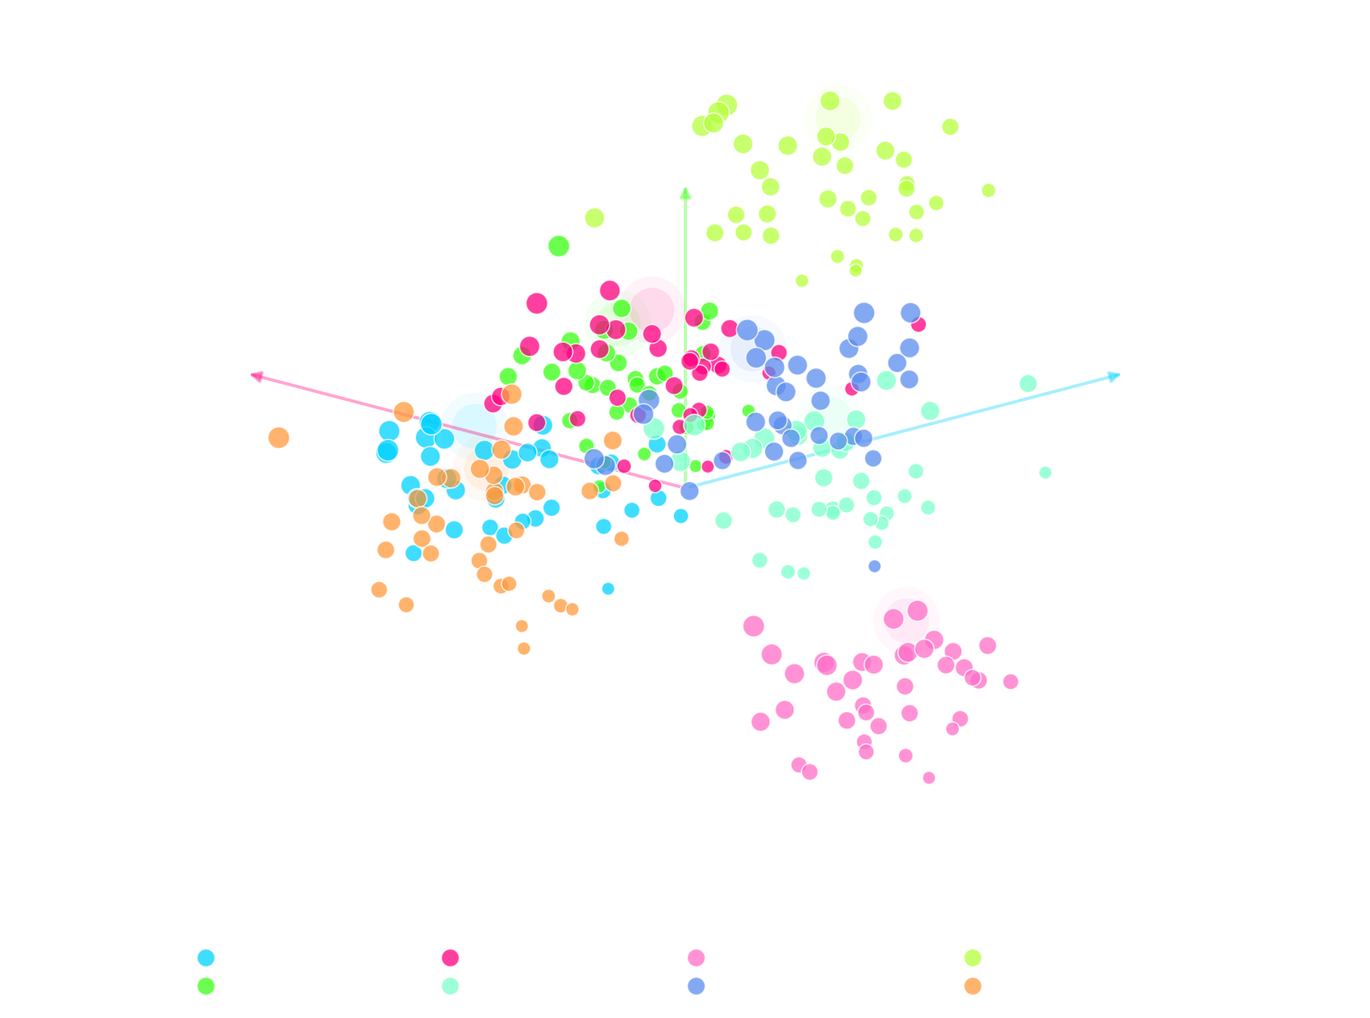
06 · UNSUPERVISED LEARNING
Discovering 8 Distinct Student Personas
K-Means clustering segments the student population into behavioral archetypes — no labels required.
3D PCA Cluster Projection
8 Personas
AI Pioneers
Traditional Scholars
Hyper-dependent
Balanced Achievers
Anxious Overachievers
Disengaged Drifters
+2 more
AI STUDENT IMPACT ANALYSIS
07 / 10
Notes:
Moving from supervised to unsupervised learning, we applied K-Means clustering on the engineered feature space (AI Usage Ratio, Burnout Index, Study Efficiency, plus raw behavioral features), then reduced dimensionality with PCA for visualization. The optimal cluster count of 8 was selected using the elbow method and silhouette score. Each cluster maps to an intuitive persona — for example 'AI Pioneers' lean heavily on GenAI but maintain strong grades, 'Traditional Scholars' barely touch AI tools, and 'Hyper-dependent' students show the highest burnout and lowest skill retention. These personas become the backbone of the personalization logic in the dashboard — each student sees recommendations tailored to their persona.

Slide 8

07 · THE DASHBOARD SOLUTION
From Models to a Living, Interactive Product
● ● ●
Streamlit Web App
3.24
19%
0.58
AVG GPA
HIGH RISK
AI RATIO
A fully interactive, responsive application putting every model from this deck into the hands of students, advisors, and administrators.
Glassmorphism glowing cards
Real-time prediction forms
Dynamic data filtering
AI STUDENT IMPACT ANALYSIS
08 / 10
Notes:
All the models above are packaged into a fully interactive, responsive Streamlit web application so the analysis doesn't stay locked in a notebook. The UI carries the same cyberpunk glassmorphism language as this deck: glowing translucent cards, neon KPI callouts, and a real-time prediction form where an advisor can input a student's study hours and GenAI usage to instantly get a predicted GPA, skill retention score, and burnout risk tier. Dynamic filtering lets users slice the population by major, year, or persona cluster, making the eight personas from the previous slide fully explorable and actionable.

Slide 9

08 · KEY TAKEAWAYS
What the Data Actually Proved
Balance Wins
Over-Reliance Hurts
Burnout Risk Climbs
Personas > Averages
Moderate, balanced AI usage correlates with a measurable GPA boost versus non-users.
High AI dependency sharply erodes foundational skill retention scores.
Hyper-dependent students show the steepest rise in the Burnout Index.
Population-wide averages hide the real story — the 8 clusters reveal it.
AI STUDENT IMPACT ANALYSIS
09 / 10
Notes:
Pulling everything together: balanced, moderate AI usage is associated with a real GPA lift compared to non-users — GenAI genuinely helps when used as a supplement. But the relationship is non-linear: past a certain usage threshold, foundational skill retention drops sharply, and the Burnout Index climbs fastest specifically within the Hyper-dependent persona cluster. The biggest meta-takeaway is that population averages are misleading — the eight personas show wildly different outcomes, which is exactly why the dashboard's persona-level personalization matters more than any single headline statistic.

Slide 10




CONCLUSION
The Future of Learning Is Not
AI vs. Human — It's AI + Human.
The data shows Generative AI is neither a shortcut to failure nor a silver bullet — it's a force multiplier that rewards intentional, balanced use and punishes over-reliance. The path forward is building systems, like this dashboard, that guide students toward that balance.
Thank You
Questions & Discussion Welcome
AI STUDENT IMPACT ANALYSIS
10 / 10
Notes:
Close on the central thesis: this project's evidence doesn't support an 'AI vs human' framing — it supports 'AI plus human,' where Generative AI acts as a force multiplier for students who use it intentionally, and a liability for those who over-rely on it. Reiterate that the entire pipeline — EDA, feature engineering, regression, classification, clustering, and the Streamlit dashboard — was built to give educators and students the tools to find that balance for themselves, not to prescribe a one-size-fits-all rule. Thank the audience and open the floor for questions.

