Slide 1
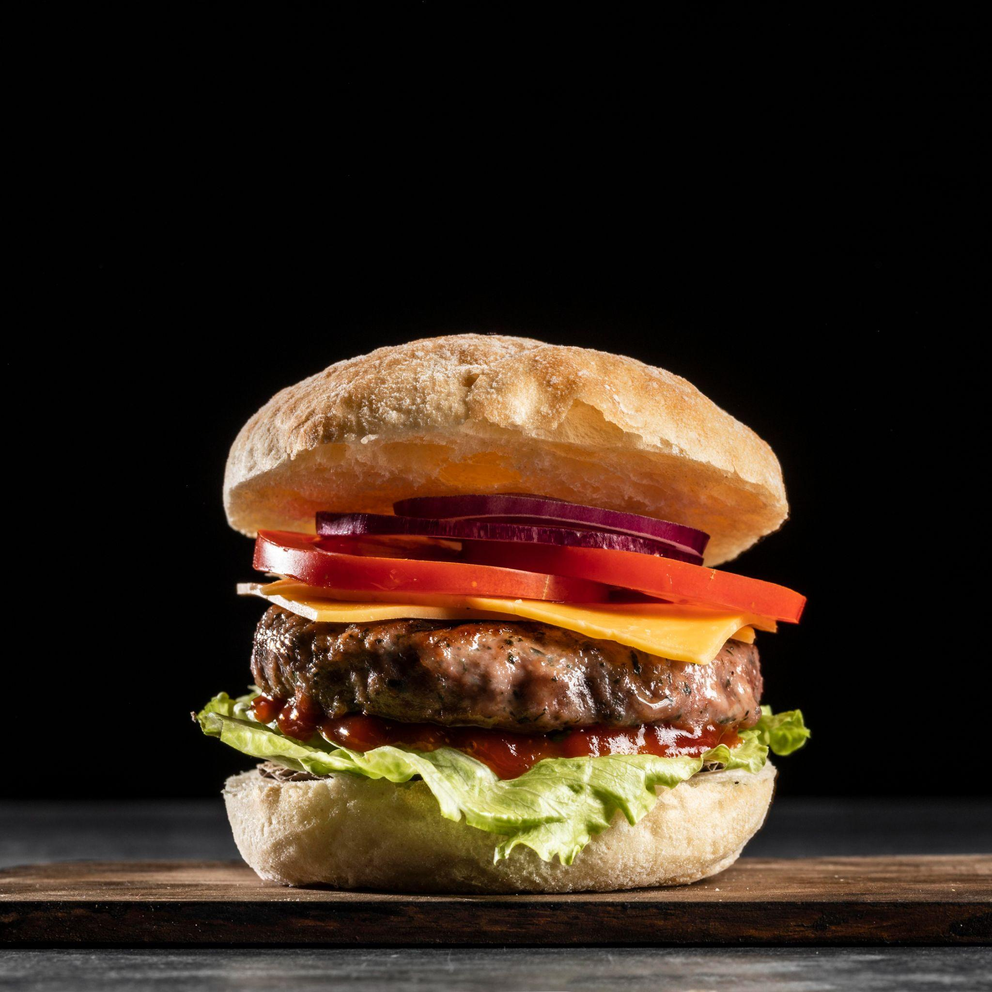
Restaurant Orders Exploratory Data Analysis Project
By :-
Bassem Sherif
Ahmed Moussa

Slide 2
DATA DESCRIPTION
SOURCE https://drive.google.com/file/d/1AvYzAQwX1gWupC9MmawXpkLwb7c5dXSo/view?usp=sharing
Worksheet 1 : menu_items
Item_id : This is a unique identifier for each item.
Item_name : This column contains the name or description of the item.
Category : This column specifies the category or type of the item.
Price : This column indicates the cost or price of the item.
Worksheet 2 : order_details
order_details_id: A unique identifier for each record in the table
order_id: A unique identifier for each order.
order_date: The date on which the order was placed.
order_time: The time at which the order was placed.
item_id: The unique identifier of the item ordered.

Slide 3
Analysis Questions
01
What is the total revenue generated per category?
1-Italian cuisine generates the highest revenue at $49,462.70.
2-Asian cuisine follows closely with $46,720.65.
.3-Mexican and American cuisines contribute $34,796.80 and $28,237.75, respectively.
Category | Total Revenue (USD)
Italian | 49462.7
Asian | 46720.65
American | 34796.8
Mexican | 28237.75

Slide 4
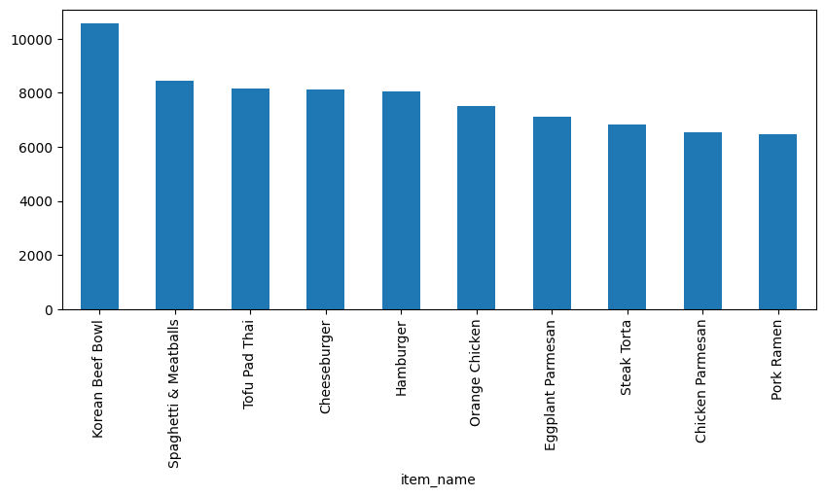
Analysis Questions
02
Which items contribute the most to revenue?
1-The Korean Beef Bowl is the top revenue-generating item, contributing $10,554.60.
2-Spaghetti & Meatballs and Tofu Pad Thai follow closely, contributing $8,436.50 and $8,149.00, respectively
.3-The top 10 items account for a significant portion of total revenue, highlighting their popularity and importance to the business.

Slide 5
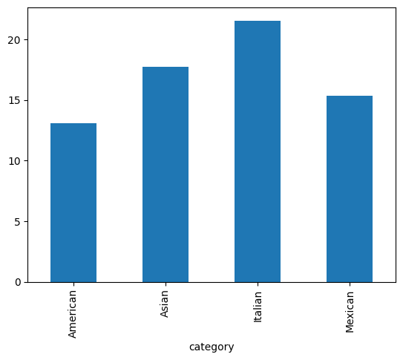
Analysis Questions
03
What is the average order value (AOV) per category? "AOV=Total Revenue/Total Number of Orders"
1-Italian cuisine has the highest AOV at $21.58, indicating that customers spend more per order in this category.
2-Asian cuisine follows with an AOV of $17.73, showing strong customer spending.
3-Mexican and American cuisines have lower AOVs at 15.36$ and $13.12, respectively.

Slide 6
Analysis Questions
04
How many unique items are sold in total, and what is the average price for items sold?
-The menu offers a diverse selection of 32 unique items, catering to a variety of customer preferences.
-The average price of $13.33 indicates a mid-range pricing strategy, which is likely accessible to a broad customer base while maintaining profitability.

Slide 7
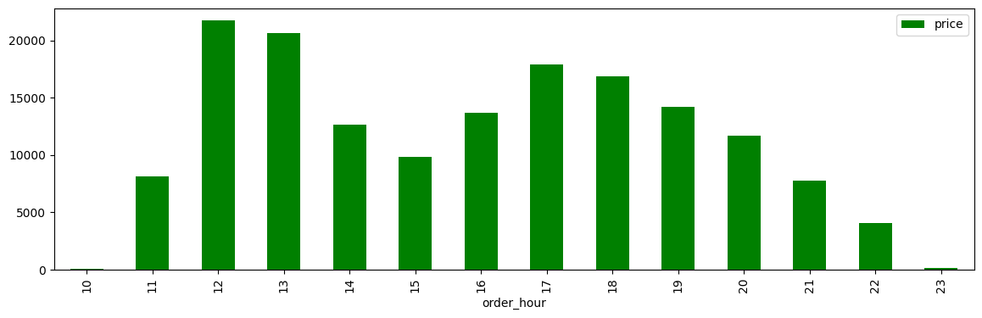
Analysis Questions
05
How does sales performance vary by time of day?
12 PM, 1 PM are the busiest times
( lunchtime demand) .
5 PM 6 PM also show strong sales
(dinner orders).
Midday & Afternoon: Sales remain.
Evening & Late Night: Sales gradually decline after 7 PM
Morning: Sales are minimal at 10 AM

Slide 8
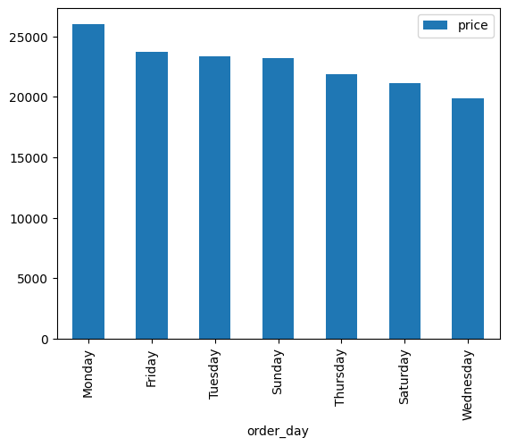
Analysis Questions
06
How does sales performance vary by day of week?
Monday generates the highest sales, which is unusual as Mondays are typically slower. This could indicate a unique trend or promotional activity.
Strong Performing Days : Friday and Tuesday, These days likely benefit from end-of-week and mid-week dining habits.
Mid-Range Sales Days : Sunday, Thursday, and Saturday
Lowest Sales Day : Wednesday, suggesting it may be the least busy day of the week.

Slide 9
Analysis Questions
07
How does sales performance vary by day of week?
Monday generates the highest sales, which is unusual as Mondays are typically slower. This could indicate a unique trend or promotional activity.
Strong Performing Days : Friday and Tuesday, These days likely benefit from end-of-week and mid-week dining habits.
Mid-Range Sales Days : Sunday, Thursday, and Saturday
Lowest Sales Day : Wednesday, suggesting it may be the least busy day of the week.

