Slide 1
Computer Graphics Lecture Review 1-2-3
Bassem Adas, ME

Slide 2
Prologue
OpenGL is a specification/standard for an API (Application Programming Interface) for graphics on graphics/video card, it’s not a library.
Khronos Group:
The Official Page for OpenGL: https://opengl.org/
The Official Page for The Group:https://www.khronos.org/
API Reference Page: https://www.khronos.org/registry/OpenGL-Refpages/
SDKs and Documentation: https://opengl.org/sdk/

Slide 3
Prologue
OpenGL has tow main versions: Legacy, Modern
Legacy: gl, it’s wrapped by one of: GLFW, GLUT, SDL, SFML…..
Modern allow programming of GPU: GLEW, GLAD, GLU,….: also wrap gl
OpenGL doesn’t specify context (window for drawing)→ required some API for that provided by GLFW, GLUT, SDL…. or WIN32 API or any other windowing API by another languages.

Slide 4
Terminology
Pixel: smallest area unit of color on screen.
Vertex: at least contains the coordinates of a position in space, and may contain additional attributes (Color, Textures…)
Animation is a draw loop of Frames, typically 60 Frames per second (GLFW)
Back Frame is being prepared while the Front Frame is being displayed on screen

Slide 5
Terminology (Cont.)
Frame Buffer is an array of pixels
There are 2 Frame Buffers: Front Frame Buffer and Back Frame Buffer
Every Frame animation these Frame Buffers are swapped
Back Frame Buffer is being prepared (rendered) while the Front Frame Buffer is being displayed on screen

Slide 6
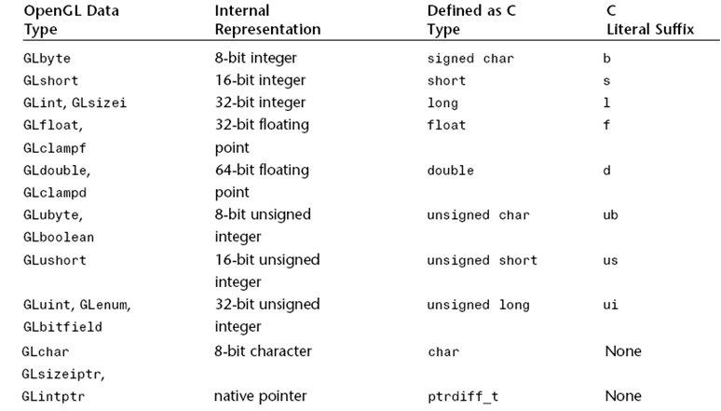
OpenGL Types
OpenGL specifies its own types.
It defines enumeration for them GL_UNSIGNED_BYTE, GL_UNSIGNED_INT…

Slide 7
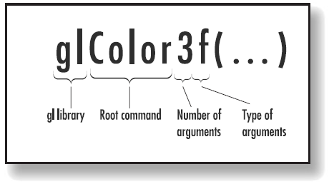
OpenGL Function Convention
<Library prefix><Root command><Optional argument count><Optional argument type>

Slide 8
Basic Functions
glClearColor: sets the background color into the state
glClear: clear using the color set by the former function
glfwSwapBuffers: swap the back and front buffers
glfwSwapInterval: sets frame swap speed
glViewport(x,y,w,h): sets a rectangular area for drawing
glfwGetFramebufferSize(window, &w, &h): returns height and width of the window.

Slide 9
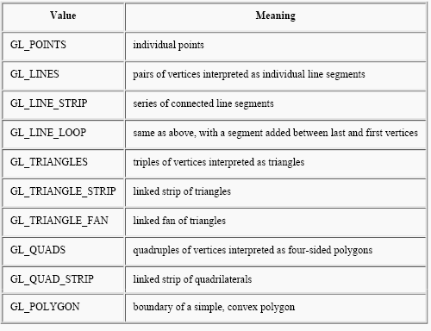
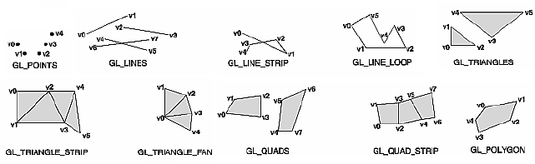
Primitives (Immediate Mode - Legacy)
glBegin( )
….
….
glEnd()

Slide 10
Example
glBegin(GL_TRIANGLES);
glVertex2f(-0.5f, -0.5f);
glVertex2f(0.0f, 0.5f);
glVertex2f(0.5f, -0.5f);
glEnd();

Slide 11
Primitives (Cont.)
glPointSize(size) : size of points (1,2, 3, ….)
glLineWidth(width): the thickness of lines

Slide 12
Basic Coloring
glColor3f: sets the drawing color (RGB)
glColor4f: sets the drawing color (RGB-Alpha)
glColor(3/4)(f,d,i…)
glShadeModel(GL_FLAT): use the last color to fill
glShadeModel(GL_SMOOTH): use gradient color to fill

Slide 13
Basic Transformations
glTranslatef(tx, ty, tz): changes the position on each axis
glScalef(sx, sy, sz): scale the shape on each axis by the specified value
glRotatef(angle, x, y, z):
x = 1.0f: rotation around X axis by angle (degree), counterclockwise
y = 1.0f: rotation around Y axis by angle (degree) , counterclockwise
z = 1.0f: rotation around Z axis by angle (degree) , counterclockwise

Slide 14
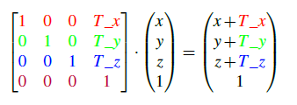
Basic Transformations (Cont.)
Transformation is changed internally into matrix multiplication
Multiply each point (vertex coordinates) by transformation matrix
Example:
glTranslatef (T_x, T_y, T_z)
The fourth dimension will be explained later.
Examples of other transformation will be explained later.

Slide 15
Basic Transformations (Cont.)
Each function changes the whole state (changes the transformation matrix)
The specified transformation is applied on all following vertices
Each vertex preserves the new position and scale
After Frame swapped, the transformation will be applied on all elements till another transformation is applied

Slide 16
Basic Transformations (Cont.)
To apply standalone transformation for a sub-group of elements, other techniques should be used.
glLoadIdentity: reinitialize the transformation matrix (Loads Identity Matrix)
glPushMatrix: saves current transformation matrix
glPopMatrix: returns the previous transformation matrix

Slide 17
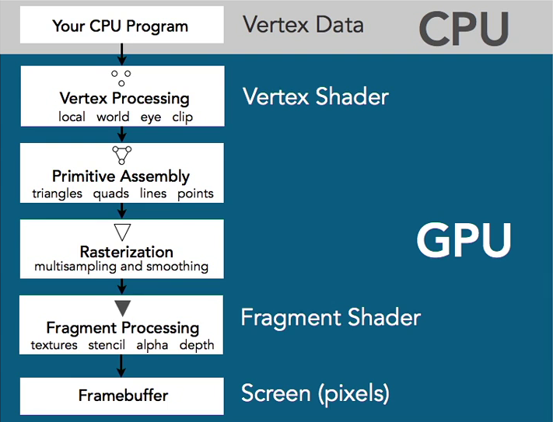
OpenGL Pipline

