Slide 1
Computer Graphics Lecture 4 Introduction To Modern OPengl
Bassem Adas, ME

Slide 2
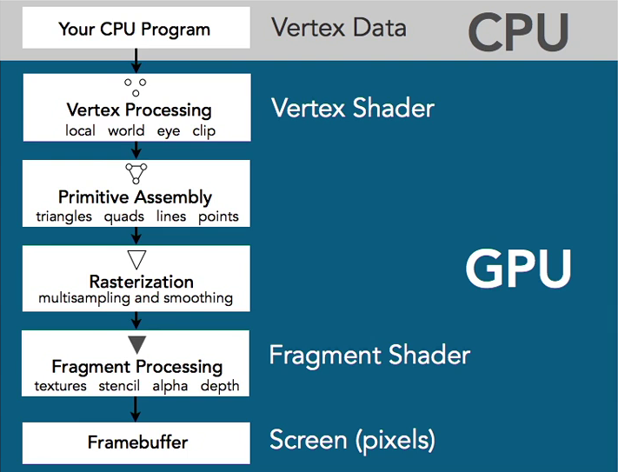
OpenGL Pipline

Slide 3
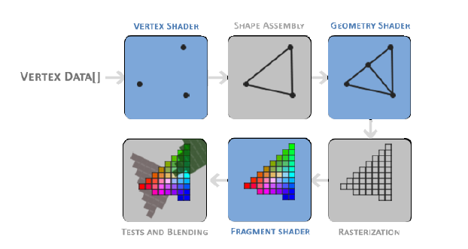
OpenGL Pipline

Slide 4
Shader
A small program runs on the GPU for each step of the pipeline (parallel)
The main input mechanism from CPU to GPU
Shaders cannot communicate with each other except via input and output.
Some of them are configurable by developer, others are not.
Use GLSL (OpenGL Shading Language): C-like Language

Slide 5
Shader and Shader Program
2 main types are configurable:
Vertex Shader: calculates and clips the vertex coordinates on your screen (3D → 2D), called for each vertex (3 times per triangle).
Fragment Shader: calculates the color of the pixel. Called for each pixel (as many times as pixels in the rendered shape).
Both shadres are written, compiled and attached to one Shader Program

Slide 6
GLSL Types
like C: int, float, double, uint and bool.
Additional 2 types
vector
matrix

Slide 7
GLSL Types
vector: 1,2,3 or 4 component container for any of the basic types (n represents the number of components)
vecn: the default vector of n floats.
bvecn: a vector of n booleans.
ivecn: a vector of n integers.
uvecn: a vector of n unsigned integers.
dvecn: a vector of n double components.

Slide 8
Shader Syntax
#version version_number
layout (location = 0) in type in_variable_name;
layout (location = 1) in type in_variable_name;
out type out_variable_name;
uniform type uniform_name;
void main()
{
// process input(s) and do some weird graphics stuff
out_variable_name = weird_stuff_we_processed;
}

Slide 9
Vertex Shader
Each input variable is also known as a vertex attribute.
Only 16 vertex attributes are available for each vertex.
Each vertex attribute may contain up to 4 components (float, int…)
Output parameters (Vertex Shader) are passed to Fragment shader (input)
layout (location = idx): is the index of the vertex attribute in the input buffer

Slide 10
Vertex Shader Sample
#version 330 core
layout (location = 0) in vec3 aPos; // the position variable has attribute position 0
out vec4 vertexColor; // specify a color output to the fragment shader
void main()
{
gl_Position = vec4(aPos, 1.0); // see how we directly give a vec3 to vec4’s constructor
vertexColor = vec4(0.5, 0.0, 0.0, 1.0); // set the output variable to a dark-red color
}

Slide 11
Fragment Shader
#version 330 core
out vec4 FragColor;
in vec4 vertexColor; // the input variable from the vertex shader (same name and same type)
void main()
{
FragColor = vertexColor;
}

Slide 12
Vertex Buffer Object
Vertex Shader gets it’s input from Vertex Buffer Object (VBO)
VBO: a buffer of vertices, each of them has up to 16 vertex attributes
Position coordinates (x, y, z) are a vertex attribute
Color components (R, G, B, Alpha) are another vertex attribute
Texture coordinates (x, y) are another vertex attribute.
…

Slide 13
Vertex Buffer Object
Declare Vertex Data (RAW) for triangle, positions and colors for vertices
float vertices[] = {
// positions // colors
0.5f, -0.5f, 0.0f, 1.0f, 0.0f, 0.0f, // bottom right
-0.5f, -0.5f, 0.0f, 0.0f, 1.0f, 0.0f, // bottom left
0.0f, 0.5f, 0.0f, 0.0f, 0.0f, 1.0f // top
};

Slide 14
Vertex Buffer Object
Creatin and Binding buffers
GLuint VBO;
glGenBuffers(1, &VBO);
glBindBuffer(GL_ARRAY_BUFFER, VBO);
glBufferData(GL_ARRAY_BUFFER, sizeof(vertices), vertices, GL_STATIC_DRAW);

Slide 15
Vertex Buffer Object and Vertex Shader Input
Input / Output params corresponding to the previous buffer
layout (location = 0) in vec3 aPos; // the position variable has attribute position 0
layout (location = 1) in vec3 aColor; // the color variable has attribute position 1
out vec3 ourColor; // output: a color to the fragment shader

Slide 16
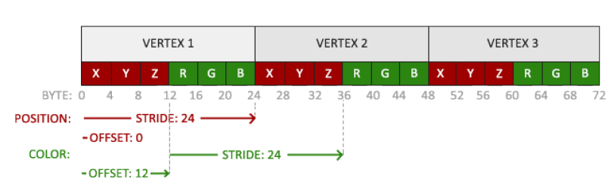
Vertex Buffer Object and Vertex Shader Input
Linking Vertex Attributes
glVertexAttribPointer(idx, SIZE, TYPE, NORMALIZED, STRIDE, OFFSET);

Slide 17
Vertex Buffer Object and Vertex Shader Input
Linking Vertex Attributes
idx1 = 0 for aPos, idx2 = 1 for aColor
// position attribute
glVertexAttribPointer(idx1, 3, GL_FLOAT, GL_FALSE, 6 * sizeof(float), (void*)0);
glEnableVertexAttribArray(idx1);
// color attribute
glVertexAttribPointer(idx2, 3, GL_FLOAT, GL_FALSE, 6 * sizeof(float), (void*)(3* sizeof(float)));
glEnableVertexAttribArray(idx2);

Slide 18
Vertex Buffer Object Drawing
glDrawArrays(mode, first, count);
mode: GL_TRIANGLES….
first: starting index in the buffer (0 in the examples)
count: number of vertices (3 for triangle)

Slide 19
Element Buffer Object (EBO)
Homework!
The Difference between EBO and VBO
How to create EBO
How to Draw EBO

Slide 20
Vertex Shader and Fragment Shader
The output of Vertex Shader may be passed as Input to Fragment Shader (corresponding to the previous vertex shader)
#version 330 core
out vec4 FragColor;
in vec3 ourColor; // the same name and type as declared in vertex shader
void main()
{
FragColor = vec4(ourColor, 1.0);
}

Slide 21
Uniforms
another way to pass data from our application on the CPU to the shaders on the GPU
Global: unique per shader program object, and can be accessed from any shader at any stage in the shader program
Declaration add the uniform keyword to a shader with a type and a name.

Slide 22
Unifroms
#version 330 core
out vec4 FragColor;
uniform vec4 ourColor; // we set this variable in the OpenGL code.
void main()
{
FragColor = ourColor;
}

Slide 23
Shader Creation
Declartion:
GLuint vsId= glCreateShader(GL_VERTEX_SHADER);
GLuint fsId = glCreateShader(GL_FRAGMENT_SHADER);
Source code: glShaderSource(vsId, 1, &source , NULL);
Compilation: glCompileShader(fsId);

Slide 24
Shader Creation
Check Shader Erros:
int success;
char infoLog[512];
glGetShaderiv(vsId, GL_COMPILE_STATUS, &success);
if (!success)
{
glGetShaderInfoLog(vsId, 512, NULL, infoLog);
cout << "ERROR\n" << infoLog << endl;
}

Slide 25
Shader Program Creation
Declartion:
GLuint pId = glCreateProgram();
Attach Shaders:
glAttachShader(pId, vsId);
glAttachShader(pId, fsId);
Compilation and Linking: glLinkProgram(pId);
Using the shader program: glUseProgram(pId);

Slide 26
Shader Program Creation
Check shader program errors
glGetProgramiv(pId, GL_LINK_STATUS, &success);
if (!success) {
glGetProgramInfoLog(pId, 512, NULL, infoLog);
cout << "ERROR\n" << infoLog << endl;
}

Slide 27
Shader Program Execution
UseProgram(pId);
//you need to bind buffers or vertex arrays
glDrawArrays(mode, first, count);

