Slide 1
Computer Graphics Lecture 5 Going 3d - mvp
Bassem Adas, ME

Slide 2
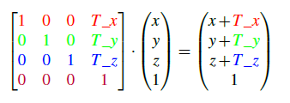
Transformations
Legacy Transformation is changed internally into matrix multiplication
Multiply each point (vertex coordinates) by transformation matrix
Example:
glTranslatef (T_x, T_y, T_z)
DIY! (Modern OpenGL)

Slide 3
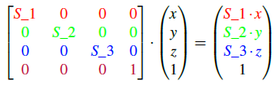
Transformations (Cont.)
Example:
glScalef (S_1, S_2, S_3)

Slide 4
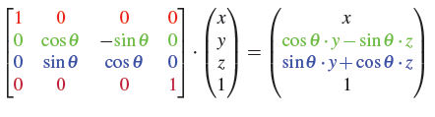
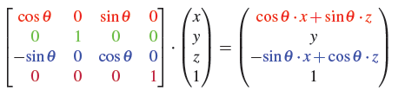
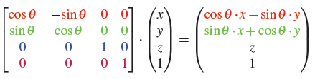
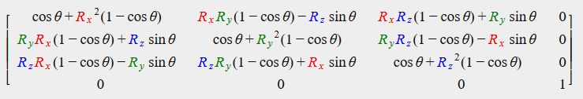
Transformations (Cont.)
Examples:
glRotatef (theta, 1.0f, 0.0f, 0.0f)
glRotatef (theta, 0.0f, 1.0f, 0.0f)
glRotatef (theta, 0.0f, 0.0f, 1.0f)
All together! (Rx,Ry,Rz)

Slide 5
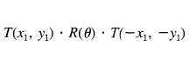
Transformations - Combining Matrices
All Transformations are relative to start of the coordinate system
Applying multiple transformations by matrix multiplication
Order of transformations is Important
The Order is reversed (last matrix to be multiplied, is the first to apply)
Translate to (-x1, -y1)
Rotate by theta
Translate to (x1, y1)

Slide 6
Transformations - Combining Matrices (Cont.)

Slide 7
Transformations - Combining Matrices (Cont.)
Rotate object around it’s beginning

Slide 8

GLM
GLM stands for OpenGL Mathematics
a header-only library (just configure include path)
#include <glm/glm.hpp>
#include <glm/gtc/matrix_transform.hpp>
#include <glm/gtc/type_ptr.hpp>

Slide 9
GLM
glm::mat4 trans(1.0f);//initializes the new matrix with the identity matrix
trans = glm::rotate(trans, glm::radians(90.0f), glm::vec3(0.0, 0.0, 1.0));
trans = glm::translate(trans, glm::vec3(1.0f, 1.0f, 0.0f));
trans = glm::scale(trans, glm::vec3(0.5, 0.5, 0.5));

Slide 10
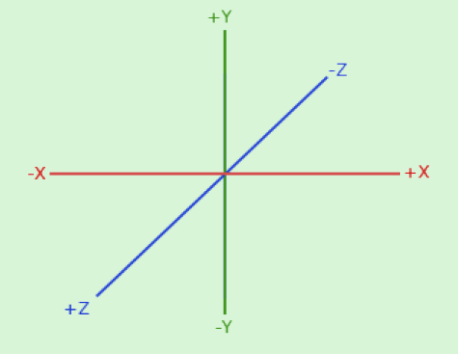
Coordinate Systems (1)
By convention, OpenGL is a right-handed system

Slide 11
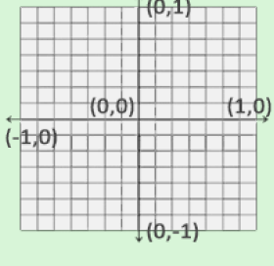
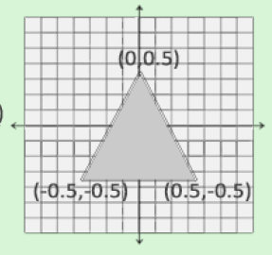
Coordinate Systems (2)
OpenGL expects all vertices to be in Normalized Device Coordinates (NDC)
Everything outside this range won’t be visible

Slide 12
Coordinate Systems (3)
There are a total of 5 different coordinate systems:
Local space (or Object space)
World space
View space (or Eye space)
Clip space
Screen space

Slide 13
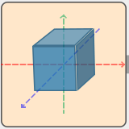
Local Space
Local space is the coordinate space that is local to your object.
i.e. where your object begins in.

Slide 14
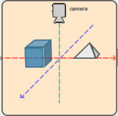
World Space
World-space coordinates are coordinates in respect of a larger world.
These coordinates are relative to a global origin of the world, together with many other objects also placed relative to the world's origin

Slide 15
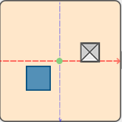
View Space
Eye space, or camera space: the space as seen from the camera's point of view.
It is the result of transforming your world-space coordinates to coordinates that are in front of the user's view

Slide 16
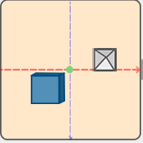
Clip Space
Clip coordinates are processed to the -1.0 and 1.0 range and determine which vertices will end up on the screen.
any coordinate that falls outside this range is clipped.
the remaining coordinates will end up as fragments visible on your screen

Slide 17
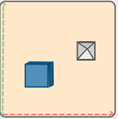
Screen Space
Clip coordinates are transformed from -1.0 and 1.0 to the coordinate range defined by glViewport.
This process is called the viewport transform.
The resulting coordinates are then sent to the rasterizer to turn them into fragments.

Slide 18
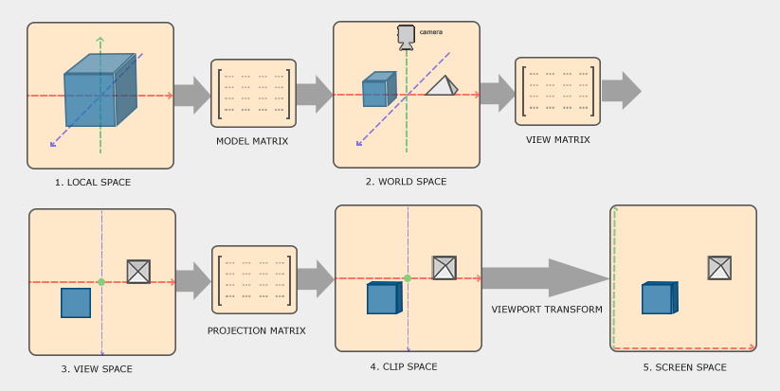
Coordinate Systems – 3D Pipeline
From 3D in the world to 2D on the screen

Slide 19
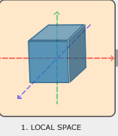
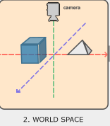



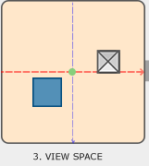
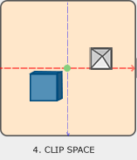
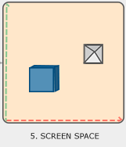
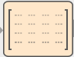


Coordinate Systems – 3D Pipeline

Slide 20
Model Matrix
The coordinates of your object are transformed from local to world space; this is accomplished with the model matrix.
The model matrix is a transformation matrix that translates, scales and/or rotates your object to place it in the world at a location/orientation they belong to.
model = translate * rotate * scale

Slide 21
View Matrix
View matrix is the result from a combination of translations and rotations to translate/rotate the scene so that certain items are transformed to the front of the camera

Slide 22
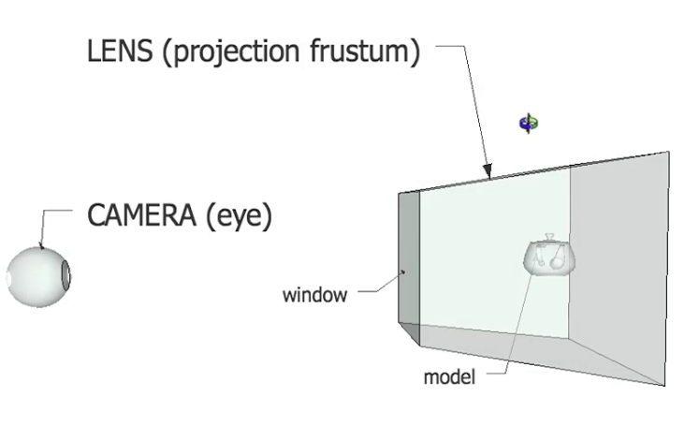
View Matrix

Slide 23
Projection Matrix
To transform vertex coordinates from view to clip-space we define a so called projection matrix that specifies a range of coordinates e.g. -1000 and 1000 in each dimension.
The projection matrix then transforms coordinates within this specified range to normalized device coordinates (-1.0, 1.0)
All coordinates outside this range will not be mapped between -1.0 and 1.0 and therefore be clipped

Slide 24
Projection Matrix
Types of Projection
Orthographic
Perspective

Slide 25
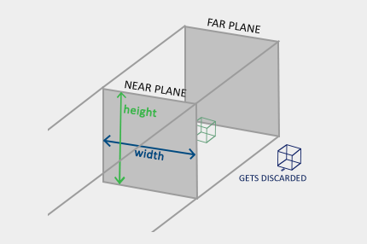
Orthographic
glm::ortho(0.0f, 800.0f, 0.0f, 600.0f, 0.1f, 100.0f);

Slide 26
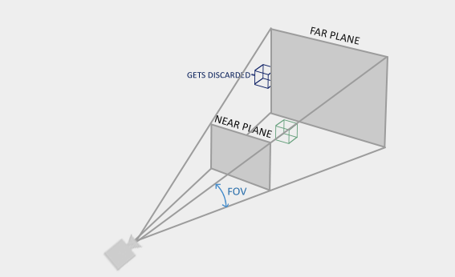
Perspective
glm::mat4 proj = glm::perspective(glm::radians(45.0f), (float)width/(float)height,
0.1f, 100.0f);

Slide 27
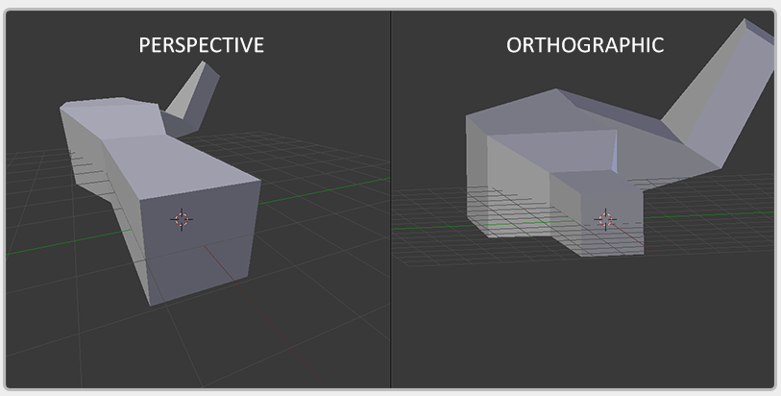
projection

Slide 28
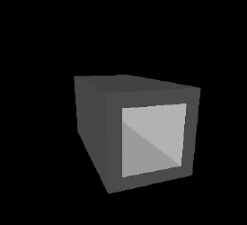
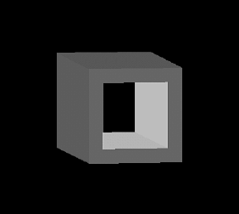
projection
Orthographic Perspective

Slide 29
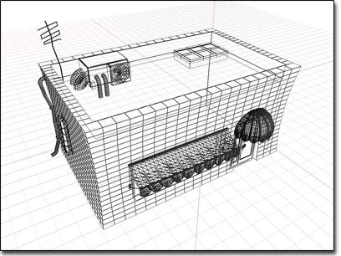
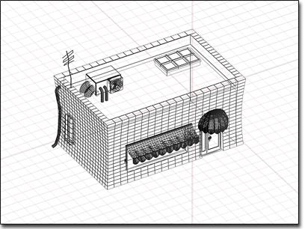
projection
Orthographic Perspective

Slide 30
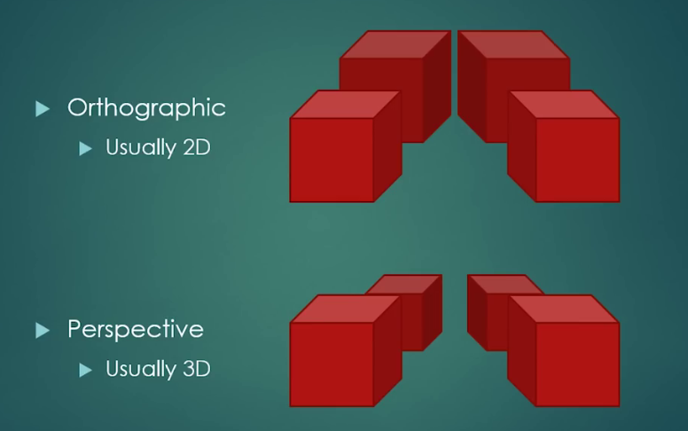
projection

Slide 31
Clipping
clip = projection * view * model * local
glViewport(x,y,width,height)
OpenGL then uses the parameters from glViewPort to map the normalized-device coordinates to screen coordinates where each coordinate corresponds to a point on your screen (in our case a 800x600 screen). This process is called the viewport transform.

Slide 32
Z-buffer
OpenGL stores all its depth information in a z-buffer, also known as a depth buffer.
whenever the fragment wants to output its color, OpenGL compares its depth values with the z-buffer and if the current fragment is behind the other fragment it is discarded, otherwise overwritten.
glEnable(GL_DEPTH_TEST);
glClear(GL_COLOR_BUFFER_BIT | GL_DEPTH_BUFFER_BIT);

