Slide 1
Computer Graphics Lecture 6 Camera
Bassem Adas, ME

Slide 2
Prologue
OpenGL by itself is not familiar with the concept of a camera
but we can try to simulate one by moving all objects in the scene in the reverse direction, giving the illusion that we are moving

Slide 3
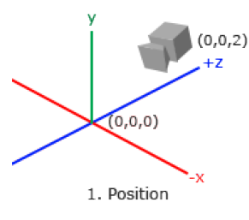
Camera Position
A vector in world space that points to the camera’s position.
The positive z-axis is going through your screen towards you so if we want the camera to move backwards, we move along the positive z-axis.
glm::vec3 cameraPos = glm::vec3(0.0f, 0.0f, 3.0f);

Slide 4
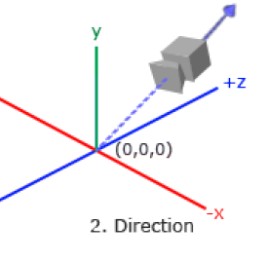
Camera Direction
The camera points to the camera target:
usually the origin of the scene: (0,0,0)
The camera points towards the negative z direction
we want the direction vector to point towards the camera's positive z-axis
Switch the subtraction order around (the difference between the position and target)
The name direction vector is not the best chosen name, since it is actually pointing in the reverse direction of what it is targeting.
Look Vector

Slide 5
Camera Direction
glm::vec3 cameraTarget = glm::vec3(0.0f, 0.0f, 0.0f);
glm::vec3 cameraDirection = glm::normalize(cameraPos - cameraTarget);
The name direction vector is not the best chosen name, since it is actually pointing in the reverse direction of what it is targeting.
Look Vector

Slide 6
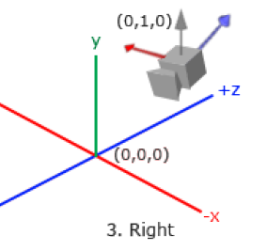
Right axis
Represents the positive x-axis of the camera space
To get the right vector we use a little trick
specify an up vector that points upwards (in world space)
do a cross product on the up vector and the direction vector
we will get a vector that points in the positive x-axis's direction

Slide 7
Right axis
glm::vec3 up = glm::vec3(0.0f, 1.0f, 0.0f);
glm::vec3 cameraRight = glm::normalize(glm::cross(up, cameraDirection));

Slide 8
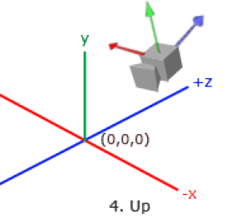
Up Axis
the vector that points in the camera's positive y-axis
the cross product of the right and direction vector
glm::vec3 cameraUp = glm::cross(cameraDirection, cameraRight);

Slide 9
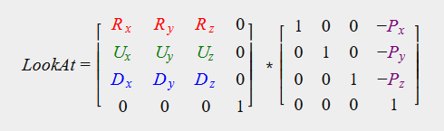
Look At
glm::lookAt(eye, center, up) = lookAt(position, target, up)
glm::mat4 view;
view = glm::lookAt(glm::vec3(0.0f, 0.0f, 3.0f), glm::vec3(0.0f, 0.0f, 0.0f),
glm::vec3(0.0f, 1.0f, 0.0f));

Slide 10
Look around
Euler angles
pitch: is the angle that depicts how much we're looking up or down
yaw: represents the magnitude we're looking to the left or to the right
roll: represents how much we roll as mostly used in space-flight cameras
Each of the Euler angles are represented by a single value and with the combination of all 3 of them we can calculate any rotation vector in 3D.

Slide 11
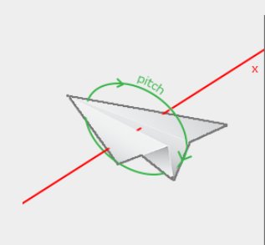
Look around
pitch: is the angle that depicts how much we're looking up or down

Slide 12
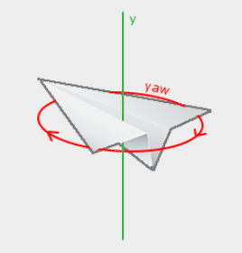
Look around
yaw: represents the magnitude we're looking to the left or to the right

Slide 13
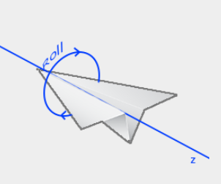
Look around
roll: represents how much we roll as mostly used in space-flight cameras

Slide 14
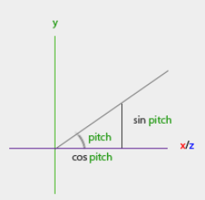
Look around
yaw = 0
x = cos(pitch)
y = sin(pitch)
z = 0

Slide 15
Look around
yaw = 90
x = 0
y = sin(pitch)
z = cos(pitch)

Slide 16
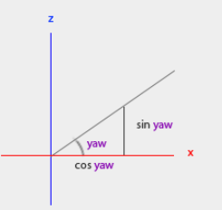
Look around
0 < yaw > 90
x = ?
y = sin(pitch)
z = ?
Proven
x = cos(pitch) * cos(yaw)
z = cos(pitch) * sin(yaw)

Slide 17
Look around
x = cos(pitch) * cos(yaw)
y = sin(pitch)
z = cos(pitch) * sin(yaw)
yaw =0
x = cos(pitch) * cos(yaw) = cos(pitch)
z = cos(pitch) * sin(yaw) = 0
yaw =90
x = cos(pitch) * cos(yaw) = 0
z = cos(pitch) * sin(yaw) = cos(pitch)

Slide 18
Look around
With glm functions:
direction.x = cos(glm::radians(pitch)) * cos(glm::radians(yaw));
direction.y = sin(glm::radians(pitch));
direction.z = cos(glm::radians(pitch)) * sin(glm::radians(yaw));

Slide 19
Mouse input
float xoffset = xpos - lastX;
float yoffset = lastY - ypos; // reversed since y-coordinates range from bottom to top
lastX = xpos; lastY = ypos;
float sensitivity = 0.05f;
xoffset *= sensitivity; yoffset *= sensitivity;

Slide 20
Zoom
the Field of view or fov defines how much we can see of the scene
When the field of view becomes smaller the scene's projected space gets smaller giving the illusion of zooming in

