Slide 1
Computer Graphics Lecture 7 Textures
Bassem Adas, ME

Slide 2
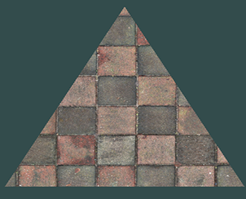
Textures
A texture is a 2D image (even 1D and 3D textures exist) used to add detail to an object
think of a texture as a piece of paper with a nice brick image (for example) on it neatly folded over your 3D house so it looks like your house has a stone exterior

Slide 3
Textures
Each vertex should have a texture coordinate associated with them that specifies what part of the texture image to sample from.
Texture coordinates range from 0 to 1 in the x and y axis.
Retrieving the texture color using texture coordinates is called sampling.
Texture coordinates
start at (0,0) for the lower left corner of a texture image
to (1,1) for the upper right corner of a texture image

Slide 4
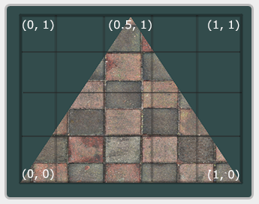
Textures
Example: a triangle
float texCoords[] = {
0.0f, 0.0f, // lower-left corner
1.0f, 0.0f, // lower-right corner
0.5f, 1.0f // top-center corner
};

Slide 5
Texture Wrapping
GL_REPEAT: The default behavior for textures. Repeats the texture image.
GL_MIRRORED_REPEAT: Same as GL_REPEAT but mirrors the image with each repeat.
GL_CLAMP_TO_EDGE: Clamps the coordinates between 0 and 1. The result is that higher coordinates become clamped to the edge, resulting in a stretched edge pattern.
GL_CLAMP_TO_BORDER: Coordinates outside the range are now given a user-specified border color.

Slide 6
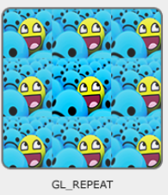
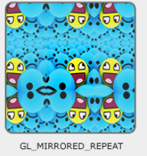
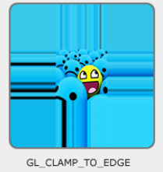

Texture Wrapping
Examples

Slide 7
Texture Wrapping
Each of the aforementioned options can be set per coordinate axis (s, t, r) equivalent to (x,y,z) with the glTexParameter* function:
glTexParameteri(GL_TEXTURE_2D, GL_TEXTURE_WRAP_S, GL_MIRRORED_REPEAT);
glTexParameteri(GL_TEXTURE_2D, GL_TEXTURE_WRAP_T, GL_MIRRORED_REPEAT);

Slide 8
Loading Image (stb_image.h)
stb_image.h is a very popular single header image loading library that is able to load most popular file formats and is easy to integrate in your project(s)
Download and Copy stb_image.h to your project. (single file), then use it just like that:
#define STB_IMAGE_IMPLEMENTATION
#include "stb_image.h"
STB_IMAGE_IMPLEMENTATION the preprocessor modifies the header file such that it only contains the relevant definition source code, effectively turning the header file into a .cpp file.

Slide 9
Loading Image (stb_image.h)
#define STB_IMAGE_IMPLEMENTATION
#include "stb_image.h”
stbi_set_flip_vertically_on_load(true); // image coordinates to clip/screen coords
int width, height, nrChannels;
unsigned char *data = stbi_load("container.jpg", &width, &height, &nrChannels, 0);
stbi_image_free(data);

Slide 10
Generating a texture
unsigned int texture; //GLuint texture;
glGenTextures(1, &texture);
glBindTexture(GL_TEXTURE_2D, texture);
glTexImage2D(GL_TEXTURE_2D, 0, GL_RGB, width, height, 0, GL_RGB, GL_UNSIGNED_BYTE, data);
glGenerateMipmap(GL_TEXTURE_2D);

Slide 11
Applying textures
float vertices[] = {
// positions // colors // texture coords
0.5f, 0.5f, 0.0f, 1.0f, 0.0f, 0.0f, 1.0f, 1.0f, // top right
0.5f, -0.5f, 0.0f, 0.0f, 1.0f, 0.0f, 1.0f, 0.0f, // bottom right
-0.5f, -0.5f, 0.0f, 0.0f, 0.0f, 1.0f, 0.0f, 0.0f, // bottom left
-0.5f, 0.5f, 0.0f, 1.0f, 1.0f, 0.0f, 0.0f, 1.0f // top left
};

Slide 12
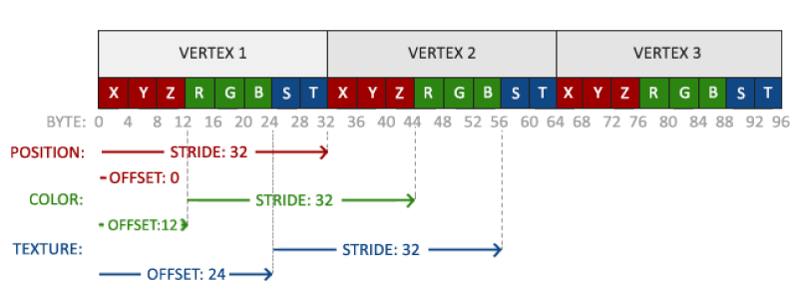
Applying textures
glVertexAttribPointer(2, 2, GL_FLOAT, GL_FALSE, 8 * sizeof(float), (void*)(6 * sizeof(float)));
glEnableVertexAttribArray(2);

Slide 13
Applying textures
#version 330 core
layout (location = 0) in vec3 aPos;
layout (location = 1) in vec3 aColor;
layout (location = 2) in vec2 aTexCoord;
out vec3 ourColor;
out vec2 TexCoord;
void main()
{
gl_Position = vec4(aPos, 1.0);
ourColor = aColor;
TexCoord = aTexCoord;
}

Slide 14
Applying textures
#version 330 core
out vec4 FragColor;
in vec3 ourColor;
in vec2 TexCoord;
uniform sampler2D ourTexture;
void main()
{
FragColor = texture(ourTexture, TexCoord);
}

Slide 15
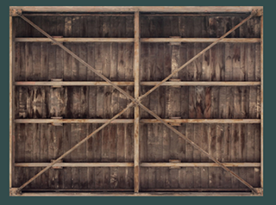
Applying textures
glBindTexture(GL_TEXTURE_2D, texture);
glBindVertexArray(VAO);
glDrawElements(GL_TRIANGLES, 6, GL_UNSIGNED_INT, 0);

Slide 16
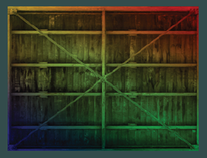
Applying textures
FragColor = texture(ourTexture, TexCoord) * vec4(ourColor, 1.0);

