Slide 1
Computer Graphics Lecture 8 lighting
Bassem Adas, ME

Slide 2
Color
Color is composed of three components
R
G
B
Alpha: and additional component for transparency/opaque.
glm::vec3 coral(1.0f, 0.5f, 0.31f);

Slide 3
Color
The colors in real life are not the colors the objects actually have,
but are the colors reflected from the object;
the colors that are not absorbed (rejected) by the objects are the colors we perceive of them.
For example, the light of the sun is perceived as a white light that is the combined sum of many different colors.
So if we would shine the white light on a blue toy, it absorbs all the white color's sub-colors except the blue color. Since the toy does not absorb the blue value, it is reflected and this reflected light enters our eye, making it look like the toy has a blue color.

Slide 4
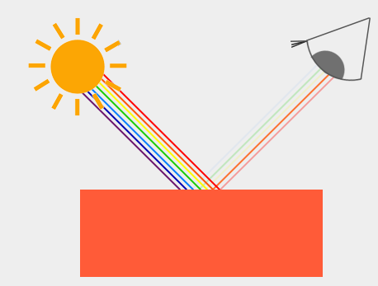
Color
You can see that the white sunlight is actually a collection of all the visible colors and the object absorbs a large portion of those colors. It only reflects those colors that represent the object's color and the combination of those is what we perceive (in this case a coral color).

Slide 5
Color
the toy's color absorbs a large portion of the white light, but reflects several red, green and blue values based on its own color value
glm::vec3 lightColor(1.0f, 1.0f, 1.0f);
glm::vec3 toyColor(1.0f, 0.5f, 0.31f);
glm::vec3 result = lightColor * toyColor; // = (1.0f, 0.5f, 0.31f);

Slide 6
Color
We can thus define an object's color as the amount of each color component it reflects from a light source:
glm::vec3 lightColor(0.0f, 1.0f, 0.0f);
glm::vec3 toyColor(1.0f, 0.5f, 0.31f);
glm::vec3 result = lightColor * toyColor; // = (0.0f, 0.5f, 0.0f);

Slide 7
Color
Another example with a dark olive-green light:
glm::vec3 lightColor(0.33f, 0.42f, 0.18f);
glm::vec3 toyColor(1.0f, 0.5f, 0.31f);
glm::vec3 result = lightColor * toyColor; // = (0.33f, 0.21f, 0.06f)
We can get unexpected colors from objects by using different light colors.
It's not hard to get creative with colors!

Slide 8
Color – Vertex Shader
#version 330 core
layout (location = 0) in vec3 aPos;
uniform mat4 model;
uniform mat4 view;
uniform mat4 projection;
void main()
{
gl_Position = projection * view * model * vec4(aPos, 1.0);
}

Slide 9
Color - Fragment Shader
#version 330 core
out vec4 FragColor;
uniform vec3 objectColor;
uniform vec3 lightColor;
void main()
{
FragColor = vec4(lightColor * objectColor, 1.0);
}

Slide 10
Color – Passin Unifroms (1)
GLuint lightColorLocation = glGetUniformLocation(pId, "lightColor");
GLuint objectColorLocation = glGetUniformLocation(pId, "lightColor");
glUniform3f(lightColorLocation, 1.0f, 0.5f, 0.31f);
glUniform3f(objectColorLocation, 1.0f, 1.0f, 1.0f);

Slide 11
Color - Passin Unifroms (2)
GLuint lightColorLocation = glGetUniformLocation(pId, "lightColor");
glm::vec3 lightColor(1.0f, 1.0f, 1.0f);
glUniform3fv(lightColorLocation, 1, glm::value_ptr(lightColor));
OR
glUniform3fv(lightColorLocation, 1, &lightColor[0]);

Slide 12
Color – VBO Embeded Colors (1)
The colors are set in the VBO
glVertexAttribPointer(1, 3, GL_FLOAT, GL_FALSE, (3 + 3) * sizeof(GLfloat), (void*)(3 * sizeof(GLfloat)));
The light might be passed by uniform
GLuint lightColorLocation = glGetUniformLocation(pId, "lightColor");
glm::vec3 lightColor(1.0f, 1.0f, 1.0f);

Slide 13
Color – VBO Embeded Colors (2)
Vertex Shader
layout (location = 0) in vec3 position;
layout (location = 1) in vec3 vertexColor;
out vec3 color;
Fragment Shader
out vec4 FragColor;
in vec3 color;
uniform vec3 lightColor;

Slide 14
Colors – Demo
Guys, let’s dive into
C++

Slide 15
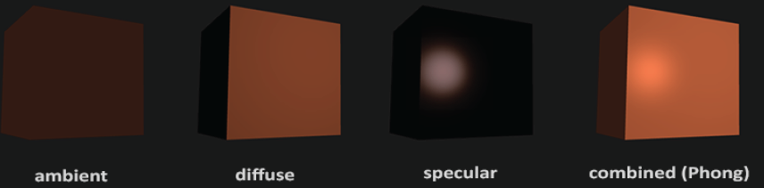
Basic Lighting
Phong lighting model:
Ambient lighting
Diffuse lighting
Specular Lighting

Slide 16
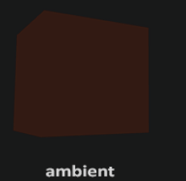
Ambient Lighting (1)
Even when it is dark there is usually still some light somewhere in the world (the moon, a distant light) so objects are almost never completely dark. To simulate this we use an ambient lighting constant that always gives the object some color.

Slide 17
Ambient Lighting (2)
Light usually does not come from a single light source, but from many light sources scattered all around us.
One of the properties of light is that it can scatter and bounce in many directions reaching spots that aren't in its direct vicinity; light can thus reflect on other surfaces and have an indirect impact on the lighting of an object.
Algorithms that take this into consideration are called global illumination algorithms (a very simplistic model of global illumination is ambient lighting).

Slide 18
Ambient Lighting (3)
We take the light's color, multiply it with a small constant ambient factor (fragment shader):
void main()
{
float ambientStrength = 0.1;
vec3 ambient = ambientStrength * lightColor;
vec3 result = ambient * objectColor;
FragColor = vec4(result, 1.0);
}

Slide 19
Ambient Lighting – Demo
Guys, let’s dive into
C++

Slide 20
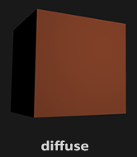
Difuse Lighting (1)
Simulates the directional impact a light object has on an object. This is the most visually significant component of the lighting model. The more a part of an object faces the light source, the brighter it becomes.

Slide 21
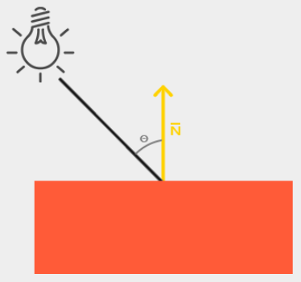
Difuse Lighting (2)
If the light ray is perpendicular to the object's surface the light has the greatest impact
We then need to measure at what angle the light ray touches the fragment.
To measure the angle between the light ray and the fragment we use something called a normal vector that is a vector perpendicular to the fragment's surface
The angle between the two vectors can then easily be calculated with the dot product

Slide 22
Difuse Lighting (3)
to calculate diffuse lighting we need:
Normal vector: a vector that is perpendicular to the vertex' surface (a unit vector)
The directed light ray: a direction vector that is the difference vector between the light's position and the fragment's position.

Slide 23
Difuse Lighting (4)
#version 330 core
layout (location = 0) in vec3 aPos;
layout (location = 1) in vec3 aNormal;
out vec3 Normal;
void main()
{
gl_Position = projection * view * model * vec4(aPos, 1.0);
Normal = aNormal;
}

Slide 24
Difuse Lighting (5)
#version 330 core
out vec4 FragColor;
in vec3 Normal; in vec3 FragPos;
uniform vec3 lightPos; uniform vec3 lightColor; uniform vec3 objectColor;
void main()
{
float ambientStrength = 0.1; vec3 ambient = ambientStrength * lightColor;
// diffuse
vec3 norm = normalize(Normal); vec3 lightDir = normalize(lightPos - FragPos);
float diff = max(dot(norm, lightDir), 0.0);
vec3 diffuse = diff * lightColor;
vec3 result = (ambient + diffuse) * objectColor;
FragColor = vec4(result, 1.0); }

Slide 25
Difuse Lighting (6)
#version 330 core
layout (location = 0) in vec3 aPos;
layout (location = 1) in vec3 aNormal;
out vec3 Normal;
void main()
{
gl_Position = projection * view * model * vec4(aPos, 1.0);
Normal = mat3(transpose(inverse(model))) * aNormal; //to avoid non uniform scaling and translate
}

Slide 26
Diffuse Lighting – Demo
Guys, let’s dive into
C++

Slide 27
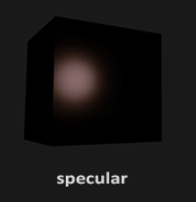
Specular Lighting (1)
Simulates the bright spot of a light that appears on shiny objects. Specular highlights are often more inclined to the color of the light than the color of the object.

Slide 28
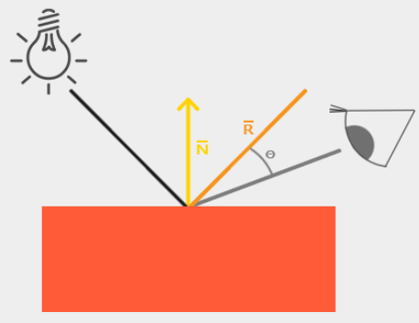
Specular Lighting (2)
Specular lighting is based on the light's direction vector and the object's normal vectors, but this time it is also based on the view direction
Specular lighting is based on the reflective properties of light

Slide 29
Specular Lighting (3)
#version 330 core
layout (location = 0) in vec3 aPos;
layout (location = 1) in vec3 aNormal;
out vec3 FragPos; out vec3 Normal;
uniform mat4 model; uniform mat4 view; uniform mat4 projection;
void main()
{
FragPos = vec3(model * vec4(aPos, 1.0));
Normal = mat3(transpose(inverse(model))) * aNormal;
gl_Position = projection * view * vec4(FragPos, 1.0);
}

Slide 30
Specular Lighting (3)
#version 330 core
out vec4 FragColor;
in vec3 Normal;
in vec3 FragPos;
uniform vec3 lightPos;
uniform vec3 viewPos;
uniform vec3 lightColor;
uniform vec3 objectColor;

Slide 31
Specular Lighting (4)
void main(){
float ambientStrength = 0.1; vec3 ambient = ambientStrength * lightColor;
vec3 norm = normalize(Normal); vec3 lightDir = normalize(lightPos - FragPos);
float diff = max(dot(norm, lightDir), 0.0); vec3 diffuse = diff * lightColor;
// specular
float specularStrength = 0.5; //specular intensity
vec3 viewDir = normalize(viewPos - FragPos);
vec3 reflectDir = reflect(-lightDir, norm);
float spec = pow(max(dot(viewDir, reflectDir), 0.0), 32);
vec3 specular = specularStrength * spec * lightColor;
vec3 result = (ambient + diffuse + specular) * objectColor;
FragColor = vec4(result, 1.0);
}

Slide 32
Specular Lighting (5)
Specular intensity: a value to give the specular highlight a medium-bright color so that it doesn't have too much of an impact.
If we would set this to 1.0f we'd get a really bright specular component which is a bit too much for a coral cube.

Slide 33
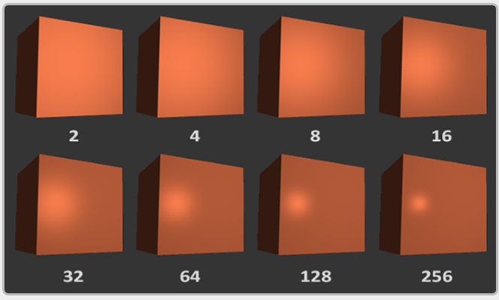
Specular Lighting (6)
This 32 value is the shininess value of the highlight. The higher the shininess value of an object, the more it properly reflects the light instead of scattering it all around and thus the smaller the highlight becomes.

Slide 34
Specular Lighting – Demo
Guys, let’s dive into
C++

