Slide 1
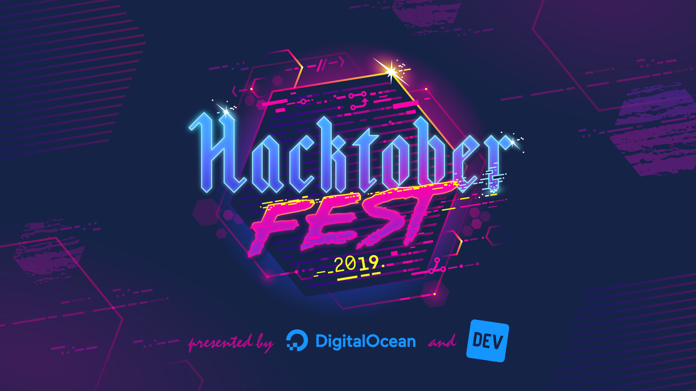

Slide 2
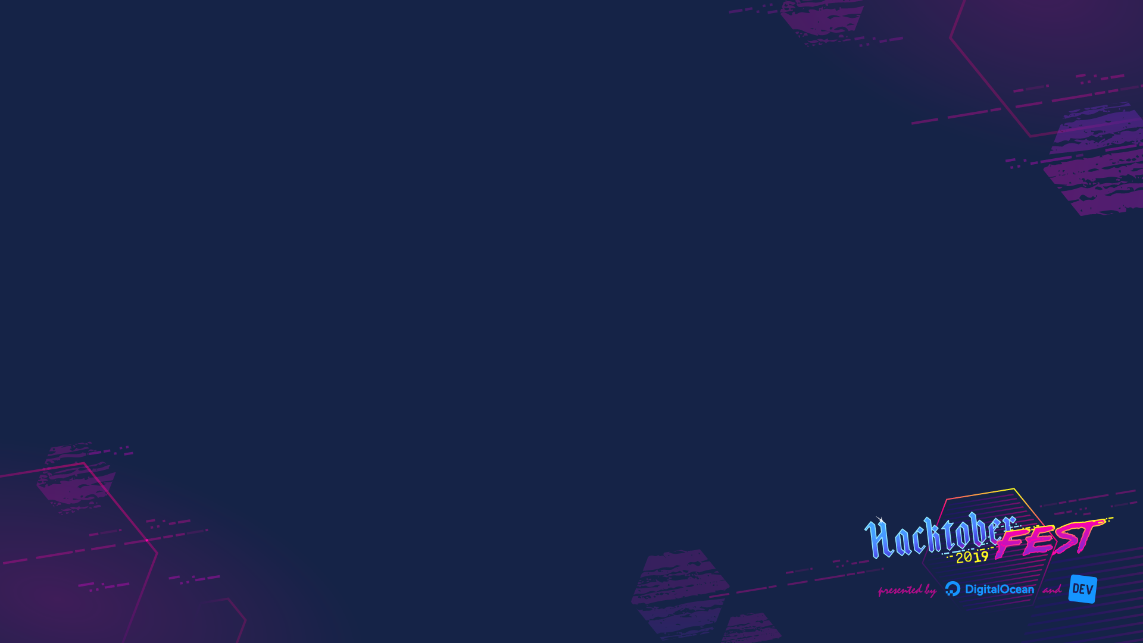
AGENDA
PART I : theoretical presentation
A – Open Source
B – Libra
C – HackotoberFest
PART II : Technical presentation
Presented by:
Facebook Developer Circle Los Angeles
Notes:
www

Slide 3
#OpenSourceSoftware

Slide 4
Technology is everywhere

Slide 5
Recent research shows that up to 99 percent of proprietary software contains OSS and 60 percent of proprietary code is from open source.

Slide 6

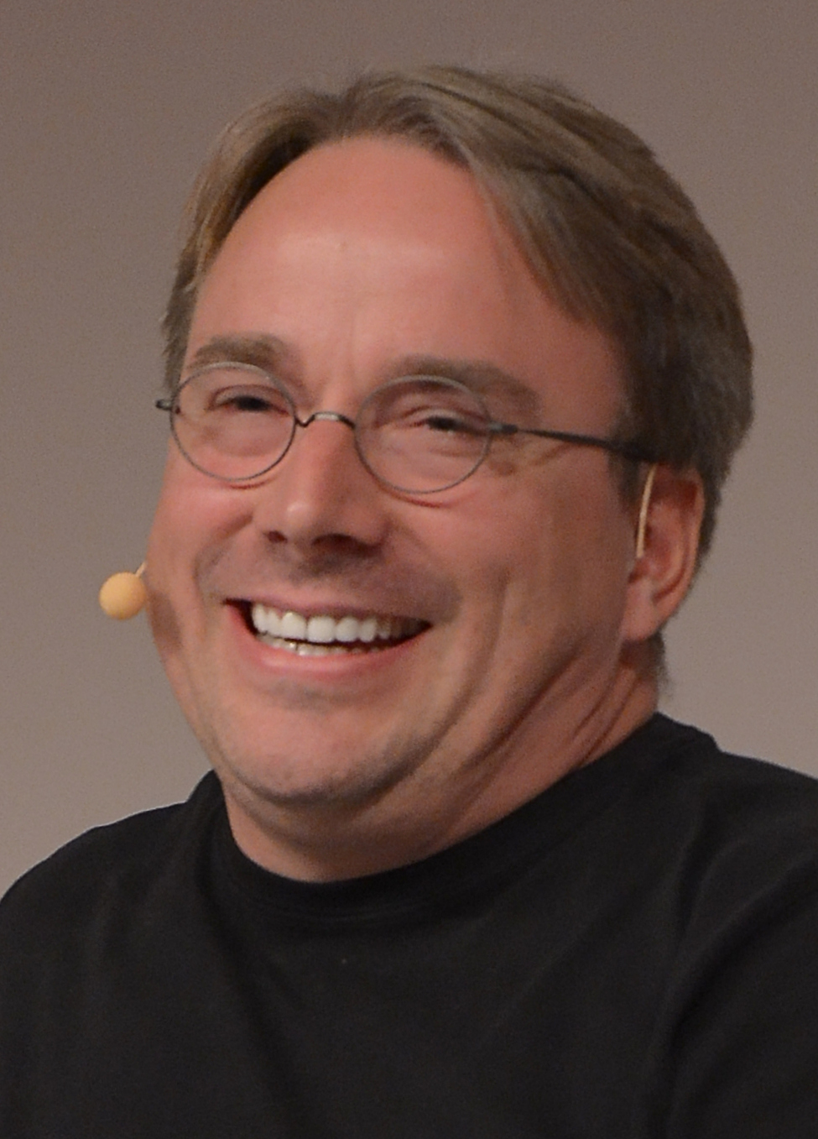
VS

Slide 7
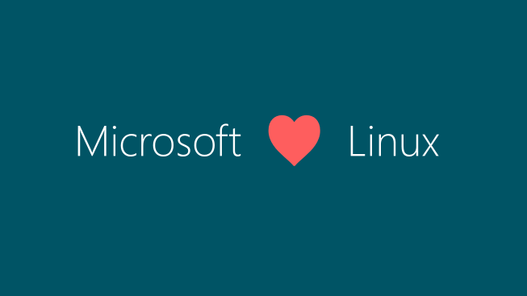
New approach to Linux and open source within Microsoft

Slide 8
1 – What is an OSS
Open-source software is software that anyone can use, inspect, and modify.

Slide 9
2 – Why using OSS

Slide 10
a. for company
- Cost effective
- Vendor lock free
- Security: you have many developers who will look your product and find bugs.
- Long life: software will be maintained
Business opportunity:
- Dual version: Have an open-source core and sell closed-source features
- Services: consulting, support, training
- Subscriptions: usually a combination of support, extended product lifetime and guaranteed updates

Slide 11
b. for individual
- want to solve problem
- want to build a reputation and good resume
- want to find mentors

Slide 12
3 – Why open source my software
- democratize the technology: the value of a technology depends on how many users it has.
- Trust: open source vendors are more trustworthy as they depend on trust to survive. There is a little risk for hidden trap doors as one anyone can examine the product code
- diversity : there is a value of collaboration (collaboration instead of competition). don't spend your time recreating the wheel, but focus on creating new value. “When you stand on the shoulders of giants, you can create and innovate at higher lever”
- We can get better together: having standard between

Slide 13
4 – Characteristics of OSS

Slide 14

a .git
Git is as a tree and every tree has a different version of the project.
We can experiment ideas without risk to break the code by creating new branch, and propose merge wherever we get something.

Slide 15
b. AUTHORS.md
(user, contributor, maintainer): review and merge code

Slide 16
c. README.md
how to install and use

Slide 17
d. LICENSE.md
There are two major types of open-source licenses: copyleft (GNU GPLv3) and permissive (MIT and Apache 2.0).
Both copyleft and permissive licenses allow developers to copy, modify, and redistribute code (derivative or otherwise) freely. The most important difference between the two, however, lies in how each approaches copyright privileges.
- Under a copyleft license, users must for example make new changes under free license.
- By contrast, permissive licenses do not restrict the licenses under which these acts can be done.

Slide 18
e. CONTRIBUTING.md
code style,
Build and test your will be applying for each new code
There are many ways to contribute:
- writing code
- writing documentation
- reporting bugs
- Design thinking, new ideas / discussion

Slide 19
f. CODE_OF_CONDUCT.md
Code of Conduct

Slide 20
5 – How to start
- Find project:
- For fun
- Fix problem
Discuss with maintainer: ask the maintainer to manually assign it to us, so it will change the status and nobody can work on it for a period of time.
- Implement
- Submit

Slide 21
#Libra

Slide 22
All over the world, people with less money pay more for financial services. Sending $200 can cost up to $19.
The current financial system is clearly not working for all and is excluding 1.7 billion adults globally.
Moving money should be as easy and cost-effective and even more safe and secure than sending a text message or sharing a photo, no matter where you live, what you do, or how much you earn.
Facebook believes that Blockchains and cryptocurrencies can potentially address some of these problems:
- wire transfer fees
- cash out fees
- slow processes

Slide 23
1 - Libra Initiative
Facebook introduced "Libra", a currency built on the “Libra Blockchain”. Its mission is to enable a simple global currency and financial infrastructure that empowers billions of people by helping underserved population to move funds and to buy physical and digital goods and services at low cost.
It is made up of four parts:
- 1. It is Able to scale to billions of accounts, with high throughput and low latency
- 2. It is backed by a reserve of assets to avoid inflation and volatility
- 3. It is governed by the independent Libra Association tasked with evolving the ecosystem
- 4. It is powered by open-source software. It means that :
- developers can build new applications that run on any kind of device.
- the public can inspect how the code works
- the community can work together to make it more secure.

Slide 24
2 - Libra Ecosystem
Consists of 3 entities: Client, Validator, Developer

Slide 25
a. client
Piece of software that has the capability to interact with the Libra Blockchain.
- Can construct, sign, and submit transactions to a validator node.
- Can issue queries to the Libra Blockchain, request the status of a transaction or account, and verify the response.

Slide 26
b. validator
Validator nodes are entities in the Libra ecosystem that collectively decide which transactions will be added to the Libra Blockchain. They are also members of the Libra Association.
The Libra Association is an independent, not-for-profit membership organization headquartered in Geneva, Switzerland. The role of the association is to manage the development of the technology. It is the only party able to create(mint) and destroy (burn) Libra.
- Coins are only minted when authorized resellers have purchased those coins from the association with fiat assets to fully back the new coins.
- Coins are only burned when the authorized resellers sell Libra coin to the association in exchange for the underlying assets.

Slide 27
c. developer
The Libra ecosystem supports a wide variety of developers, ranging from people who contribute to Libra Core to those who build applications that use the blockchain.
- Build Libra clients.
- Build applications to interact with a Libra client.
- Write smart contracts to execute on the blockchain.
- Contribute to the Libra Blockchain software.

Slide 28
3 - Libra Protocol
The Libra Blockchain is a cryptographically authenticated distributed database, and it is based on the Libra protocol.
All of the data in the Libra Blockchain is persisted in a SINGLE-VERSIONED DISTRIBUTED database.
At the heart of it, are two fundamental concepts "transactions" and "states"

Slide 29
a. transaction
A Client of the Libra Blockchain submit a signed transaction to request update to the state:
- Sender address
- Sender public key
- Program
- Gas price
- Sequence
- Expiration time
- Signature

Slide 30
b. state
A validator receives and executes the transaction and stores the result in the blockchain. It also decides whether the transaction should be added to the blockchain and in what order.
At any point in time, after any transaction, the blockchain create a global “state.” comprised of the state of all accounts in the blockchain.
This state (or ledger state) represents the current snapshot of data on the chain. Executing a new transaction changes the state of the blockchain to a new state.

Slide 31
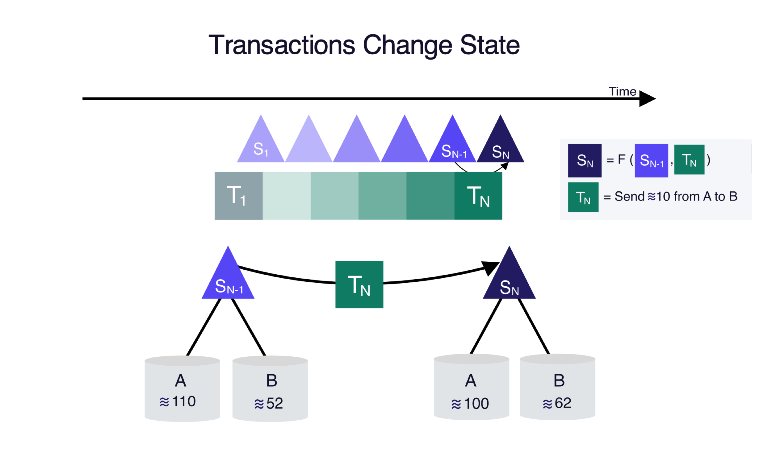

Slide 32
4 - Libra Vs Bitcoin

Slide 33
- Libra is a digital currency: runs on blockchain
- Bitcoin is a crypto currency: runs on blockchain

Slide 34
- Libra is a digital currency: its value is backed 1 to 1 to real asset (avoid inflation)
- Bitcoin is a crypto currency: its value is tied to its scarcity (volatile)

Slide 35
- Libra Blockchain is a single data structure that records the history of transactions
- Bitcoin blockchain is a collection of blocks of transactions

Slide 36
- Libra is permissioned: access is granted by a validator node.
- Bitcoin is permissionless: anyone who meets the technical requirements can build on it

Slide 37
- Libra is based on consensus algorithm
- Bitcoin is based on peer to peer algorithm

Slide 38
- libra: fast and cheap, 1000 transactions/sec
- Bitcoin : low and expensive, 7 transactions/sec

Slide 39
5 - Libra blockchain components

Slide 40
a. move
New programming language designed to prevent assets from being cloned.
A resource has a single owner, it can only be spent once, and the creation of new resources is restricted.

Slide 41
b. libraBFT
Modified version of Byzantine Fault Tolerant (BFT) consensus algorithm.
A transaction proposed as long that 2/3 approve the transaction will be added to the layer.

Slide 42
c. merkle tree
The blockchain is represented as an ever-growing Merkle tree of transactions where a “leaf” is appended to the tree for each transaction executed on the blockchain.
It allows to:
- Read any data from any point in time.
- Verify the integrity of the data

Slide 43
6 - Libra validation modules

Slide 44
a. admission control (AC) module
Any request made by a client to the validator node goes to AC first.

Slide 45
b. mempool module
Buffer that holds the transactions that are “waiting” to be executed.

Slide 46
c. consensus module
Responsible for ordering blocks of transactions and agreeing on the results of execution by participating in the consensus protocol with other validator nodes in the network.

Slide 47
d. execution module
Maintains an in-memory representation of the results of execution until consensus and commits the block to the distributed database.

Slide 48
e. virtual machine (VM)
Used to run the program included in a transaction and determine the results.

Slide 49
f. storage (VM)
Storage is used to persist agreed upon blocks of transactions and their execution results.

Slide 50
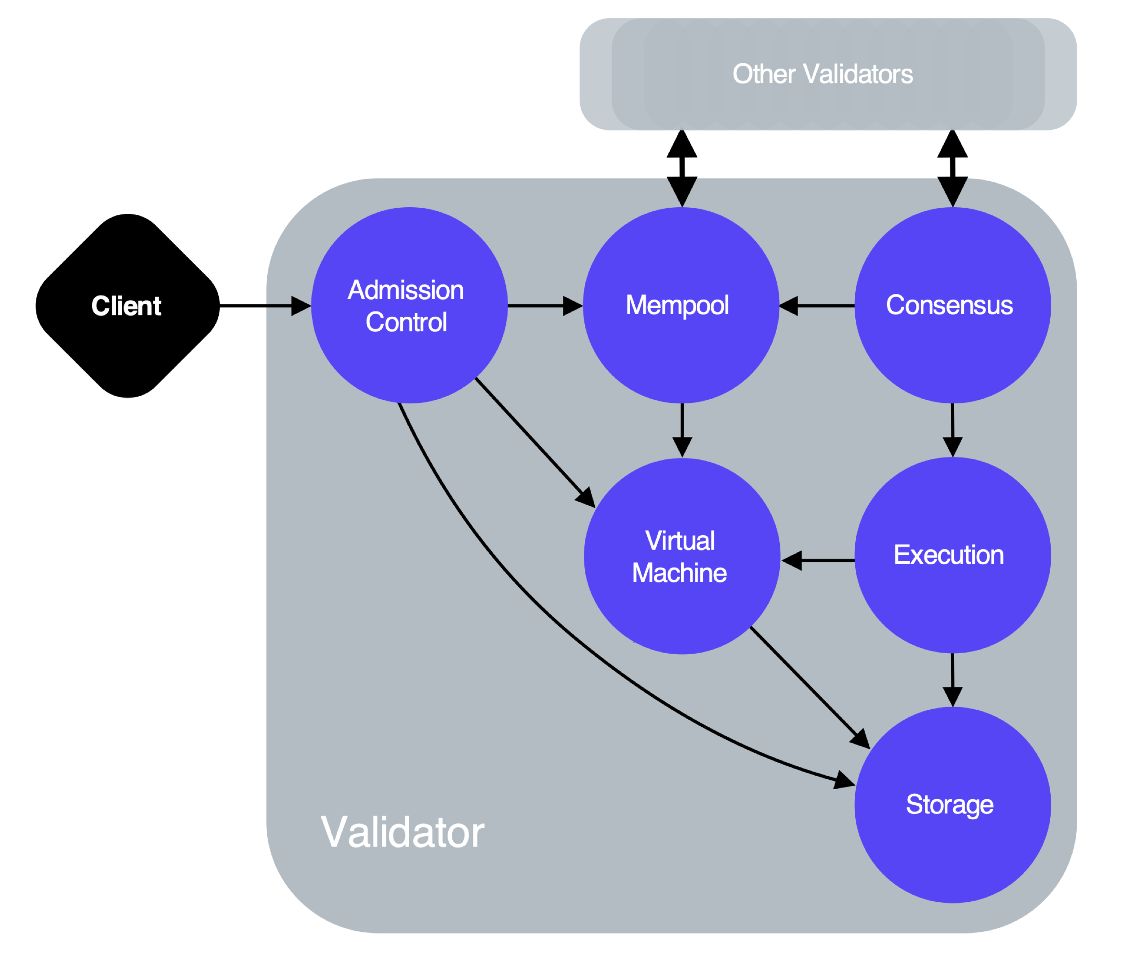

Slide 51
#Hacktoberfest

Slide 52
1- What ?
A month-long celebration of OSS brought by DigitalOcean in partnership with DEV.

Slide 53
2 - Why ?
- Learn about the open source ecosystem, from how to start an open source project to marketing your project, sustaining growth, and troubleshooting and maintenance
- Encouraging meaningful contributions to the open source ecosystem

Slide 54
3 - Who and Where ?
Everyone and everywhere.
It Is virtual and open to participants from around the globe.

Slide 55
4 - How ?
- Read code of conduct ” https://do.co/hacktoberconduct”
- Create a GitHub account.
- Sign up “ https://hacktoberfest.digitalocean.com“
- Find project “https://hacktoberfest.digitalocean.com/#projects”
- Submit 4 PRs
- Demos and Hack (optional) anyone interested in sharing their open source projects.

Slide 56
Part II - Demo and Hack

Slide 57
Setup
1) Install Git on your computer
https://git-scm.com/downloads
2) Create a GitHub account if you don't have one
https://github.com/join
3) Create your hacker profile by linking your GitHub account:
https://hacktoberfest.digitalocean.com/profile
4) Find a project
https://github.com/topics
4) Hack.

Slide 58
Links
https://github.com/mungell/awesome-for-beginners
https://github.github.com/training-kit/downloads/github-git-cheat-sheet.pdf
https://guides.github.com/introduction/flow/
https://github.com/github/gitignore
https://www.digitalocean.com/community/tutorials/how-to-create-a-pull-request-on-github
http://try.github.io/

Slide 59
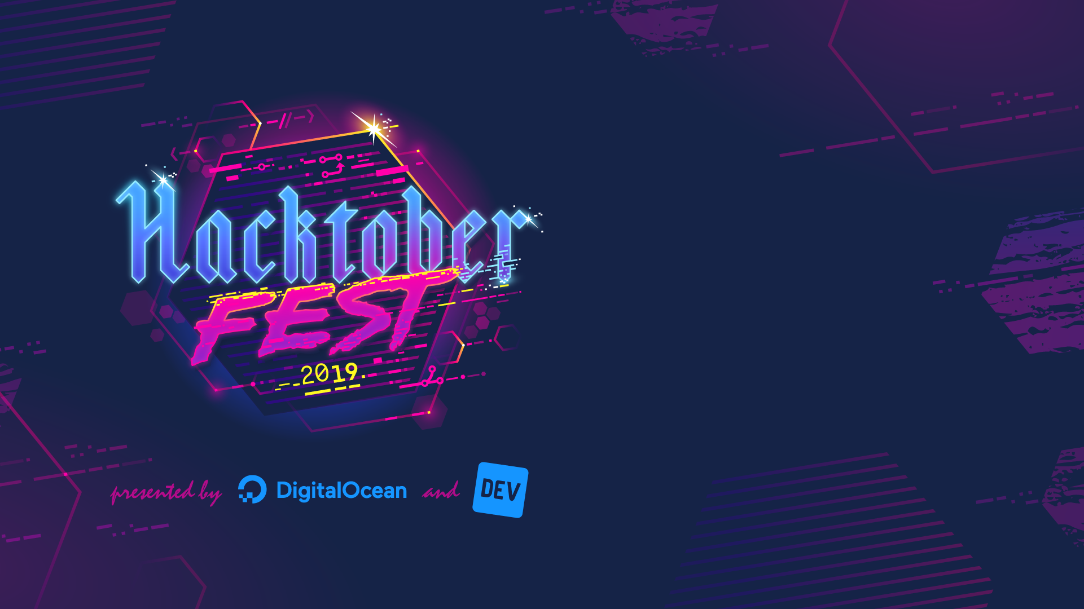
Thank You

