Slide 1


INDE1
Nandi TRAORE
Bastien HOORELBEKE
Mohamed LAIMECHE

Slide 2


Summary
1) Context
2) Statistics
3) Alert
4) Mistakes
5) Forgotten informations
Architecture

Slide 3
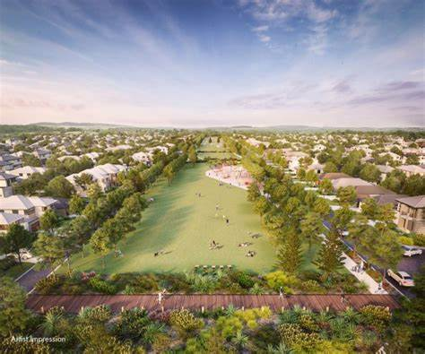
1) Context

Slide 4
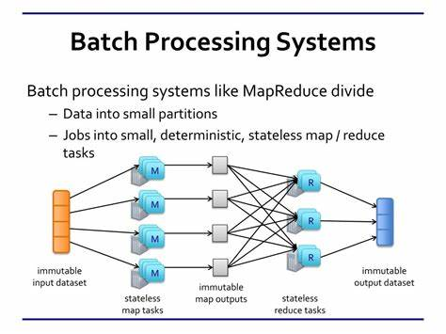

2) Statistics : Distributed Storage
Large amount of Data
scalability
« fault-tolerant »
Avaibility
-> Batch Processing
=> Hadoop

Slide 5
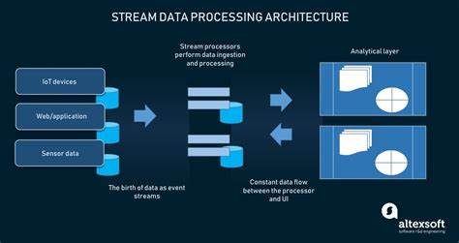

3) Alert
Rapidity constraints
Reliability constraints
-> Streaming
=> Apache Kafka

Slide 6

4) What mistake(s) from Harmonystate can explain the failed attempt ?
Human complexity
Large group of people
Lacks in the process of creation
philosophy

Slide 7
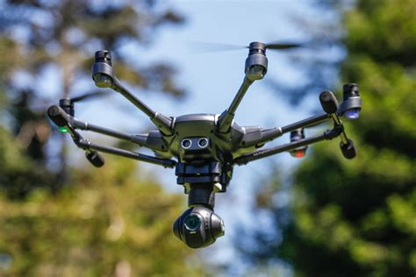
5) Information they forgot ?
Drone efficiency
Information on the context (fire…)

Slide 8
Architecture

