Slide 1
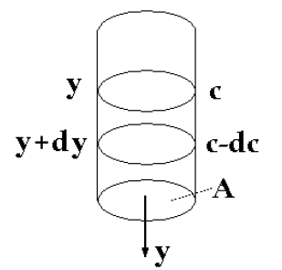

Slide 2
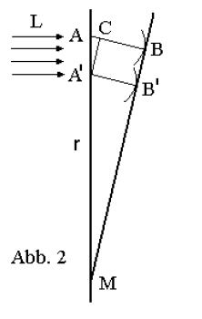

Slide 3
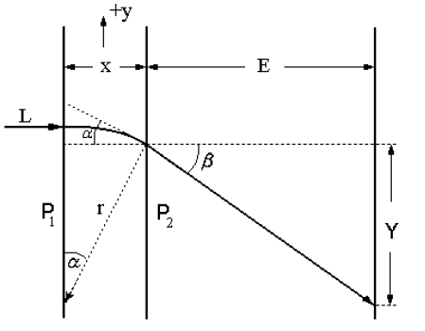

Slide 4
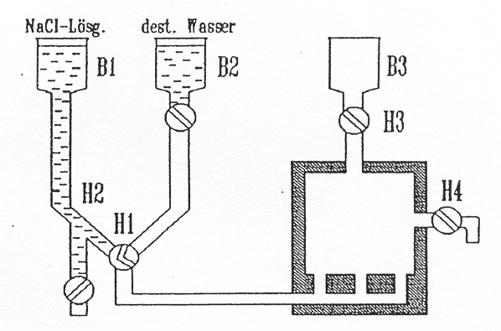
GP2-DI-abb4

Slide 5
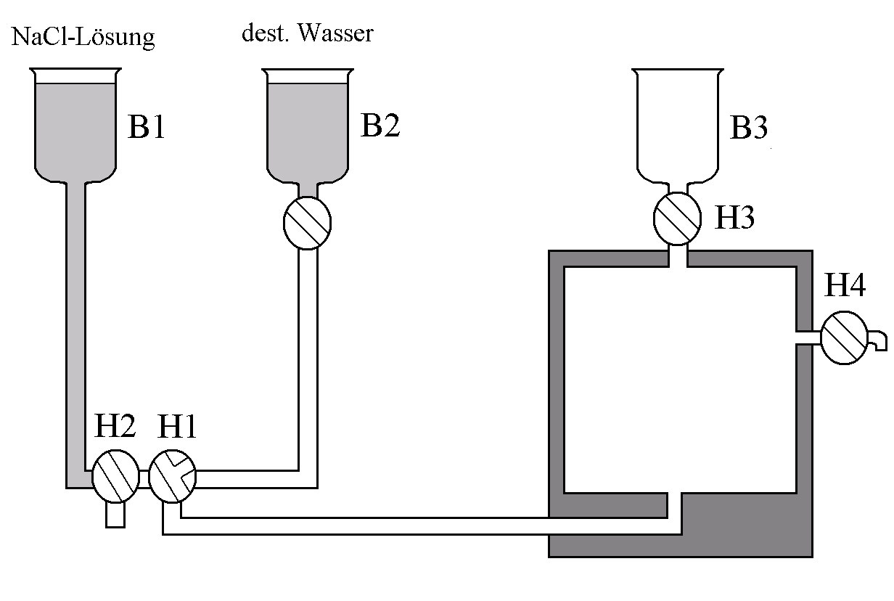
NaCl-solution
distilled water
GP2-DI-kurz-aufbau

Slide 6
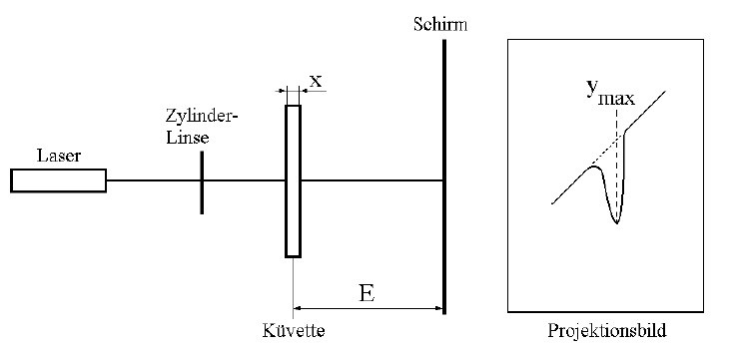
screen
cylindrical lens
laser
GP2-DI-prinzip
cuvette
projection image

