Slide 1
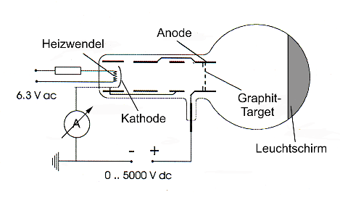
schema_en
filament
anode
graphite target
cathode
phosphorescent screen

Slide 2
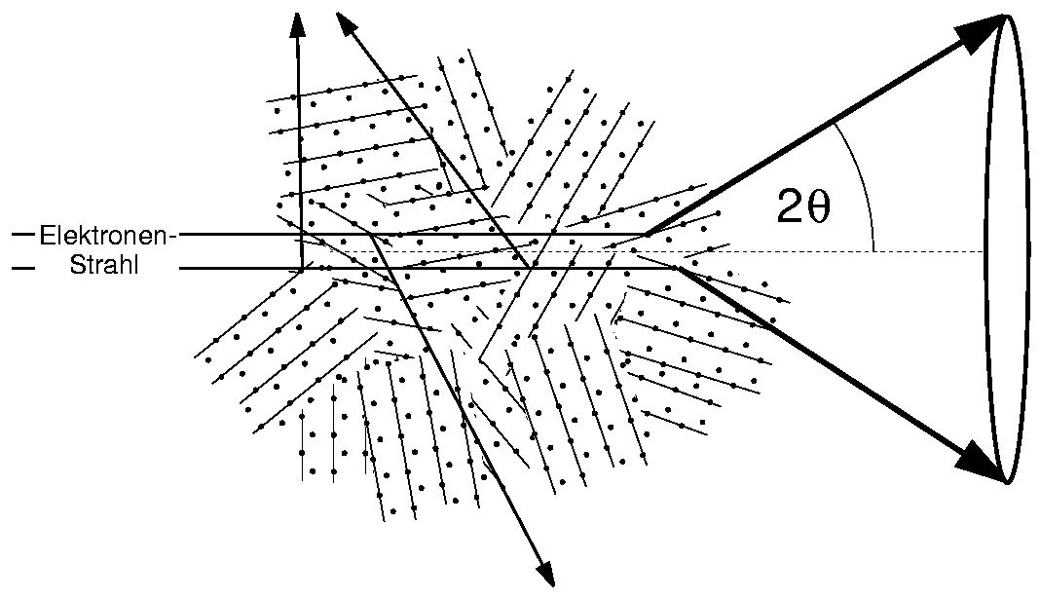
polycrystal3_en
Electron Beam

Slide 3
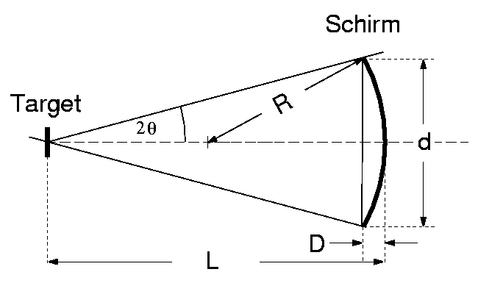
korrektur_en
screen
target
D
D

Slide 4
korrektur_en
D
D

