Slide 2
Green’s function method for inter-layer tunneling between two-dimensional materials
Bastian Valhøj Kristensen
Supervisor and Co-supervisor
Mads Brandbyge (mabr@dtu.dk)
Alan Ernesto Anaya Morales (alemor@dtu.dk)

Slide 3
General idea

Slide 4
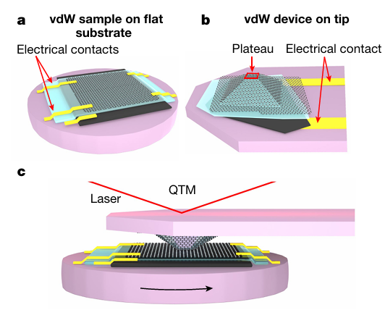
Motivation
[1]
[1] https://doi.org/10.1038/s41586-022-05685-y

Slide 5
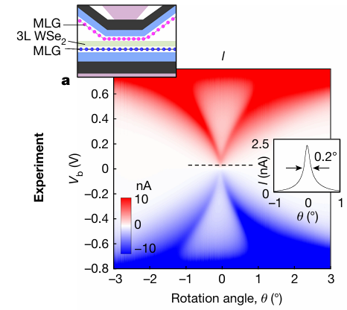
What is QTM?
Conservation:
Energy
Momentum
[1]
Conservation:
Energy
Momentum
[1]
[1] https://doi.org/10.1038/s41586-022-05685-y

Slide 6
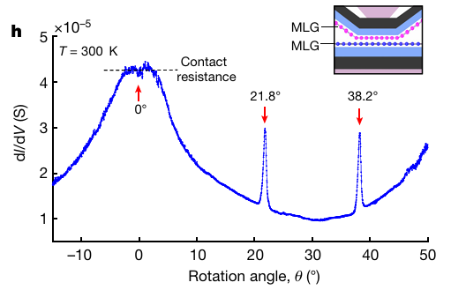
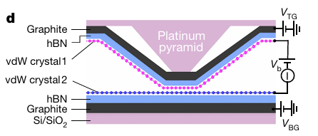
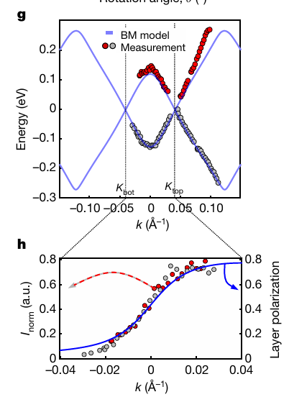
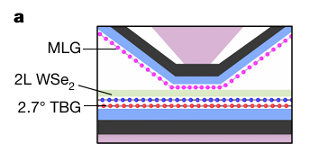
What is QTM?
[1]
[1]
[1]
[1]
[1]
[1] https://doi.org/10.1038/s41586-022-05685-y

Slide 7
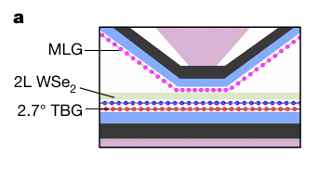
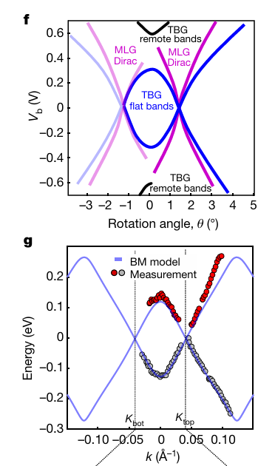
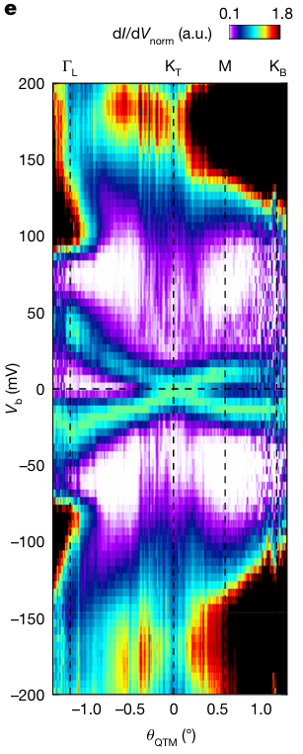
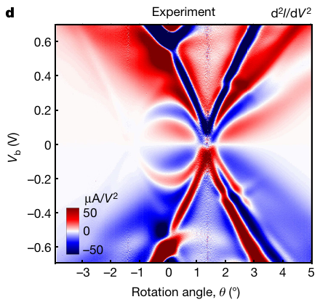



What is QTM?
$$θ_{TBG}$$
[1]
$$θ_{TBG}={1.2}^{∘}$$
$$θ_{TBG}={2.7}^{∘}$$
[1]
[1]
[1]
[2]
[1] https://doi.org/10.1038/s41586-022-05685-y
[2] https://doi.org/10.1038/s41586-026-10378-x

Slide 8
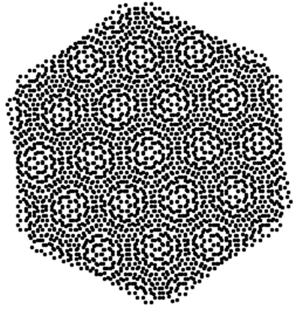
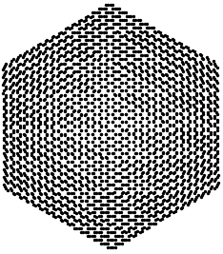
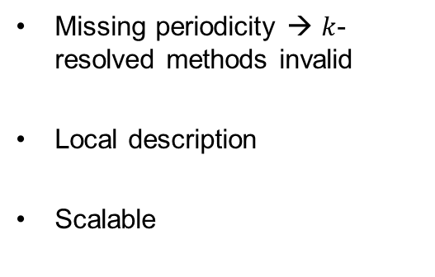


Motivation
Missing periodicity → $k$-resolved methods invalid
Local description
Scalable
$$θ_{TBG}={10}^{∘}$$
$$θ_{TBG}={1.1}^{∘}$$
??

Slide 9
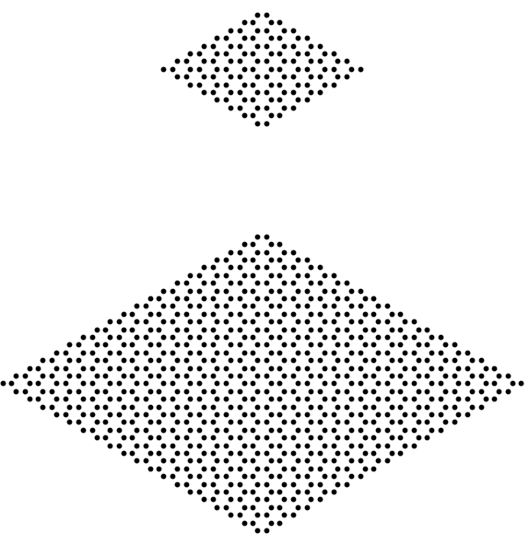
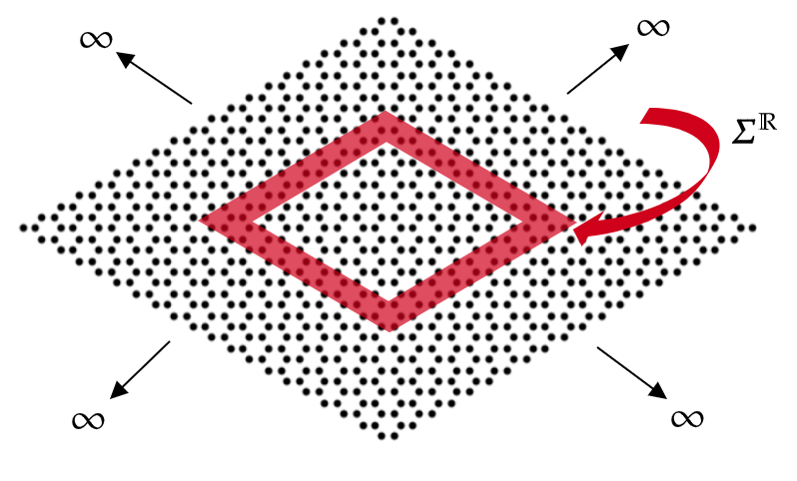
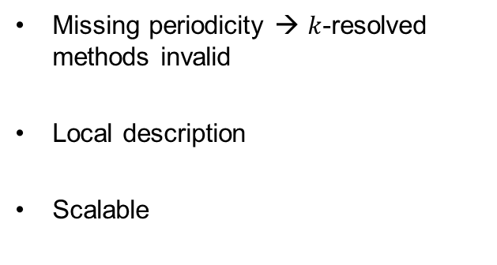
Motivation
Missing periodicity → $k$-resolved methods invalid
Local description
Scalable

Slide 10
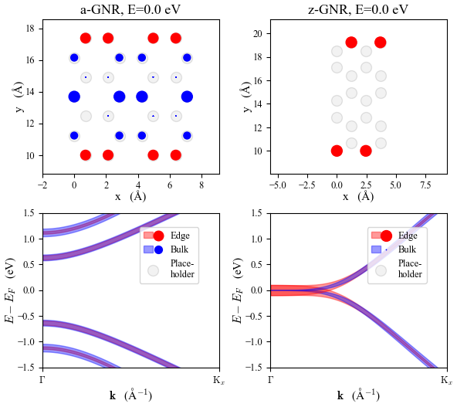
Base Edge Exploration

Slide 11
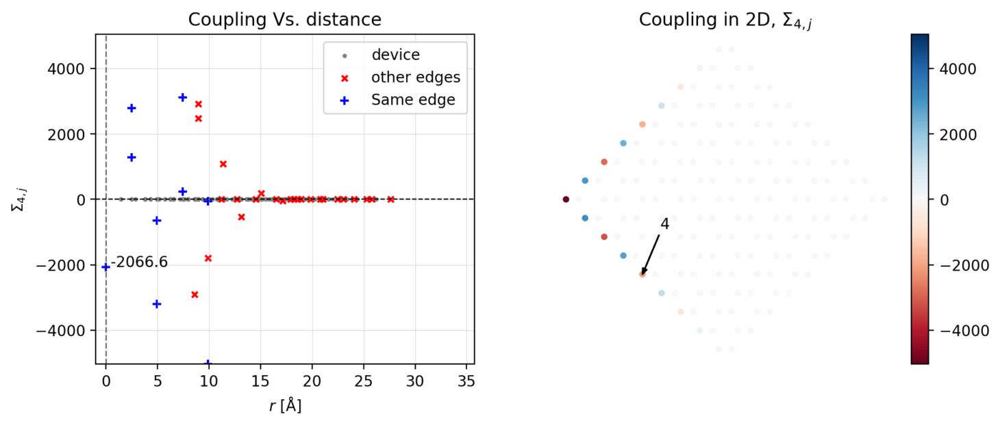
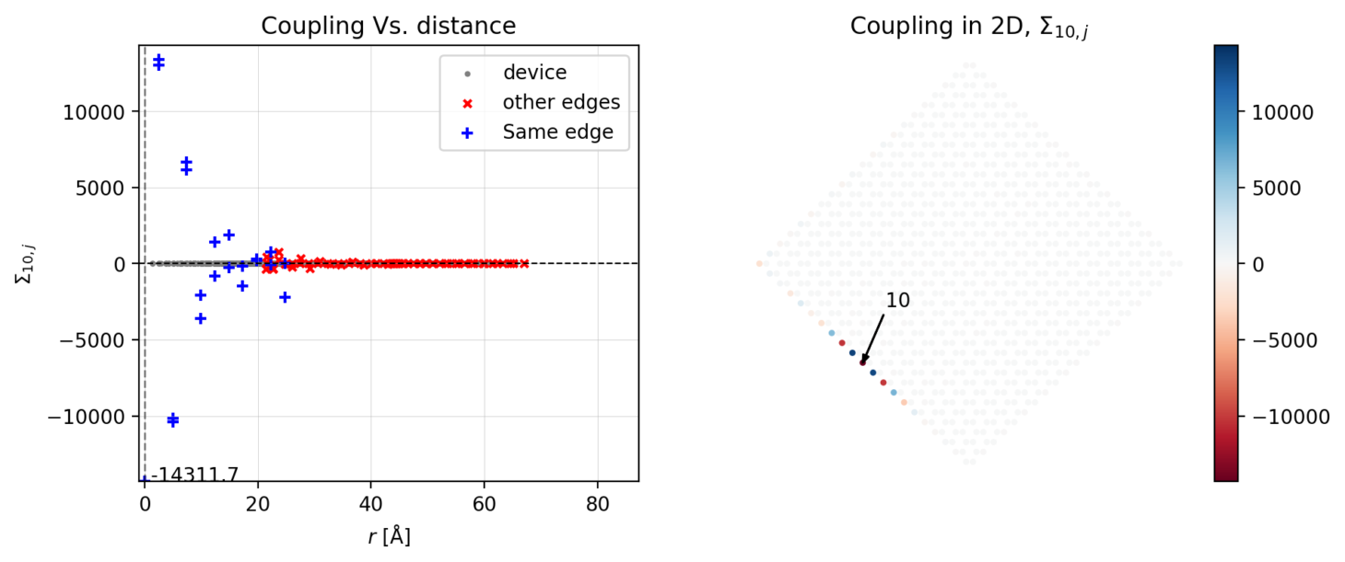
Investigate self-energies, z-GNR – onsite
N=9
N=21

Slide 12
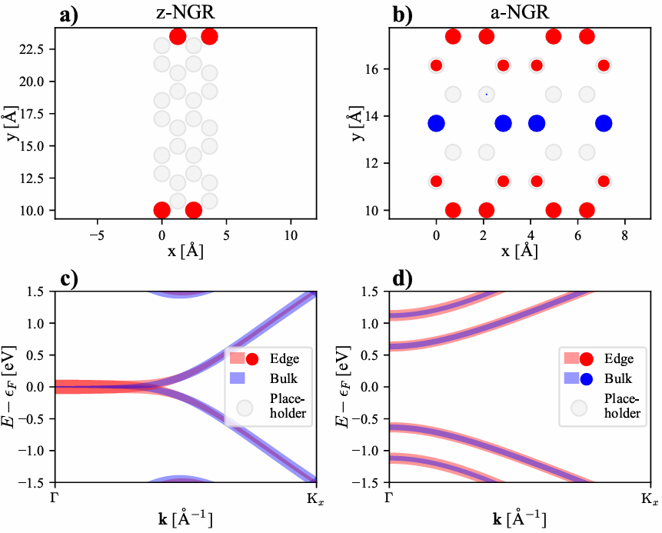

Slide 13
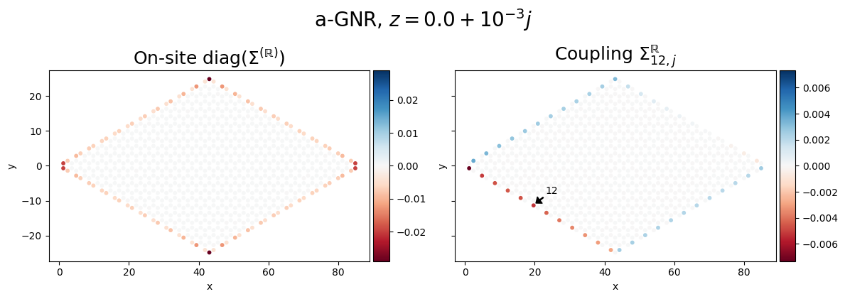
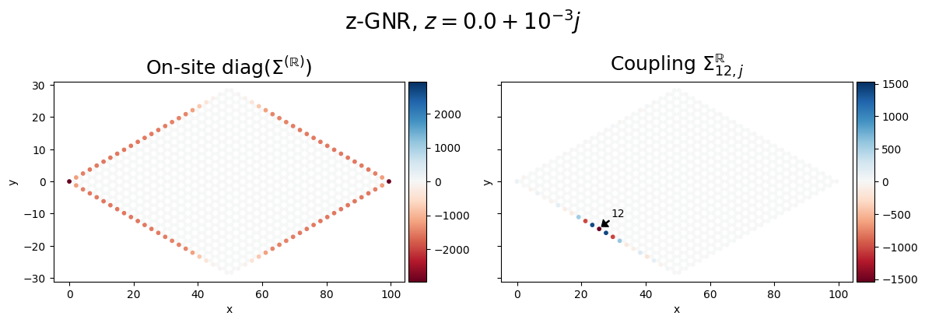
Armchair, N=12
Zig-zag, N=12*2

Slide 14
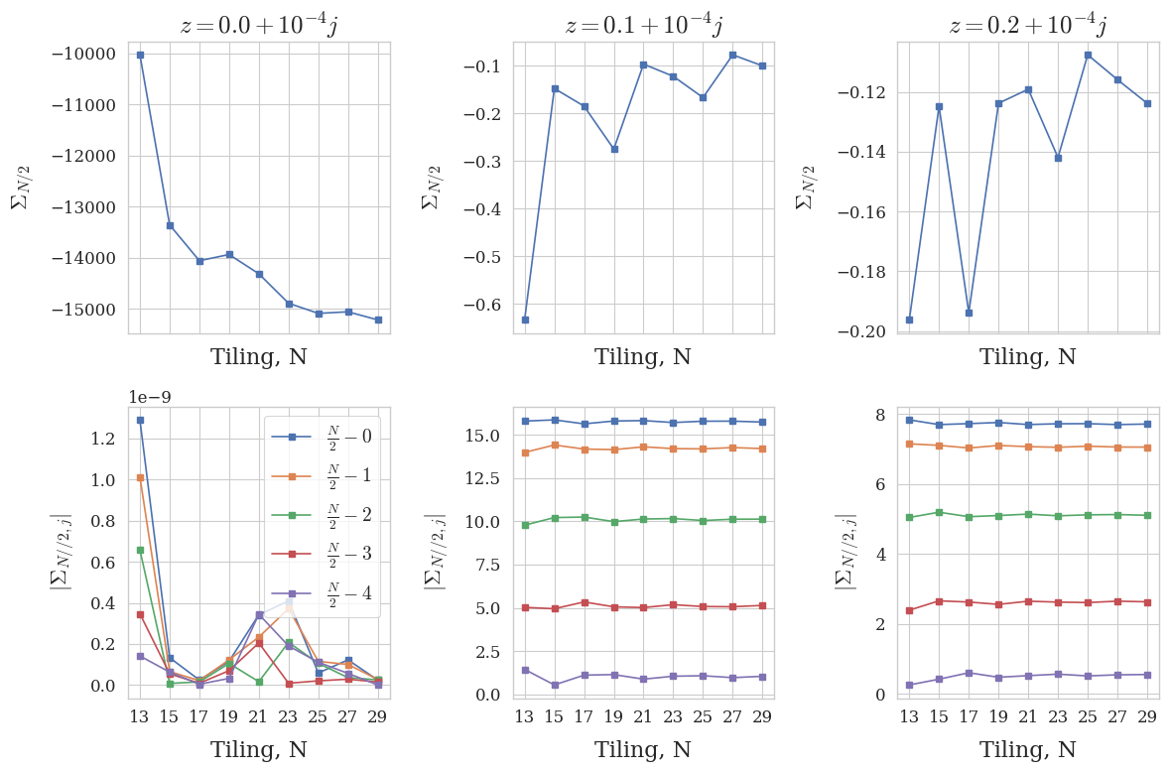

Slide 15
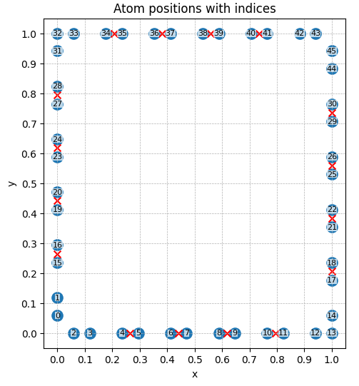
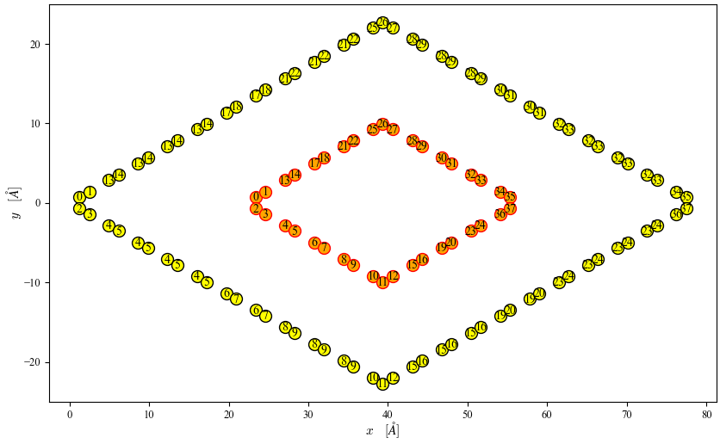
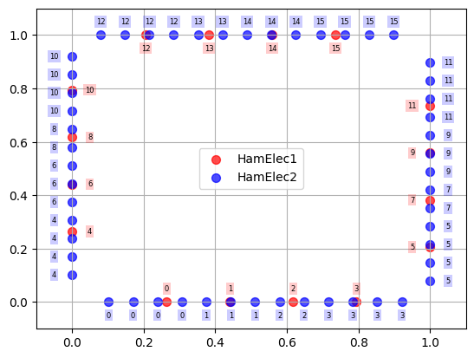
Naïve extrapolate: k-NN
3.
1.
2.

Slide 16
Naïve extrapolate: k-NN
Pit-falls:
Number of equivalent pairs scale (sort of) linearly → overweight of corner-neighboring pairs
4-atom corners occupy more space → more edge pairs for this region

Slide 18
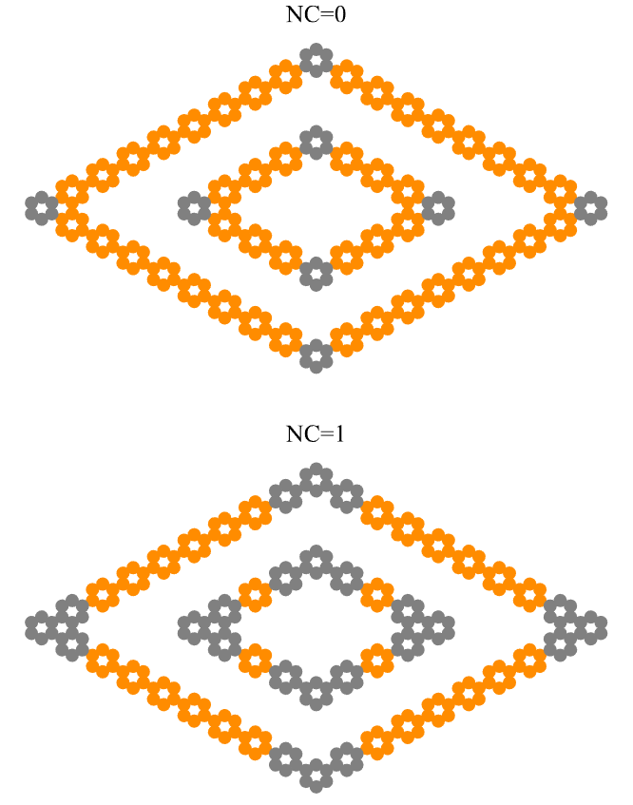
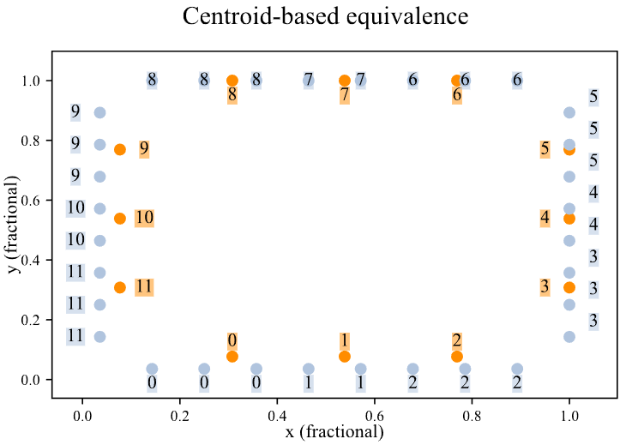
Extrapolation
Using NC
kNN: Finding equivalent centroids
In practice: only one edge at a time

Slide 19
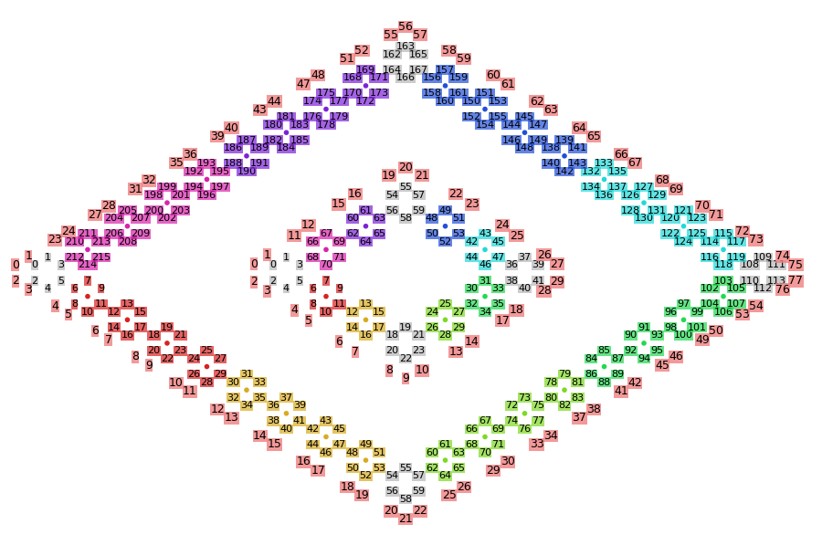
Adaptive kNN for reduced corner-edge pair influence

Slide 20
DFT
DOS + bandpath

Slide 21
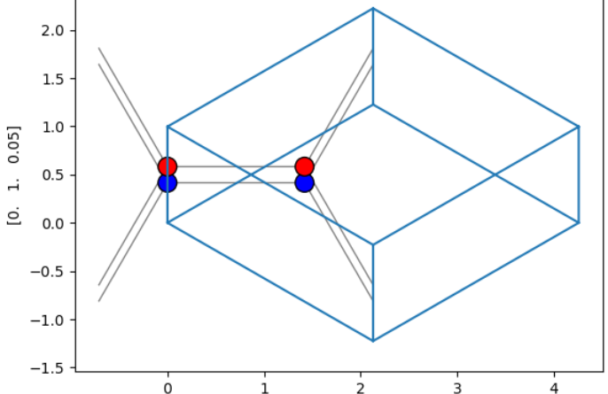
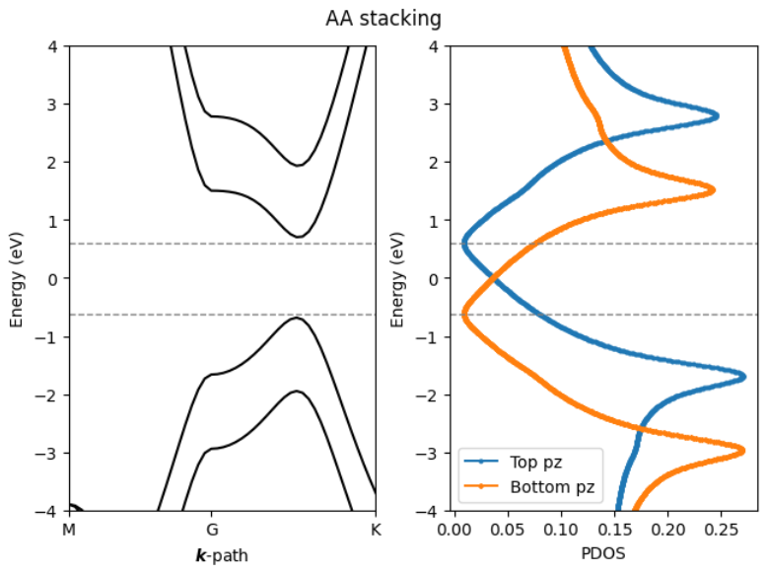
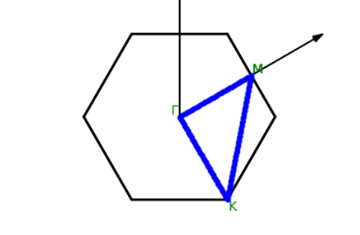
AA stacking, 4 atoms/UC

Slide 22
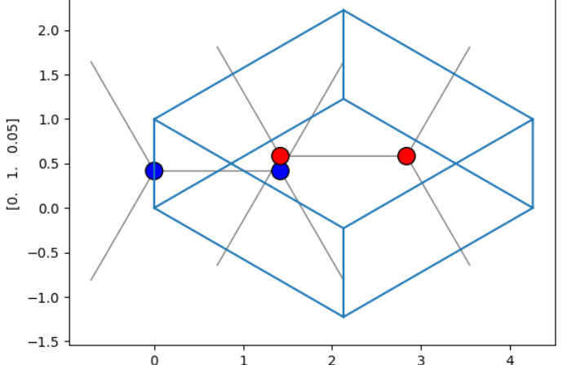
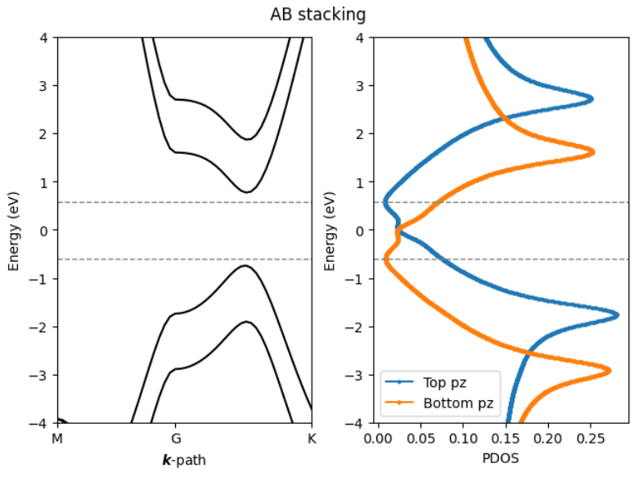
AB stacking, 4 atoms/UC

Slide 23
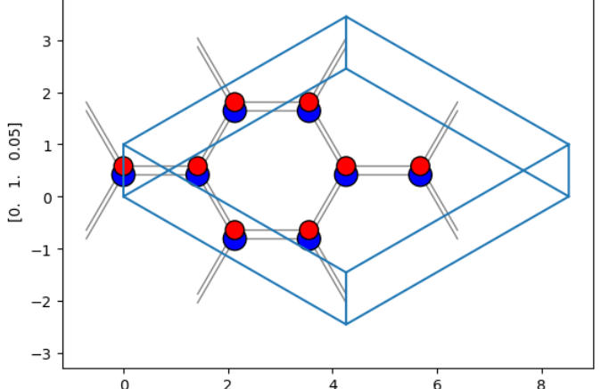
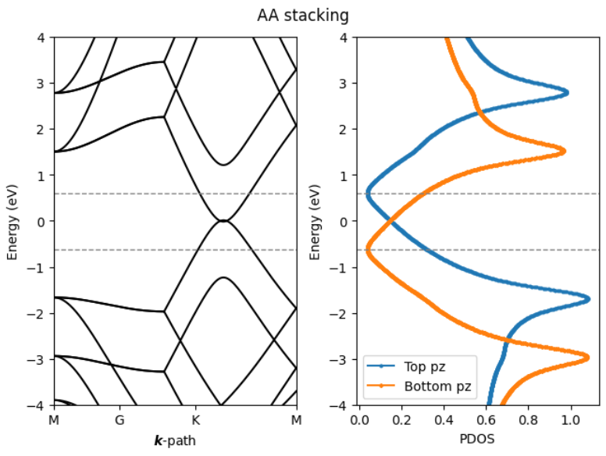
AA stacking, 16 atoms/UC

Slide 24
AA stacking, 16 atoms/UC Vs. 4 atoms/UC

Slide 25
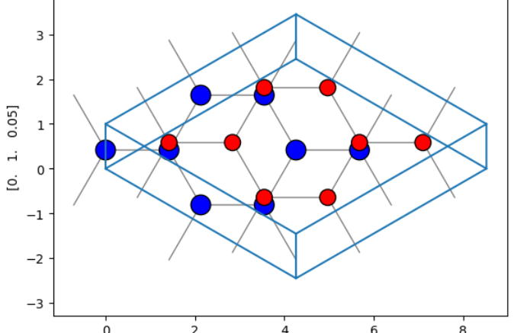
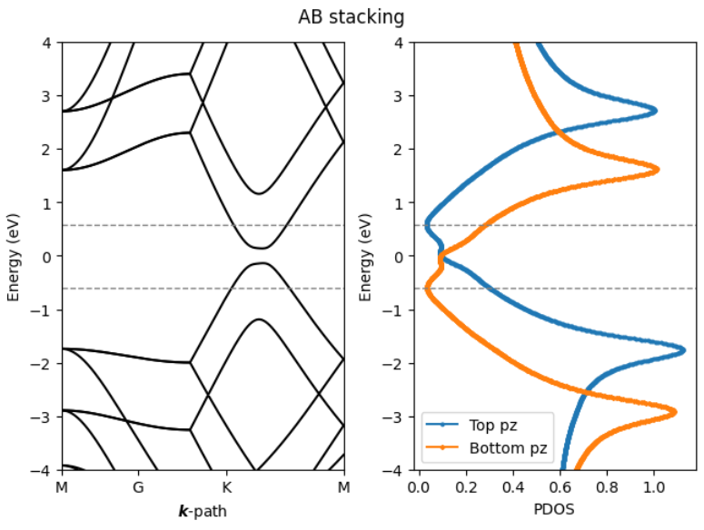
AB stacking, 16 atoms/UC

Slide 26
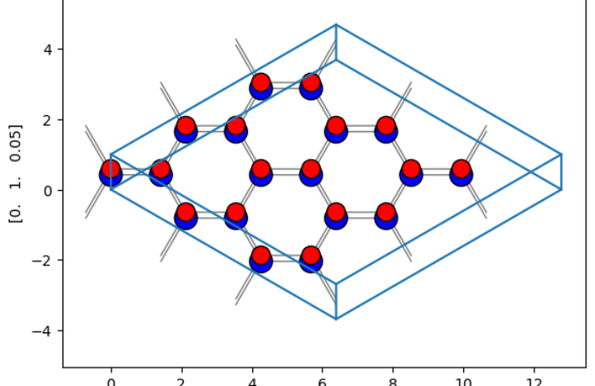
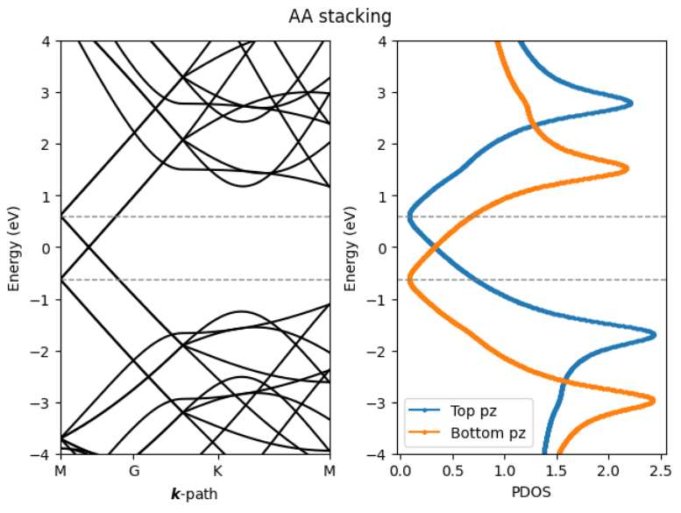
AA stacking, 32 atoms/UC

Slide 27
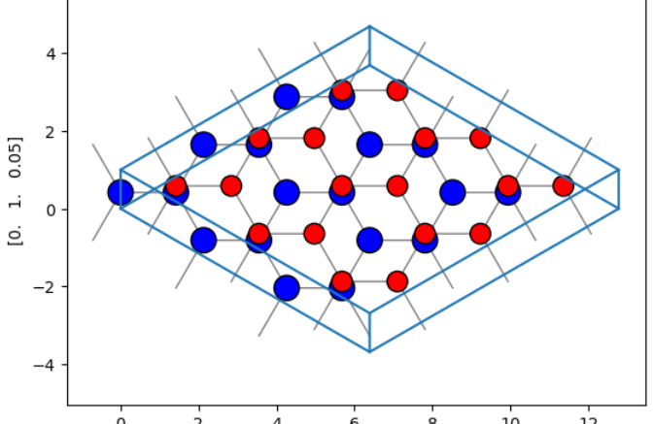
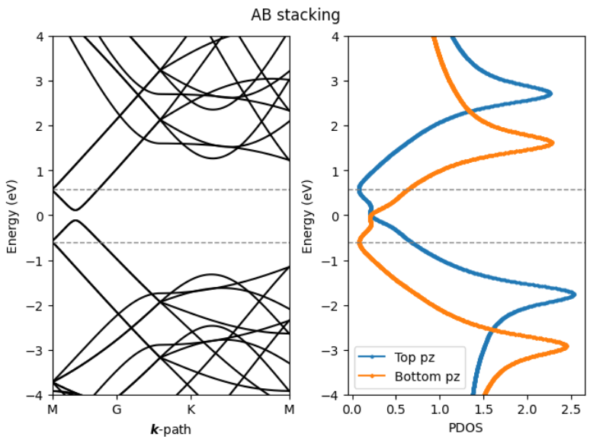
AB stacking, 32 atoms/UC

