Slide 1
Issue:

Slide 2
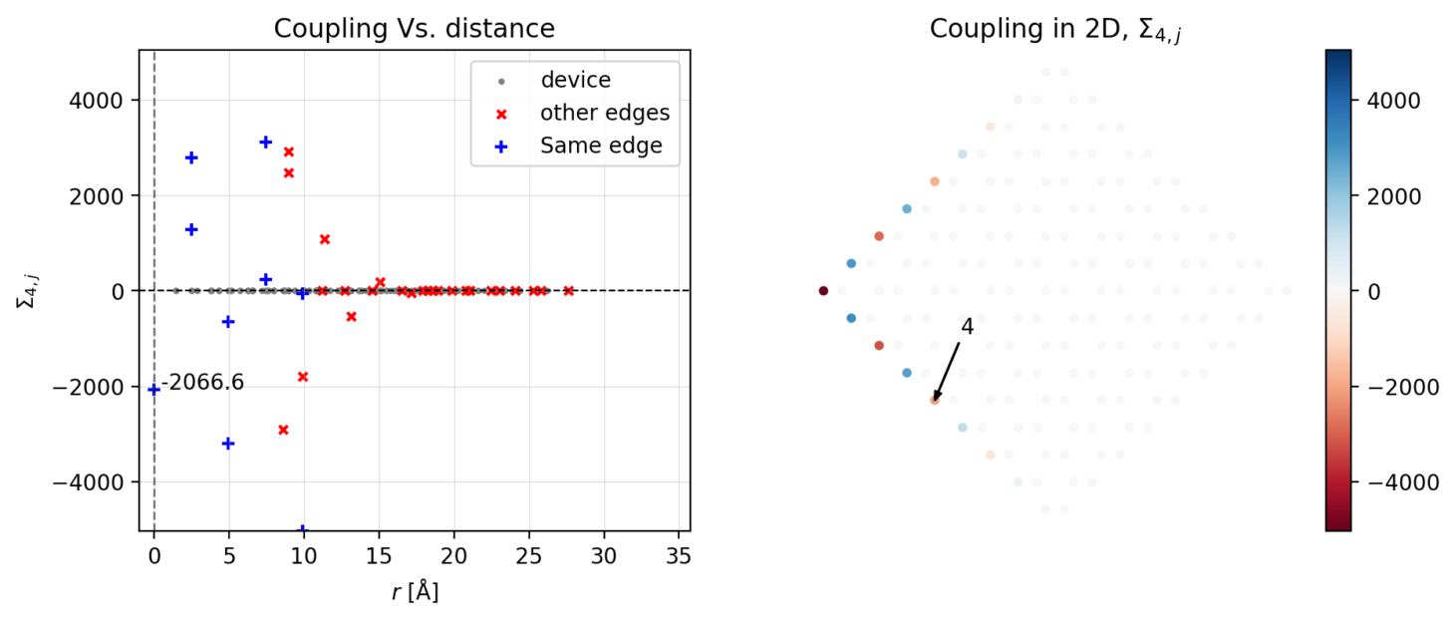
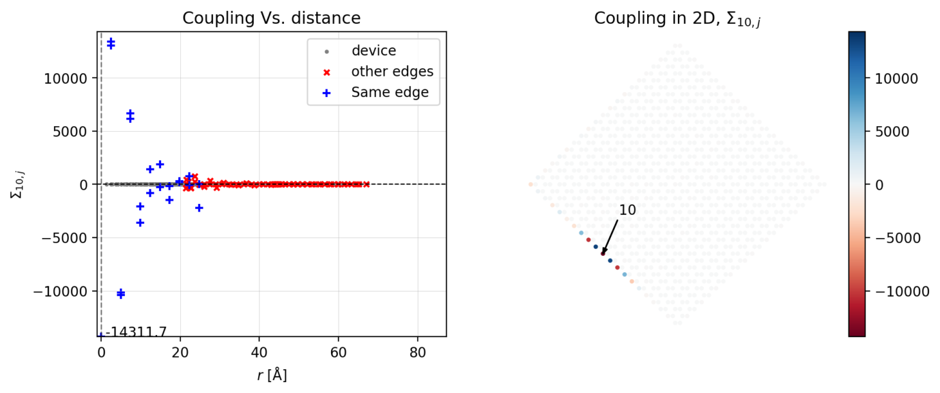
Issue: Is the ‘erratic’ coupling RSE due to the other edges?
N=9
N=21

Slide 3
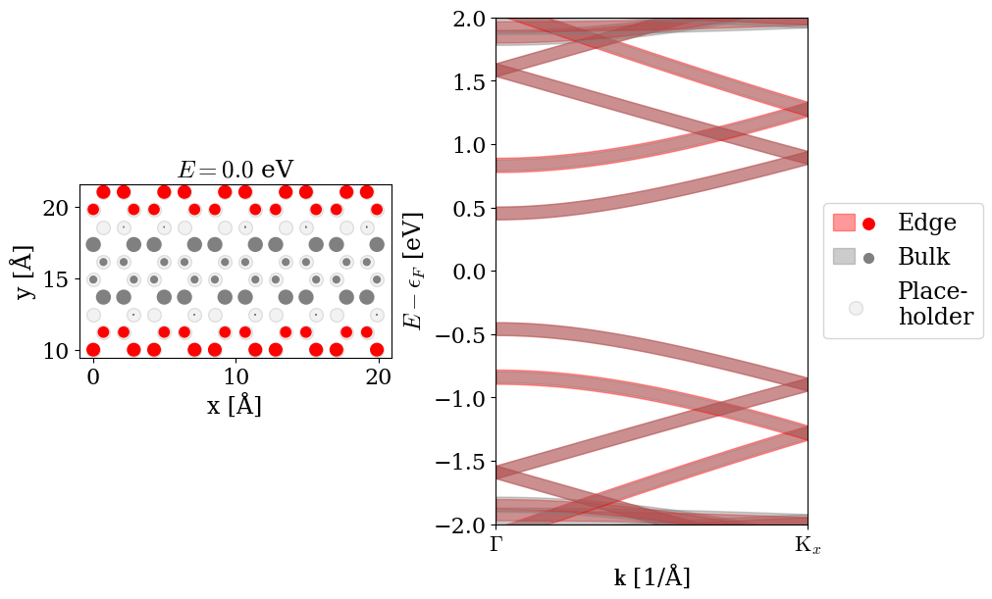
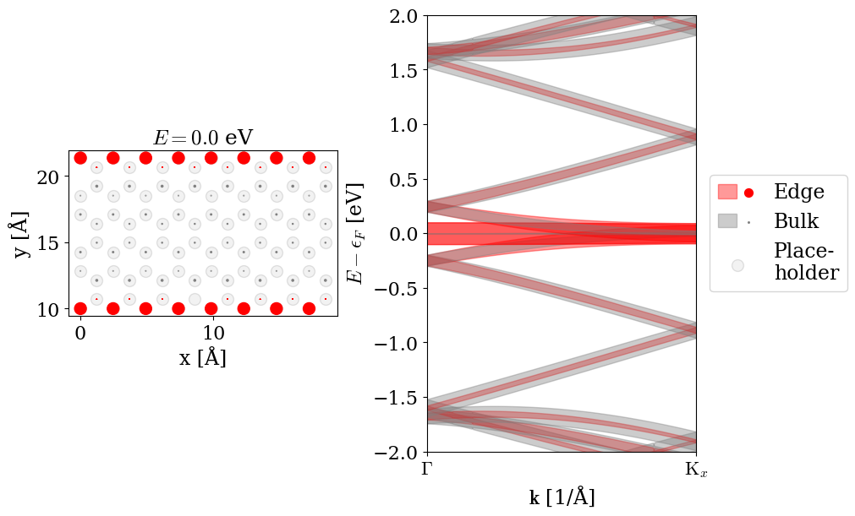
BS
Armchair
Zig-zag

Slide 4
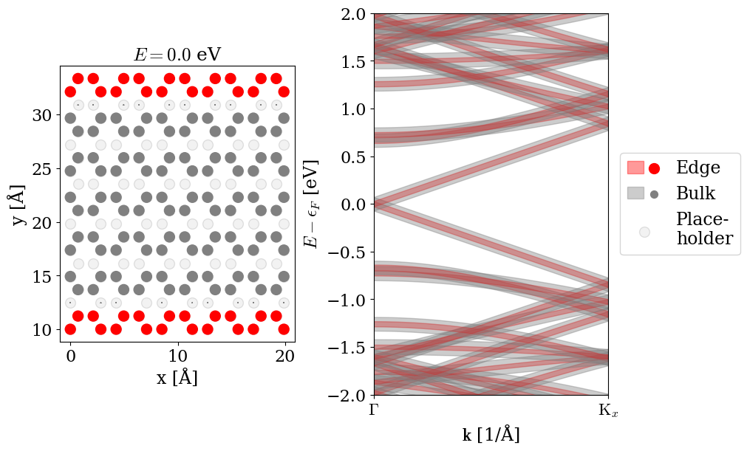
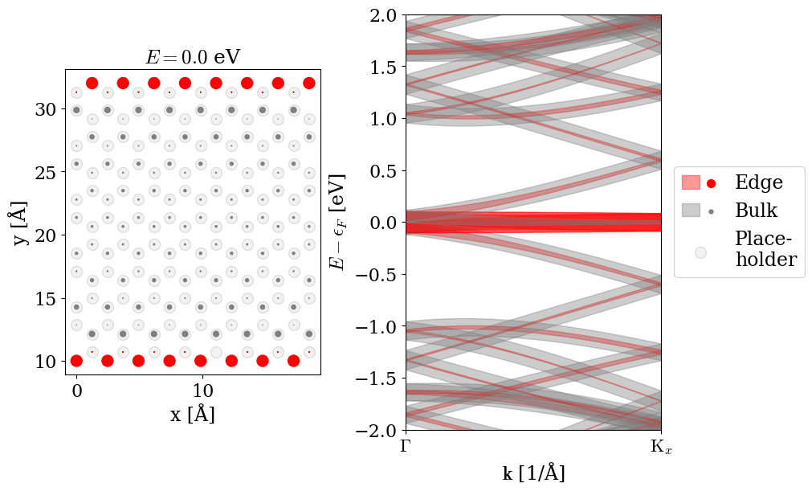
BS
Armchair
Zig-zag

Slide 5
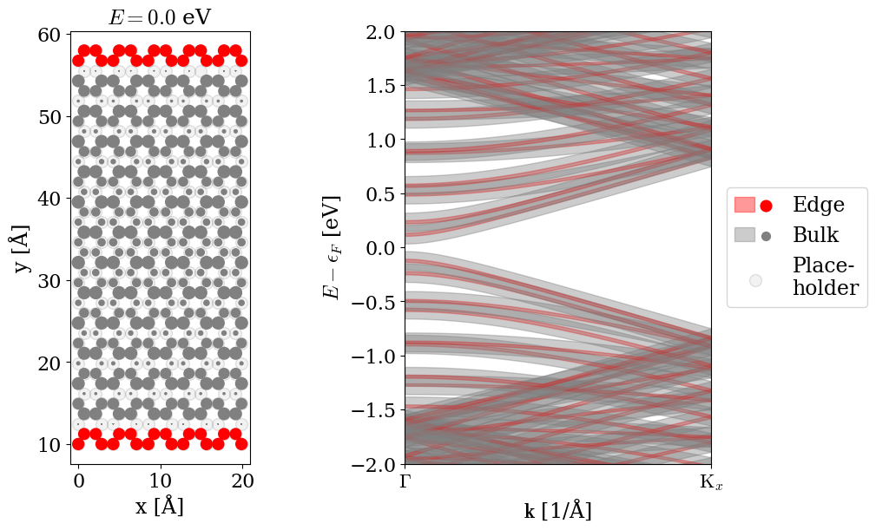
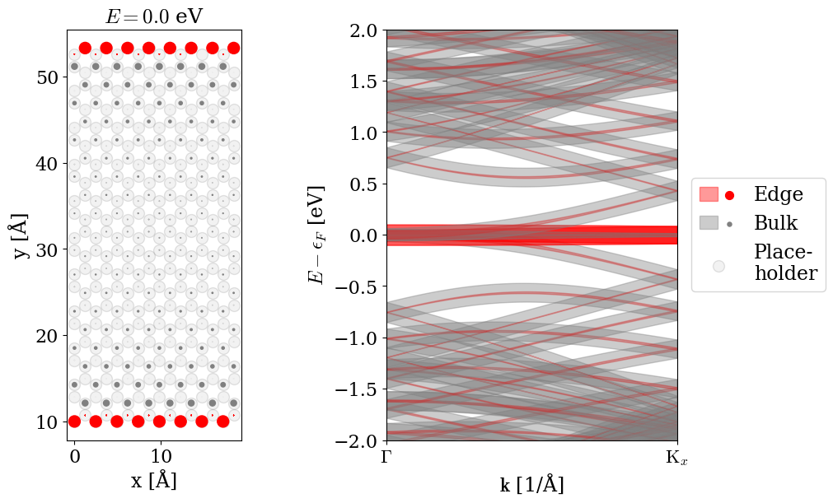
BS
Armchair
Zig-zag

Slide 7
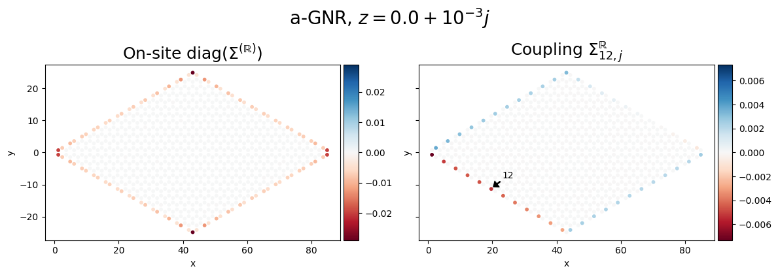
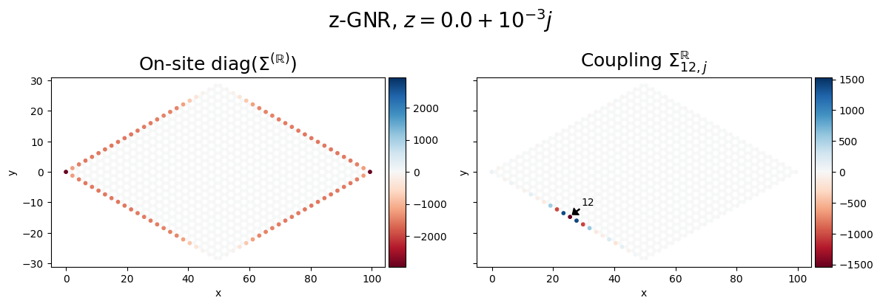
Issue: Which is optimal for the problem: a- or z-GNR
Armchair, N=12
Zig-zag, N=12*2

Slide 8
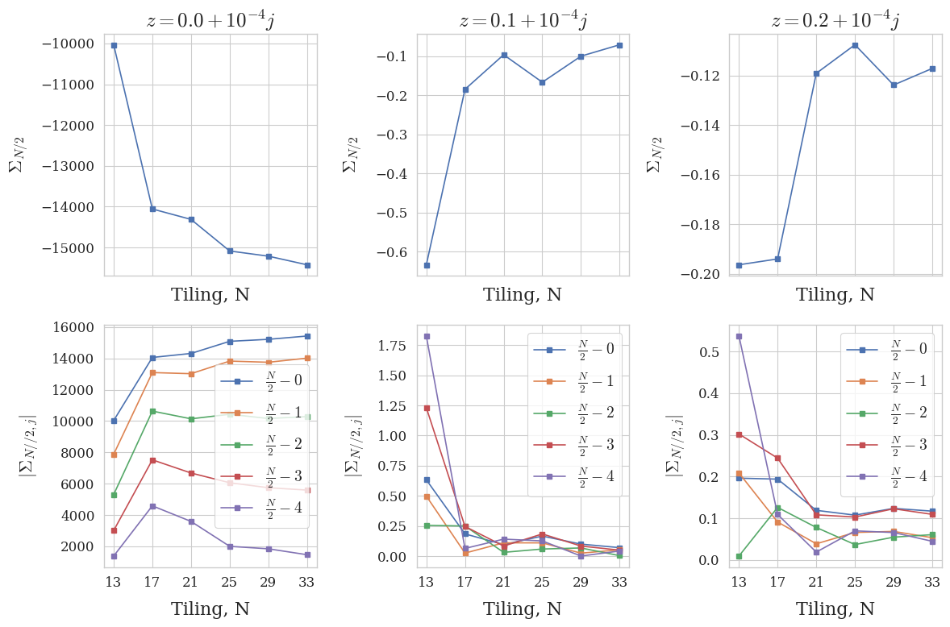
Issue: How does edge center on-site change with N

Slide 9
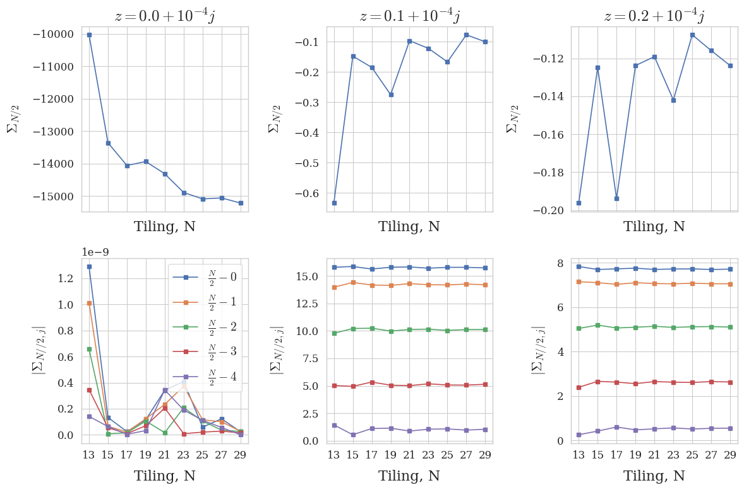
Same calculation again smaller steps : 4 → 2

Slide 10
Naïve extrapolation

