Slide 1
Results for RSE
Bastian

Slide 2
Primitive unitcell tiling
For interactive plot: bastian-explore-rse.streamlit.app

Slide 3
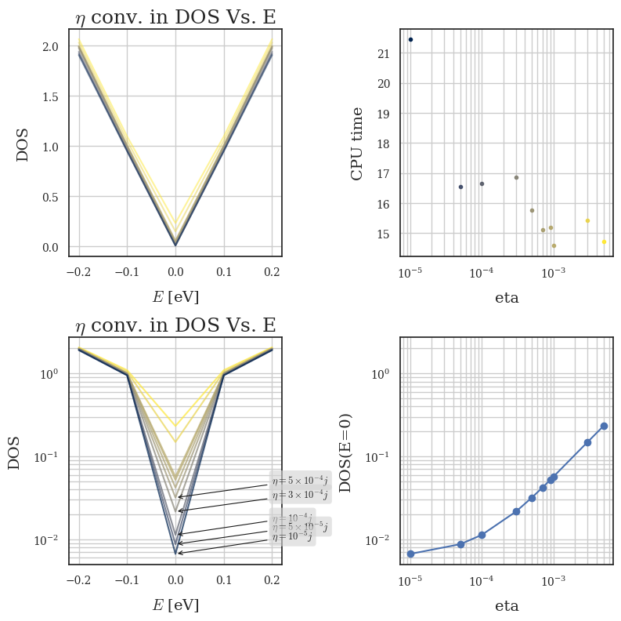
Performance

Slide 4
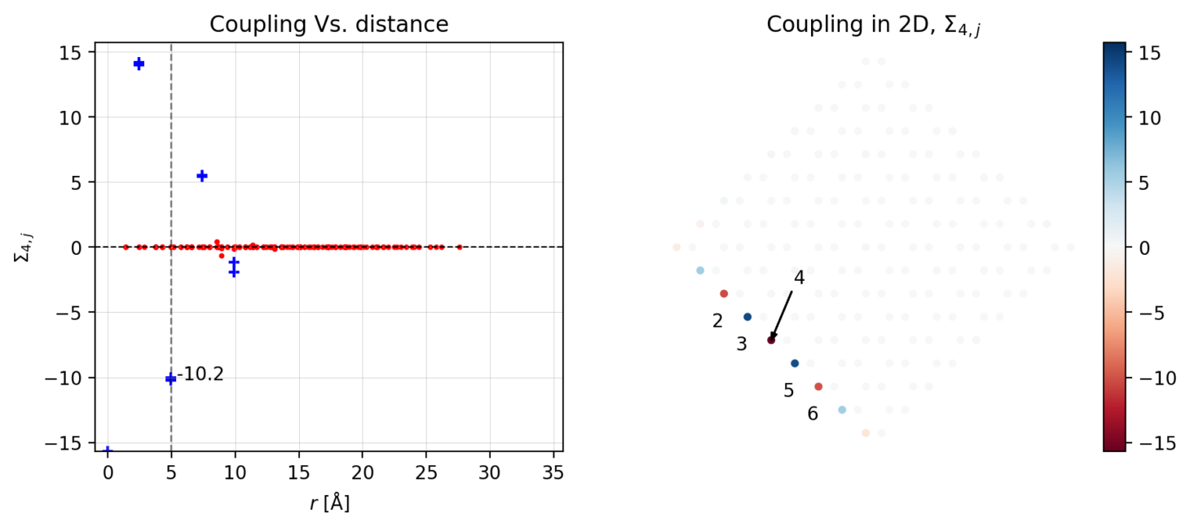
Default (romb), Increasing eta
E=0 eV, eta=10⁻¹, NN=2
N=9

Slide 5
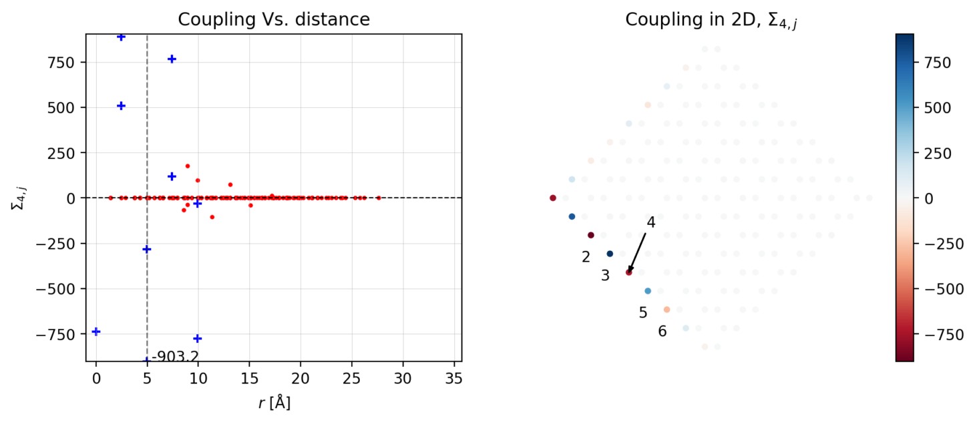
Default (romb), Increasing eta
E=0 eV, eta=10⁻³, NN=2
N=9

Slide 6
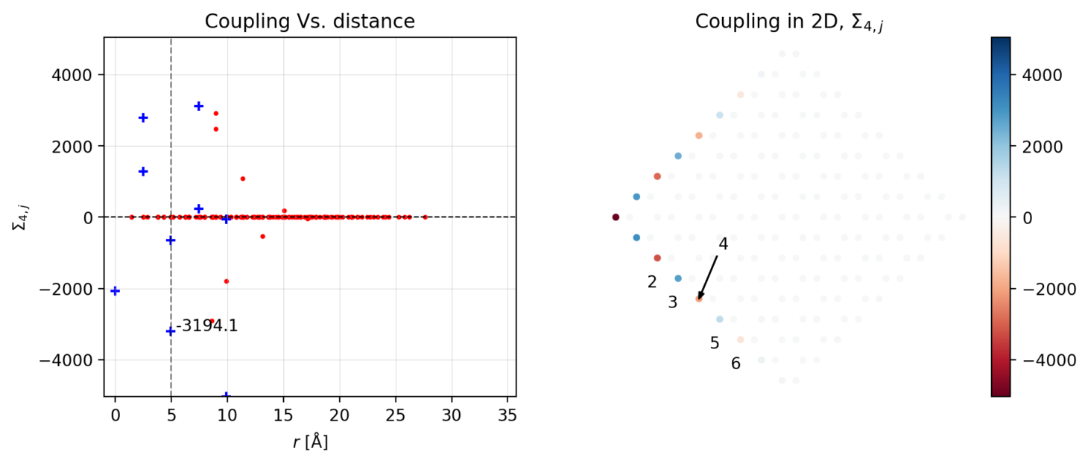
Default (romb), Increasing eta
E=0 eV, eta=10⁻⁴, NN=2
N=9

Slide 7

Default (romb), Increasing eta
E=0 eV, eta=10⁻⁵, NN=2
N=9

Slide 8
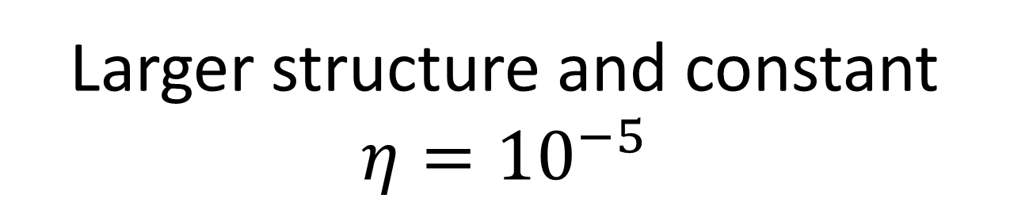
Larger structure and constant $$η={10}^{−5}$$

Slide 9
Default (romb), Increasing N
E=0 eV, eta=10⁻⁵, NN=2
N=9

Slide 10
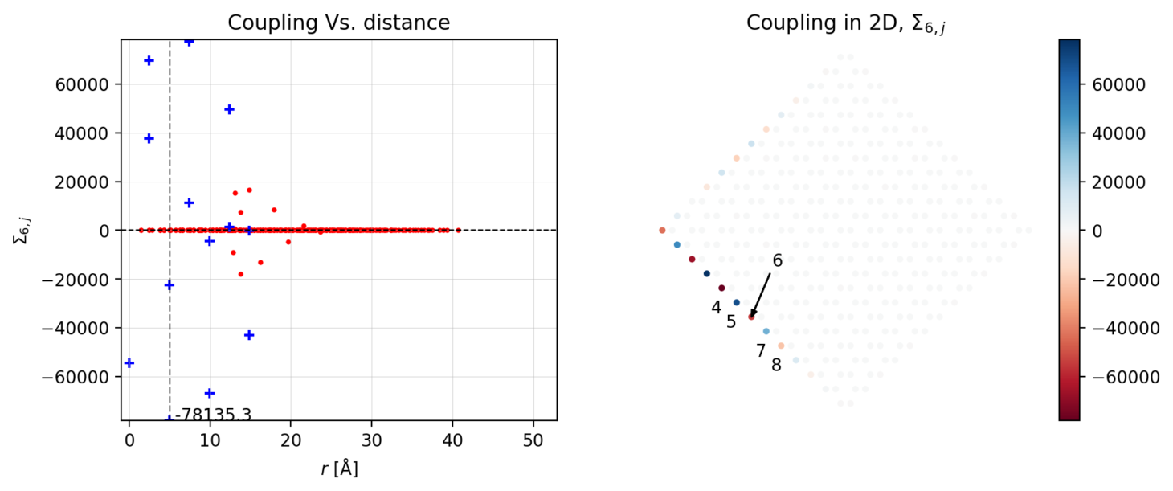
Default (romb), Increasing N
E=0 eV, eta=10⁻⁵, NN=2
N=13

Slide 11
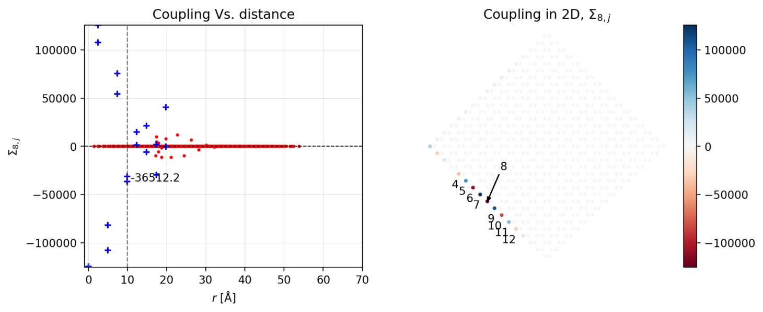
Default (romb), Increasing N
E=0 eV, eta=10⁻⁵, NN=4
N=17

Slide 12
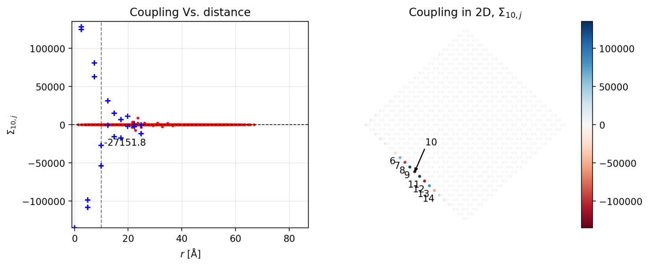
Default (romb), Increasing N
E=0 eV, eta=10⁻⁵, NN=4
N=21

Slide 13

Energy offset $$η={10}^{−5},N=21$$

Slide 14
Energy offset (romb)
E=0 eV, eta=10⁻⁵, NN=4
N=21

Slide 15
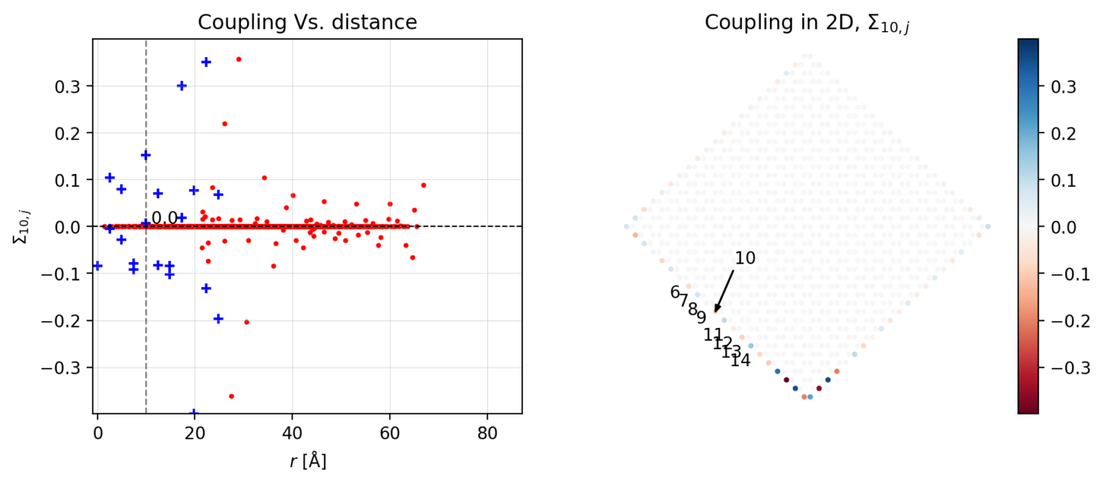
Energy offset (romb)
E=-0.1 eV, eta=10⁻⁵, NN=4
N=21

Slide 16
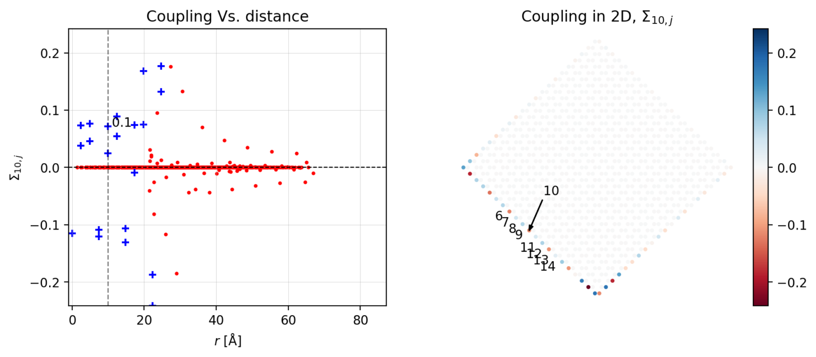
Energy offset (romb)
E=-0.2 eV, eta=10⁻⁵, NN=4
N=21

Slide 17
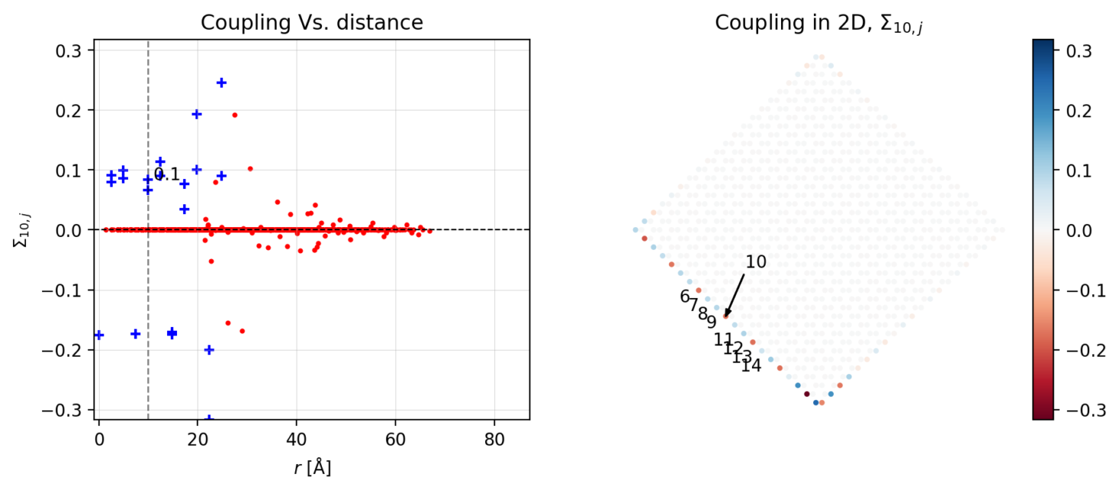
Energy offset (romb)
E=-0.3 eV, eta=10⁻⁵, NN=4
N=21

Slide 18
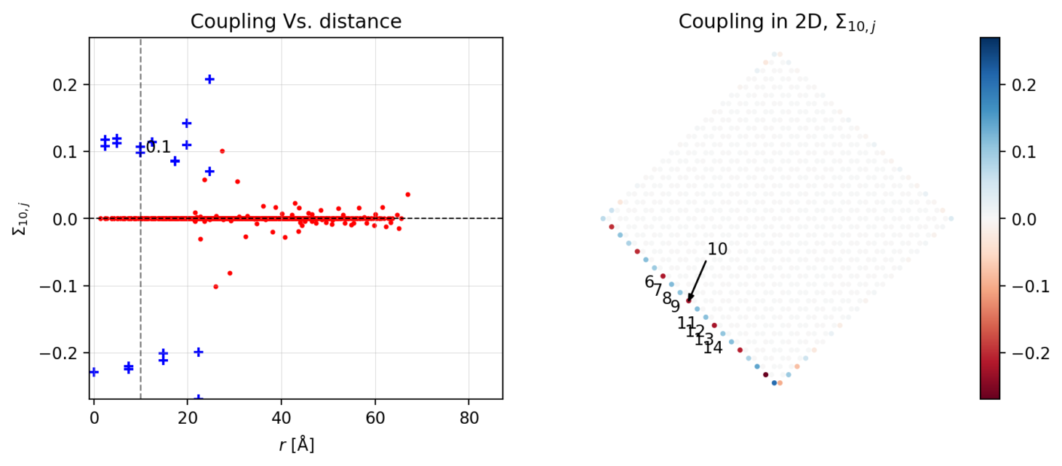
Energy offset (romb)
E=-0.4 eV, eta=10⁻⁵, NN=4
N=21

Slide 19
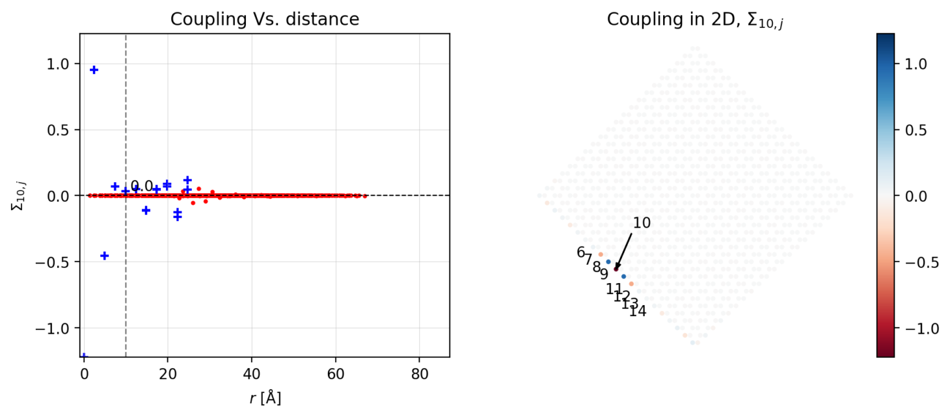
Energy offset (romb) Using higher eta
E=-0.4 eV, eta=10⁻¹, NN=4
N=21
Little to no difference between energies

Slide 20
Armchair vs zig-zag (N=12)

Slide 21
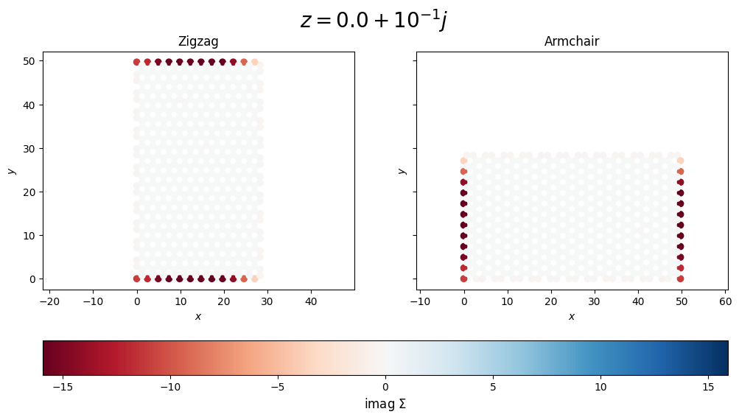
Armchair vs zigzag
E=0 eV, N=12, eta=10⁻¹

Slide 22
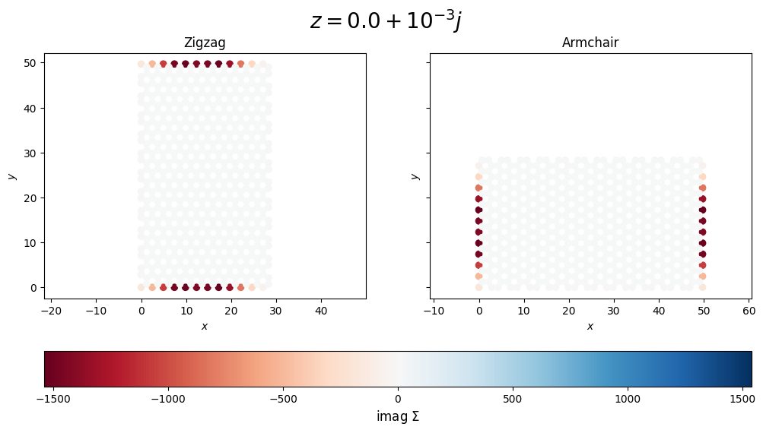
Armchair vs zigzag
E=0 eV, N=12, eta=10⁻³

Slide 23
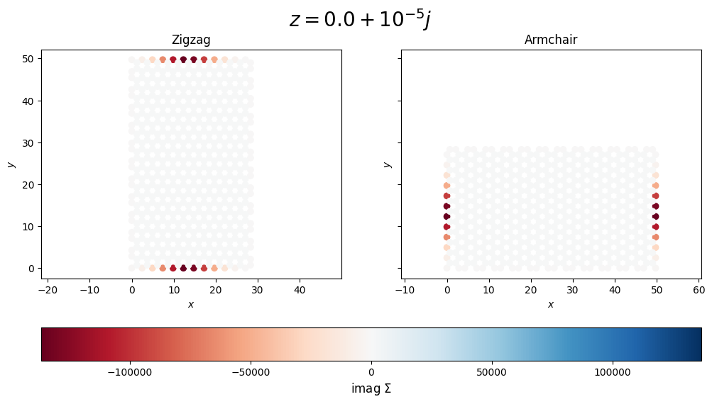
Armchair vs zigzag
E=0 eV, N=12, eta=10⁻⁵

Slide 24
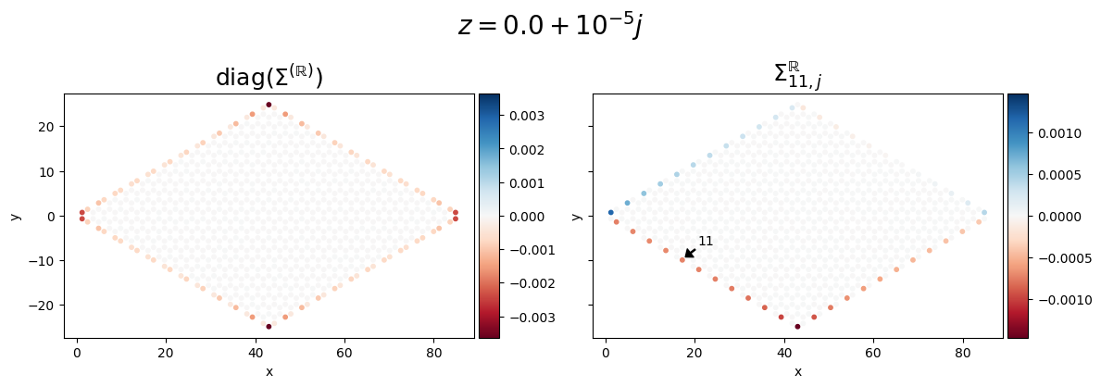
All Armchair
N=12, eta=10⁻⁵

Slide 25
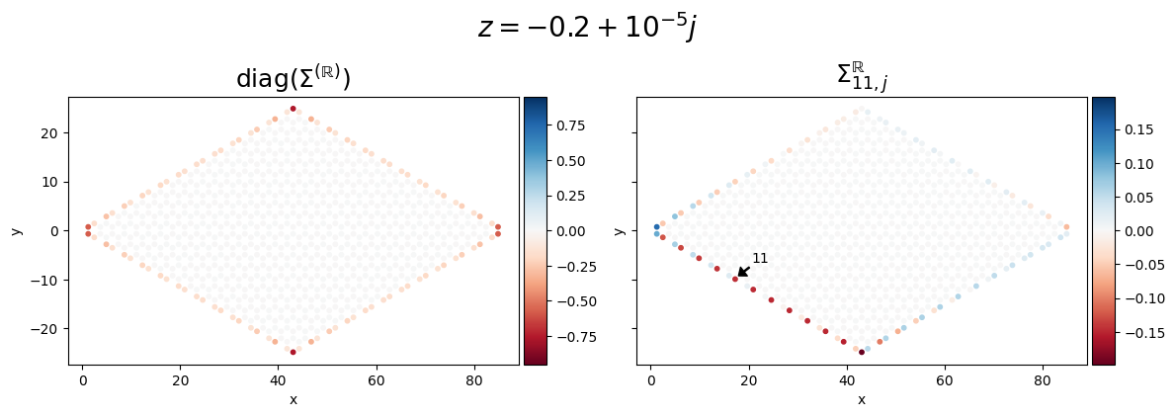
All Armchair
N=12, eta=10⁻⁵

Slide 26
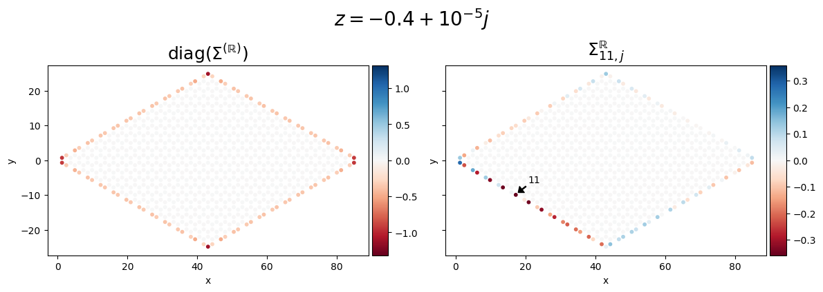
All Armchair
N=12, eta=10⁻⁵

Slide 27
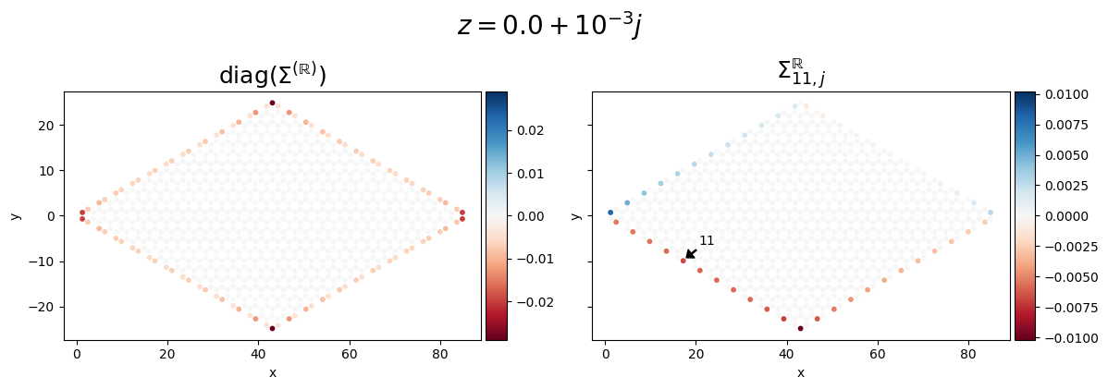
All Armchair
N=12, eta=10⁻³

Slide 28
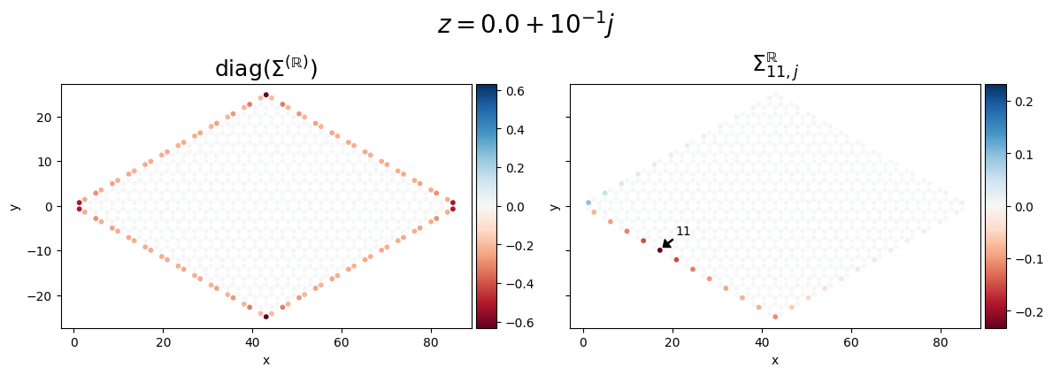
All Armchair
N=12, eta=10⁻¹

Slide 29
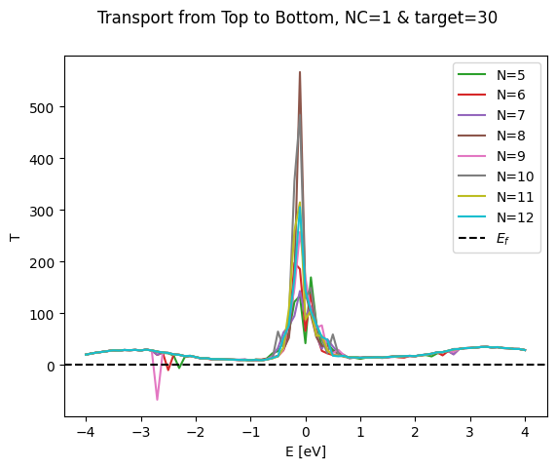
Now deleted data
NC=1 angle=0 deg. R/2 -> R layer

Slide 30
RSE for armchair + zigzag

Slide 31
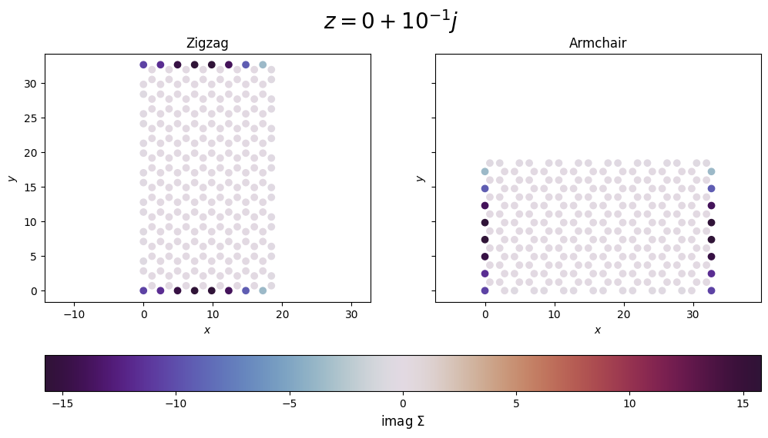
Armchair vs zigzag
E=0 eV, N=8, eta=10⁻¹
Armchair side
Transport direction

Slide 32
Armchair vs zigzag
E=0 eV, N=8, eta=10⁻¹

Slide 33

Armchair vs zigzag
E=0 eV, N=8, eta=10⁻²

Slide 34

Armchair vs zigzag
E=0 eV, N=8, eta=10⁻³

Slide 35

Armchair vs zigzag
E=0 eV, N=8, eta=10⁻⁴

Slide 36

Armchair vs zigzag
E=0 eV, N=8, eta=10⁻⁵

