Slide 1


OBESITY IN SOUTH-AMERICA
PYTHON FOR DATA ANALYSIS 2023
Bastien CHEREL
Amine CHOUAKI
Yann THEAGENE

Slide 2

ESTIMATION OF THE OBESITY LEVELS FOR COUNTRIES OF SOUTH AMERICA

Slide 3



CONTENT
1
2
3
4
Dataset
Data Preprocessing
Data visualization
Modeling & comparison

Slide 4
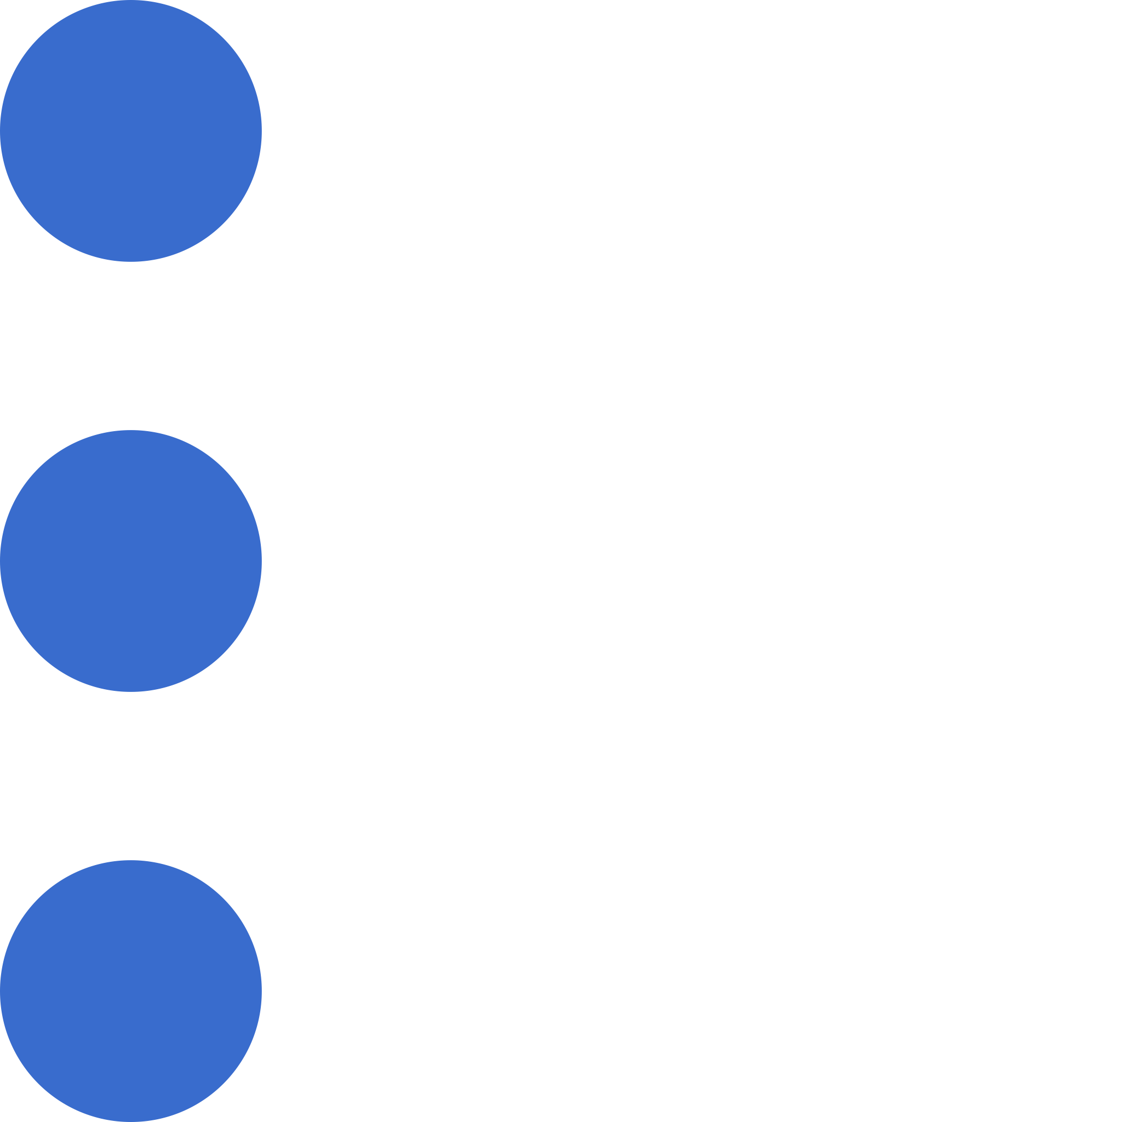

ABOUT THE DATASET
OVERVIEW
The data contains 17 attributes and 2111 records, the records are labeled with the class variable Obesity Level, that allows classification of the data using the categories : Insufficient Weight, Normal Weight, Overweight Level I, Overweight Level II, Obesity Type I, Obesity Type II and Obesity Type III.
GENERATED DATA
77% of the data was generated synthetically using the Weka tool and the SMOTE filter, 23% of the data was collected directly from users through a web platform.

Slide 5
DATA PRE-PROCESSING
01
DATA CLEANING & EXPLORATION
Rename the columns for a better understanding
Shape of the data frame and informations
Summary statistics of the numeric columns
02
DATA TRANSFORMATION & FEATURE ENGINEERING
Map the numerical codes to their corresponding answer
Round the values (weight, height, age)
Create feature : Mass Body Index (MBI) = Mass/Height²

Slide 6
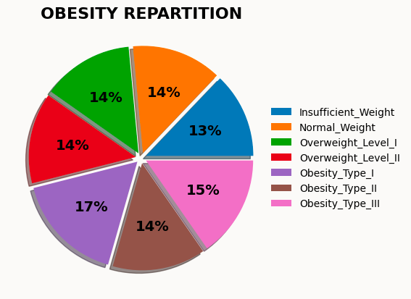
DATA VISUALIZATION

Slide 7
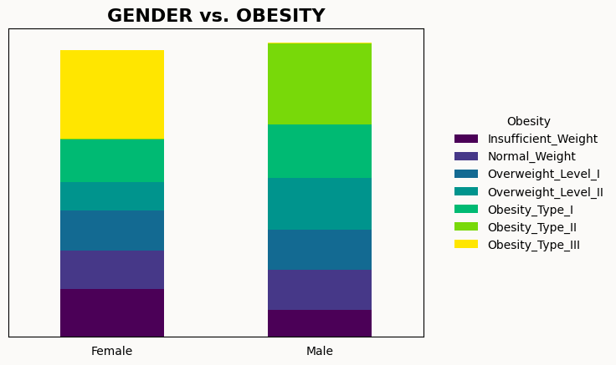
DATA VISUALIZATION

Slide 8
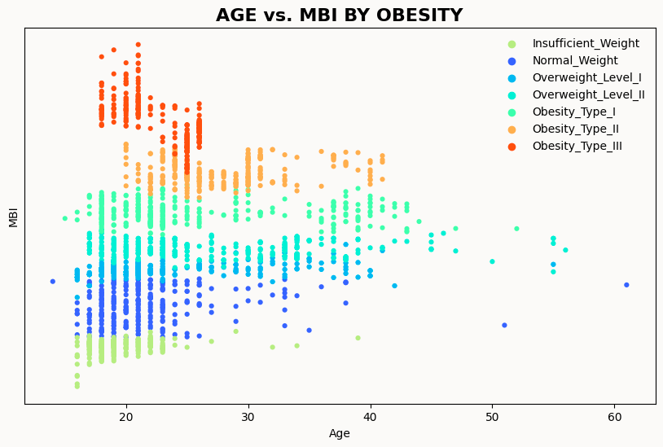
DATA VISUALIZATION

Slide 9
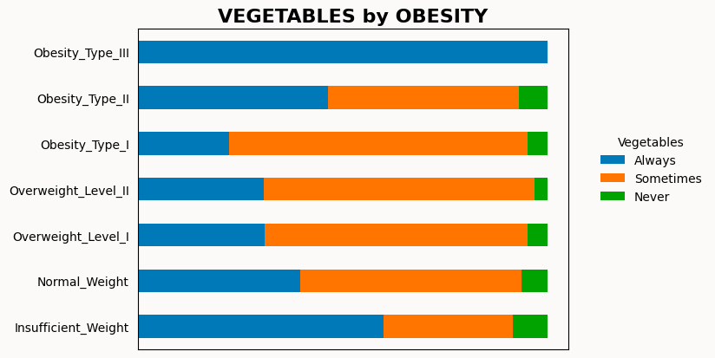
DATA VISUALIZATION

Slide 10
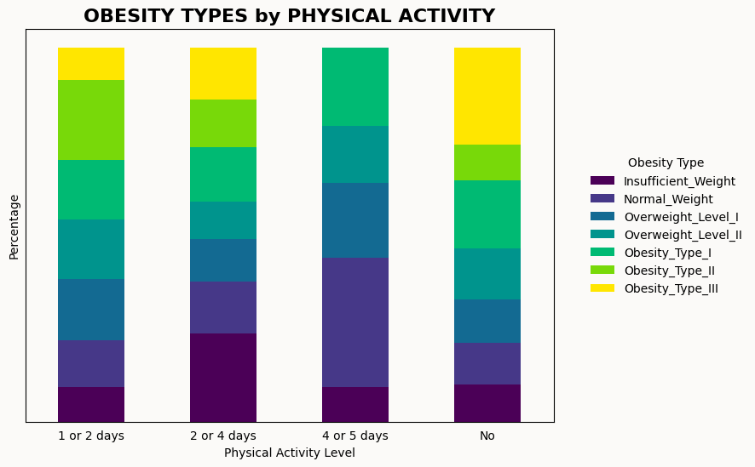
DATA VISUALIZATION

Slide 11

MODELLING
3 SUPERVISED LEARNING MODELS
NAIVE BAYES
RANDOM FOREST
EXTREME GRADIENT BOOSTING
CROSS-VALIDATION
Ensures strongness of the results
MODEL COMPARISON
ACCURACY & R-SQUARED

Slide 12



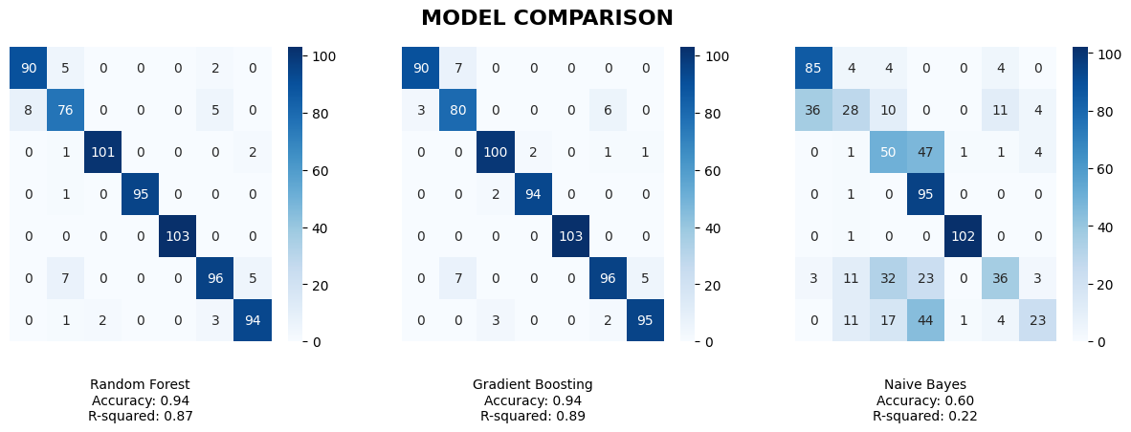
RESULTS

Slide 13
THANK YOU FOR YOUR ATTENTION
SHOULD YOU HAVE ANY QUESTIONS?

