Slide 1



Leveraging Neural Networks In a Hybrid Model Predictive Control framework for District Heating Networks
Full paper #87
Dubon Rodrigue, Mohamed Tahar Mabrouk, Bastien Pasdeloup, Patrick Meyer, Bruno Lacarrière
ECOS 2024, Rhodes, Greece
Notes:
Thank you for having me
Give us the opportunity to present our work about …

Slide 2
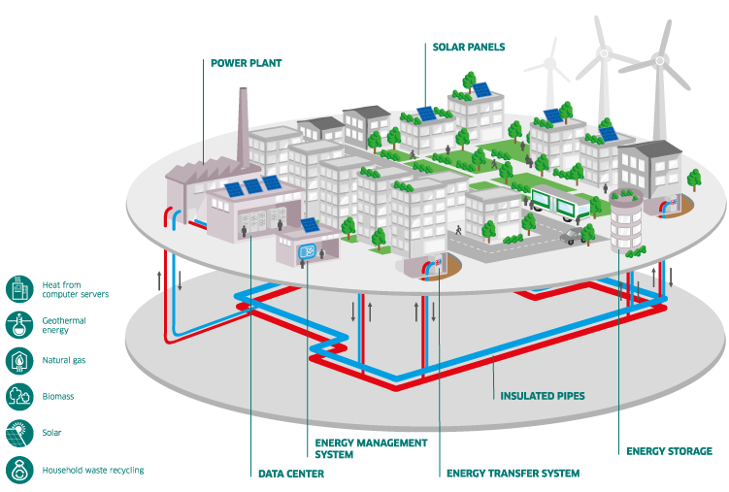
Context
A local sized heat energy supply system
Hot waters traverse network of pipes to transport heat from sources to consumers
Enhances flexibility and efficiency
Optimal control of the network
(Jansen et al., 2023)
District Heating Network (DHN)
Source: ENGIE website [link]
Integration of renewable sources
(Saloux et al., 2023
1
Notes:
Let us start with a little context and introduction on District Heating Network
Based on previous talks, I think most of the people here is familiar with it
Brievly, system to transport system supply heat energy
in a local area by transporting hot waters (or steam) via a network of insulated pair of pipes (point ENGIE website)
Numerous operational advantages but our focus will be on control

Slide 3
Model Predictive Control (MPC)
A subcategory of control optimization
Use of moving horizon in which decisions are taken
(Marquant et al., 2023)
High effectiveness by combining predictions and decision optimization
t-1
t
t+1
t+2
t+3
(Jansen et al., 2023)
Moving horizon
Optimization within the horizon
Applying the first step decisions
Slide the horizon to one step
Can be used with analytic or metaheuristics based optimizer
2
Notes:
Controlling DHN is not an easy-task
MPC (a subcategory of control optimization) has recently gained momentum due to its adaptivity and effectiveness
MPC requires a modeling of the system in study (DHN) on with each decision will be evaluated
Recent works have shown that performing control within a moving horizon helps in improving the found solutions

Slide 4
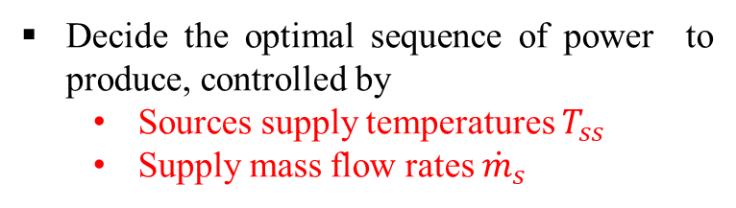
Model Predictive Control (MPC)
Use of moving horizon in which decisions are taken
In our case:
(Marquant et al., 2023)
Decide the optimal sequence of power to produce, controlled by
Sources supply temperatures $T_{ss}$
Supply mass flow rates ${\dot{m}}_{s}$
t-1
t
t+1
t+2
t+3
Moving horizon
Optimization within the horizon
Applying the first step decisions
Slide the horizon to one step
Optimally fulfilling all consumers heating demands
2
Notes:
- Our case, our case, the objective is to :

Slide 5
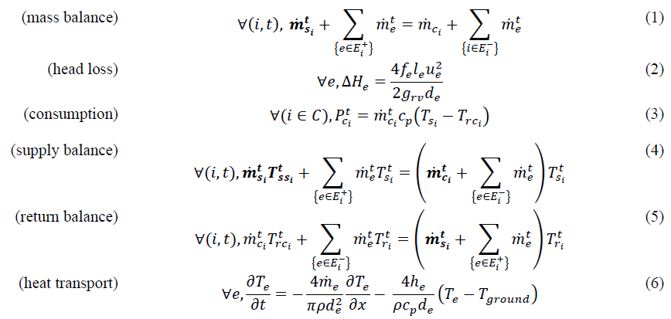

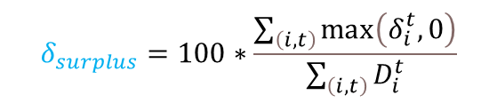
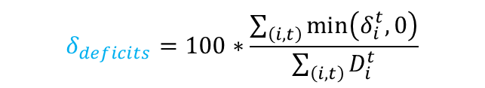
Model Predictive Control (MPC)
$$J=\sum_{t=1}^{N_{t}}{\left[\sum_{\left\{i∈S\right\}}{{\dot{m}}_{s_{i}}^{t}c_{p}\left(T_{{ss}_{i}}^{t}−T_{sr_{i}}\right)}\right]}+M\left(\max{{\left(0, \left(δ_{surplus}−2\right)\right)}^{2}}+\max{{\left(0, \left(δ_{deficits}−2\right)\right)}^{2}}\right)$$
$$δ_{deficits}=100∗\frac{\sum_{\left(i,t\right)}{\min\left(δ_{i}^{t}, 0\right)}}{\sum_{\left(i,t\right)}{D_{i}^{t}}}$$
$$δ_{surplus}=100∗\frac{\sum_{\left(i,t\right)}{\max\left(δ_{i}^{t}, 0\right)}}{\sum_{\left(i,t\right)}{D_{i}^{t}}}$$
$$δ_{i}^{t}=D_{i}^{t}−{\dot{m}}_{c}c_{p}\left(T_{s_{i}}^{t}−T_{{r_{c}}_{i}}\right)$$
Requires the numerical solving of differential equations
3
Notes:
In our work,
We formulate the objective and the constraints with one objective function J which encapsulates the energy produced by the heat sources and the responsiveness to the heat demands of the consumers. In fact, we want to both minimize the energy produced and the differences between heat delivered and heat demanded by the consumers.
The model of the DHN is a dynamic-based simulation of the DHN which contains thermal and hydraulic models.

Slide 6

Problematic
Control variables of the heat sources
Optimization
A repetitive dynamic simulation of the DHN is required for each time step.
Dynamic simulation of the DHN
One simulation is computationally expensive for large DHN.
Evaluation of objective $J$
otherwise
Proposed approach: reduce the computational costs (CPU time) by reducing the topology of the DHN.
Stopping criteria reached
yes
Computationally intensive
4
Notes:
The problem is that: the MPC is computationally intensive
A simulation is expensive
We propose to reduce the computational time by reducing the topology of the DHN

Slide 7
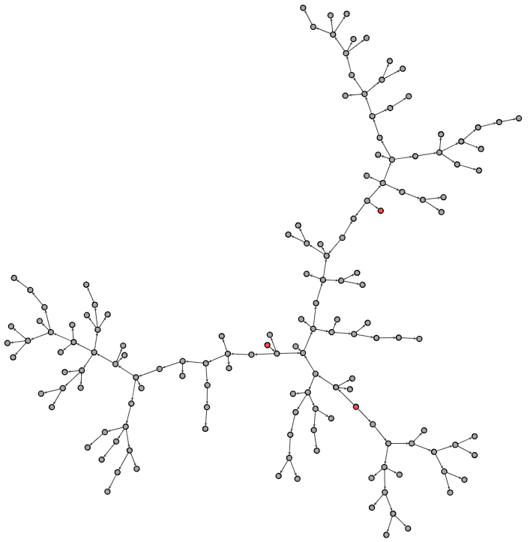
Proposed methodology
DHN viewed as oriented graph
consumers
producers
Case study DHN with 150 nodes
5
Notes:
How do you proposed to achieve that topology and computational time reduction ?

Slide 8
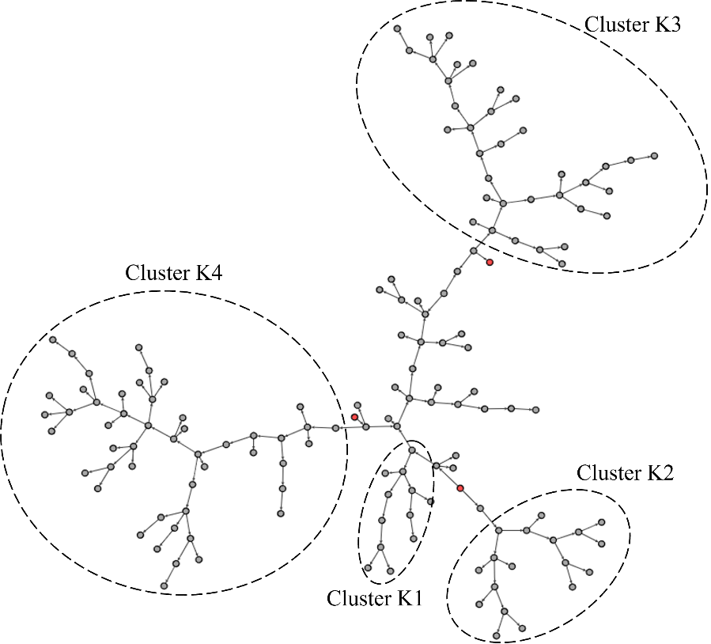
Proposed methodology
DHN viewed as oriented graph
Identify or select clusters of consumer nodes (i.e., K1-K4)
Case study DHN with 150 nodes
5

Slide 9
Proposed methodology
DHN viewed as oriented graph
Reduced version of the case study DHN by replacing cluster K1
Identify or select clusters of consumer nodes (i.e., K1-K4)
Replace each cluster with a trained neural networks acting as surrogate of the cluster
5

Slide 10
Proposed methodology
DHN viewed as oriented graph
Reduced version of the case study DHN by replacing cluster K2
Identify or select clusters of consumer nodes (i.e., K1-K4)
Replace each cluster with a trained neural networks acting as surrogate of the cluster
5

Slide 11
Proposed methodology
DHN viewed as oriented graph
Reduced version of the case study DHN by replacing cluster K3
Identify or select clusters of consumer nodes (i.e., K1-K4)
Replace each cluster with a trained neural networks acting as surrogate of the cluster
5

Slide 12
Proposed methodology
DHN viewed as oriented graph
Reduced version of the case study DHN by replacing cluster K4
Identify or select clusters of consumer nodes (i.e., K1-K4)
Replace each cluster with a trained neural networks acting as surrogate of the cluster
5

Slide 13
Proposed methodology
DHN viewed as oriented graph
Reduced version of the case study DHN by replacing cluster K4
Identify or select clusters of consumer nodes (i.e., K1-K4)
Replace each cluster with a trained neural networks acting as surrogate of the cluster
Maintain temperatures at interfaces
Maintain consumptions
5

Slide 14
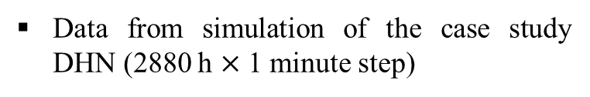
Surrogate neural networks models
GRU-NN based architectures with hyperparameters selected from grid search
Data from simulation of the case study DHN (2880 h $×$ 1 minute step)
Incoming water flows
Outgoing water flows
Temperatures
Mass flow rates
(Chung et al., 2014)
Temperatures
GRU
GRU
Dense
Dense
Nodes heating demands
(nodes of replaced cluster)
Cluster effective heat consumption
Dropout
Dropout
Training procedures:
Temporal split: first 2/3 of data is used for train, and last 1/3 is used for test
Adam optimizer (40 epochs, early stopping, decreasing learning rate, mse)
6
Notes:
Tell that we use a dynamic simulation model developed in prior of my phd
20 units on the GRU
80 units on the hidden dense layer
Batch size of 64
A dropout 0,0
Mention here that in our paper we paper two versions of this learning approach but We found that this simple version combines effective accuracy and performances

Slide 15
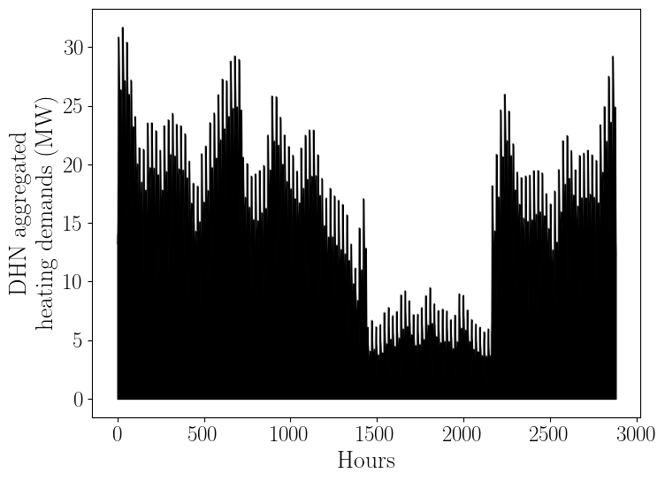
Data generation
Train
Test

Slide 16



Hybrid MPC vs Physical MPC
Control variables of the heat sources
Optimization
Control variables of the heat sources
Optimization
Hybrid simulation of the reduced DHN
Dynamic simulation
(non-clustered regions)
Inlet information
NN models
(replaced clusters)
Dynamic simulation of the DHN
Outlet information
Nodes consumptions
Clusters consumptions
Evaluation of objective $J_{physical}$
Evaluation of objective $J_{hybrid}$
otherwise
Stopping criteria reached
otherwise
Stopping criteria reached
$$J_{hybrid}≈J_{physical}$$
yes
yes
7
Notes:
Now that if we compare our proposed hybrid MPC and physical MPC (or baseline MPC), you can see that the difference resides in the model used to evaluate the impact of each decision variables and how the objective function. Both MPC approach must be equivalent, therefore both objective functions should be equivalent

Slide 17
Results (learning performances)
*Nb: number of
*MAPE: Mean Absolute Percentage Error
 | Cluster K1 | Cluster K2 | Cluster K3 | Cluster K4
Nb clustered nodes | 13 | 18 | 36 | 50
Nb output features | 3 | 2 | 2 | 2
MAPE (%) on temperatures | 0.58 | 0.06 | 0.22 | 0.23
MAPE (%) on consumption On power level On energy level | 2.31 0.07 | 0.92 0.52 | 2.65 0.43 | 1.79 0.24
Ability of the NN models to learn different sizes of clusters.
Lower errors in heat consumption energy than powers as over and under-estimations might cancel off.
8
Notes:
Here we compare the results of learning the clusters in terms of errors in temperatures at the interfaces of the replaced clusters and the consumption clusters
We note that K2 and K3 have the lowest errors

Slide 18
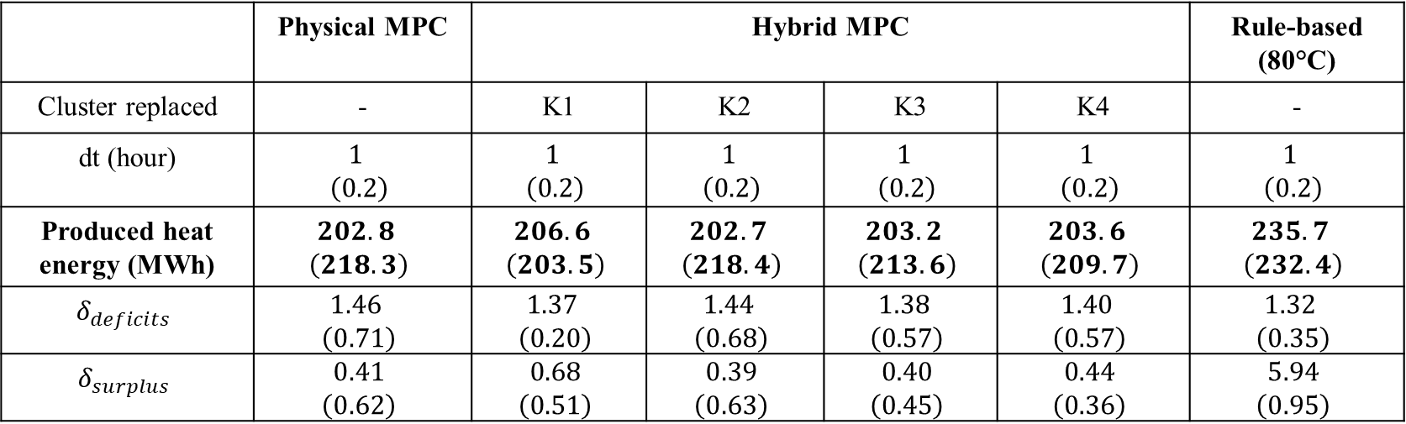
Results (Hybrid MPC accuracy)
Results for 10 hours operational running
Decisions are taken every dt hour: 1 hour and 0.2 hour (12 minutes).
 | Physical MPC | Hybrid MPC |  |  |  | Rule-based (80°C)
Cluster replaced | - | K1 | K2 | K3 | K4 | -
dt (hour) | $$1$$ $$\left(0.2\right)$$ | $$1$$ $$\left(0.2\right)$$ | $$1$$ $$\left(0.2\right)$$ | $$1$$ $$\left(0.2\right)$$ | $$1$$ $$\left(0.2\right)$$ | $$1$$ $$\left(0.2\right)$$
Produced heat energy (MWh) | $$202.8$$ $$\left(218.3\right)$$ | $$206.6$$ $$\left(203.5\right)$$ | $$202.7$$ $$\left(218.4\right)$$ | $$203.2$$ $$\left(213.6\right)$$ | $$203.6$$ $$\left(209.7\right)$$ | $$235.7$$ $$\left(232.4\right)$$
$$δ_{deficits}$$ | $$1.46$$ $$\left(0.71\right)$$ | $$1.37$$ $$\left(0.20\right)$$ | $$1.44$$ $$\left(0.68\right)$$ | $$1.38$$ $$\left(0.57\right)$$ | $$1.40$$ $$\left(0.57\right)$$ | $$1.32$$ $$\left(0.35\right)$$
$$δ_{surplus}$$ | $$0.41$$ $$\left(0.62\right)$$ | $$0.68$$ $$\left(0.51\right)$$ | $$0.39$$ $$\left(0.63\right)$$ | $$0.40$$ $$\left(0.45\right)$$ | $$0.44$$ $$\left(0.36\right)$$ | $$5.94$$ $$\left(0.95\right)$$
Hybrid MPC has satisfyingly conserved the objective function values
9
Notes:
Hybrid MPC succefully preserves the objective functions as the produced heat energy are very similar to produced by the physical MPC while satisfying the energy and surplus deficits below our threshold of 2 %
Again, the K2 and K3 have the lowest difference with the heat produced by the physical MPC which we use as baseline
On the contrary, a rule-based approach with fixed supply temperature which will be faster overproduce heat energy which is expected

Slide 19
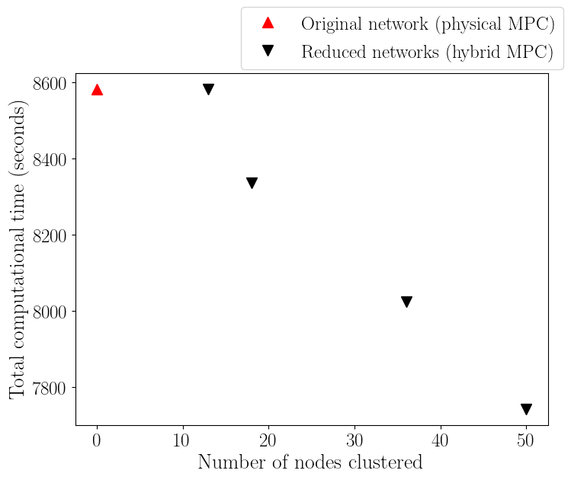
Results (CPU gains)
Decrease of optimization computational time proportionally to the clusters sizes
9 % decrease for largest cluster
Predicting the temperatures (cluster K4) is 2x faster in CPU time than simulating the cluster
Effective gains come from the repetitive simulation and optimization
10
Notes:
Now that we know the hybrid MPC mimics quite well the physical MPC, we compare the computatational gain of the reduced DHN
As you can see successfully reduce the computataionl time necessary to derive the optimal decision variables while keeping high accuracy

Slide 20
Conclusion and perspectives
We proposed an hybrid MPC approach to optimally control DHNs with lower CPU time
Surrogate Neural Networks based models learn and replace consumers clusters within the DHNs
Satisfying accuracy and computational time reductions validate our approach
Further reduction of CPU times will be considered

Slide 21

Thank you for your attention
Questions ?
Contact

