Slide 1
Intelligent Museum Guide
Is a neural network worth it in production?
Baroque
Cubism
Impressionism
Pop Art
Ukiyo-e
Bastien Ragueneau · Colin Pietri · Cristian Larrain
Neural Networks & Deep Learning Foundations · Albert School

Slide 2
Can a neural network guide museum visitors?
INTRODUCTION
Recognise an artwork
Answer questions
A photo
Its style and story
A question
Matching artworks
Modest CPUs, small team, limited budget
Is a neural network worth it?
2

Slide 3
1,500 artworks, 5 styles, a strict protocol
DATA AND PROTOCOL
Baroque
17th century
Cubism
Early 1900s
Impressionism
Late 1800s
Pop Art
1950s, 1960s
Ukiyo-e
Edo Japan
Train
learn
Validation
choose
Test
report, only once
No artist in two splits
Simple model first
One change at a time
3

Slide 4
Baselines: the number to beat is 0.427
STEP 1 · BASELINES
Model | Validation accuracy
Random guess | 0.200
Logistic regression | 0.427
Dense network | 0.302
The dense network
starts below the linear model
So we watch it train
4

Slide 5
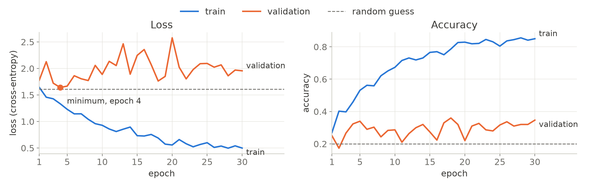
Monitoring: the dense network overfits from epoch 4
STEP 2 · MONITORING AND DIAGNOSIS
Train loss keeps falling
Validation loss climbs back
Overfitting
5

Slide 6
What blocked us on the dense network
STEP 2 · TRAINING PROBLEMS
Problem |  | To fix it
Overfitting from epoch 4 | → | Test fixes one at a time
Loss explodes to NaN (ReLU, He init) | → | Lower the learning rate
Vanishing gradient with 6 sigmoid layers | → | Keep a single hidden layer
Mac GPU slower than the CPU | → | Train the dense network on CPU
6

Slide 7
One fix matters: dividing the learning rate by 100
STEP 2 · FIXES TESTED ONE AT A TIME
Change, tested alone | Accuracy
Reference | 0.302
Learning rate ÷ 100 | 0.419
Adam optimiser | 0.386
Dropout | 0.307
0.302
before
0.419
after
The overfitting is gone
but it only matches the linear model
7

Slide 8
Errors: the network mostly reads colour and brightness
STEP 2 · ERROR ANALYSIS
Six colour statistics
almost match all the pixels
Dark images
become Baroque
Reading colour is not reading style
We need a model that sees local patterns
8

Slide 9
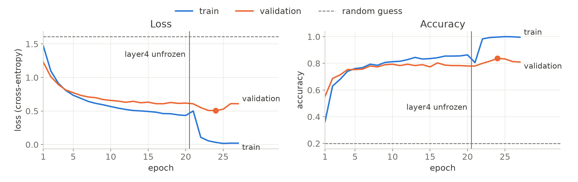
A pretrained ResNet-18 doubles the accuracy
STEP 3 · PRETRAINED CNN
Train the head only
0.780
Fine-tune the last block
0.838
Stop early
keep the best epoch
9

Slide 10
What blocked us on ResNet-18
STEP 3 · TRAINING PROBLEMS
Problem |  | To fix it
128-pixel images too small for ImageNet | → | Upscale to 224 pixels
Frozen batch norms keep updating | → | Keep frozen blocks in evaluation mode
Fine-tuning overfits within a few epochs | → | Early stopping, keep the best epoch
Training too slow on the CPU | → | Train on the Mac GPU
10

Slide 11
Visitor questions: embeddings understand paraphrases
STEP 4 · VISITOR QUESTIONS
45 test questions | TF-IDF | Embeddings
All questions | 0.622 | 0.911
Paraphrases | 0.000 | 0.923
Time per question | < 1 ms | ≈ 10 ms
No shared word needed
“Picasso”
Cubism
“Monet and Renoir”
Impressionism
“geisha and samurai”
Ukiyo-e
Share of questions with a right artwork in the top 5
11

Slide 12
Final test, used once: ResNet-18 reaches 0.750
FINAL EVALUATION
Model | Test accuracy | Time, one CPU core | Size
Logistic regression | 0.420 | ≈ 0.2 ms | 1 MB
Dense network | 0.400 | ≈ 0.8 ms | 25 MB
Fine-tuned ResNet-18 | 0.750 | ≈ 30 ms | 45 MB
Validation said
0.837
Test says
0.750
We report the test
no model changed after
12

Slide 13
Recommendation: yes, if the network is pretrained
CONCLUSION
Training from scratch brings nothing. Pretrained models bring the gain, with no GPU in production.
Recognise an artwork
Answer questions
Fine-tuned ResNet-18
Right 3 times out of 4, on a simple CPU
Sentence embeddings
Finds a match 9 times out of 10, no training
Before deployment
Test on real visitor photos
Go beyond five styles
Add a French language model
13

