Slide 1
Table format ingestion

Slide 2
Tableau
Provider | Model | input price per 1k Token | output price per 1K Token | input price per 1M Token | output price per 1M Token
(Azure) OpenAI | GPT-4 (8K) | $0.03000 | $0.06000 | $30.00 | $60.00
 | GPT-4 Turbo | $0.01000 | $0.03000 | $10.00 | $30.00
 | GPT-3.5-turbo | $0.00050 | $0.00150 | $0.50 | $1.50
Google Vertex AI 1 token ~= 4 chars | Gemini Pro | $0.00100 | $0.00200 | $1.00 | $2.00
 | PaLM 2 | $0.00200 | $0.00200 | $2.00 | $2.00

Slide 3
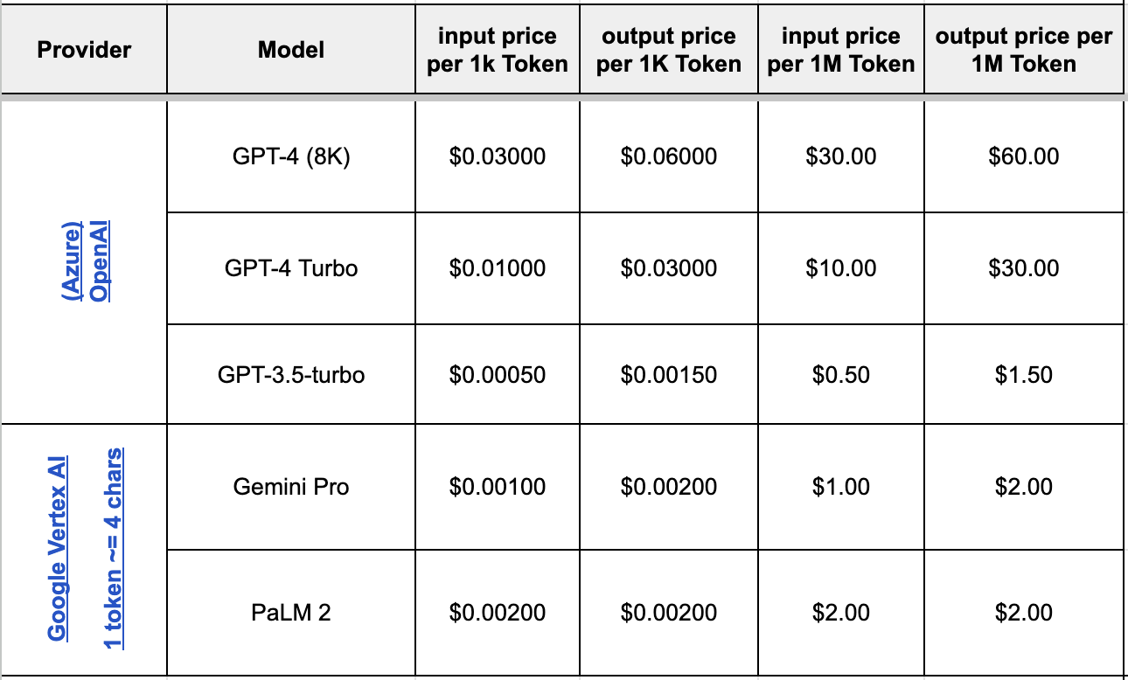
Image

