Slide 1
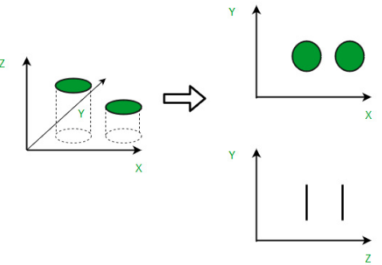
Dimensionality Reduction

Slide 2
High number of features makes hard to visualize & modeling.
Most features are redundant & correlated.
Few algorithms won’t work such as KNN, Dtree
We cannot visualize data more than 3D.

Slide 3
Dimensionality Reduction
Feature Selection
Feature Extraction

Slide 4
Feature Selection
find a subset of the original set of variables, or features, to get a smaller subset
which can be used to model the problem. It usually involves three ways:
Filter
Wrapper
Embedded

Slide 5
Feature Selection – Filter Method
Filter methods select features from a dataset independently for any machine learning algorithm.
These methods rely only on the characteristics of these variables, so features are filtered out of
the data before learning begins.
Advantages
Selected features can be used in any machine learning algorithm.
They’re computationally inexpensive—you can process thousands of features in
a matter of seconds.
Filter methods are very good for eliminating irrelevant, redundant, constant, duplicated,
and correlated features.

Slide 6
Feature Selection – Filter Method
Types
Univariate Filter Method
Univariate evaluate and rank single feature according to certain criteria, they treat feature
individually and independently of the feature space.
Then select the highest ranking features according to criteria.
Multivariate Filter Method
Multivariate filter methods, on the other hand, evaluate the entire feature space.
They take into account features in relation to other ones in the dataset.
These methods are able to handle duplicated, redundant, and correlated features.

Slide 7
Feature Selection – Wrapper Method
In wrapper methods, the feature selection process is based on a specific
machine learning algorithm that we are trying to fit on a given dataset.
Advantages
They detect relationship between variables.
They find the optimal feature subset for the desired machine learning algorithm.

Slide 8
Feature Selection – Wrapper Method
Process
Search for a subset of features: Using a search method (described next),
we select a subset of features from the available ones.
Build a machine learning model: In this step, a chosen ML algorithm is trained on
the previously-selected subset of features.
Evaluate model performance: And finally, we evaluate the newly-trained ML model with
a chosen metric.
Repeat: The whole process starts again with a new subset of features, a new
ML model trained, and so on.
We stop until the desired condition is met, and then we choose the best subset with
the best result in the evaluation phase.

Slide 9
Feature Selection – Wrapper Method
Stopping Criteria
Model performance decreases.
Model performance increases.
A predefined number of features is reached
Search methods
Forward Feature Selection
Backward Feature Elimination
Exhaustive Feature Selection
Bidirectional Search
(And this last one does both forward and backward feature selection simultaneously in order to get one unique solution.)

Slide 10
Feature Selection – Embedded Method
Embedded methods complete the feature selection process within the construction
of the machine learning algorithm itself. In other words, they perform feature selection
during the model training, which is why we call them embedded methods.
A learning algorithm takes advantage of its own variable selection process and performs
feature selection and classification/regression at the same time.
Advantages
They take into consideration the interaction of features like wrapper methods do.
They are faster like filter methods.
They are more accurate than filter methods.
They find the feature subset for the algorithm being trained.
They are much less prone to overfitting.

Slide 11
Feature Selection – Embedded Method
Process
First, these methods train a machine learning model.
They then derive feature importance from this model, which is a measure of how much is
feature important when making a prediction.
Finally, they remove non-important features using the derived feature importance.

Slide 12
Advantages of Dimensionality Reduction
It helps in data compression, and hence reduced storage space.
It reduces computation time.
Helps to remove noise so that we can improve the performance of models
It also helps remove redundant features, if any.

Slide 13
Disadvantages of Dimensionality Reduction
It may lead to some amount of data loss.
PCA tends to find linear correlations between variables, which is sometimes
undesirable.
PCA fails in cases where mean and covariance are not enough to define datasets.

Slide 14
Different types of Dimensionality Reduction

Slide 15
Linear Dimensionality Reduction Methods
PCA
Factor Analysis
LDA
Non Linear Dimensionality Reduction Methods
MDS
t-SNE
HLLE
Spectral Embedding
Other techniques like
Auto encoders
Missing value ratio
Low variance filter

Slide 16
Summarize

