Slide 1
Introduction to
CMOS VLSI
Design
Design for Low Power

Slide 2
Outline
Power and Energy
Dynamic Power
Static Power
Low Power Design

Slide 3

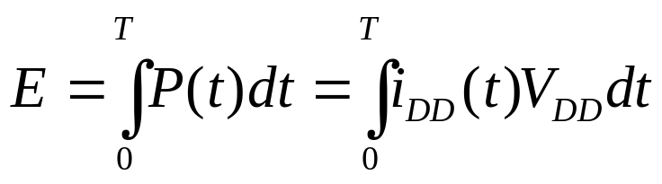
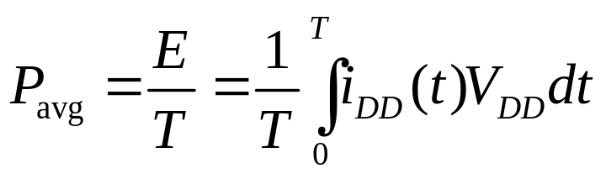
Power and Energy
Power is drawn from a voltage source attached to the V_{DD} pin(s) of a chip.
Instantaneous Power:
Energy:
Average Power:

Slide 4
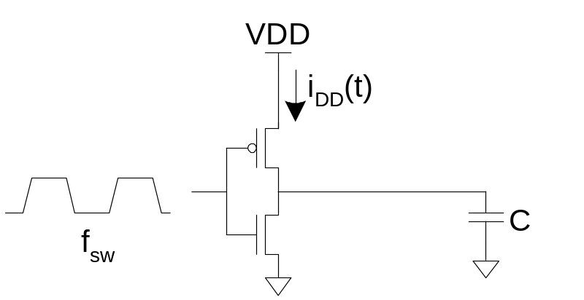
Dynamic Power
Dynamic power is required to charge and discharge load capacitances when transistors switch.
One cycle involves a rising and falling output.
On rising output, charge Q = CV_{DD} is required
On falling output, charge is dumped to GND
This repeats Tf_{sw} times
over an interval of T

Slide 5
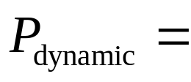
Dynamic Power Cont.

Slide 6
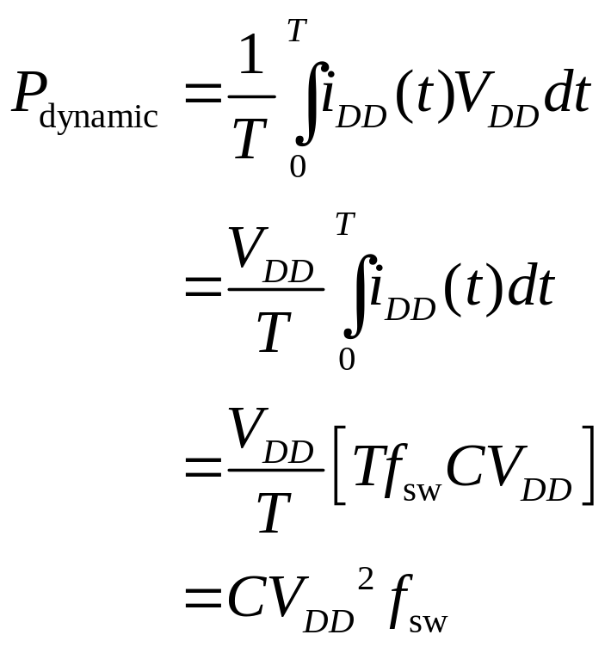
Dynamic Power Cont.

Slide 7
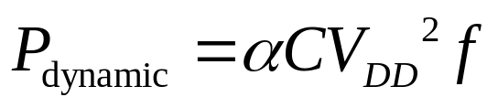
Activity Factor
Suppose the system clock frequency = f
Let f_{sw} = αf, where α = activity factor
  If the signal is a clock, α = 1
  If the signal switches once per cycle, α = ½
  Dynamic gates:
    Switch either 0 or 2 times per cycle, α = ½
  Static gates:
    Depends on design, but typically α = 0.1
Dynamic power:

Slide 8
Short Circuit Current
When transistors switch, both nMOS and pMOS networks may be momentarily ON at once
Leads to a blip of “short circuit” current.
< 10% of dynamic power if rise/fall times are comparable for input and output

Slide 9
Example
200 Mtransistor chip
  20M logic transistors
    Average width: 12 λ
  180M memory transistors
    Average width: 4 λ
  1.2 V 100 nm process
  C_{g} = 2 fF/μm

Slide 10
Dynamic Example
Static CMOS logic gates: activity factor = 0.1
Memory arrays: activity factor = 0.05 (many banks!)
Estimate dynamic power consumption per MHz. Neglect wire capacitance and short-circuit current.

Slide 11
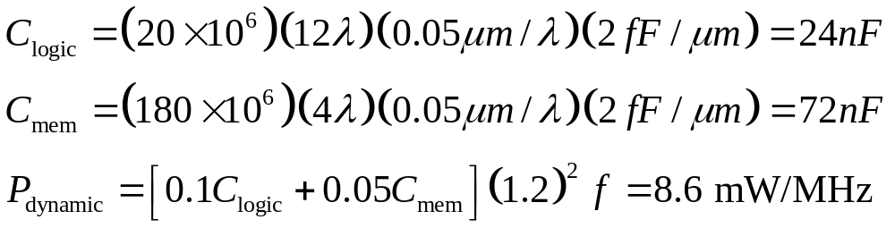
Dynamic Example
Static CMOS logic gates: activity factor = 0.1
Memory arrays: activity factor = 0.05 (many banks!)
Estimate dynamic power consumption per MHz. Neglect wire capacitance.

Slide 12
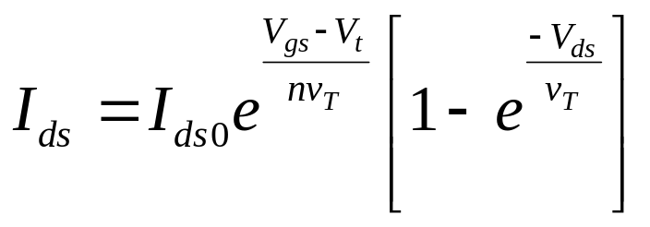
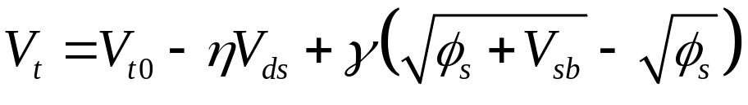
Static Power
Static power is consumed even when chip is quiescent.
  Ratioed circuits burn power in fight between ON transistors
  Leakage draws power from nominally OFF devices

Slide 13
Ratio Example
The chip contains a 32 word x 48 bit ROM
  Uses pseudo-nMOS decoder and bitline pullups
  On average, one wordline and 24 bitlines are high
Find static power drawn by the ROM
  β = 75 μA/V²
  V_{tp} = -0.4V

Slide 14
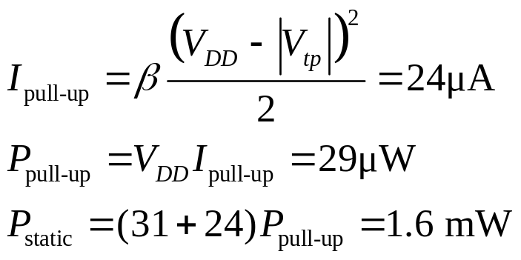
Ratio Example
The chip contains a 32 word x 48 bit ROM
  Uses pseudo-nMOS decoder and bitline pullups
  On average, one wordline and 24 bitlines are high
Find static power drawn by the ROM
  β = 75 μA/V²
  V_{tp} = -0.4V
Solution:

Slide 15
Leakage Example
The process has two threshold voltages and two oxide thicknesses.
Subthreshold leakage:
  20 nA/μm for low V_{t}
  0.02 nA/μm for high V_{t}
Gate leakage:
  3 nA/μm for thin oxide
  0.002 nA/μm for thick oxide
Memories use low-leakage transistors everywhere
Gates use low-leakage transistors on 80% of logic

Slide 16
Leakage Example Cont.
Estimate static power:

Slide 17
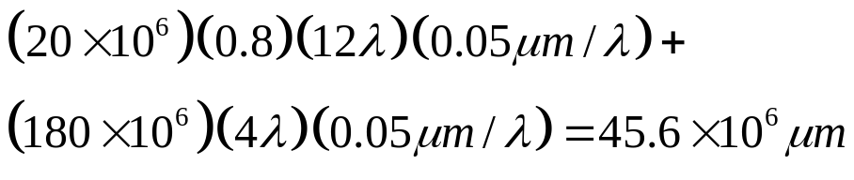
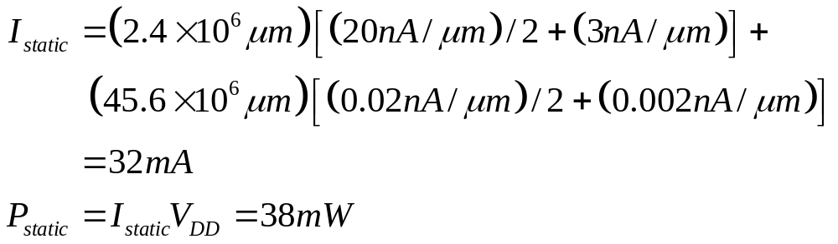
Leakage Example Cont.
Estimate static power:
  High leakage:
  Low leakage:

Slide 18
Leakage Example Cont.
Estimate static power:
  High leakage:
  Low leakage:
If no low leakage devices, P_{static} = 749 mW (!)

Slide 19
Low Power Design
Reduce dynamic power
  α:
  C:
  V_{DD}:
  f:
Reduce static power

Slide 20
Low Power Design
Reduce dynamic power
  α: clock gating, sleep mode
  C:
  V_{DD}:
  f:
Reduce static power

Slide 21
Low Power Design
Reduce dynamic power
  α: clock gating, sleep mode
  C: small transistors (esp. on clock), short wires
  V_{DD}:
  f:
Reduce static power

Slide 22
Low Power Design
Reduce dynamic power
  α: clock gating, sleep mode
  C: small transistors (esp. on clock), short wires
  V_{DD}: lowest suitable voltage
  f:
Reduce static power

Slide 23
Low Power Design
Reduce dynamic power
  α: clock gating, sleep mode
  C: small transistors (esp. on clock), short wires
  V_{DD}: lowest suitable voltage
  f: lowest suitable frequency
Reduce static power

Slide 24
Low Power Design
Reduce dynamic power
  α: clock gating, sleep mode
  C: small transistors (esp. on clock), short wires
  V_{DD}: lowest suitable voltage
  f: lowest suitable frequency
Reduce static power
  Selectively use ratioed circuits
  Selectively use low V_{t} devices
  Leakage reduction:
  stacked devices, body bias, low temperature

