Slide 1

Dynamic Hand Gesture Detection using EMG Signals

Slide 2

About the IET
Professional home for engineers, across the world
Headquartered in the UK, 150-years of engineering legacy
Powered by members, driven by volunteers
We inspire, inform and influence the global engineering community to engineer a better world.
We are a diverse home for engineering and technology intelligence throughout the world. This breadth and depth mean we are uniquely placed to fast-track solutions to societal problem.
We want to build the profile of engineering and technology to change outdated perceptions and tackle the skills gap.

Slide 3




Communities & Networks
IET in India:
Thought Leadership Platforms
Professional Registration
Improving the quality of Engineering Education
Technology-led Events
Position papers
Scholarship and Awards
Technical publishing
Government Advisory

Slide 4
Dynamic Hand Gesture Detection using EMG Signals
Mentees:
Rahul Basu
Sumukha S Shetty
Srinidhi
Mentor: Rajashri

Slide 5
01
Objectives and Introduction

Slide 6
The proposed project aims to develop a real-time visualization system for Electromyography (EMG) signals, to provide detailed insights into muscle activity. Electromyography is a technique used to record and analyze the electrical activity produced by muscles during contraction and relaxation. Real time visualization of EMG signals plays a crucial role in various fields such as sports science, rehabilitation and biomechanics.
According to a survey by the World Health Organization, the estimated number of amputees in the developing world is 40 million. In India, as per the 2011 census, the population of persons with disabilities was approximately 2.68 crore, which accounts for 2.22% of the total population. Amputation is a major cause of disability in India, but only a small percentage (around 5%) have access to prosthetic devices.

Slide 7
Motivation
Sophisticated and expensive advanced prosthetic devices even if available, can not be bought by the common man due to different social and economical issues.
In light of that, our goal is to get to know how this circuits are implemented and find cost-effective methods. The current project focuses on collection, analysis and classification of EMG signals which in turn can be used as input for advanced Prosthetic devices.
With very simple equipment and ideas, the project has been initiated. Results may not be convincing right now, but the experience accumulated will further the chances to meet the goal set. With this we next define the objectives of the project

Slide 8
The main aim of this project is to collect signal from a subject with well functioning limbs, process the signals and use these signals for people with an absence in any of their limbs by using these signals to make a prosthetic arm which duplicates the functions of regular limb.
The goal is to implement a robust system for the acquisition of EMG signals using appropriate sensors and hardware and apply signal processing algorithms to filter and preprocess EMG data, ensuring accuracy and reliabilty in real time.

Slide 9
Objectives:
Implementing the system setup
Data collection and pre-processing
Exploring gesture recognition for the system
Compilation of results

Slide 10
02
Methodology

Slide 11
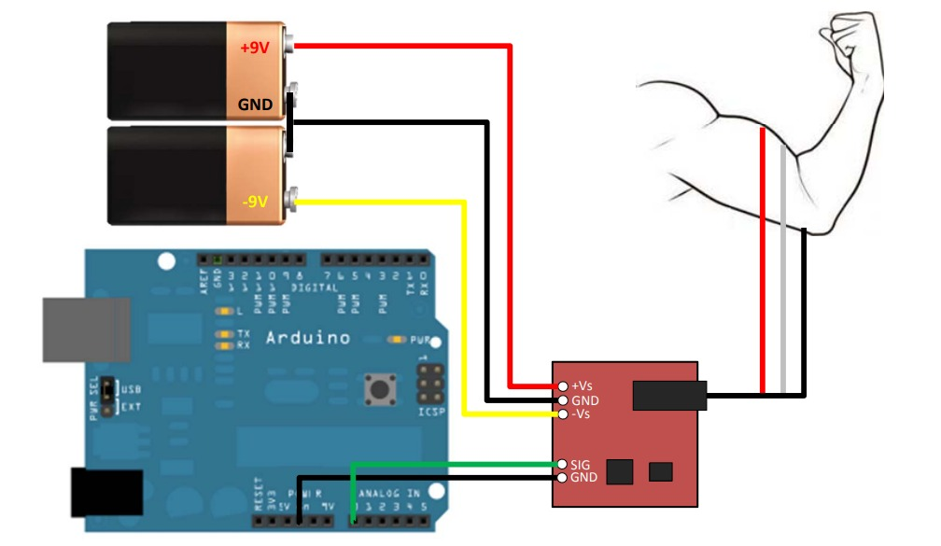
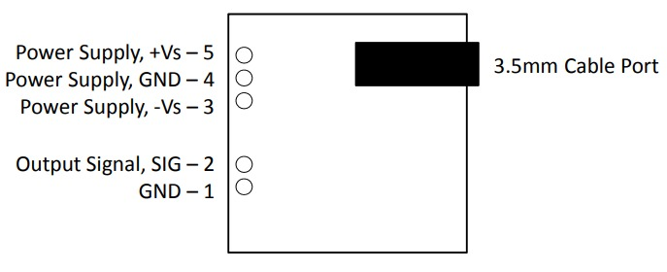
The aim of the project is classification of dynamic hand
gestures using EMG signals as input and ML implementation
to run the analysis.
Circuit Diagram
Pin Layout

Slide 12
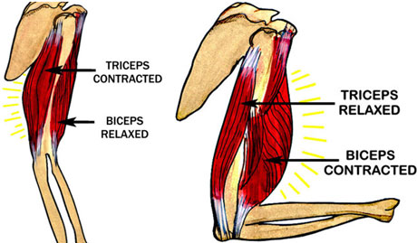
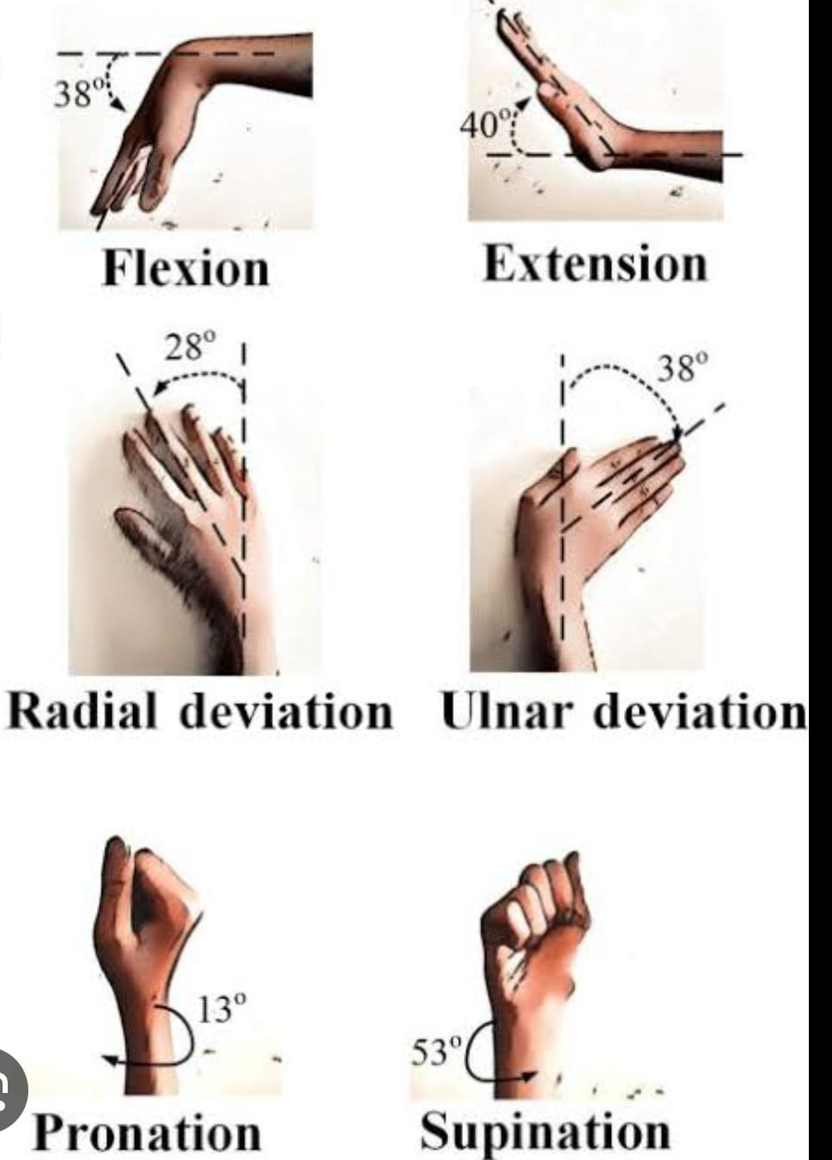
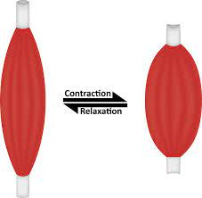
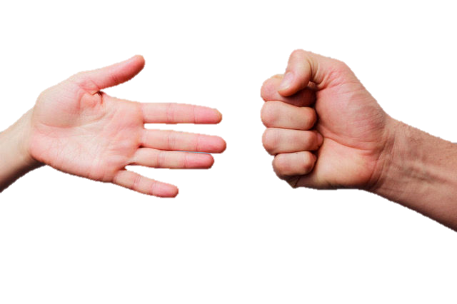
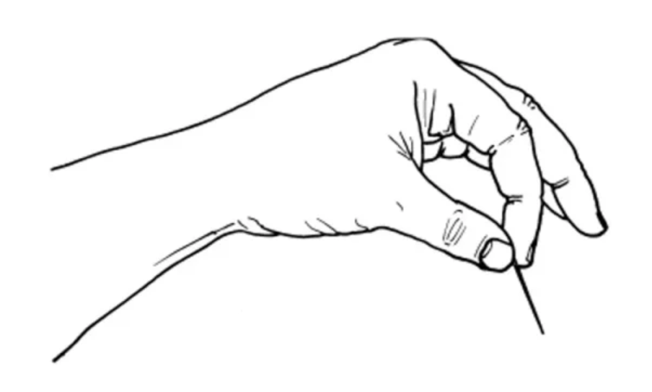
Open palm
Closed fist
Pinch grip

Slide 13
Frequency-domain analysis
preprocess the data, based on the conditions, used a frequency domain representation gave much better output than time domain.
then 240 point DFT of the signal was taken and then normalised it to be used as model input.
Model input contain 120 features(one-sided DFT) and 1 target were the gesture observed was given an ordinal encoding.
Random Forest Classifier was used as model and final result presented in confusion matrix, to measure the ability to classify the gestures.

Slide 14
Discrete Fourier Transform
The Discrete Fourier Transform (DFT) is a mathematical tool used to analyze discrete signals in the frequency domain.
It decomposes a finite-length signal into its constituent sinusoidal components (sine and cosine waves) of different frequencies.
This allows us to understand the frequency content of the signal and how different frequencies contribute to its overall shape.
The DFT is a fundamental tool in various applications, including signal processing, image compression, and spectral analysis. It plays a crucial role in understanding and manipulating the frequency content of digital signals.
We have elaborated in next slide.

Slide 15
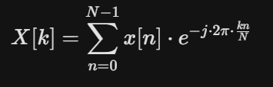
Explanation of Parameters:
X[k]: This represents the complex-valued frequency domain representation of the signal at the k-th frequency component.
It contains both the magnitude (amplitude) and phase information of that frequency component.
n: This is the index variable iterating through all N samples of the original signal x[n].
x[n]: This is the value of the signal at the n-th sample point.
k: This is the index variable representing the k-th frequency component in the transformed signal X[k]. It typically ranges from 0 to N-1.
j: This is the imaginary unit, where j^2 = -1.
e: This is the base of the natural logarithm (approximately 2.71828).
π: This is the mathematical constant pi (approximately 3.14159).
N: This represents the total number of samples in the discrete signal x[n].

Slide 16
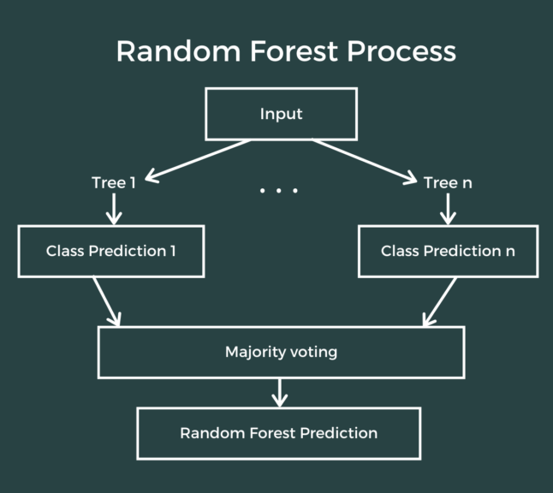
Random Forest Classifier
A powerful ensemble learning method that combines multiple decision trees, trained on random subsets of features and data points, to improve classification accuracy and prevent overfitting.
The image depicts a Random Forest with several decision trees, each making predictions based on different feature splits. The final prediction is based on the majority vote of these individual trees.
Image of Random Forest Classifier diagram

Slide 17
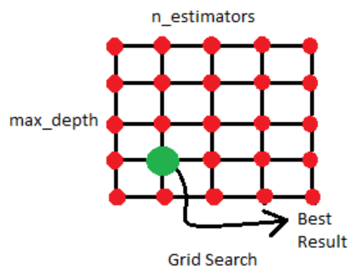
GridSearch
We used GridSearch on the estimator(Random Forest) which automates hyperparameter tuning by trying out different combinations of settings for a machine learning model and selects the one that performs best on a validation set, preventing overfitting and improving model performance.

Slide 18
Time domain analysis
Focused on first 400 samples of each reading and made 20 length 20 boxes for each calculated RMS, variance, absolute mean, integrated emg. Next, we are grouping them based on each subject; trial wise. Later for first trial of each of the gestures we are modifying the array size from (5,20,4) to (100,4).
Later divided the collected data in train and test. And train data further into train and validation.
next this dataset used for models(svc and convolutional neural network) and training it and compared the accuracies obtained from them.

Slide 19
RMS (Root Mean Square): Calculates the average strength (magnitude) of an EMG signal by considering both positive and negative fluctuations.
Variance: Measures how spread out an EMG signal is, indicating the variability in its amplitude over time.
Mean: Represents the average value of an EMG signal over a specified time window.
Integrated EMG (iEMG): Captures the total electrical activity of an EMG signal within a defined period, reflecting the overall muscle effort.

Slide 20
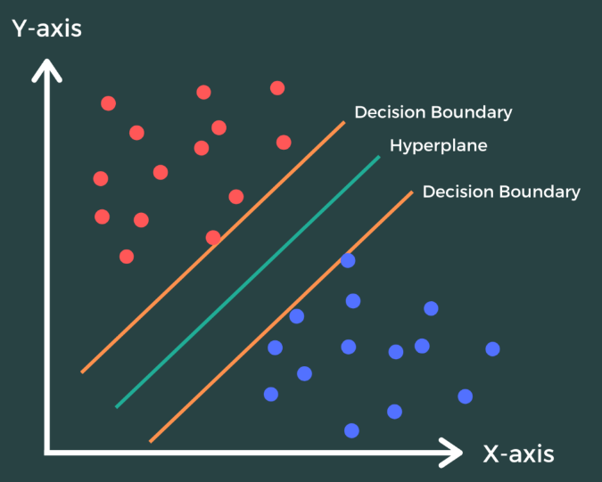
Support Vector Classifier (SVC)
A powerful algorithm that finds a hyperplane in high-dimensional space to separate different classes in your data. It maximizes the margin between the classes for better classification and is effective for high-dimensional and potentially non-linear data.

Slide 21
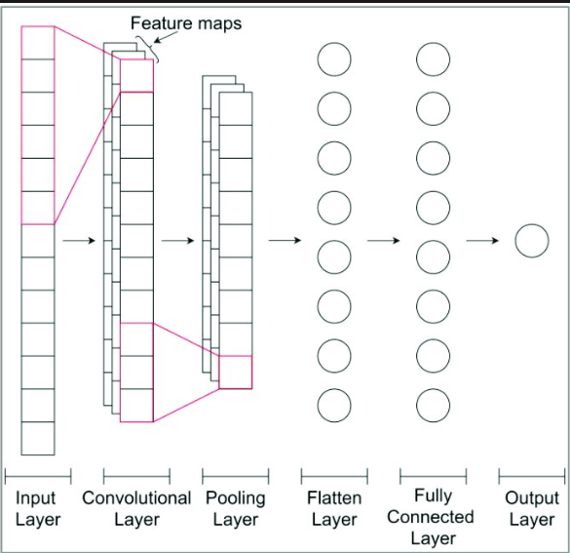
1D Convolutional Neural Network (1D CNN):
A type of CNN designed for processing data with one-dimensional structure, like time series or sensor signals. It uses convolutional layers to extract features along the single dimension, making it useful for tasks like gesture recognition, speech analysis, and signal processing.
1D CNNs are well-suited for tasks where the order of data points matters, such as predicting the next word in a sentence or identifying anomalies in a time series.

Slide 22
03
Work Done

Slide 23
Collection of samples: Components and procedure
Components Required: Arduino UNO, Myoware EMG sensor, connecting wires, two 9V DC output adapter, electrodes, 5V supply, hand sanitizer .
Using the analogRead() we are getting the input and using CoolTerm application, we are storing them into text file. Later we compiled all the data into excel file. Next we fetched it to Jupyter Notebooks for further operation.

Slide 24
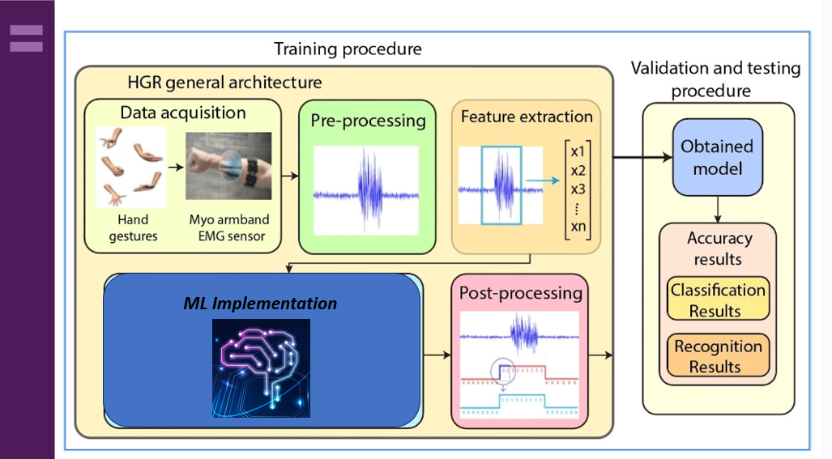

Slide 25
Gestures we have focused on pattern of 1-2-1 were transition takes place in middle. Each gesture sample is of average 30s with first 10s, in position '1', then 10s in position '2' and last 10s in position '1' again. Dataset comprises of 22 samples each of 5 gesture patterns. Data collection is done by the project mentees. The patterns we are detecting are:
Open palm - Closed fist - Open palm
Closed fist - Radial deviation - Closed fist
Extension - Flexion – Extension
Supination - Pronation – Supination
Pinch grip - Open palm - Pinch grip

Slide 26
04
Dataset Generation and Results

Slide 27
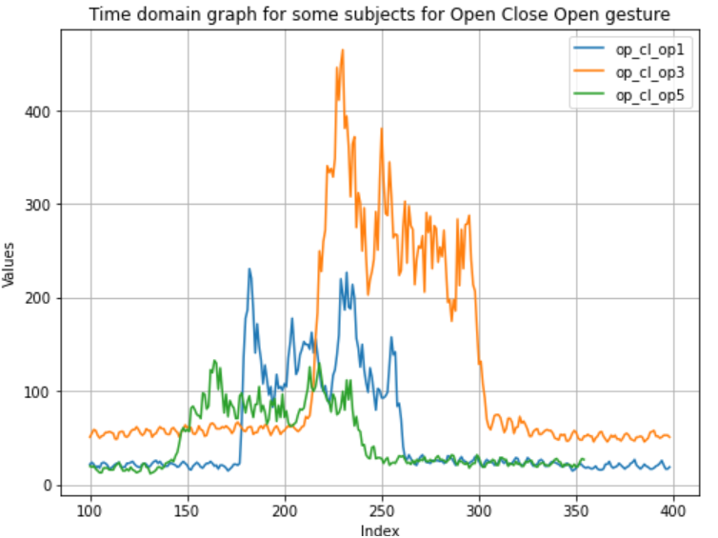
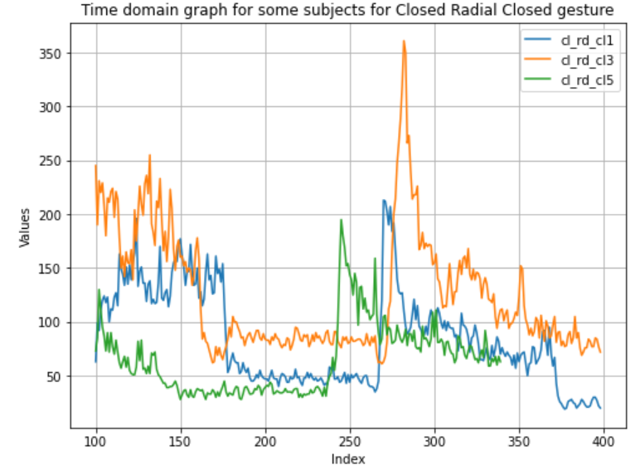

Slide 28
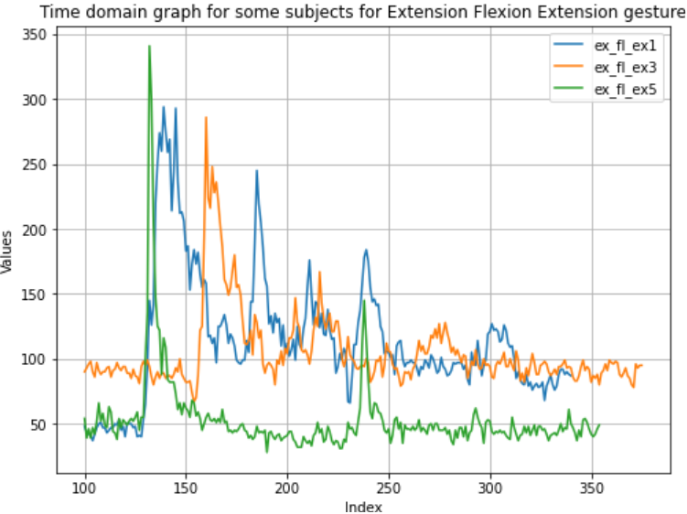
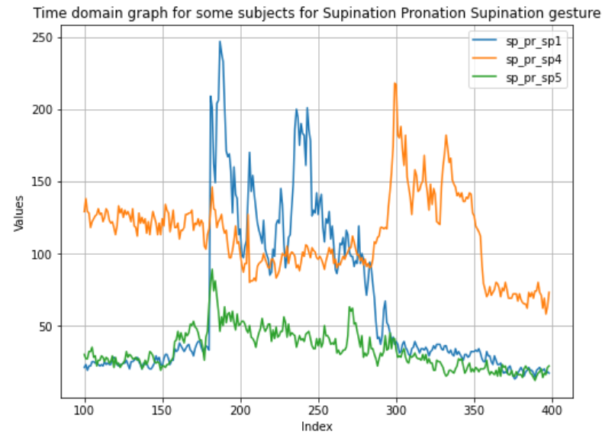

Slide 29
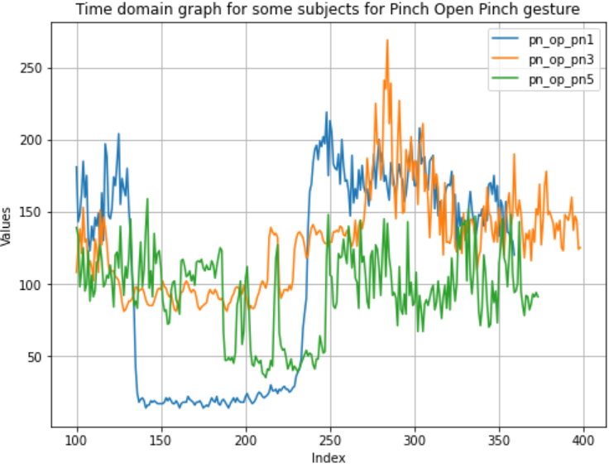
0 | 1 | 2 | 3
644.2914 | 2198.997 | 198.55 | 3971
646.5273 | 2251.608 | 199.15 | 3983
637.6014 | 2169.419 | 196.45 | 3929
541.5446 | 9360.366 | 142.95 | 2859
65.75713 | 4.115789 | 20.7 | 414
66.63708 | 5.418421 | 20.95 | 419
70.22108 | 4.936842 | 22.1 | 442
66.64458 | 5.523684 | 20.95 | 419
123.1929 | 739.5237 | 28.55 | 571
455.6534 | 1924.463 | 137.6 | 2752
443.5871 | 389.3132 | 138.95 | 2779
507.9296 | 2176.682 | 154.05 | 3081
358.1599 | 521.8395 | 111.05 | 2221
98.17332 | 110.8526 | 29.3 | 586
82.87038 | 8.576316 | 26.05 | 521
76.48856 | 6.997368 | 24.05 | 481
74.83315 | 8.157895 | 23.5 | 470
62.39391 | 5.410526 | 19.6 | 392
63.45865 | 7.042105 | 19.9 | 398
64.01172 | 8.155263 | 20.05 | 401
Some rows from csv containing RMS, variance, mean and iEMG
0 - RMS
- Variance
- Mean(abs)
- iEMG

Slide 30
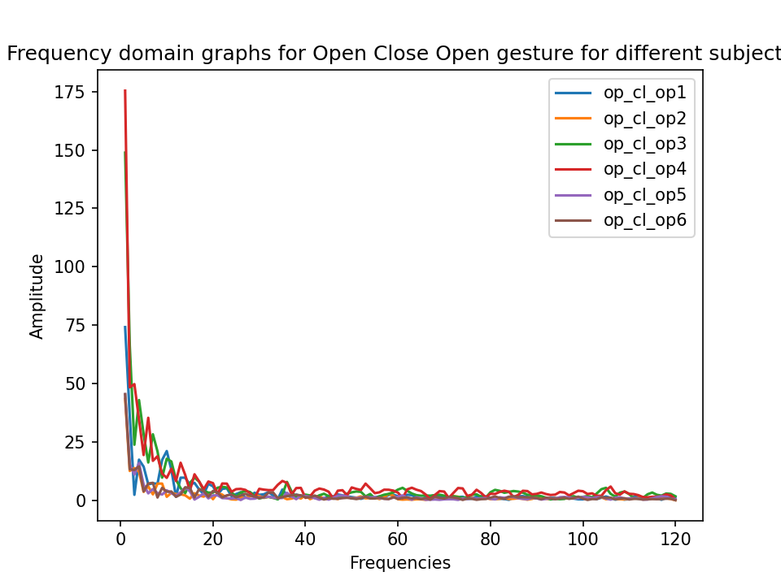
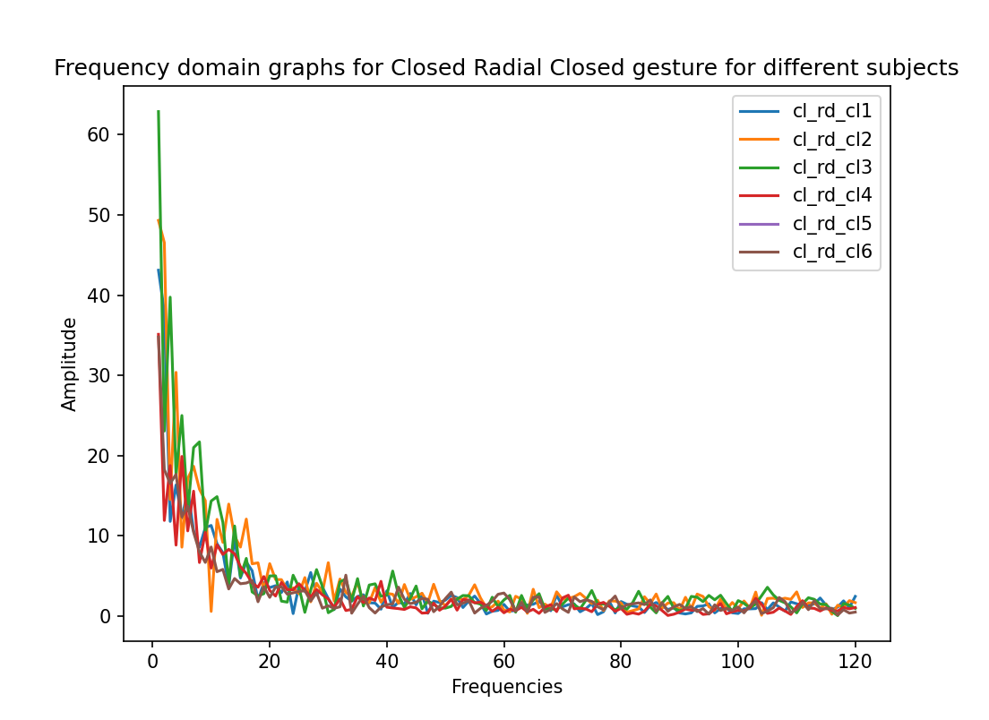
op_cl_opi: refers to open close open gesture for i th subject
cl_rd_cli: refers to closed radial closed gesture for i th subject

Slide 31
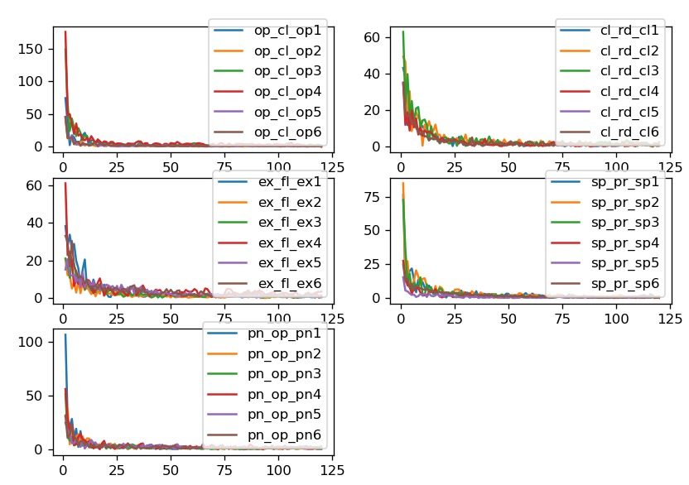
Open palm - Closed fist - Open palm | op_cl_op
Closed fist - Radial deviation -Closed fist | cl_rd_cl
Extension - Flexion – Extension | ex_fl_ex
Supination - Pronation – Supination | sp_pr_sp
Pinch grip - Open palm - Pinch grip | pn_op_pn
Same Gesture Different Subjects

Slide 32
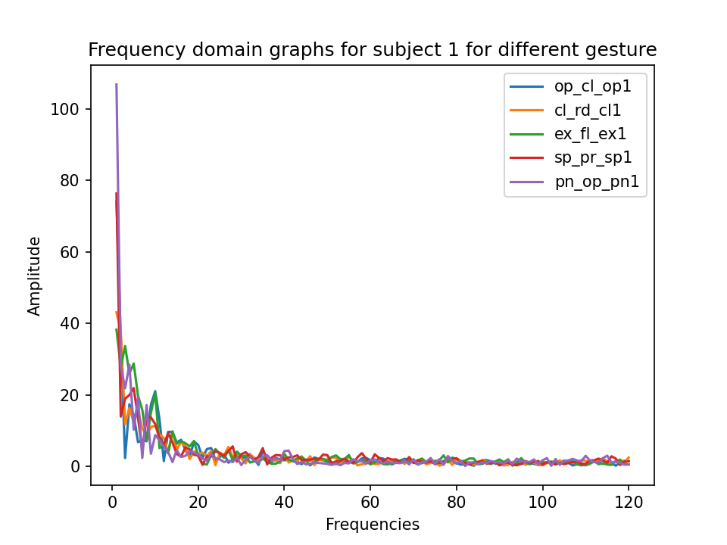
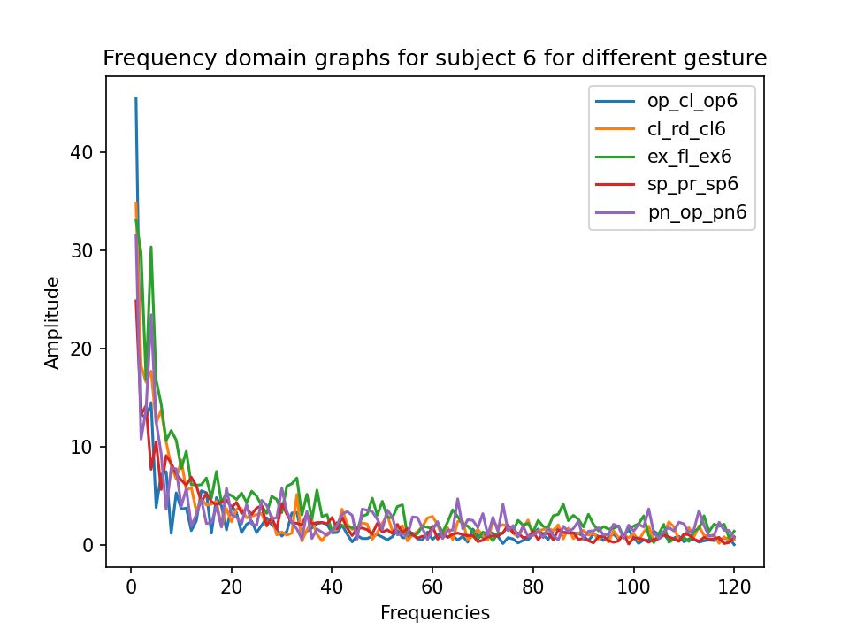
op_cl_opi: refers to open close open gesture for i th subject
cl_rd_cli: refers to closed radial closed gesture for i th subject
and likewise

Slide 33
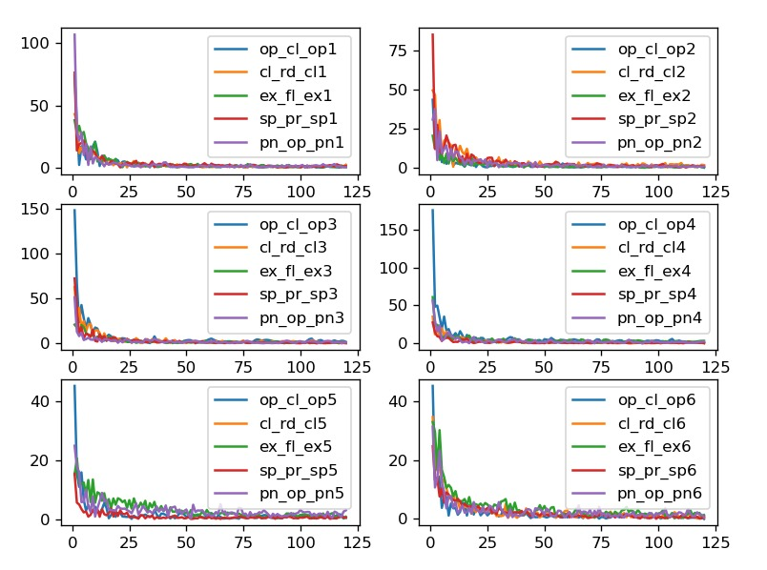
Same Person different Gestures
Open palm - Closed fist - Open palm | op_cl_op
Closed fist - Radial deviation -Closed fist | cl_rd_cl
Extension - Flexion – Extension | ex_fl_ex
Supination - Pronation – Supination | sp_pr_sp
Pinch grip - Open palm - Pinch grip | pn_op_pn

Slide 34
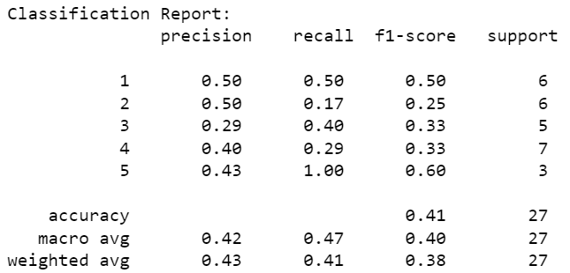
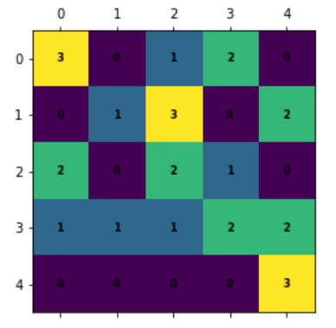
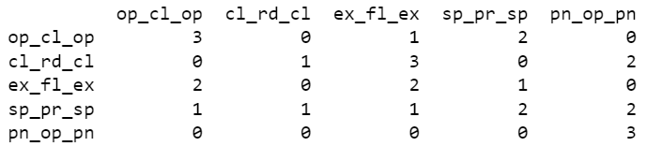
Results from frequency domain analysis

Slide 35
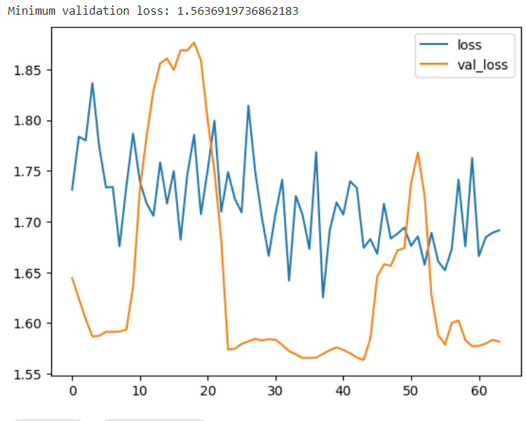
Results from time domain analysis
parameters:
batch_size=200,epochs=100,
early_stopping: min_delta=0.001, patience=20,
restore_best_weights=true,
1D CNN loss curve and accuracy
CNN test accuracy : 0.23125000298023224
Batch normalization reduced the validation loss significantly
Dropouts were kept in two layers with rate 0.2 and 0.3
There are signs of overfitting which can be reduced by taking more inputs.

Slide 36
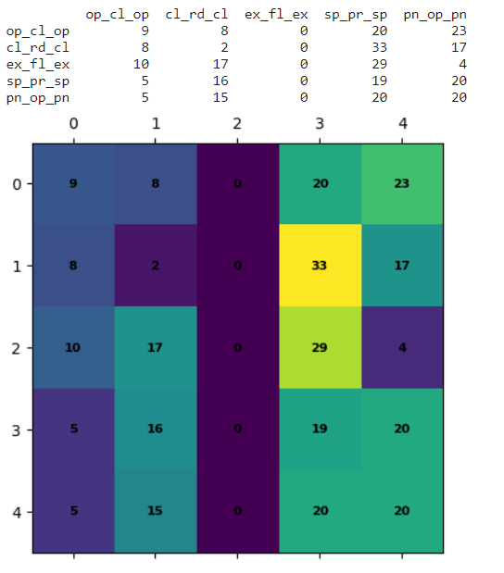
The train set results itself requires improvement before testing and we intend to work to improve it.
One possible way is to increase the number of signals taken.
CNN Train Accuracy: 0.1666666716337204

Slide 37
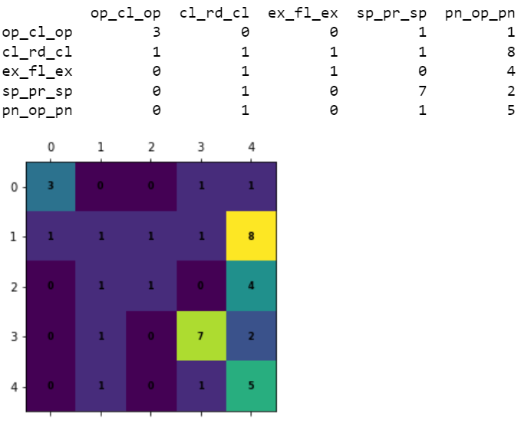
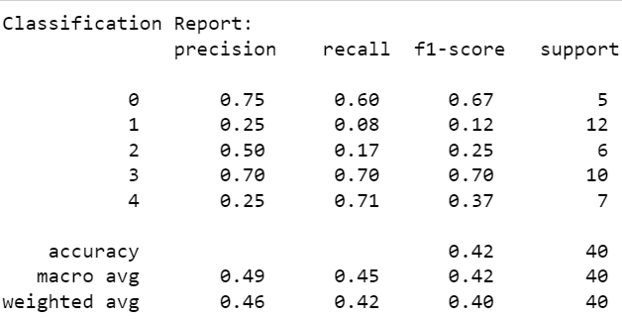
SVC test accuracy: 0.425

Slide 38
Observations :
From both the methods, we could only achieve around 40% to 45% accuracy at best. We understand the data points are overlapping thus not giving good results. But, we realize this is due to constraints we unknowingly set before the sample collection was done:
Using combination of two or four instead of one electrode, would have been better for getting unique signatures among the different gestures.
The muscle sensor we used gives rectified and smoothed EMG signal (instead of raw EMG signal), which is easier to work with Arduino UNO, but affects greatly in our classification.
The rectified and smoothed EMG signal works quite well for static gesture detection but for dynamic, makes certain features absent.

Slide 39
05
Future Work

Slide 40
The current model that we have presented is based on a few simple gestures, by taking readings of them in a fixed order to show the change in signals given by the muscle.
As we have above stated there are many places for improvement in our current model.
The model could also be made to process real time data to precisely determine the gestures being made.

Slide 41
06
Conclusion

Slide 42
We got to learn a whole lot of stuff in domains like biomedical signals, machine learning, CNN and likewise.
We do get a much clearer picture on real world signals and how hard it is to formulate it into some fixed constraints.
We get a good idea of why sophisticated equipment are essential for better feature/signature detection.
But it was a somewhat full-filling experience for our first time venturing into this domain.
We expect our project can help others who are starting it new.

Slide 43
07
Acknowledgements

Slide 44
We are grateful to Krishnan sir and Prathap sir, dept. of EEE, NITK for giving us the opportunity to work on the project where we got to learn extensively about biomedical signals, machine learning and glimpse on prosthetic arm rehabilitation.

Slide 45
08
References

Slide 46
P. K. Koppolu and K. Chemmangat, "A two-stage classification strategy to reduce the effect of wrist orientation in surface myoelectric pattern recognition," 2022 IEEE International Conference on Signal Processing and Communications (SPCOM), Bangalore, India, 2022, pp. 1-5, doi: 10.1109/SPCOM55316.2022.9840809.
O. S. Powar, K. Chemmangat, S. Figarado, "A novel pre-processing procedure for enhanced feature extraction and characterisation of electromyogram signals," Biomedical Signal Processing and Control, vol. 42, pp. 277-286, 2018, ISSN: 1746-8094, doi: 10.1016/j.bspc.2018.02.006.
Powar, Omkar S & Chemmangat Manakkal Cheriya, Krishnan. (2020). Reducing the effect of wrist variation on pattern recognition of Myoelectric Hand Prostheses Control through Dynamic Time Warping. Biomedical Signal Processing and Control. 55. 10.1016/j.bspc.2019.101626.
O. S. Powar and K. Chemmangat, "Dynamic time warping for reducing the effect of force variation on myoelectric control of hand prostheses," J. Electromyogr. Kinesiol., vol. 48, pp. 152-160, Oct. 2019. doi: 10.1016/j.jelekin.2019.07.006. PMID: 31357113.
R. Tamilselvi, A. Merline, M. P. Beham, R. V. Anand, M. S. Karthik and R. H. Uthayakumar, "EMG activated robotic arm for amputees," 2018 2nd International Conference on Inventive Systems and Control (ICISC), Coimbatore, India, 2018, pp. 456-461, doi: 10.1109/ICISC.2018.8399114.
C. Tejas, V. Tejashwini, S. Dhal and P. S. Sirisha, "Flex controlled robotic arm for the amputees," 2017 2nd International Conference on Communication and Electronics Systems (ICCES), Coimbatore, India, 2017, pp. 92-97, doi: 10.1109/CESYS.2017.8321224.

Slide 47
Thank You

