Slide 1


Basura
Ratnayake
DSE121FT41
Visuddha
Samarasekara
DSE121FT43
Nipuna Aravinda
DSE121FT07
Prasanga
Weerasuriya
DSE121FT60
Punarjeewa
Abeysekera
DSE121FT02

Slide 2
Be the change you want to be
~ Mahatma Gandhi

Slide 3


MOLE ????
Lecturer : What are you talking about?, Get to the point , Don’t waste my Time.
Student : Please Wait.....Wait Sir, Let me Explain what MOLE is?
Lecturer : Ok, I’ll give you 5 minutes to explain
Student : Thank you Sir, MOLE is the short name for
Mathematics for Ordinary Level Examination.
Lecturer : Ohhh, Why didn’t you say so earlier?, So what does it do and to whom is it for?
Student : Sir, MOLE is an Electronic Teacher that help School Students effectively to learn GCE O/L Mathematics at School/ Home Digitally, free of charge
Lecturer : Ok, so what more about MOLE?
Student : Sir, there are many more things to tell you, I suggest you take a seat and enjoy the journey.

Slide 4
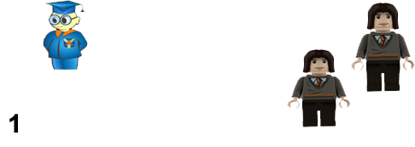

A student’s scenario
This is where MOLE
comes into play and solve
the situation once and
For all.
Not so practical
Solution 3

Slide 5


Why MOLE????
Release you from 2 years of burden, study anywhere you wish.
Failure rate can be reduced.
This gives you real-life practical approach.
Learning virtually motivates, inspire and fascinating experience to students.
MOLE is there to help you anytime, anywhere
MOLE is free of charge no need to pay penny!.

Slide 6
Mole made from and for..
MOLE is made using the following
Main Components: MOLE Software, Website and User Database
MOLE Desktop Application
C++, Java, J2EE
MOLE Website
HTML , MYSQL(Database), PHP, JavaScript, AJAX
MOLE is made for the following
Main Targets : School Students, O\L Repeaters
MOLE is implemented in
Company: JMC College International Kaduwela.
MOLE is designed and developed based on
Manual Data Sources: National Textbooks for Grades 10 and 11 Mathematics
MOLE takes the following inputs
Data Inputs: User Account Information, Lesson Completion, Exam Submissions

Slide 7
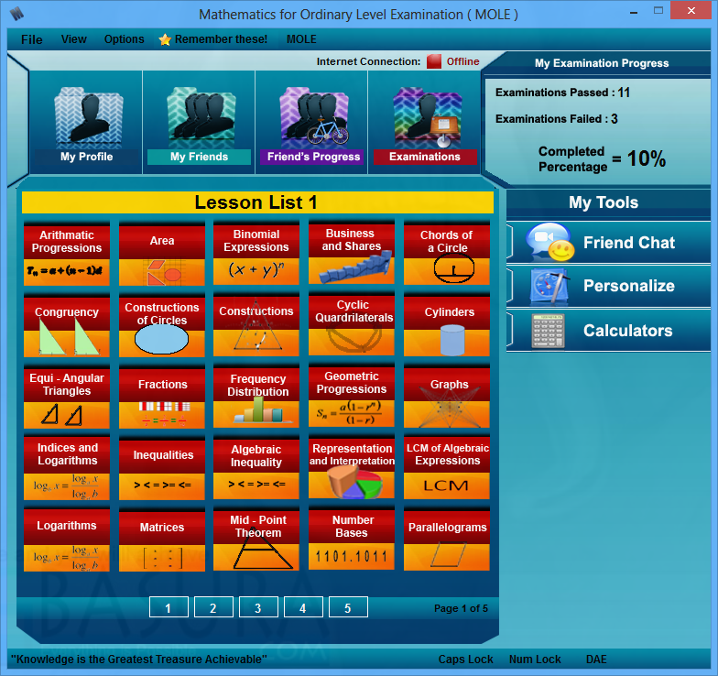
We are Gorgeous and so is MOLE!!!
Examinations Results
Friend Chat
Personalization
Calculators
Lessons

Slide 8
MOLE Features
Friend Chat
Calculators
Examinations
Personalization

Slide 9
MOLE Website
What Website?, I don’t see any!
Here it is

Slide 10
Anything more you like to
Know about mole???
Meet US later

Slide 11
If two wrongs don't make a right,
try three.
~Author Unknown

