Slide 1
KBE app to support the design of automotive rear spoilers Knowledge Acquisition
Group 40
Bas v. Manen & Stijn Nolet

Slide 2
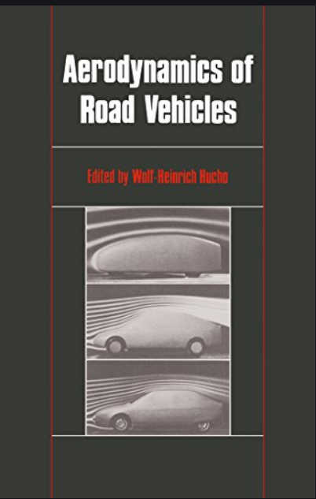
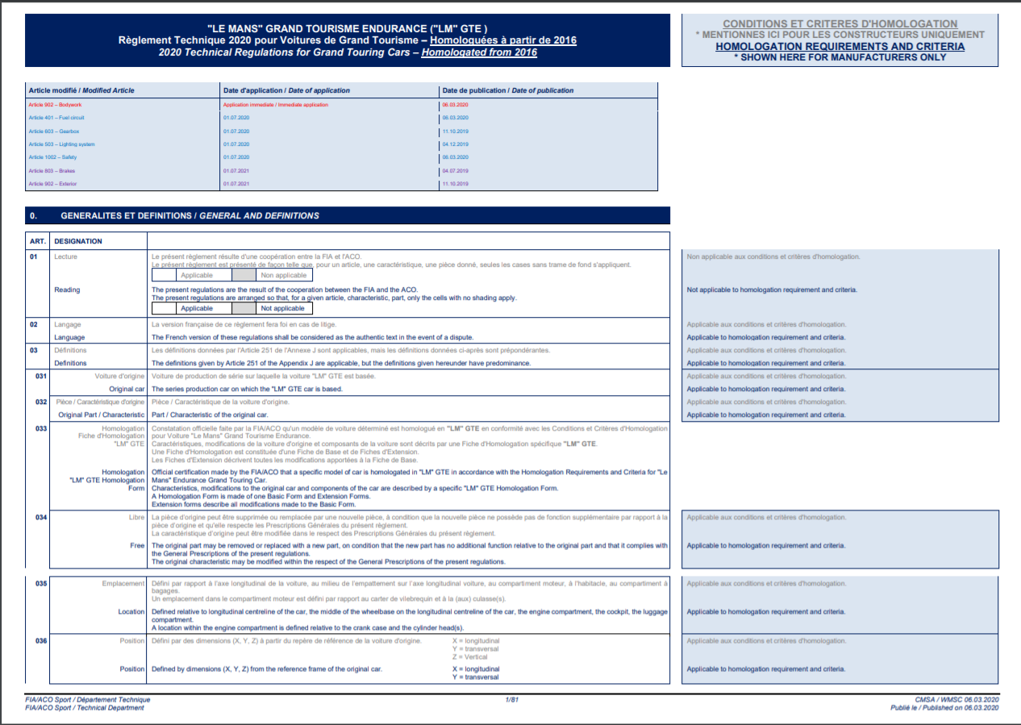
“Knowledge” for parametric model of high-performance spoiler design
Notes:
Book is for basic spoiler principles
Regulations is for more detailed modelling

Slide 3

“Knowledge” for parametric model of high-performance spoiler design is taken from existing spoiler designs
Rear spoiler function is to generate downforce
Simple, robust model consists of
Upside down wing
Connector struts
Optional endplates

Slide 4

Part identification
Main plate
Endplate
Strut

Slide 5
Part identification (2)
Main plate (1 … *)
Main source of downforce, airfoil shape
Struts (2 … *)
Can be either airfoil shaped or flat plate
Endplates
Can be either present or not, acting like winglets
Car model
Based on existing high-performance vehicles

Slide 6
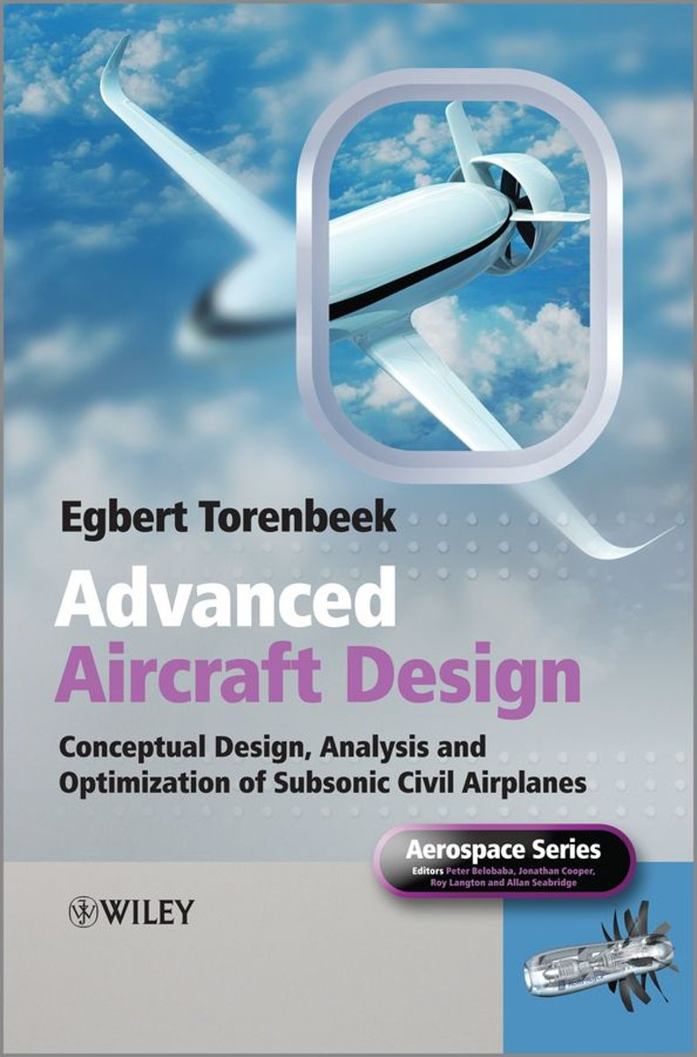
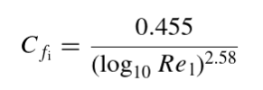
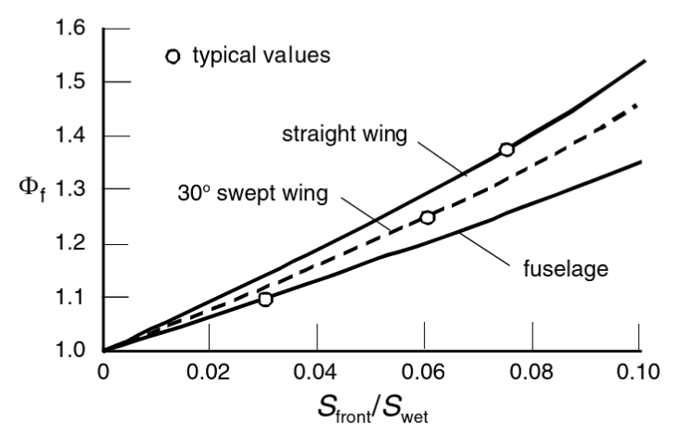
Aerodynamic analysis: Parasite drag
Parasite drag calculated with
Reynolds number
Form factor
Wetted area
Frontal area

Slide 7
Aerodynamic analysis: AVL
AVL is used to calculate:
Lift distribution
Lift-induced drag distribution
Total lift and total lift induced drag

Slide 8
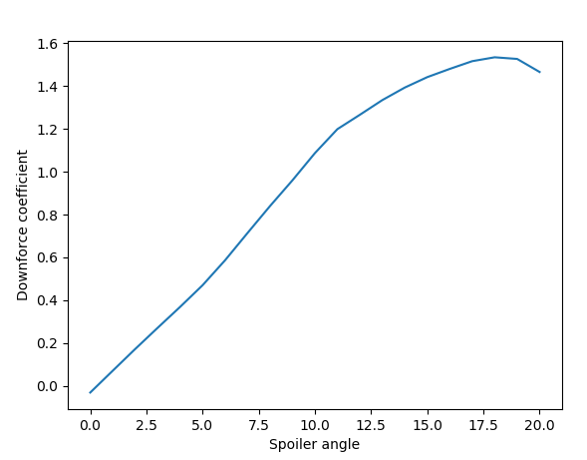
Aerodynamic analysis: XFOIL
XFOIL is used to calculate sectional pressure distribution
Investigate effect of spoiler angle on sectional downforce coefficient

Slide 9
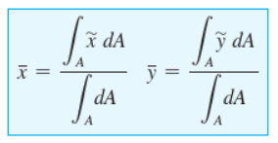


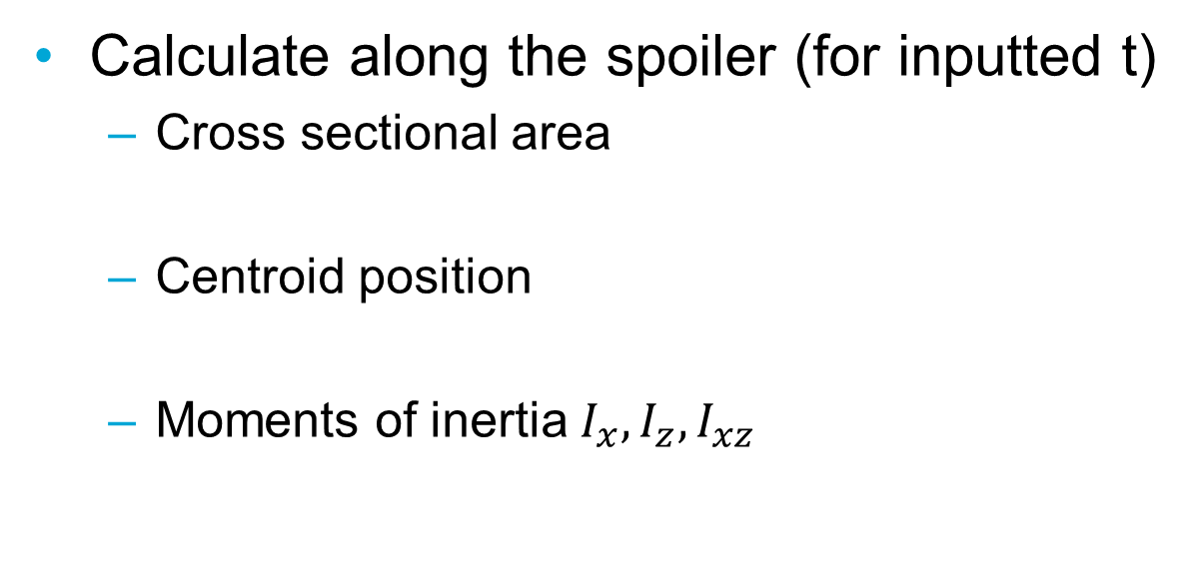
Structural analysis: sectional properties
Calculate along the spoiler (for inputted t)
Cross sectional area
Centroid position
Moments of inertia $I_{x}, I_{z}, I_{xz}$

Slide 10

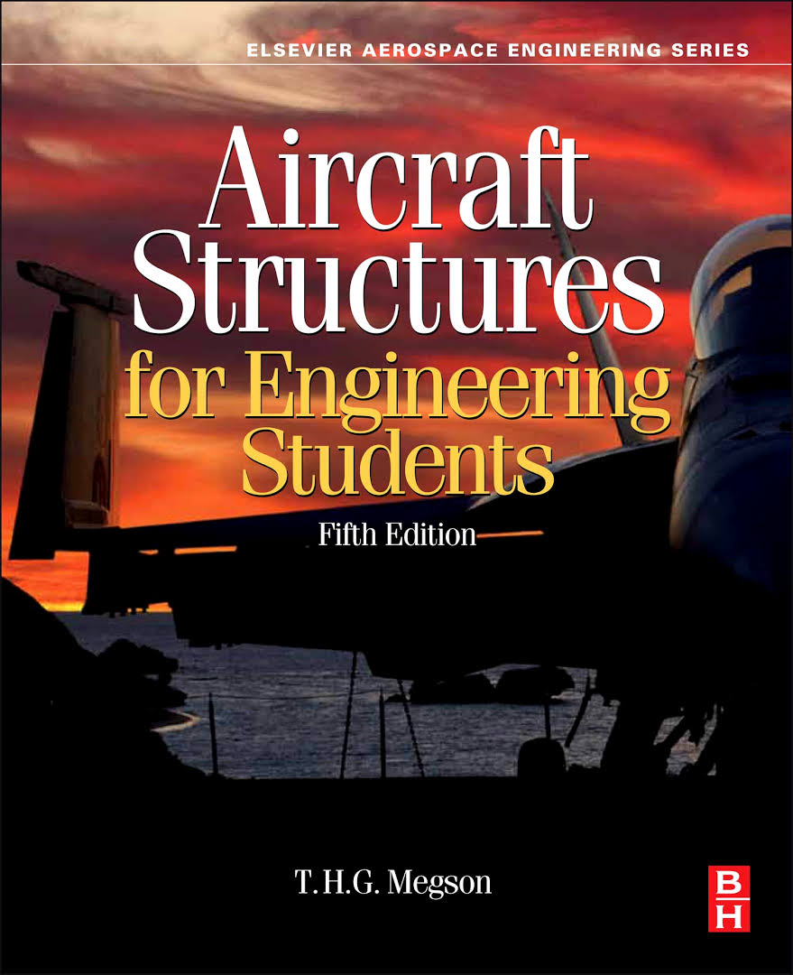
Structural analysis: bending calculations
The spoiler is modelled as a beam using the Euler-Bernouli beam theory.
Bending and shear is calculated using the methods described in Megson.

Slide 11



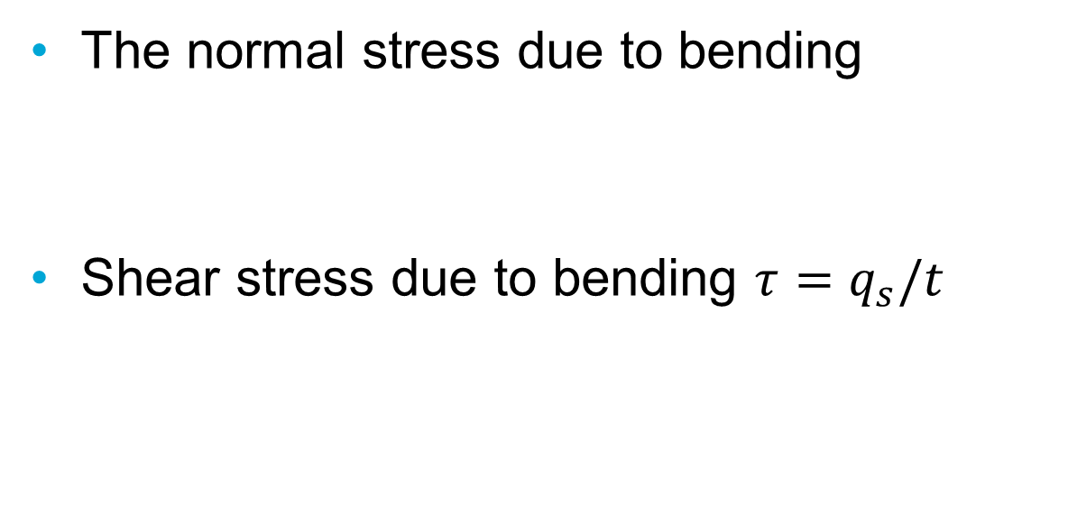
Structural analysis: stress calculations
The normal stress due to bending
Shear stress due to bending $τ=q_{s}/t$

Slide 12
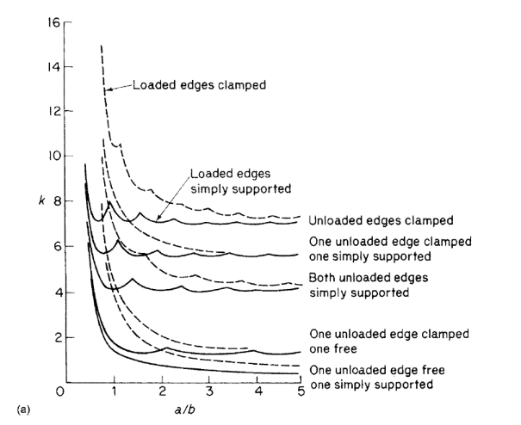

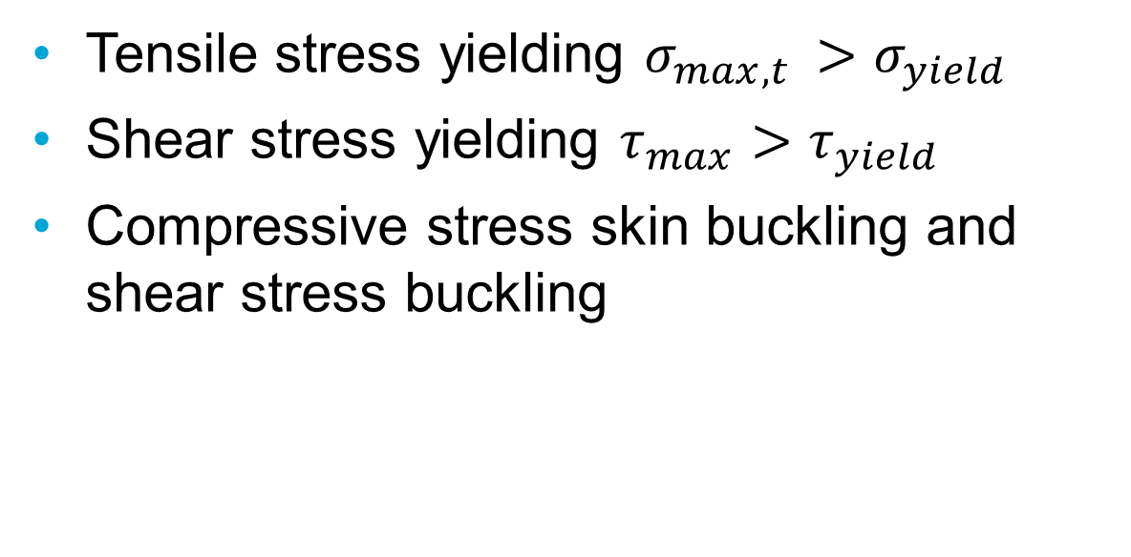
Structural analysis: Failure modes
Tensile stress yielding $σ_{max,t }>σ_{yield}$
Shear stress yielding $τ_{max}>τ_{yield}$
Compressive stress skin buckling and shear stress buckling

Slide 13

Structural analysis: Failure modes cont.
Compressive stress column buckling
Max deflection > 5% of half span

Slide 14
Bibliography
Engineering Mechanics Statics, 14th edition, R.C. Hibbeler.
Aircraft structures for engineering students, 5th edition, T.H.G. Megson.
Advanced Aircraft Design (2013), Egbert Torenbeek
Aerodynamics of Road Vehicles : From Fluid Mechanics to Vehicle Engineering, Wolf-Heinrich Hucho, Elsevier Science & Technology, 1987.
Technical Regulations for Grand Touring Cars, FIA Sport / Technical Department, 2020.

