Slide 1
KBE app to support the design of automotive rear spoilers Knowledge Acquisition
Group 40
Bas v. Manen & Stijn Nolet

Slide 2

“Knowledge” for parametric model of high-performance spoiler design is taken from existing spoiler designs
Rear spoiler function is to generate downforce
Simple, robust model consists of
Upside down wing
Connector struts
Optional endplates

Slide 3
Schets van de parts??

Slide 4
Aerodynamic analysis: AVL
AVL is used to calculate:
Lift distribution
Lift-induced drag distribution
Total lift and total lift induced drag

Slide 5
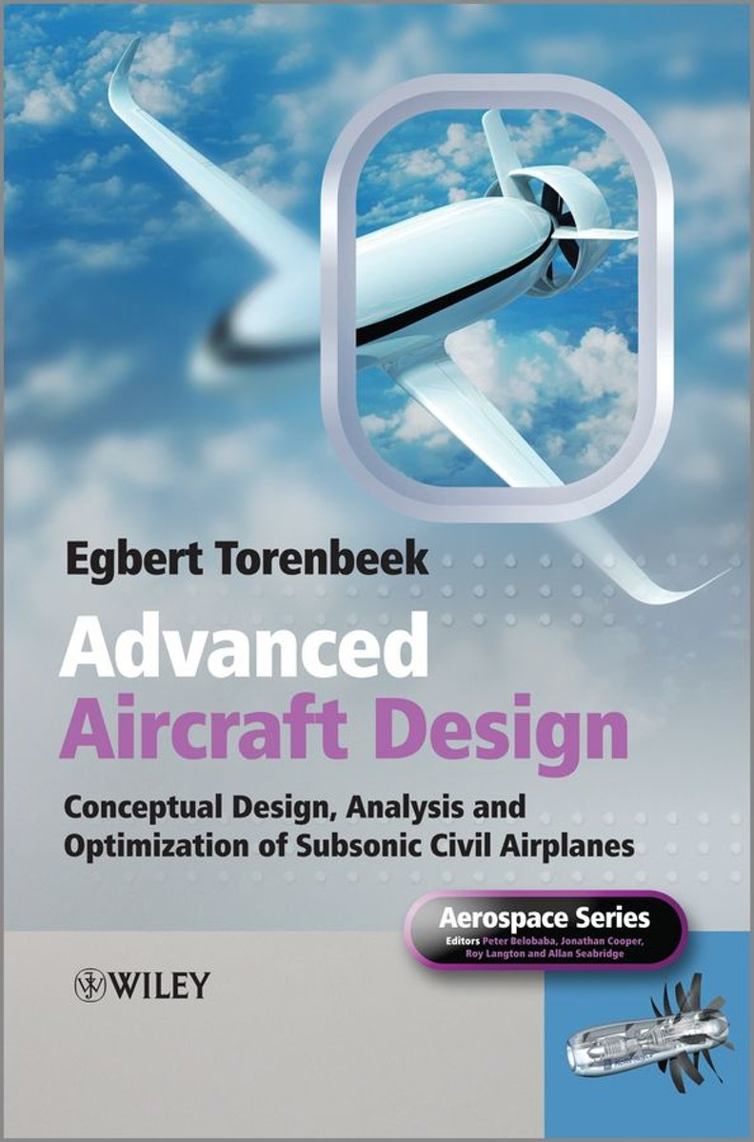
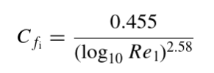
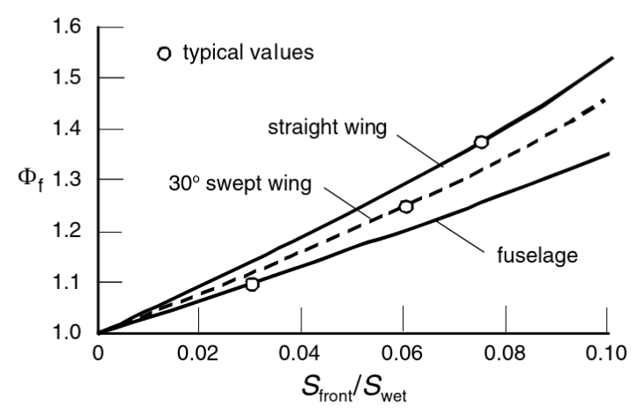
Aerodynamic analysis: Parasite drag
Parasite drag calculated with
Reynolds number
Form factor
Wetted area
Frontal area

Slide 6
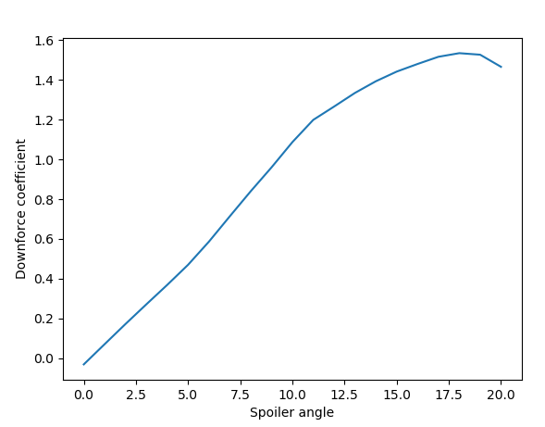
Aerodynamic analysis: XFOIL
XFOIL is used to calculate sectional pressure distribution
Investigate effect of spoiler angle on sectional downforce coefficient

Slide 7
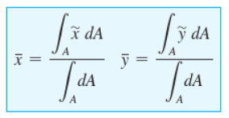


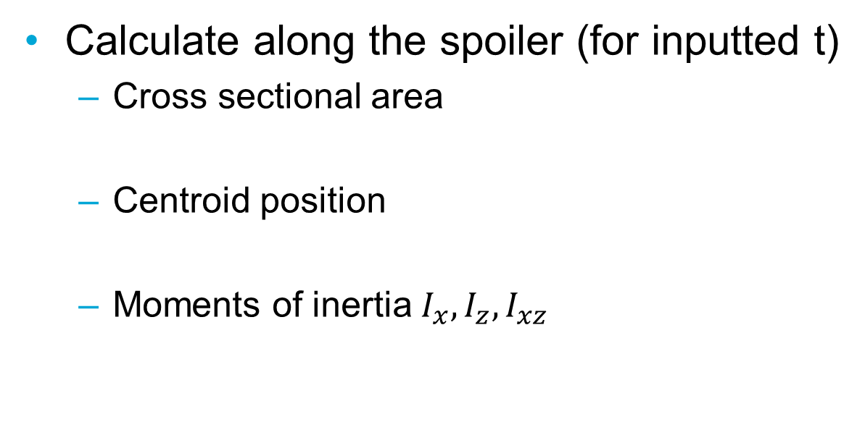
Structural analysis: sectional properties
Calculate along the spoiler (for inputted t)
Cross sectional area
Centroid position
Moments of inertia $I_{x}, I_{z}, I_{xz}$

Slide 8

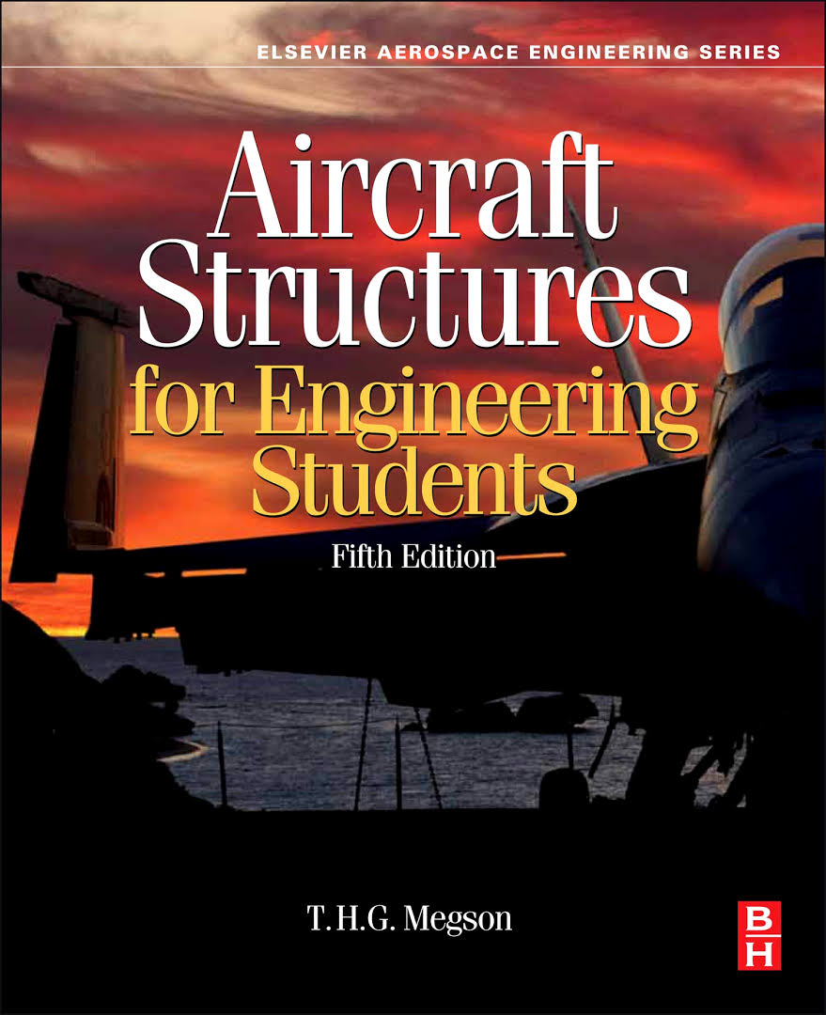
Structural analysis: bending calculations
The spoiler is modelled as a beam using the Euler-Bernouli beam theory.
Bending and shear is calculated using the methods described in Megson.

Slide 9



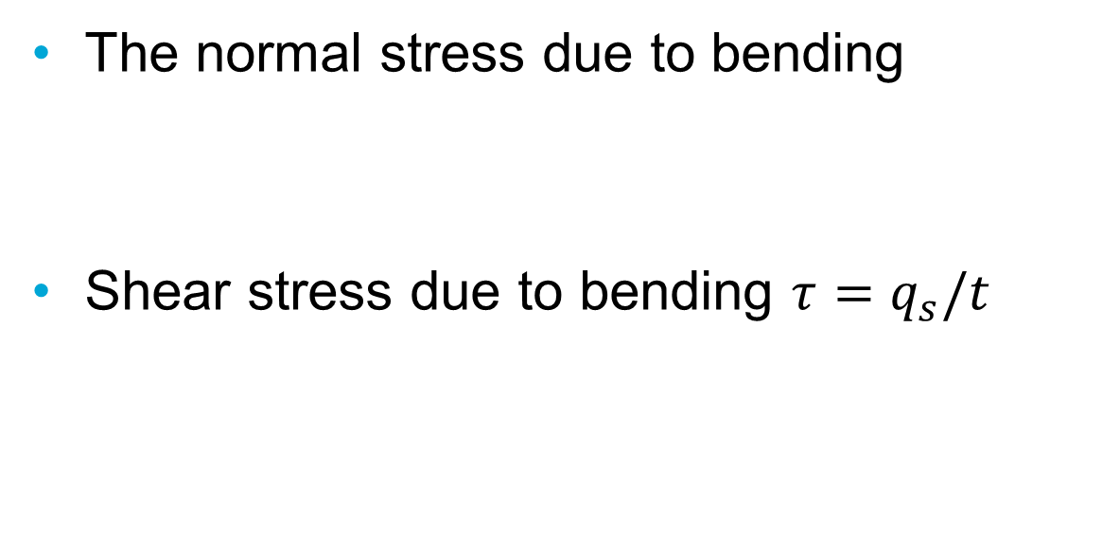
Structural analysis: stress calculations
The normal stress due to bending
Shear stress due to bending $τ=q_{s}/t$

Slide 10
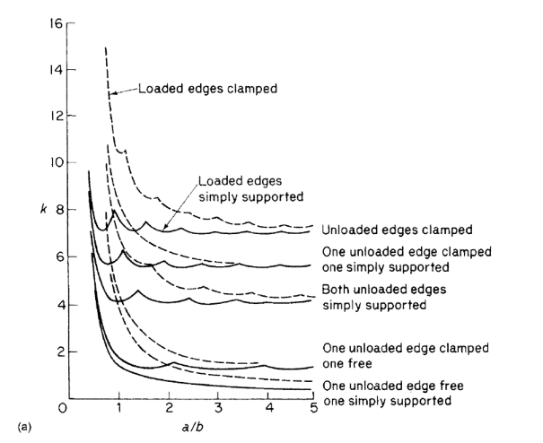

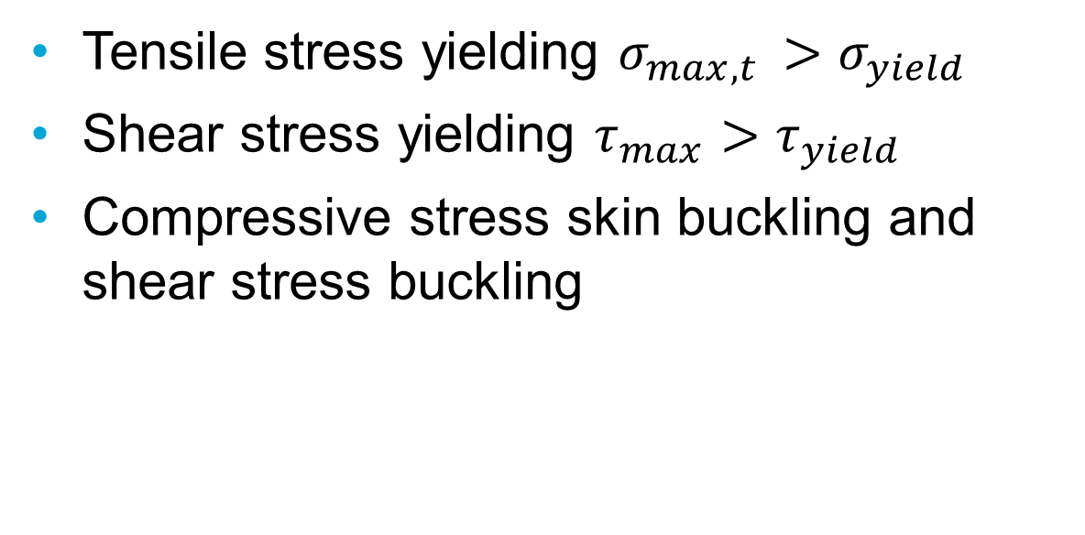
Structural analysis: Failure modes
Tensile stress yielding $σ_{max,t }>σ_{yield}$
Shear stress yielding $τ_{max}>τ_{yield}$
Compressive stress skin buckling and shear stress buckling

Slide 11

Structural analysis: Failure modes cont.
Compressive stress column buckling
Max deflection > 5% of half span

Slide 12
Bibliography
Engineering Mechanics Statics, 14th edition, R.C. Hibbeler.
Aircraft structures for engineering students, 5th edition, T.H.G. Megson.

