Slide 1
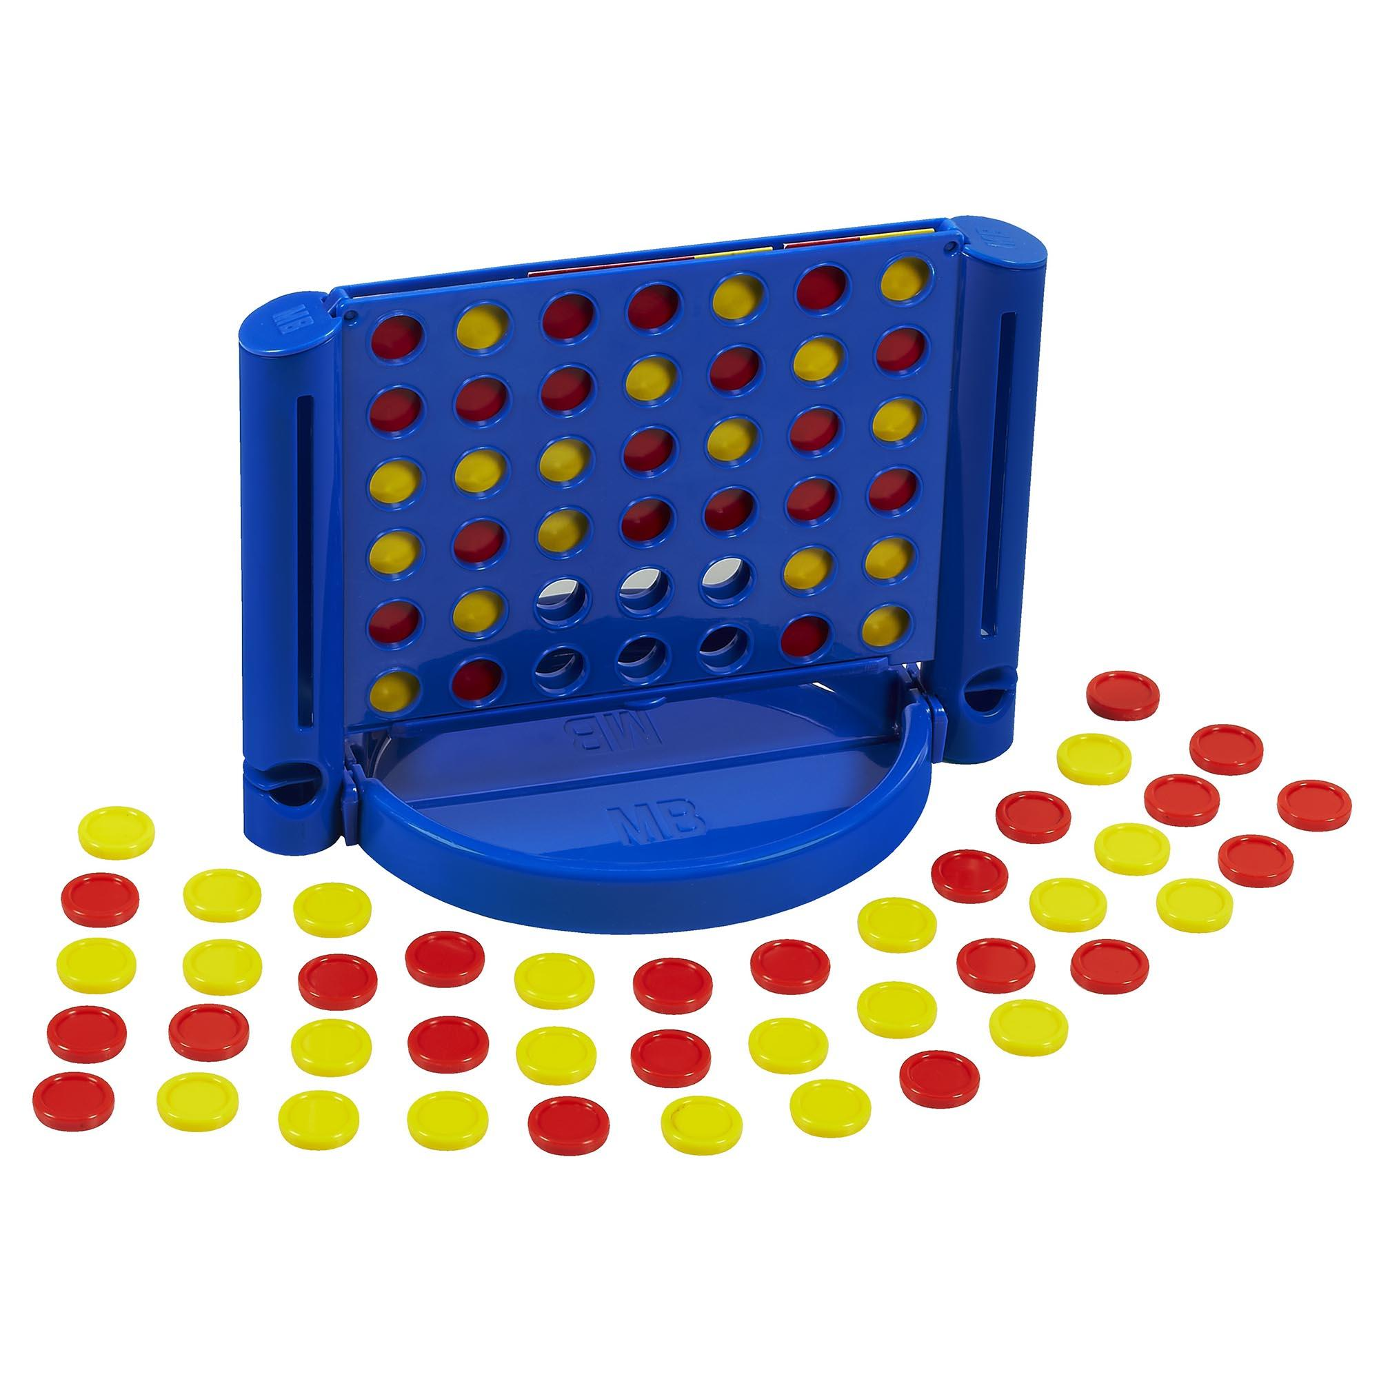
Connect 4
David Betteridge
Notes:
Picture is wrong!

Slide 2
The classic game
One player is red, the other yellow
Players take it in turns to place a counter into a column
Yellow goes first
The first player to get 4 in a row (vertically, horizontally or diagonally) wins
The board is 7 columns by 6 rows
Notes:
Could add animation

Slide 3
Your Challenge
Write a bot to win a game of connect 4
The bot runs on your machine but calls a set of (simple) APIs on the server.
The API calls are made using http GET and POST commands

Slide 4
The Steps
Choose a name (and password) for your team. Then ‘Post’ to Register
Then ‘Get’ the current state of the game. This will include the board and whose turn it is.
If it is your turn then make your move
Repeat from step 2

Slide 5
The API
There is some example code in C# and C++
https://github.com/YorkCodeDojo/Connect4/tree/master/Connect4.ExampleBot
and some details in these slides if you want to start from scratch
Online help (swagger)
http://yorkdojoconnect4.azurewebsites.net/swagger

Slide 6
URLS
View games
http://yorkdojoconnect4.azurewebsites.net/
Documentation
http://yorkdojoconnect4.azurewebsites.net/Swagger
Example
https://github.com/YorkCodeDojo/Connect4/tree/master/Connect4.ExampleBot
APIs
http://yorkdojoconnect4.azurewebsites.net/api/

Slide 7
/api/Register [POST]
Register your team and returns your unique player ID.
Parameters:
TeamName
Password
Returns:
Your player ID
Example
api/Register?teamName=Winners&password=Secret

Slide 8
/api/GameState [GET]
Returns the current state of the game
Parameters:
PlayerID
Returns:
A json object shown on the next slide
Example
api/GameState?playerID=1234567

Slide 9
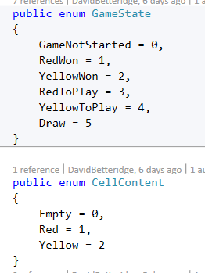
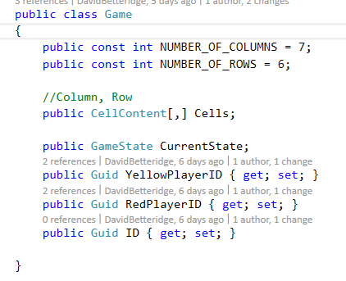
Game Object
Notes:
0,0 is bottom left
7 columns
6 rows

Slide 10
/api/MakeMove [POST]
Places your piece into a column
Parameters:
PlayerID
ColumnNumber
Password
Returns:
Nothing
Example
api/MakeMove?playerID=1234567&ColumnNumber=2&Password=secret

Slide 11
/api/NewGame [POST]
Clears the board
Parameters:
PlayerID
Returns:
Nothing
Example
api/NewGame?playerID=1234567

Slide 12
Techniques
Random Play
Systematic (left to right)
Logical thinking
Minimax
Minimax with Alpha-Beta pruning
Monte Carlo tree search

Slide 13
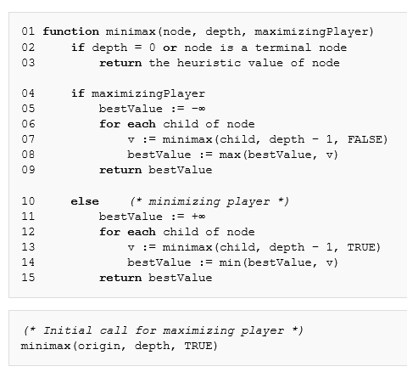
Minimax
Notes:
Each node in the tree is a game position.
For the root node we have 7 possible moves. So we have 7 branches
What is the maximum depth of the tree? 41
Upper bound of the tree size? 7 ^ 41
Draw max/min on different levels
Place values against leaf nodes
Work up

Slide 14
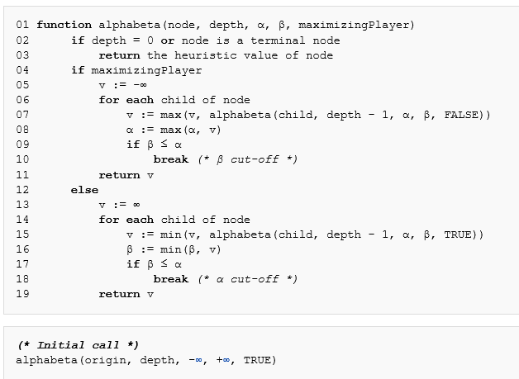
Alphabeta
Notes:
If you get time, then this optomisation will speed up the search dramatically.

Slide 15
Exercises
Pair Up
Play against the server
Show / Contest?
Pub
Notes:
Time permitting

