Slide 1
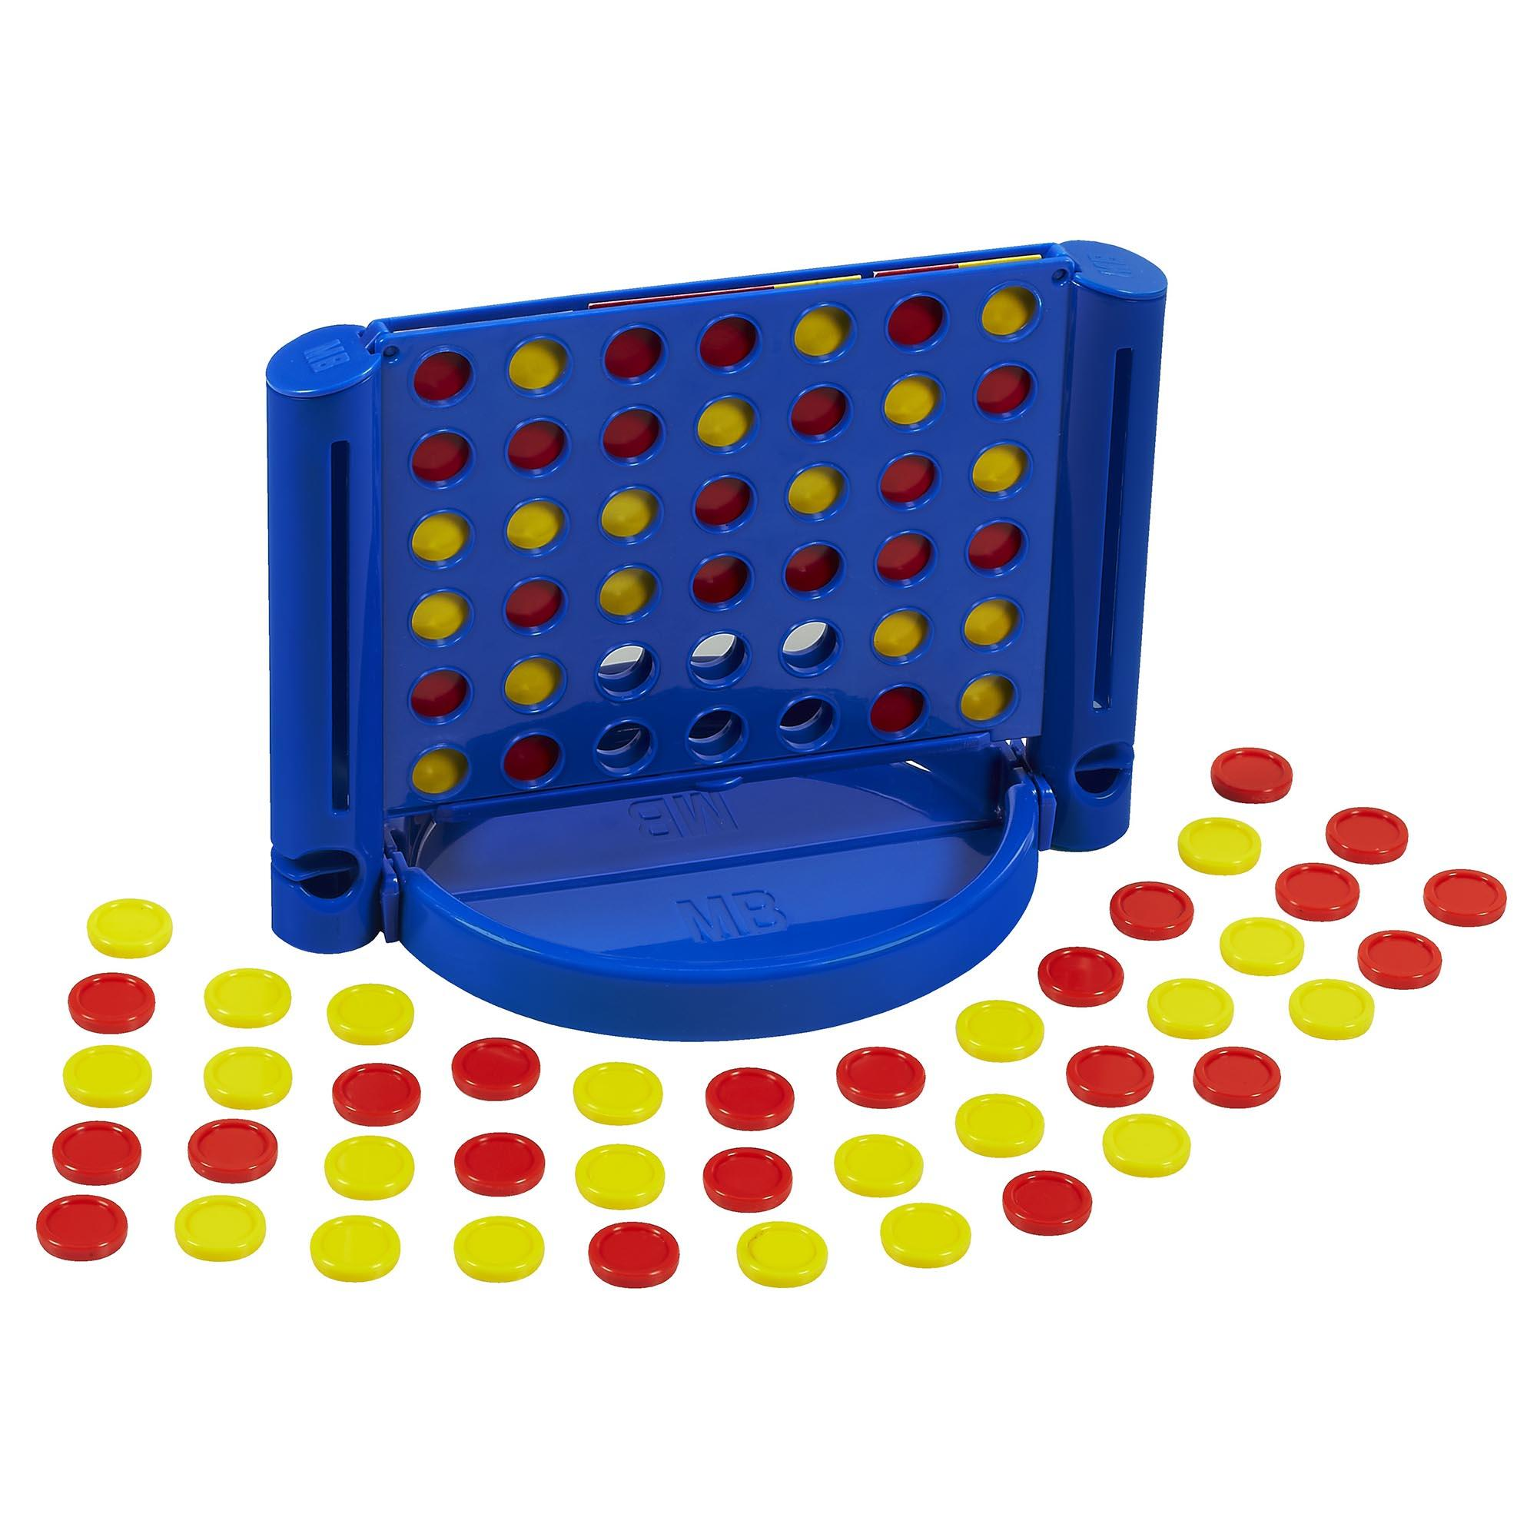
Connect 4
David Betteridge
Notes:
Picture is wrong!

Slide 2
The classic game
Players take it in turns to place a counter
Yellow goes first
The first player to get 4 in a row (vertically, horizontally or diagonally) wins
The board is 7 columns by 6 rows
Notes:
Could add animation

Slide 3
Your Challenge
Write a bot to win a game of connect 4
The bot runs on your machine but calls a set of (simple) APIs on the server.
The API calls are made using html GET and POST commands

Slide 4
The API
Choose a name (and password) for your team. Then ‘Post’ to RegisterTeam
Then ‘Get’ the current state of the game. This will include the board and whose turn it is.
Make your move
Repeat from step 2

Slide 5
The API
There is some example code in C# which hopefully is easy to read
.
and some handouts if you want to start from scratch
Online help (swagger)

Slide 6
Techniques
Random Play
Systematic (left to right)
Logical thinking
Minimax
Minimax with Alpha-Beta pruning
Monte-carlo?

Slide 7
Exercises
Pair Up
Do the exercises
Show and Tell
Pub
Notes:
Suggest you use unit tests

