Slide 1
C++ Slideshow

Slide 2
Agenda
Introduction & Project Overview
Core Features
Supported Shapes & Colors
Project Architecture
OOP Design Patterns Used
Commands & User Interface
File Format & Data Persistence
Image Export Capabilities
Live Demo
Conclusion & Future Work

Slide 3
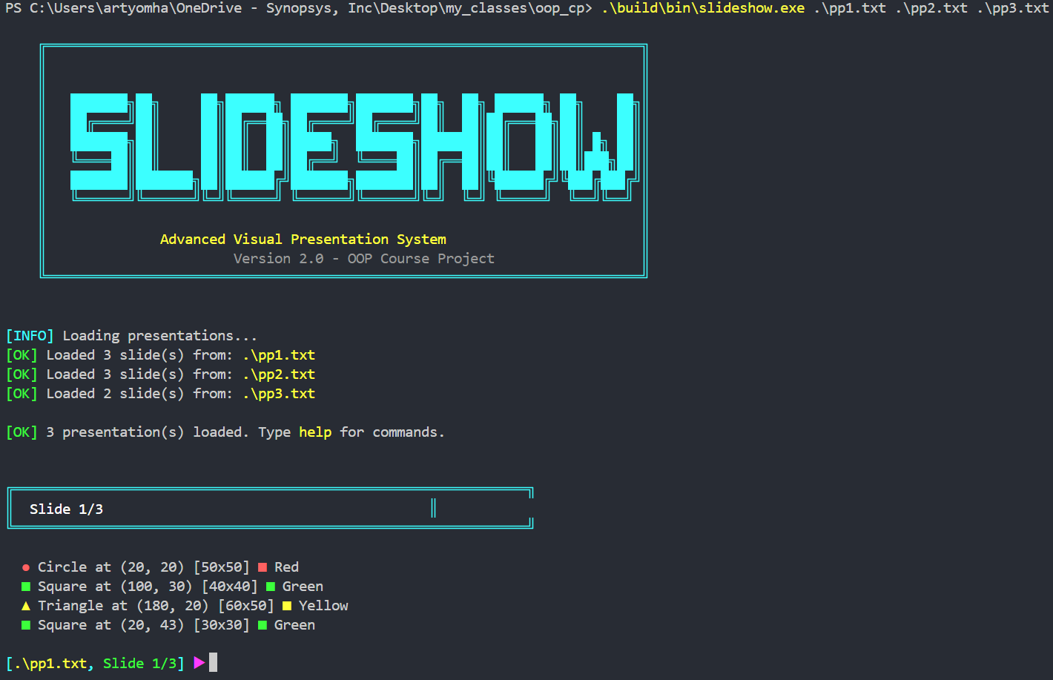
Introduction & Project Overview
Create, view, and manage visual presentations from the terminal
Demonstrate Object-Oriented Programming principles in practice
CMake build system for easy compilation
Real-time ASCII art visualization with colors

Slide 4
Core Features
Visual Rendering: Real-time ASCII art visualization directly in terminal
Full Color Support: 20+ named colors using ANSI escape codes
Image Export: Export to BMP (bitmap) and SVG (vector graphics)
Rich Shape Properties: Color, size, position, border width, fill options
Factory Pattern:Professional shape creation using Factory design pattern
Interactive Editing: Add, edit, delete shapes with intuitive wizard
Multi-Presentation: Load and navigate between multiple presentation files
File Persistence: Save and load presentations from text files

Slide 5
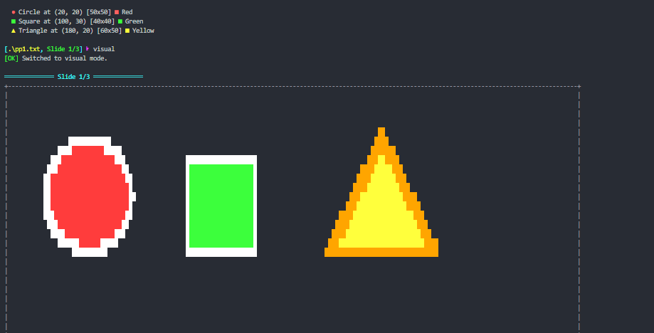
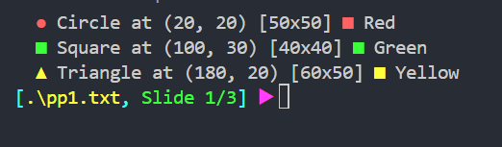
Visual mode output showing colored shapes in terminal
Text mode output showing shape list:

Slide 6
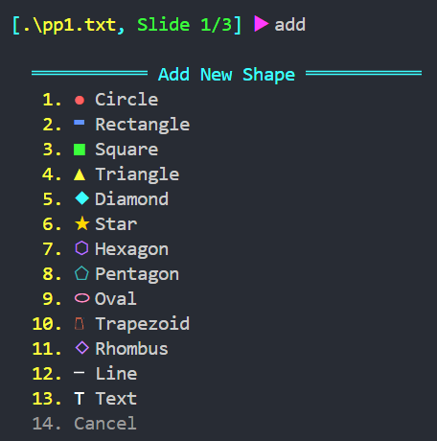
Supported Shapes & Colors
Shape Types Available:
20 Available Colors:
Red, Green, Blue, Yellow, Cyan, Magenta, Orange, Purple, Pink, White, Black, Gray, Brown, Gold, Silver, Navy, Teal, Lime, Coral, Violet

Slide 7
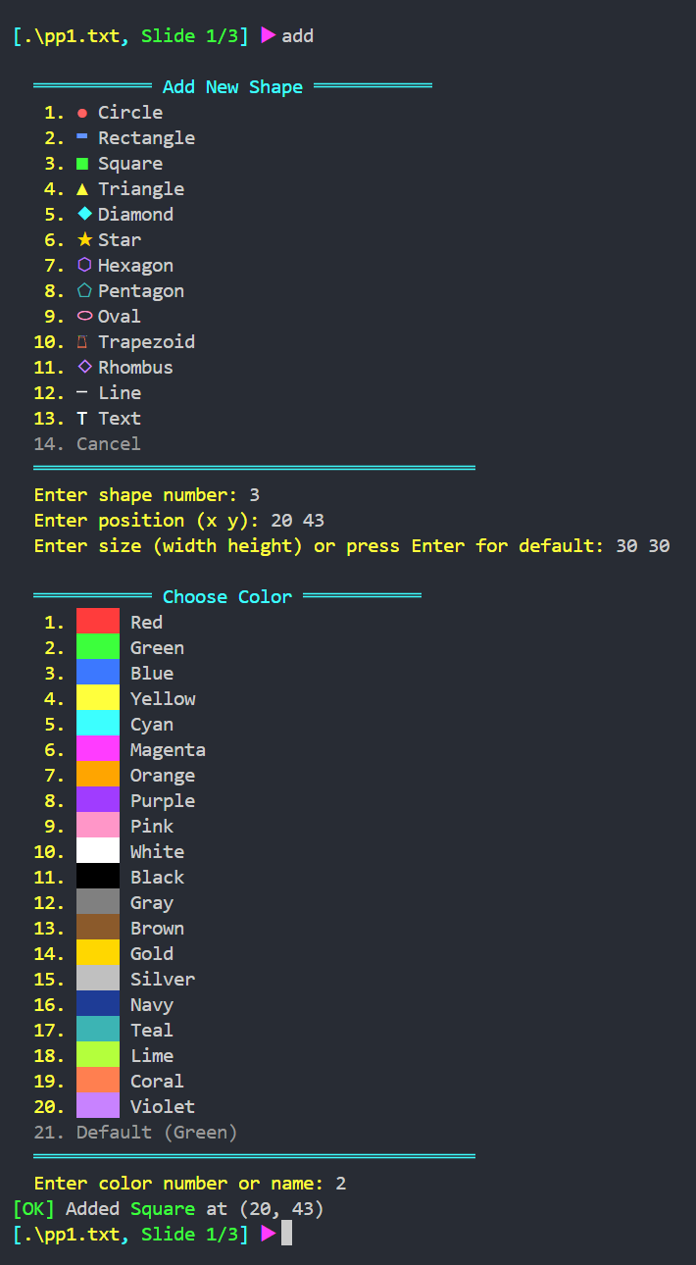
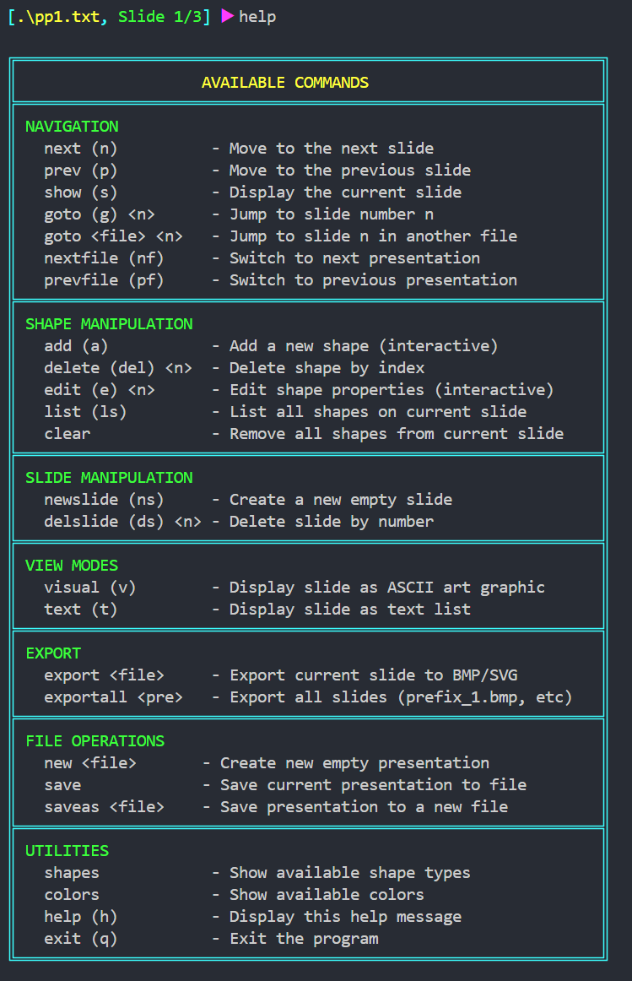
Help and Add Shape

Slide 8
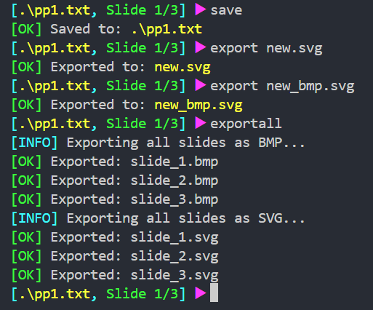

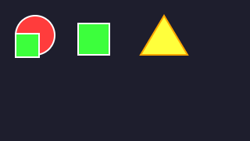
Save and Export
Format | Type | Best For | How to Open
BMP | Bitmap | Windows, quick preview | Double-click
SVG | Vector graphics | Scalable, web, printing | Any browser
slide_1.bmp
slide_1.svg

Slide 9
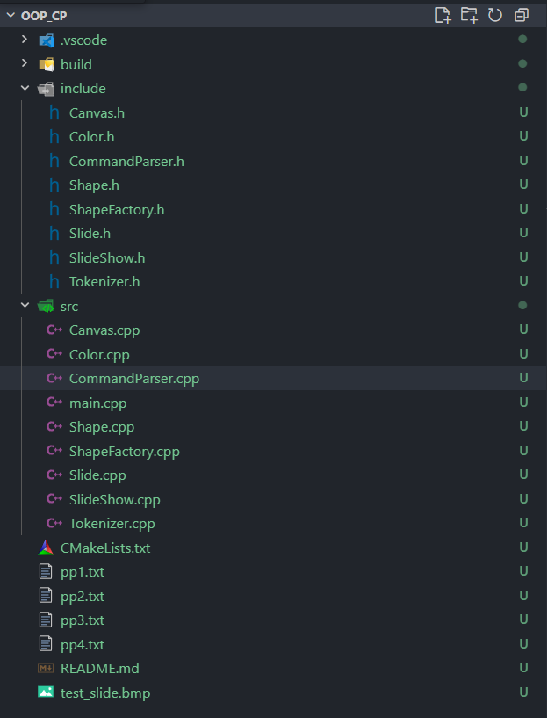
Project Architecture
Key Components:
Shape - Base class for all geometric shapes
Slide - Container holding multiple shapes
SlideShow - Manages multiple slides and presentations
Canvas - Renders shapes to pixels for display/export
ShapeFactory - Creates shape objects from strings
Slideshow
(Manager)
Slide
(Container)
Shape
(Abstract)
Canvas
(Renderer)

Slide 10
ARCHITECTURE
DIAGRAM
USER INPUT
"add circle 50 50 red"
      TOKENIZER
      split() → ["add", "circle", "50", "50", "red"]
      trim() → remove whitespace
      toLower() → case-insensitive
class Circle : public Shape {
public:
Circle(int x, int y, int radius = 20,
const Color& fillColor = Color::Red(),
const Color& borderColor = Color::White(),
int borderWidth = 2, bool filled = true);
void render(Canvas& canvas) const override;
std::string toSVG() const override;
std::string getAsciiIcon() const override;
std::unique_ptr<Shape> clone() const override;
int getRadius() const { return width / 2; }
};
  COMMAND PARSER
  parse("add circle...") → Command { type: ADD, args: [...] }
  Supports aliases: n→next, p→prev, g→goto
SHAPE FACTORY
    create("circle", params) → std::unique_ptr<Circle>
    Uses std::map with lambda creators
SHAPE HIERARCHY
Shape (Abstract)
virtual render(), toSVG(), clone()
Circle Rectangle Star Triangle ... (13 types)

Slide 11
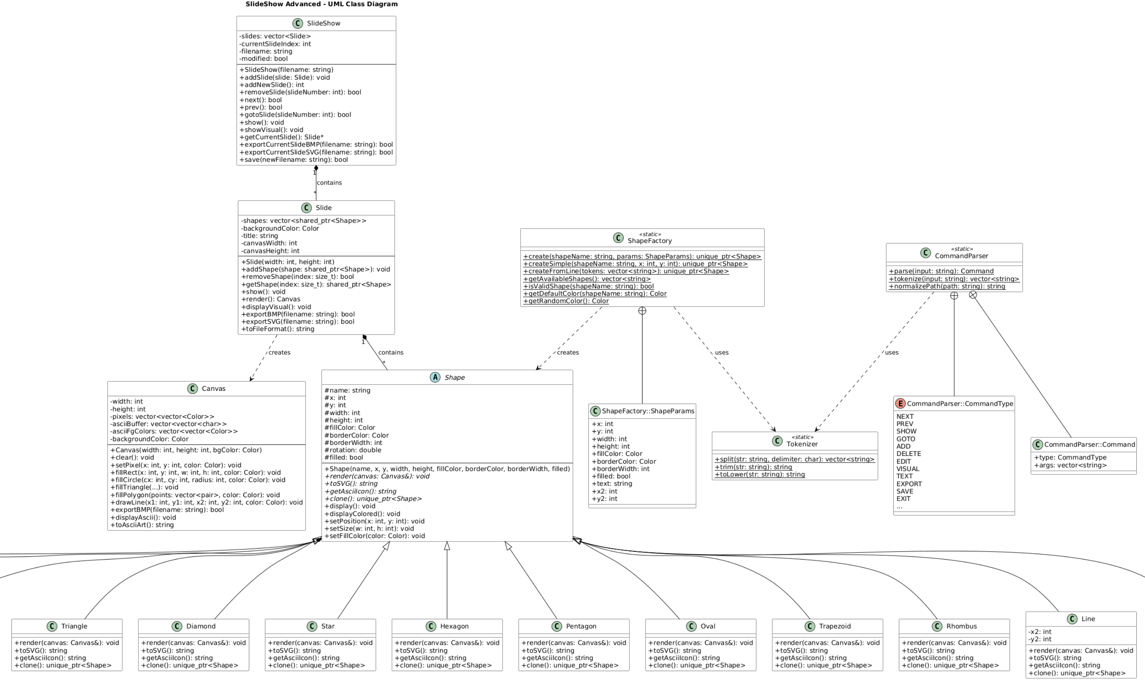
UML DIAGRAM

Slide 12
Thank you
Artyom Hakobyan
Artyom.Hakobyan.2003.23@gmail.com

