Slide 1








PBL MENGGUNAKAN KONSEP OOP DAN MVC
PROJECT BASE
LEARNING ( KEL 1 )
Group 1 : SchedU : Web ApplicationPlatform for Schedule Reminder
Alif Fajriadi ( Leader ) – 3312401103
Bastian Henriko L – 3312401092
Dwiky Putra Dachi - 3312401086
Rafif Ihsaan Syawaly - 3312401095

Slide 2


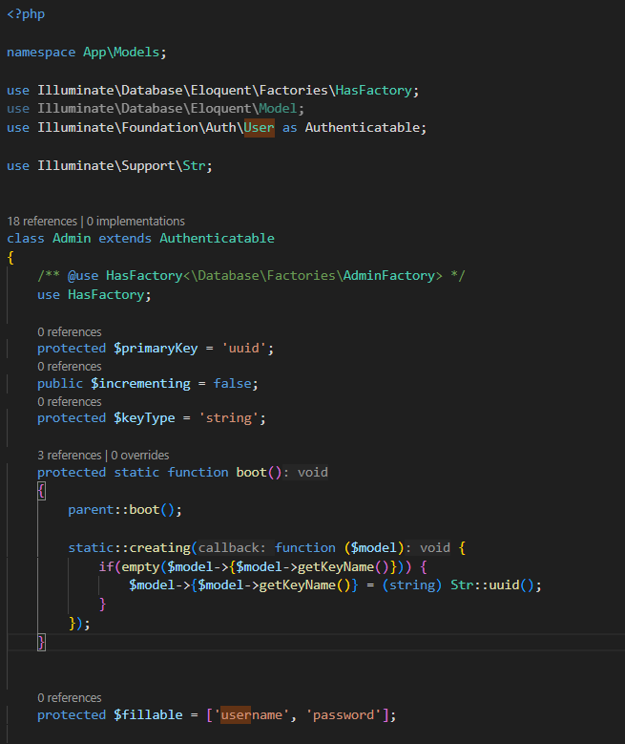
Class Admin
PBL MENGGUNAKAN KONSEP OOP DAN MVC
PROJECT BASE
LEARNING ( KEL 1 )
Group 1 : SchedU : Web ApplicationPlatform for Schedule Reminder
Class | Property | Method | Objek
Admin | uuid (primary key, UUID otomatis), username, password | - Boot method untuk generate UUID otomatis | $admin1 = new Admin()
Alif Fajriadi ( Leader ) – 3312401103
Bastian Henriko L – 3312401092
Dwiky Putra Dachi - 3312401086
Rafif Ihsaan Syawaly - 3312401095

Slide 3





Class Admin
PROJECT DESCRIPTION
GENERAL DESCRIPTION
SchedU is a web application designed to simplify academic schedule management and collaboration between admins, staff, teachers, and students in schools. The project aims to improve the efficiency of managing academic schedules, assignments, and activities, as well as facilitate communication and collaboration between users.
Class | Property | Method | Objek
Admin | uuid (primary key, UUID otomatis), username, password | - Boot method untuk generate UUID otomatis | $admin1 = new Admin()
SchedU is a web-based application designed to facilitate schedule management and academic collaboration in a school environment. This application provides various features that allow admins, staff, teachers, and students to interact according to their roles in the system.

Slide 4

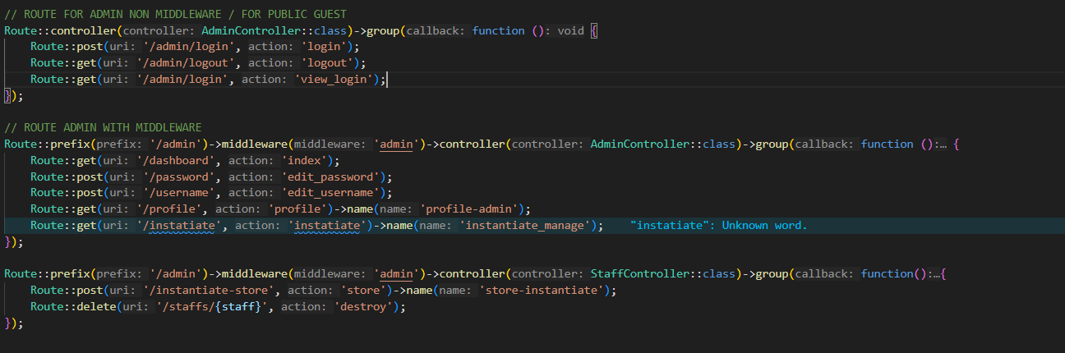

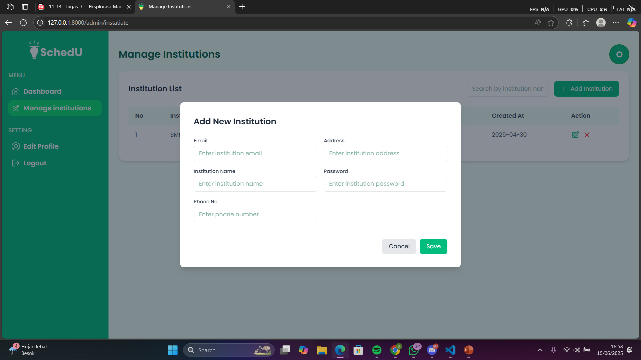

Kode Program PHP
Hasil Program

Slide 5
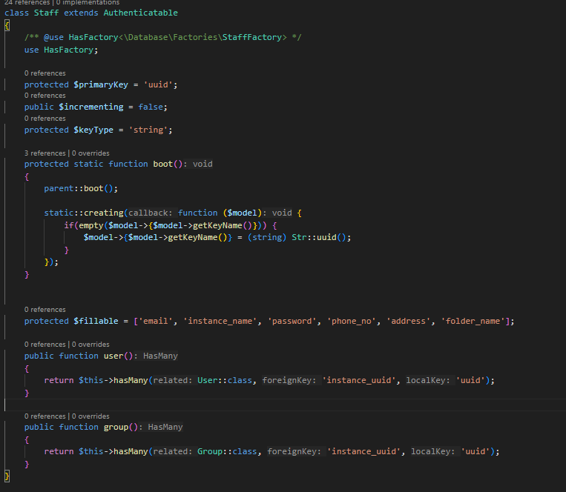
Class Staff
PROJECT DESCRIPTION
GENERAL DESCRIPTION
Class | Property | Method | Objek
Staff | uuid, email, instance_name, password, phone_no, address, folder_name | user(), group() → relasi ke model lain menggunakan Eloquent | $staff = Staff::find($id) (digunakan di controller untuk dashboard)
SchedU is a web application designed to simplify academic schedule management and collaboration between admins, staff, teachers, and students in schools. The project aims to improve the efficiency of managing academic schedules, assignments, and activities, as well as facilitate communication and collaboration between users.
SchedU is a web-based application designed to facilitate schedule management and academic collaboration in a school environment. This application provides various features that allow admins, staff, teachers, and students to interact according to their roles in the system.

Slide 6
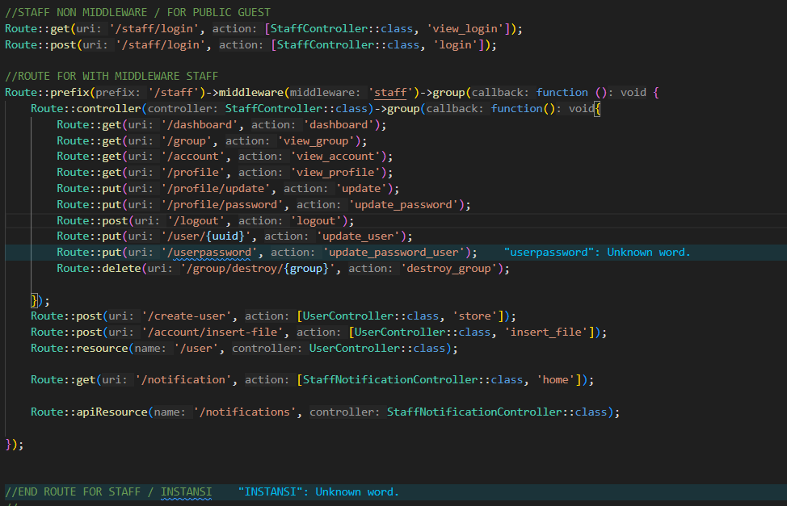
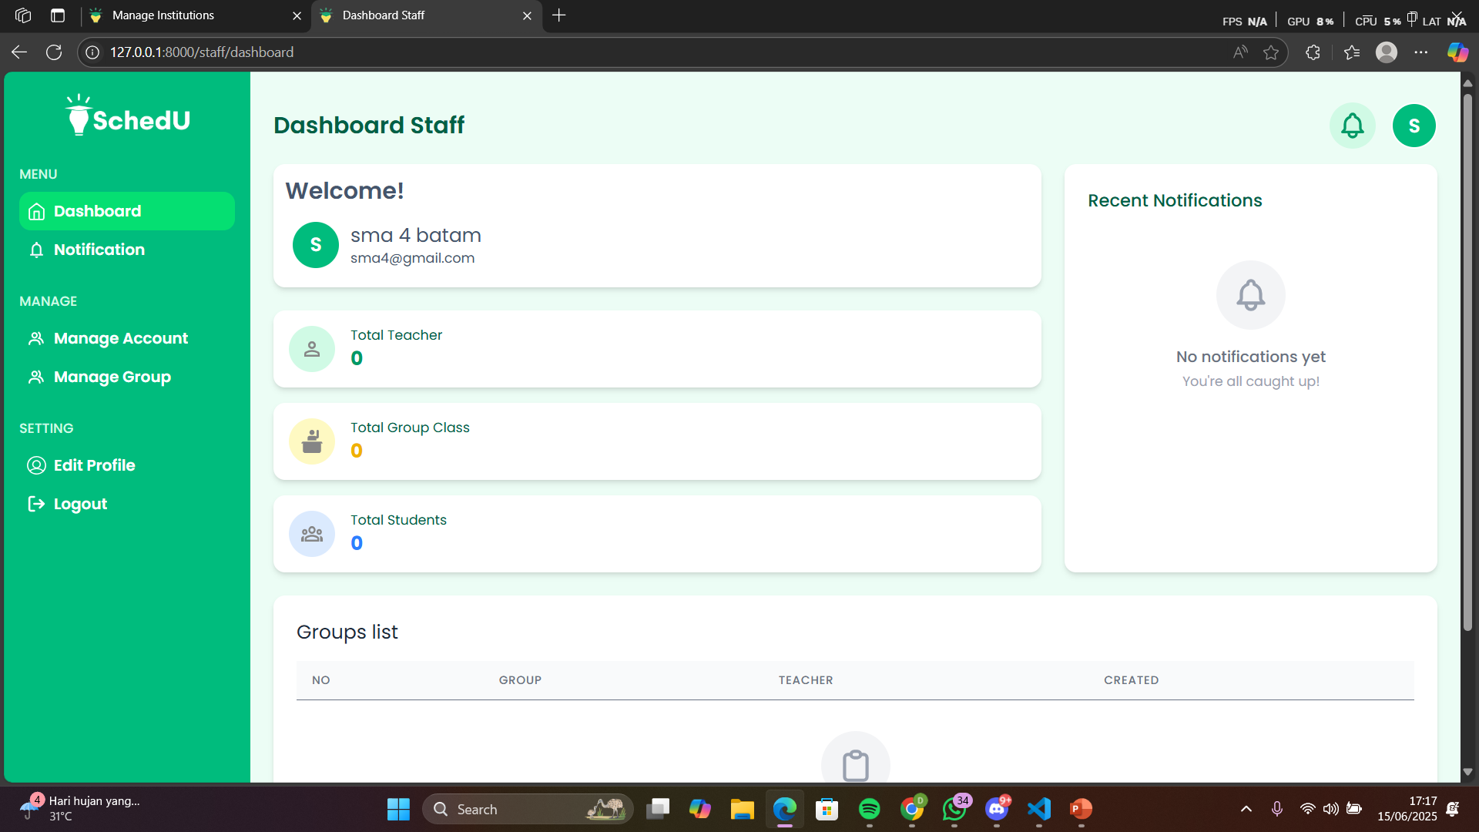
Kode Program PHP
Hasil Program

Slide 7
Class User
PROJECT DESCRIPTION
Class | Property | Method | Objek
User | uuid, name, email, password, gender, birth_date, is_teacher, instance_uuid, profile_pic | instance(), note(), make_note(), notification(), member_of() | $user = User::find($uuid) atau $staff->user → relasi dari Staff ke User
GENERAL DESCRIPTION
SchedU is a web application designed to simplify academic schedule management and collaboration between admins, staff, teachers, and students in schools. The project aims to improve the efficiency of managing academic schedules, assignments, and activities, as well as facilitate communication and collaboration between users.
SchedU is a web-based application designed to facilitate schedule management and academic collaboration in a school environment. This application provides various features that allow admins, staff, teachers, and students to interact according to their roles in the system.

Slide 8
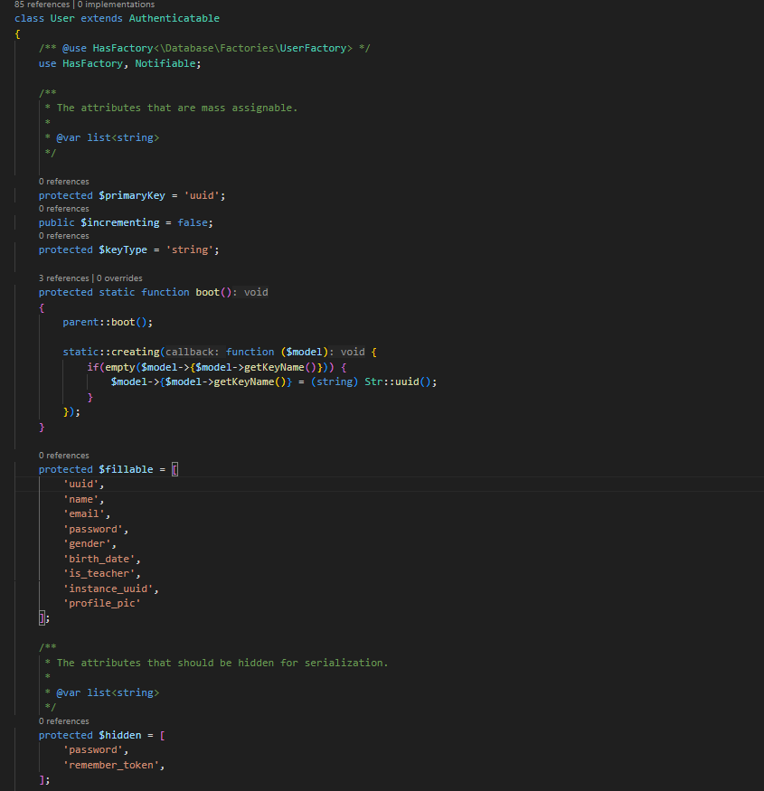
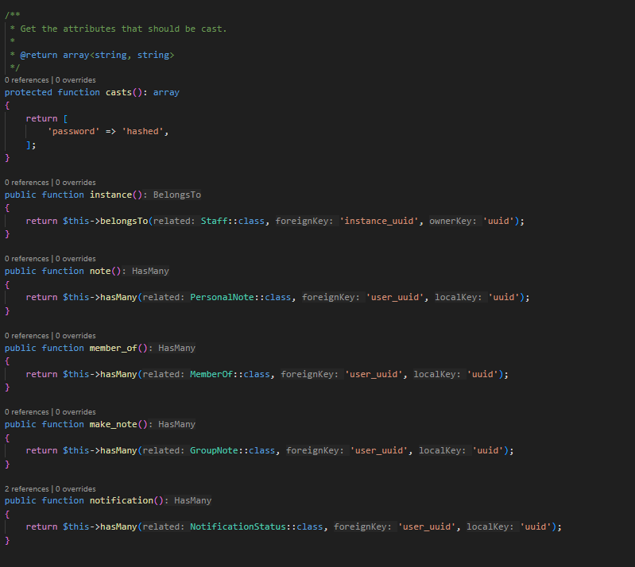
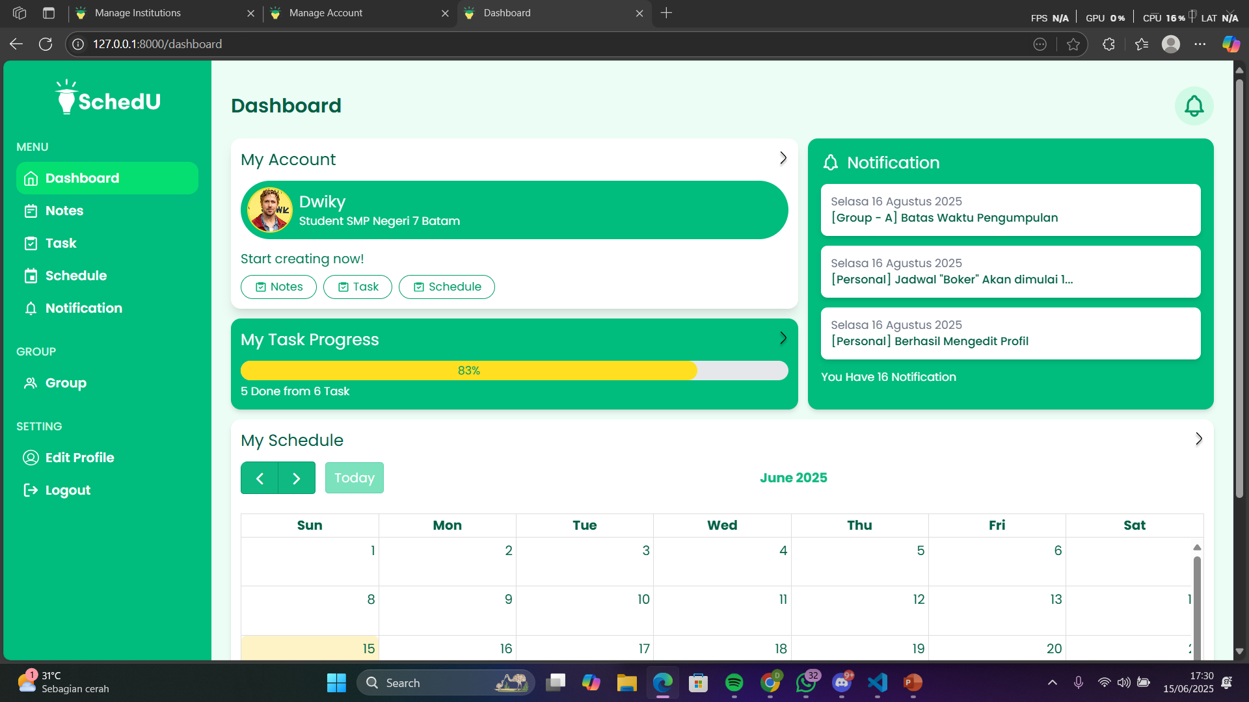
Kode Program PHP
Hasil Program

Slide 9

Kode Program PHP
Hasil Program
BAGIAN 2

Slide 10
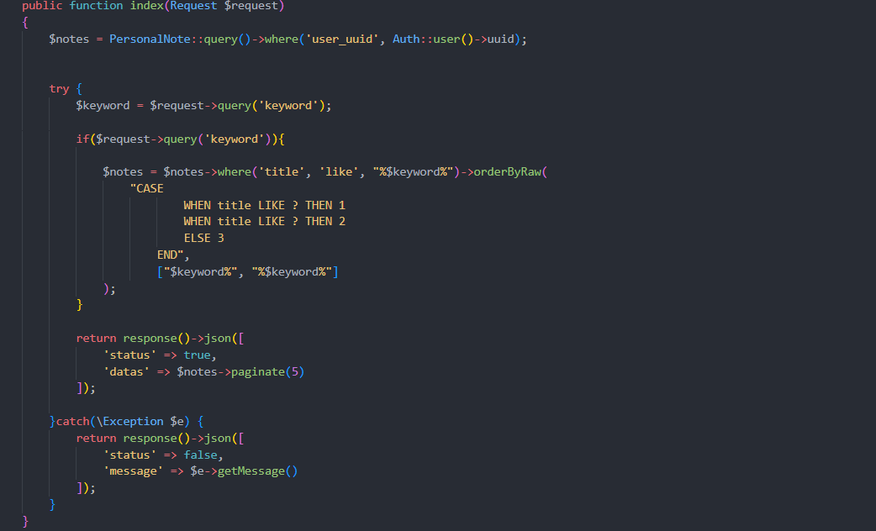


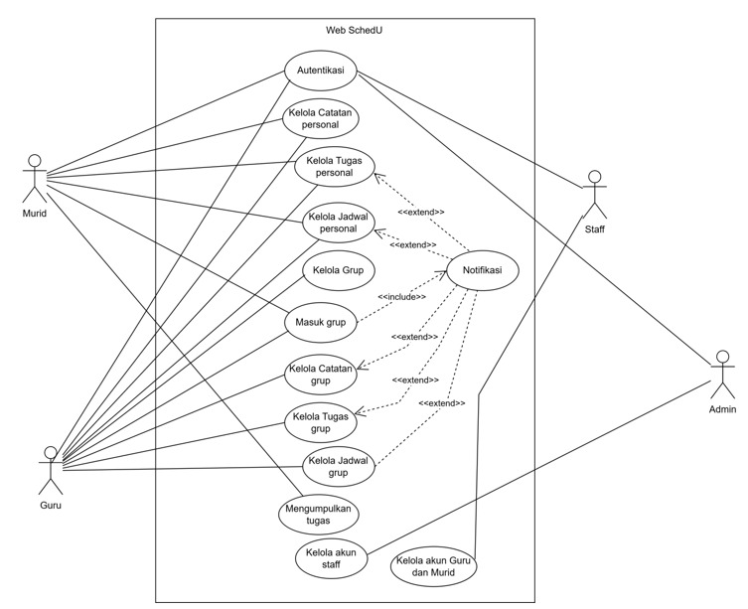




Controller: PersonalNoteController.php
Controller akan mengambil semua catatan dari database menggunakan model Note, lalu mengirimnya ke view Notes.blade.php
FUNGTIONAL REQRUITMENTS
FUNCTIONAL REQRUITMENTS
PROJECT DESCRIPTION
BAGIAN 2
GENERAL DESCRIPTION
SchedU is a web application designed to simplify academic schedule management and collaboration between admins, staff, teachers, and students in schools. The project aims to improve the efficiency of managing academic schedules, assignments, and activities, as well as facilitate communication and collaboration between users.
SchedU is a web-based application designed to facilitate schedule management and academic collaboration in a school environment. This application provides various features that allow admins, staff, teachers, and students to interact according to their roles in the system.

Slide 11





NOTES
Controller: PersonalNoteController.php
Controller akan mengambil semua catatan dari database menggunakan model Note, lalu mengirimnya ke view Notes.blade.php
NoteController show mengambil detail catatan berdasarkan id, lalu menampilkan isi catatan lewat notes-detail.blade.php.
BAGIAN 2
4
3
5
2
The source code is structured, understandable, maintainable and easily reusable.
The application interface uses English or Indonesian.
The user interface is friendly, intuitive, responsive and easy to navigate.
1

Slide 12

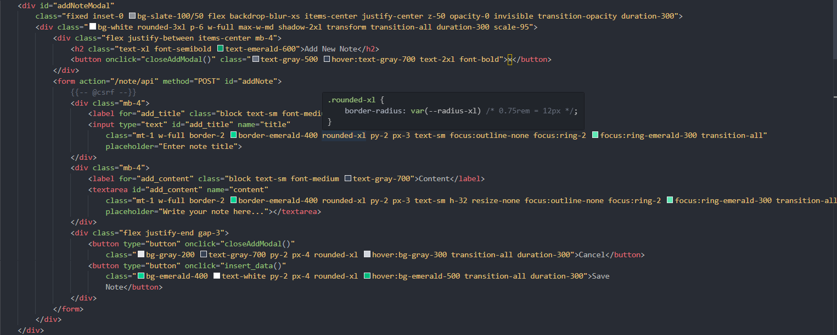


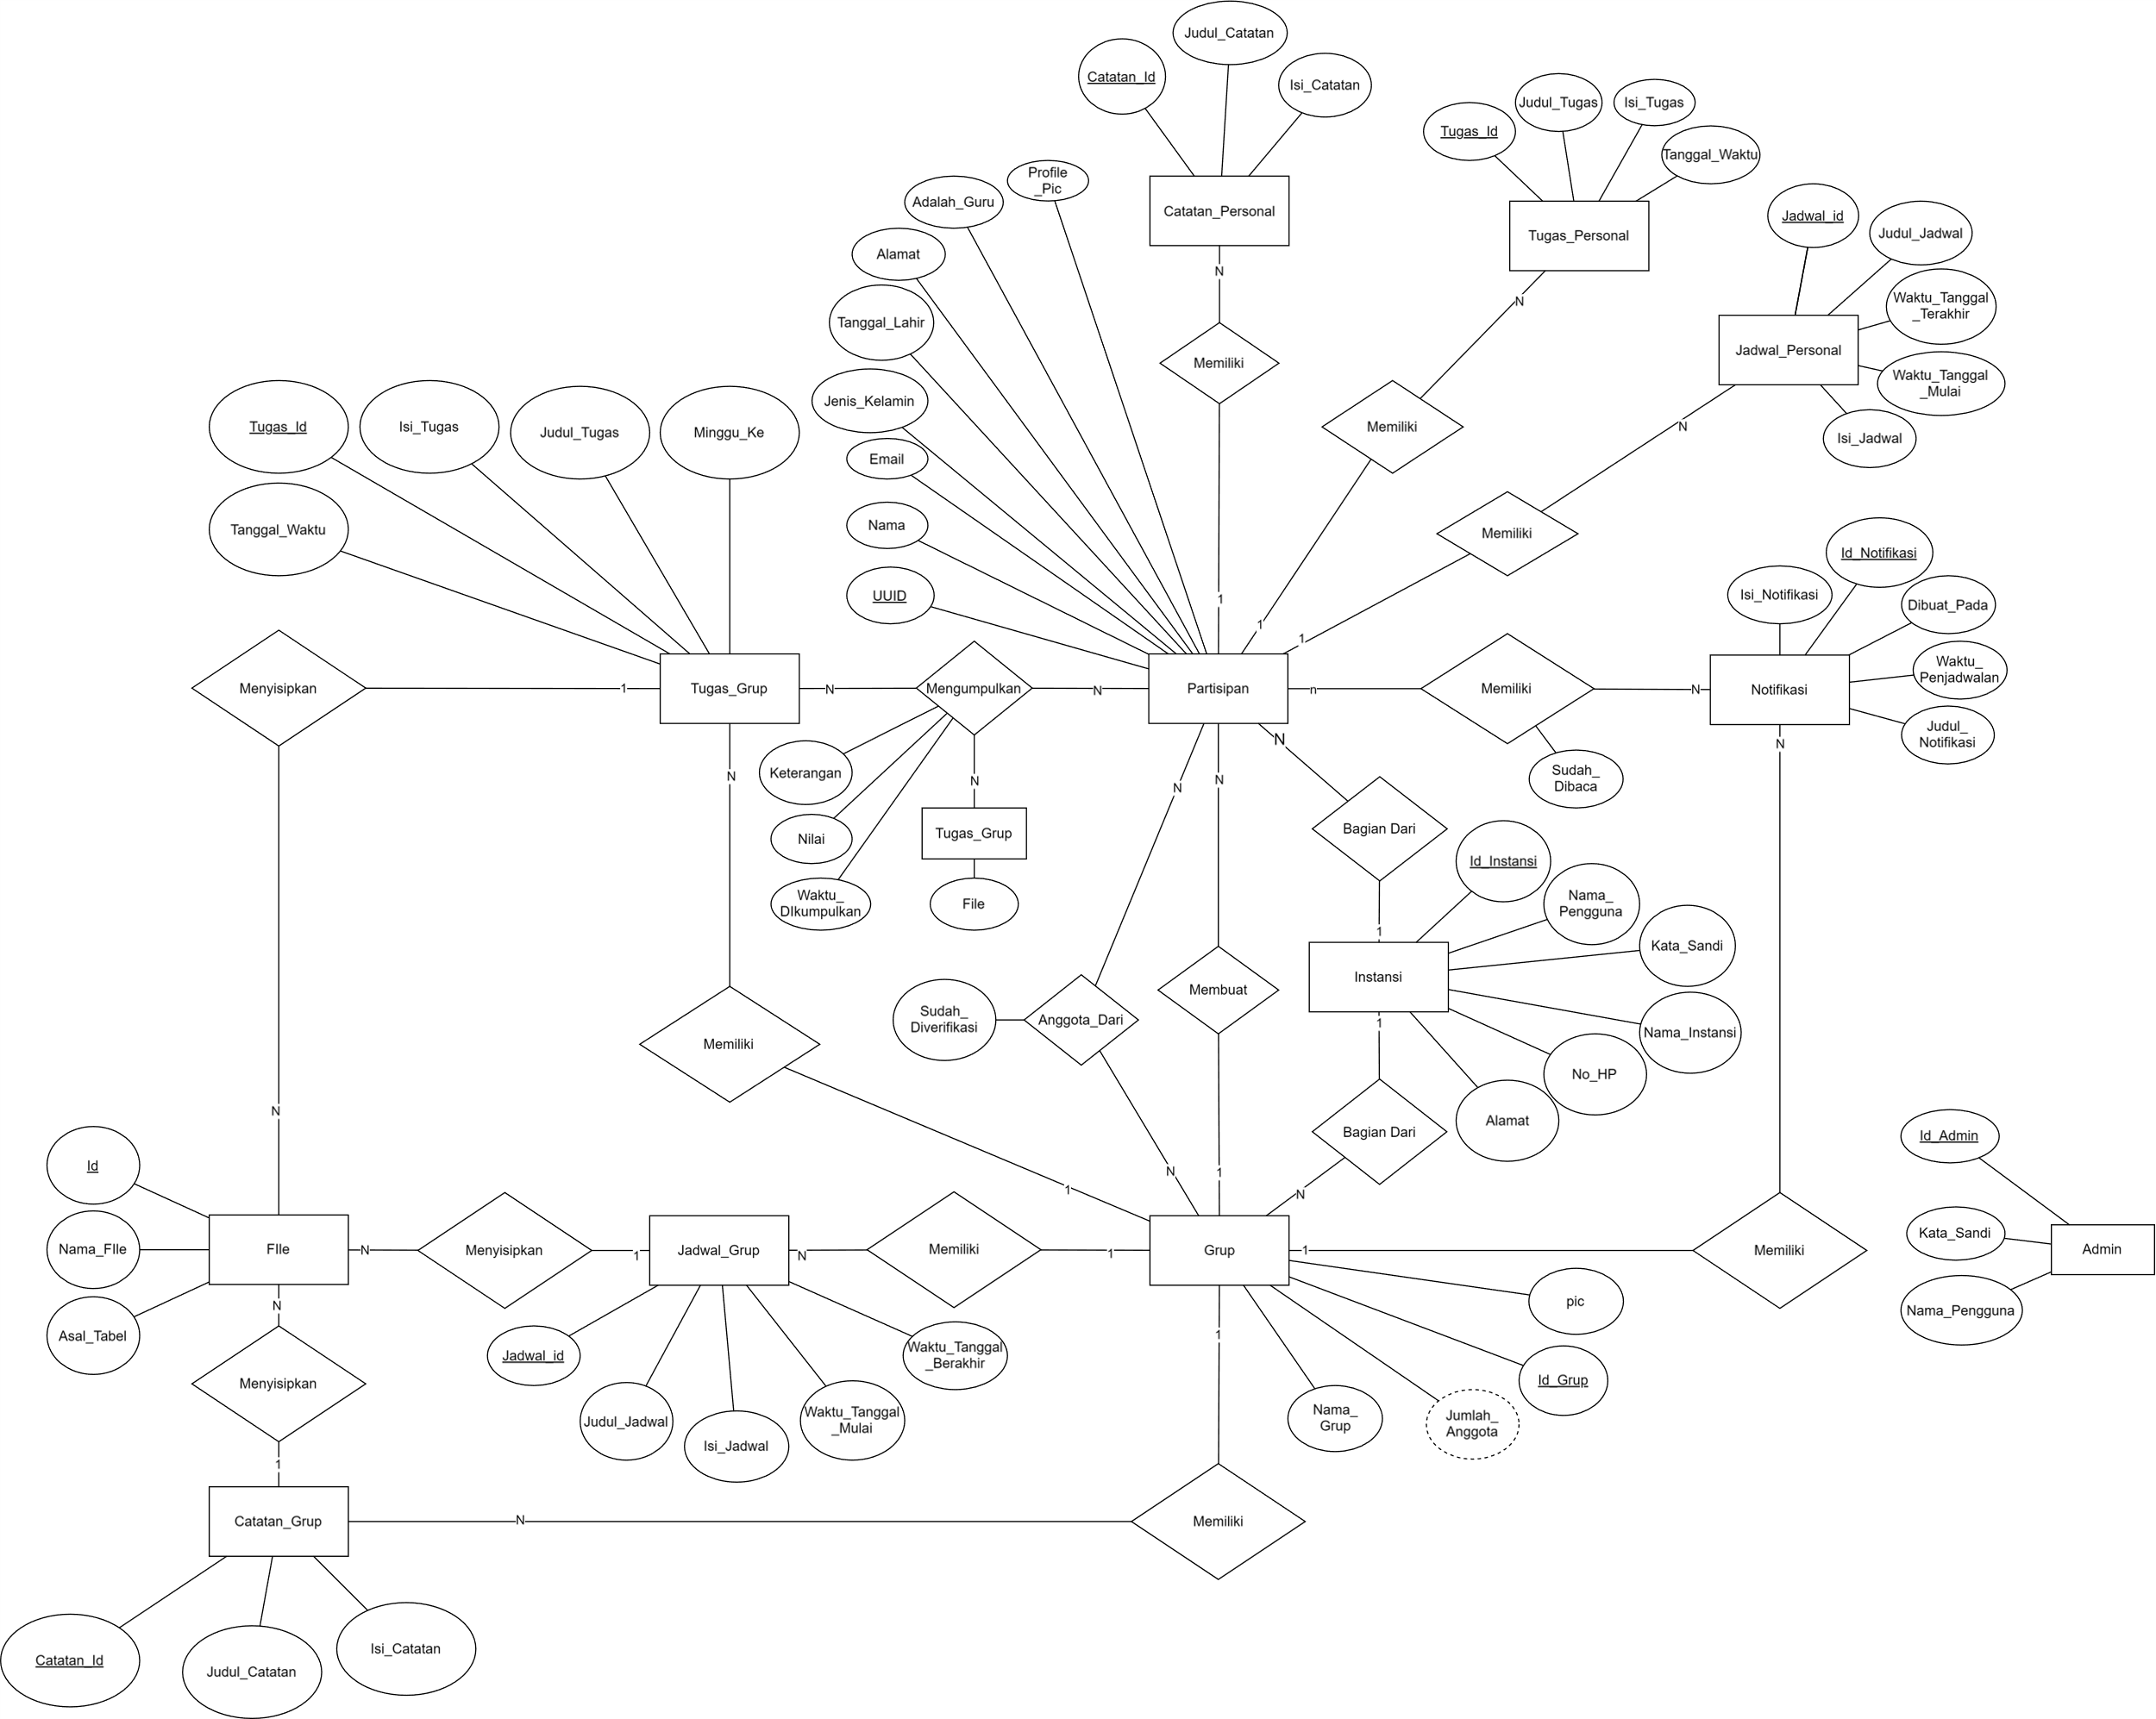
FUNCTIONAL REQRUITMENTS
DATABASE DESIGN
NOTES
Model: Notes.blade.php
4
3
5
Di halaman notes.blade.php, daftar judul catatan ditampilkan. Jika diklik, akan diarahkan ke NoteController show
2
1

Slide 13

NOTES
Controller: PersonalNoteController.php
Controller akan mengambil semua catatan dari database menggunakan model Note, lalu mengirimnya ke view Notes.blade.php
NoteController show mengambil detail catatan berdasarkan id, lalu menampilkan isi catatan lewat notes-detail.blade.php.

Slide 14
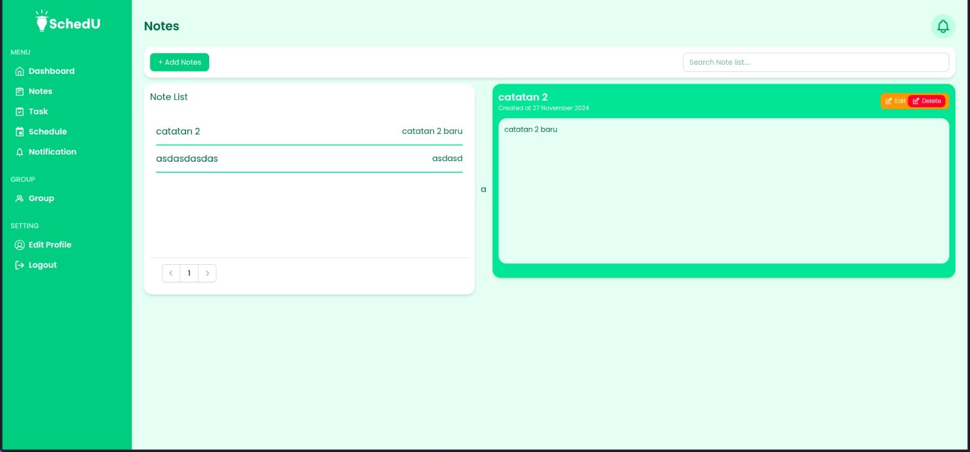




HASIL PROGRAM NOTES
THANK YOU!
For your attention

Slide 15

Next project plans and stages
Creating backend logic for the application, implementing the entire database, creating poster designs, creating demo videos for the application, overall completion and testing.
THANK YOU!
For your attention

