Slide 1
Plant Disease Detection using Convolutional Neural Networks
ROHINI S (211417104226)
PADMASHREE M (211417104176)
PROJECT GUIDE
S.T.SANTHANALAKSHMI M.Tech(IT).
ASSISTANT PROFESSOR (GRADE I)
DOMAIN : DEEP LEARNING

Slide 2
Introduction
Crop cultivation plays an essential role in the agricultural field. Presently, the loss of food is mainly due to infected crops, which reflexively reduces the production rate. To identify the plant diseases at an untimely phase is not yet explored.
The main challenge is to reduce the usage of pesticides in the agricultural field and to increase the quality and quantity of the production rate. Proposed system explore the leaf disease prediction at an untimely action.
The enhanced CNN algorithm to predict the infected area of the leaves. A color based segmentation model is defined to segment the infected region and placing it to its relevant classes.
Experimental analyses were done on samples images in terms of time complexity and the area of infected region. Plant diseases can be detected by image processing technique. Disease detection involves steps like image acquisition, image pre-processing, image segmentation, feature extraction and classification.

Slide 3
Literature Survey
S.NO | TITLE | YEAR | AUTHOR | JOURNAL | DESCRIPTION | OUTCOME
1 | A Framework for Detection and Classification of Plant Leaf and Stem Diseases | 2010 | D.A. Bashish, et.a | International conference | The k-means clustering gives greater efficiency when applied on large datasets hence it was used for segmentation in this paper. The color histogram of two images has been compared using sum of squared distances. Morphology is useful for boundary extraction or the shape vector. CCV is used for comparing images having spatial information. In this work, SVM is used for classification | The overall system disease detection and classification accuracy was found to be around 93%. Whereas, the best overall average accuracy of 99.66% was achieved using HS color features in BPNN. The following texture oriented features were found, angular moment, mean intensity level, variance, correlation, product moment, contrast and entropy.
 |  |  |  |  |  | Using SVM, the authors were able to achieve 82% overall system accuracy. The training time of Support vector machine is slow but they are highly accurate. As a result, three feature vectors were obtained i.e., one for color histogram, morphology and CCV each

Slide 4
S.NO | TITLE | YEAR | AUTHOR | JOURNAL | DESCRIPTION | OTCOMES
2 | Smart Farming: Pomegranate Disease Detection Using Image Processing | 2015 | M.Bhange et.al | International conference | The k-means clustering gives greater efficiency when applied on large datasets hence it was used for segmentation in this paper. The color histogram of two images has been compared using sum of squared distances. Morphology is useful for boundary extraction or the shape vector. CCV is used for comparing images having spatial information. In this work, SVM is used for classification | Using SVM, the authors were able to achieve 82% overall system accuracy. The training time of Support vector machine is slow but they are highly accurate. As a result, three feature vectors were obtained i.e., one for color histogram, morphology and CCV each.

Slide 5
S.NO | TITLE | YEAR | AUTHOR | JOURNAL | DESCRIPTION | OUTCOMES
3 | Detection of Plant Leaf Diseases Using Image Segmentation and Soft Computing Techniques | 2019 | V. Singh et.al | International conference | For performing clustering, the search capability of genetic algorithm has been used, to separate unlabeled points of N-dimension into K clusters. In CCM methodology, both texture and color of an image have been considered. The minimum distance criterion was used in two methods i.e. one with kmeans clustering and the other with Genetic algorithm. | Texture features included Local homogeneity, contrast, cluster shade, energy and cluster prominence which are computed for the H image. The minimum distance criterion with k-mean clustering gave an accuracy of 86.54% and with SVM the accuracy was 95.71%. Using Genetic Algorithm along with the minimum distance criterion increased the accuracy to 93.63%.

Slide 6
S.NO | TITLE | YEAR | AUTHOR | JOURNAL | DESCRIPTION | OUTCOMES
4 | Identification of plant disease infection using soft-computing: Application to modern botany | 2016 | E.Kiani et.al | International conference | The algorithm has five inputs and two outputs. Two of the inputs refer to the iron deficiency and the remaining refers to fungal infection. The outputs refer to the two diseases if the leaf is diseased. | The authors of this work were able to achieve an overall system accuracy of 96% using the proposed algorithm

Slide 7
S.NO | TITLE | YEAR | AUTHOR | DESCRIPTION | JOURNAL | OUTCOMES
5 | Symptom based automated detection of citrus diseases using color histogram and textural descriptors | 2012 | H. Ali et.al | The delta E color difference based algorithm calculates the distance between two colors. LBP (local binary patterns), RGB histogram and HSV histogram features are used for feature extraction. | International conference | In RGB histogram, we get the rotation invariance. In HSV histogram as feature, we get the illumination invariance caused due to different lightning conditions

Slide 8
S.NO | TITLE | YEAR | AUTHOR | DESCRIPTION | JOURNAL | OUTCOME
6 | Plant Disease Detection and its Solution using Image Classification | 2018 | G. Saradhambal, et.al | The Otsu’s algorithm assumes image to contain two classes of pixels i.e. it forms bimodal histogram with the foreground and background pixels. For feature extraction, shape and texture oriented features were used. | International conference | The shape oriented features used were area, color axis length, eccentricity, solidity and perimeter whereas, contrast, correlation, energy, homogeneity and mean were the texture oriented feature

Slide 9
Existing System
The existing system can only identify the type of diseases which affects the leaf. Its not efficient. Result will be provided within fraction of seconds and guided throughout the project.
Samples of 1000 images are collected that comprised of different plant diseases like Alternaria Alternata, Anthracnose, Bacterial Blight, Cercospora leaf spot and Healthy Leaves. Different number of images is collected for each disease that was classified into dataset and input images.
Proposed System
Plant diseases are detected and the solutions to recover from the leaf diseases will be provided. The affected part of the leaf are shown by image processing technique

Slide 10
SYSTEM CONFIGURATION
HARDWARE SYSTEM CONFIGURATION
Processor - Intel Core i3
RAM - 4 GB
Hard Disk - 500 GB
SOFTWARE SYSTEM CONFIGURATION
Operating System - Windows 7/8/10
Programming Language : Python

Slide 11
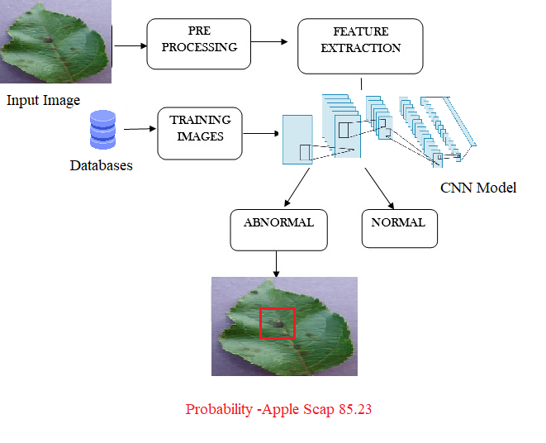
Architecture Diagram

Slide 12
USECASE DIAGRAM
USER
Input or image
Vein segmentation
Central plate extraction
CNN Model
Comparing the image
Revert plate extraction
Identify the plant

Slide 13
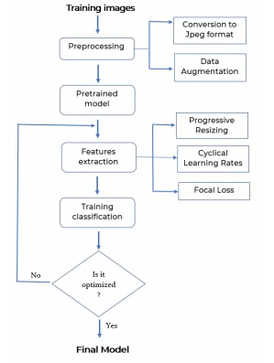
Flow diagram

Slide 14
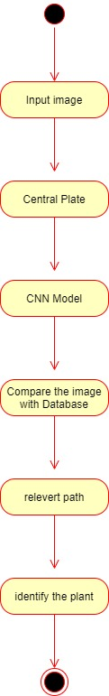
Activity Diagram

Slide 15
Sequence Diagram

Slide 16
COLLABORATION DIAGRAM

Slide 17
MODULES
Image Acquisition
Image Preprocessing
Image Segmentation
Feature Extraction

Slide 18
MODULES DESCRIPTION Image Acquisition
The initial process is to collect the data from the public repository.
It takes the image as input for further processing.
Popular image domains are take so that any formats can be given as input to the process ( .bmp, .jpg, .gif ).
The main goal is to detect and recognize the class disease in the image.
To adapt it with different feature extractors that detect diseases in the image.

Slide 19
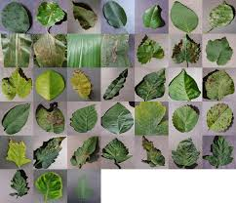
Sample Images
Diseases of different plants database:
• Apple black spot
• Apple broad leaf spot
• Apple needle leaf spot
• Apple normal
• Bell paper normal
• Blueberry normal
• Cherry normal
• Cherry powder normal
• Corn blight
• Corn rust

Slide 20
Dataset Link
https://www.kaggle.com/vipoooool/new-plant-diseases-dataset

Slide 21
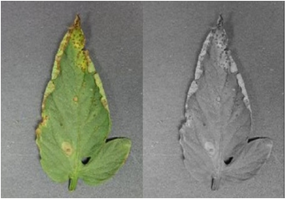
Image Preprocessing
As the images are acquired from the real field it may contain dust, spores and water spots as noise.
The purpose of data preprocessing is to eliminate the noise in the image, so as to adjust the pixel values.
It enhances the quality of the image.

Slide 22
Image segmentation
Image segmentation is the third step in the proposed method.
The segmented images are clustered into different sectors using Otsu classifier and k-mean clustering algorithm.
Before clustering the images, the RGB color model is transformed into Lab color model.
The advent of Lab color model is to easily cluster the segmented images.

Slide 23
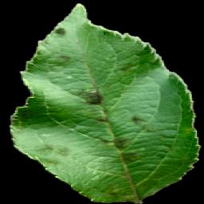
Segmented Image

Slide 24
Feature extraction
Feature extraction is the important part to gracefully predict the infected region.
Here shape and textural feature extraction is done.
The shape oriented feature extraction like Area, Color axis length, eccentricity, solidity and perimeter are calculated.
Similarly the texture oriented feature extraction like contrast, correlation, energy, homogeneity and mean is captured and processed to determine the health of each plant.
There are some conditions that should be taken into consideration when choosing a Feature Extractor, such as the type of layers, as a higher number of parameters increases the complexity of the system and directly influences the speed, and results of the system.
Although each network has been designed with specific characteristics, all share the same goal, which is to increase accuracy while reducing computational complexity.
In this system each object detector to be merged with some of the feature extractor.

Slide 25
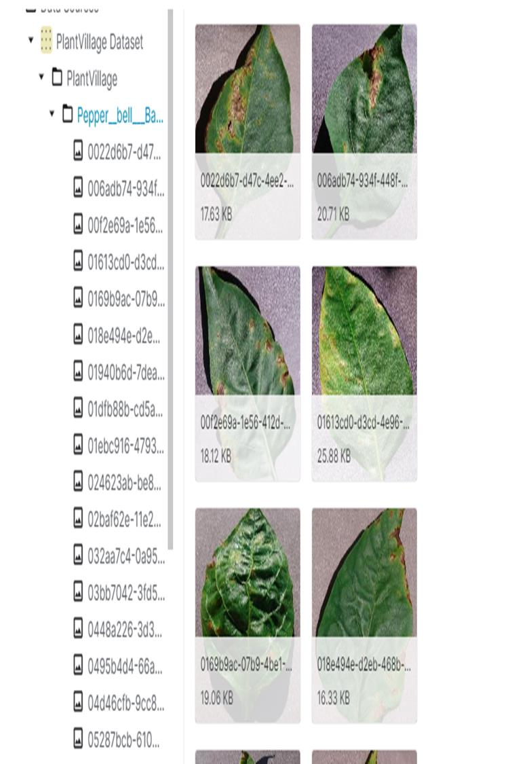
SCREENSHOTS

Slide 26
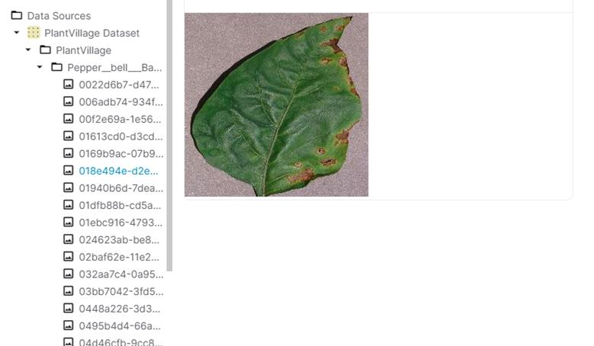

Slide 27
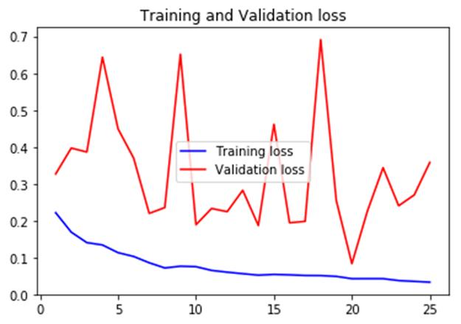

Slide 28
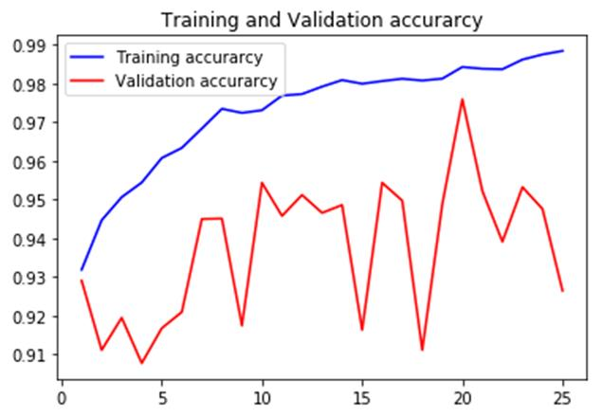

Slide 29
Conclusion
38 Categories of plant diseases were studied.
The VGG 16 model is constructed by using deep learning theory and convolution neural network technology.
Experiments show that the model can effectively identify the data set, and the overall recognition accuracy is as high as 95%.
It can be effectively applied to the identification and detection of plant diseases

Slide 30
References
[1] K. Padmavathi, and K. Thangadurai, “Implementation of RGB and Gray scale images in plant leaves disease detection –comparative study,” Indian J. of Sci. and Tech., vol. 9, pp. 1- 6,Feb. 2016.
[2] Kiran R. Gavhale, and U. Gawande, “An Overview of the Research on Plant Leaves International Journal of Pure and Applied Mathematics Special Issue 882 Disease detection using Image Processing Techniques
[3] Y. Q. Xia, Y. Li, and C. Li, “Intelligent Diagnose System of Wheat Diseases Based on Android Phone,” J. of Infor. & Compu. Sci., vol. 12, pp. 6845-6852, Dec. 2015.
[4] Wenjiang Huang, Qingsong Guan, JuhuaLuo, Jingcheng Zhang, Jinling Zhao, Dong Liang, Linsheng Huang, and Dongyan Zhang, “New Optimized Spectral Indices for Identifying and Monitoring Winter Wheat Diseases”, IEEE journal of selected topics in applied earth observation and remote sensing,Vol. 7, No. 6, June 2014
[5] Monica Jhuria, Ashwani Kumar, and RushikeshBorse, “Image Processing For Smart Farming: Detection Of Disease And Fruit Grading”, Proceedings of the 2013 IEEE Second International Conference on Image Information Processing (ICIIP-2013)
[6] Zulkifli Bin Husin, Abdul Hallis Bin Abdul Aziz, Ali Yeon Bin MdShakaffRohaniBinti S Mohamed Farook, “Feasibility Study on Plant Chili Disease Detection Using Image Processing Techniques”, 2012 Third International Conference on Intelligent Systems Modelling and Simulation.
[7] Mrunalini R. Badnakhe, Prashant R. Deshmukh, “Infected Leaf Analysis and Comparison by Otsu Threshold and k-Means Clustering”, International Journal of Advanced Research in Computer Science and Software Engineering, Volume 2, Issue 3, March 2012.
[8] H. Al-Hiary, S. Bani-Ahmad, M. Reyalat, M. Braik and Z. ALRahamneh, “Fast and Accurate Detection and Classification of Plant Diseases”, International Journal of Computer Applications (0975 – 8887)Volume 17– No.1, March 2011

Slide 31
THANK YOU

