Slide 1
Android Development
Android Studio, Activities & Fragments

Slide 2
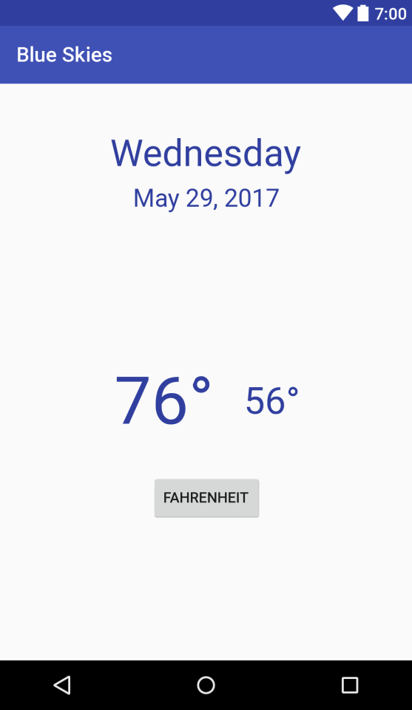
Goals
Develop a Blue Skies App
Activity
Fragment
Layout
Services
Http communication

Slide 3
What is Android
Google mobile SDK
Support Java and Kotlin
Open Source

Slide 4
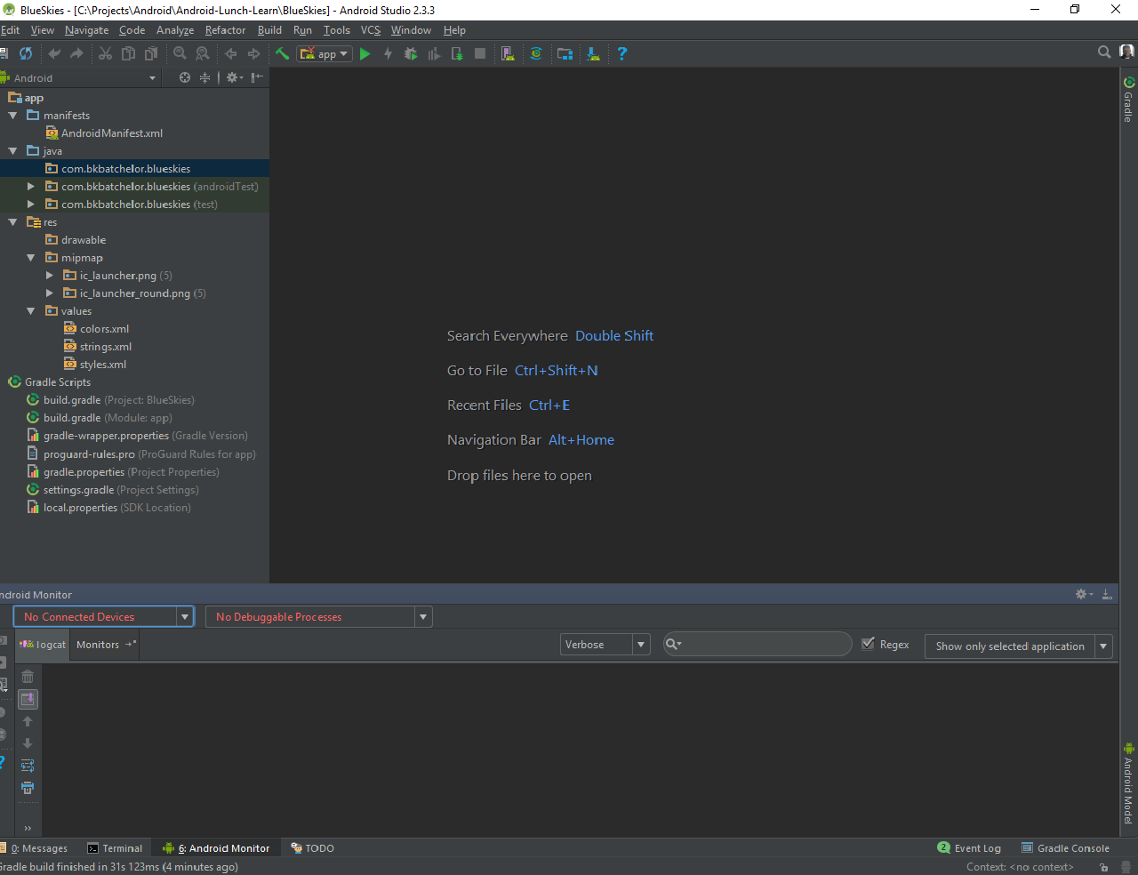
Android Studio
De facto standard for Android development
Built on the IntelliJ
Some features
Layout Editor
Built in emulator
Gradle integration
Instant Run (Hot swap)
https://developer.android.com/studio/index.html

Slide 5
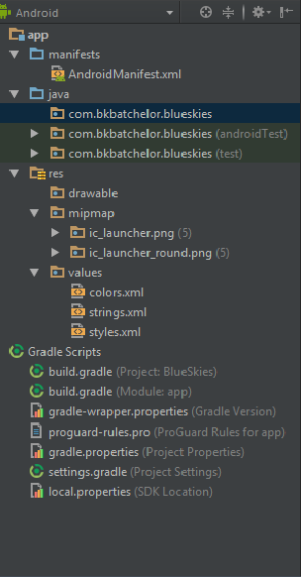

Project Pane

Slide 6
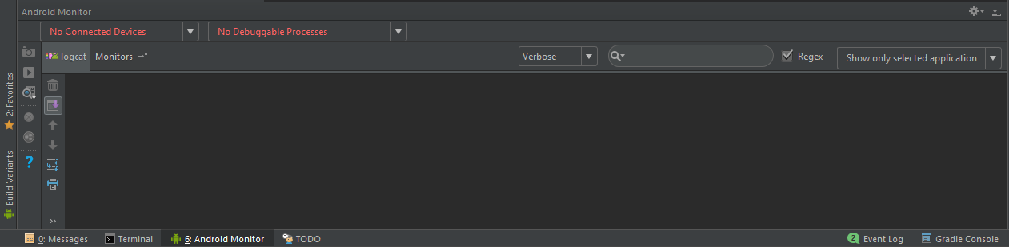
Logcat and Monitoring pane

Slide 7

Run and Debug

Slide 8
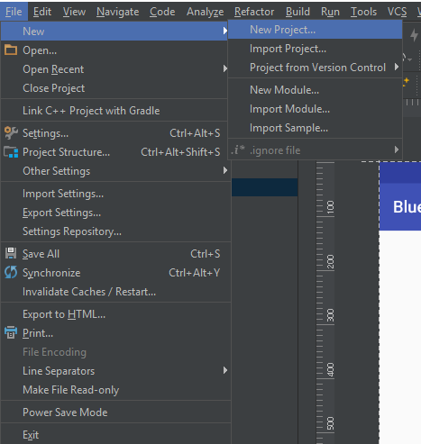
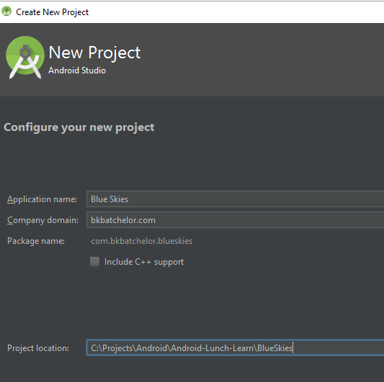
New Project

Slide 9
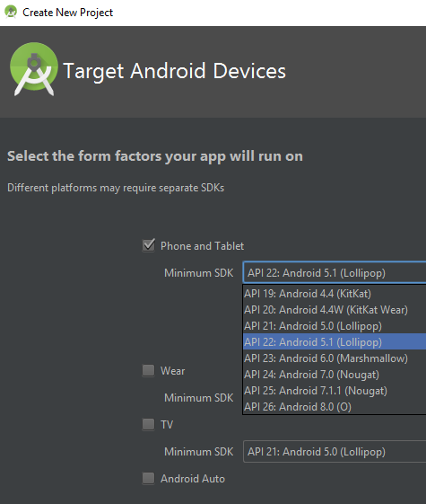
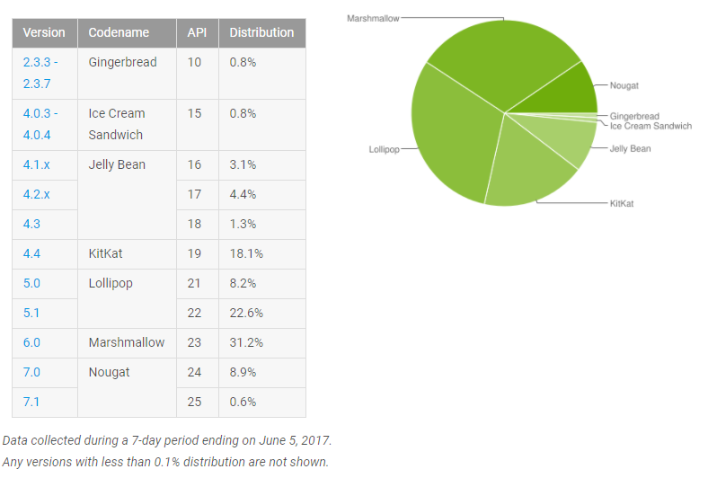
New Project (cont)

Slide 10
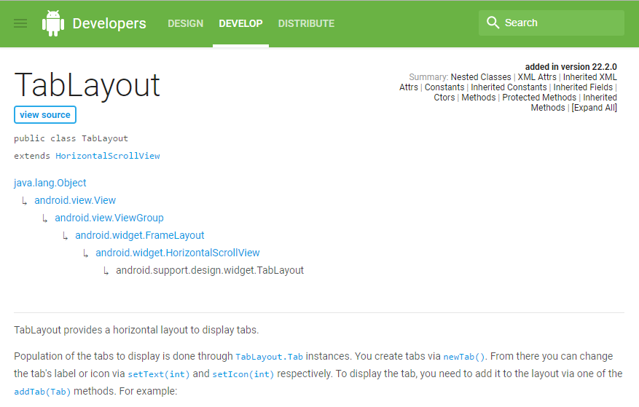
Android Reference
Min Support SDK Version

Slide 11
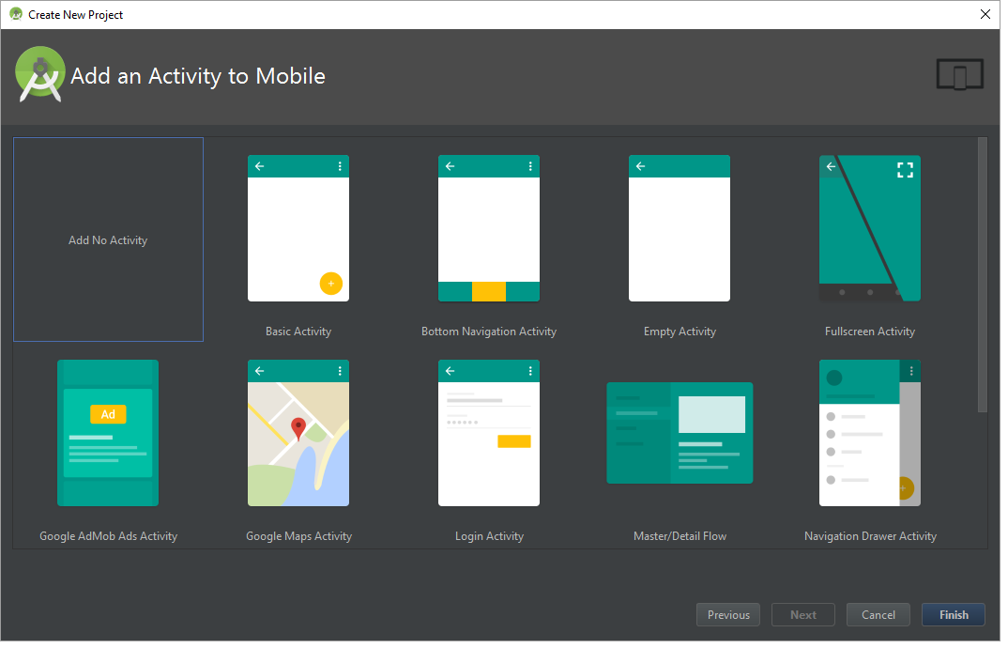
Add Activity

Slide 12
Exploring build.gradle file
Set target SDK version
Set minimum SDK version
Define dependencies

Slide 13
Activity

Slide 14

Activity https://developer.android.com/guide/components/activities/index.html
Fundamental building blocks
Entry point for user's interaction
Provides navigates within an app
Communication between other activities
Communication between child fragments
No Creation or Modification of Views

Slide 15
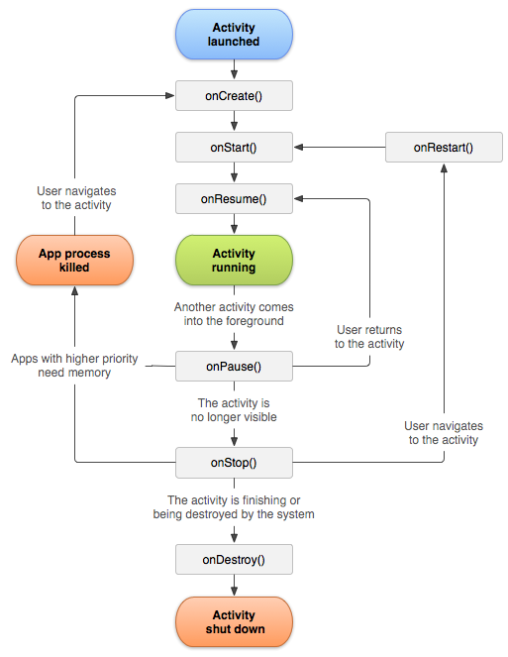
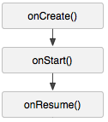
Activity Lifecycle
onCreate() started, but not visible
onStart() visible, but not ready for interaction
onResume() moved to the foreground and ready for interaction

Slide 16
Inside onCreate()
Initialize variables (non-view)
Assign Activity layout

Slide 17
Activity Lifecycle
onCreate() started, but not visible
onStart() visible, but not ready for interaction
onResume() moved to the foreground and ready for interaction

Slide 18
Inside onStart()
Register services

Slide 19
Activity Lifecycle
onCreate() started, but not visible
onStart() visible, but not ready for interaction
onResume() moved to the foreground and ready for interaction

Slide 20
Inside onResume()
Continue a service or action (ex. Stock market ticker)

Slide 21
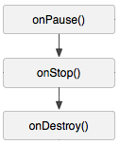
Activity Lifecycle
onPause() moving to the background, visible/partial and stopping user interaction
onStop() moved to the background and not visible
onDestroy() moved to the background and flagged to be destroyed by the system

Slide 22

Inside onPause()
Pause service(s) or actions
Save data to a persistent storage

Slide 23
Activity Lifecycle
onPause() moving to the background and stopping user interaction
onStop() moved to the background and not visible
onDestroy() moved to the background and flagged to be destroyed by the system

Slide 24
Inside onStop()
Unregister Service(s)

Slide 25
Activity Lifecycle
onPause() moving to the background and stopping user interaction
onStop() moved to the background and not visible
onDestroy() moved to the background and flagged to be destroyed by the system

Slide 26
Inside onDestroy()
Clean up anything else

Slide 27
Cycle Relationships
onCreate()
onDestroy()
onStart()
onStop()
onResume()
onPause()

Slide 28
Creating MainActivity
Best Practices
Keep lifecycle methods in order
Place other methods (helpers) below the lifecycle methods

Slide 29
XML Layout (View)
XML Layout holds ViewGroups (layouts) and Views (widgets)

Slide 30
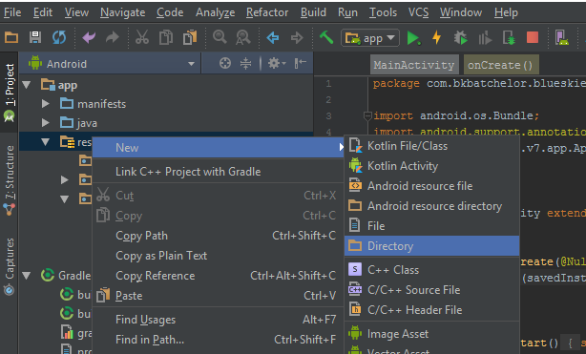
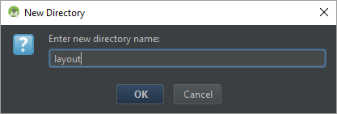
Creating Layout directory

Slide 31
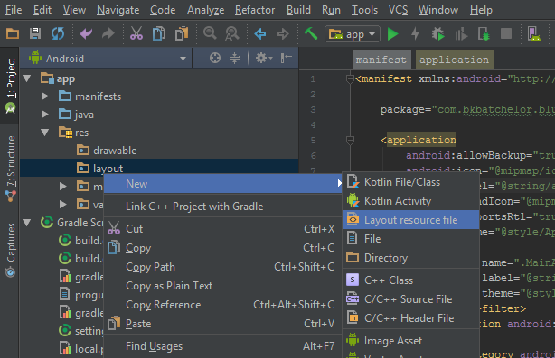
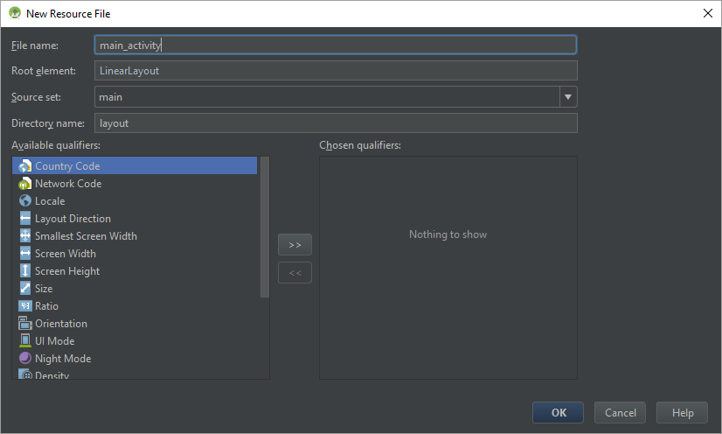
Creating layout XML

Slide 32
Show main_layout.xml

Slide 33
Layouts
Types of layouts
Linear
Relative
Frame
Constraint

Slide 34

Flat Layout
<LinearLayout android:layout_width="match_parent" android:layout_height="match_parent"> <LinearLayout android:layout_width="match_parent" android:layout_height="match_parent"> ..... </LinearLayout> <LinearLayout android:layout_width="match_parent" android:layout_height="match_parent"> <LinearLayout android:layout_width="match_parent" android:layout_height="match_parent"> <FrameLayout android:layout_width="match_parent" android:layout_height="match_parent"> ... </FrameLayout> </LinearLayout> </LinearLayout> </LinearLayout>

Slide 35
Link Activity to Layout

Slide 36
Editing Android Manifest
Add MainActivity to AndroidManifest.xml
The manifest file provides essential information about your app to the Android system, which the system must have before it can run any of the app's code. (i.e. activities, services, content provider…)

Slide 37
Adding MainActivity to manifest file

Slide 38
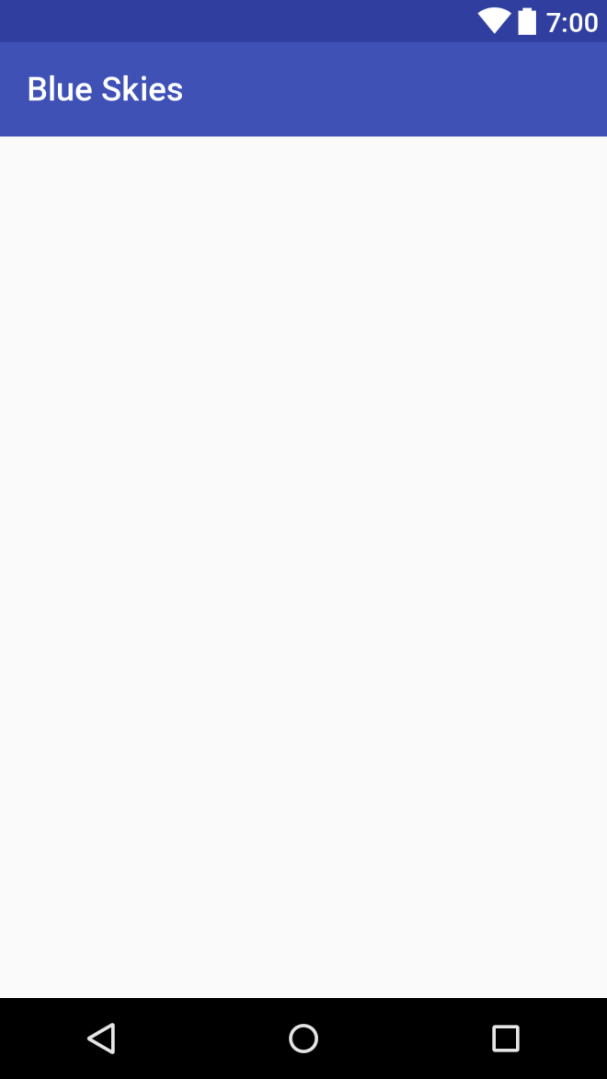

Slide 39

Fragments

Slide 40
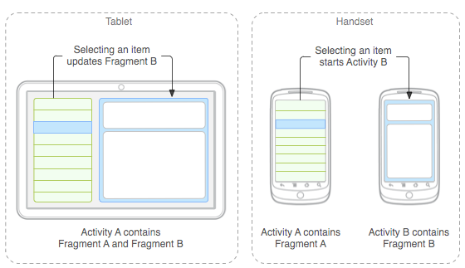

Why Fragments?
Reusing View and Logic
Single responsibility
Phone and tablet layouts
Screen orientation

Slide 41
Fragment Responsibilities
View and Layout logic
Event handling (i.e. onClick())
Network request
Interacting with a persistence storage

Slide 42
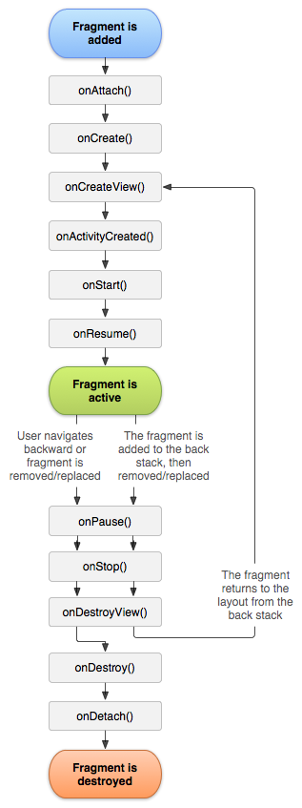
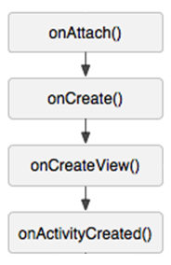
Fragment Lifecycle
onAttach() connected to an activity, but not started
onCreate() started, but view object has not been created
onCreateView() started, view object being created, but not visible
onActivityCreated() started, view object instantiated by parent Activity, but not visible

Slide 43
Inside onAttach()
Save parent activity context for:
Callbacks to parent activity
Content provider (database)
others

Slide 44
Fragment Lifecycle
onAttach() connected to an activity, but not started
onCreate() started, but view object has not been created
onCreateView() started, view object being created, but not visible
onActivityCreated() started, view object instantiated by parent Activity, but not visible

Slide 45
Inside onCreate()
Initialize non-view attributes

Slide 46
Fragment Lifecycle
onAttach() connected to an activity, but not started
onCreate() started, but view object has not been created
onCreateView() started, view object being created, but not visible
onActivityCreated() started, view object instantiated by parent Activity, but not visible

Slide 47
Inside onCreateView()
Inflate fragment view with layout
Initialize view attributes

Slide 48
Fragment Lifecycle
onAttach() connected to an activity, but not started
onCreate() started, but view object has not been created
onCreateView() started, view object being created, but not visible
onActivityCreated() started, view object instantiated by parent Activity, but not visible

Slide 49
Inside onActivityCreated()
Perform callbacks by referencing context

Slide 50
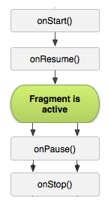
Fragment Lifecycle
onStart() visible, but not ready for interaction
onResume() moved to the foreground and ready for interaction
onPause() moving to the background and stopping user interaction
onStop() moved to the background and not visible

Slide 51
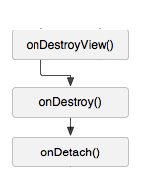
Fragment Lifecycle
onDestroyView() not visible and view detached from fragment
onDestroy() flagged for deletion
onDetach() detached from parent Activity

Slide 52
setRetainInstance
void setRetainInstance (boolean retain) -
Control whether a fragment instance is retained across Activity re-creation (such as from a configuration change)

Slide 53
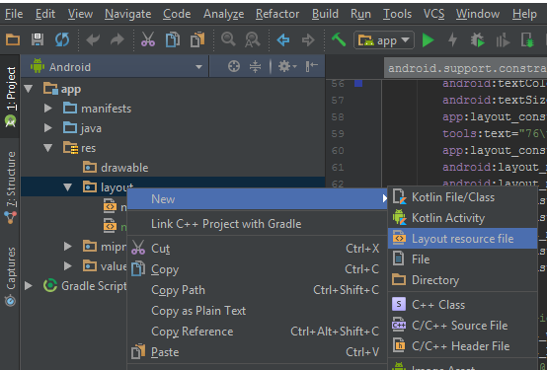
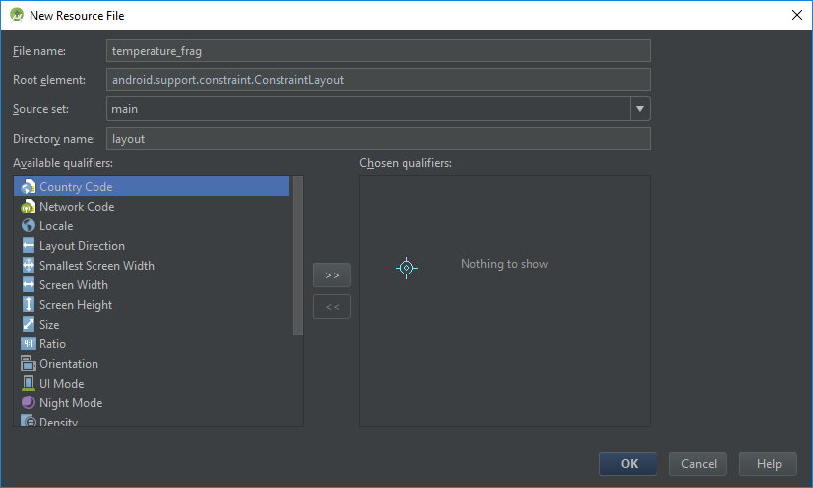
Creating Fragment XML Layout

Slide 54
Show Fragment Layout Code

Slide 55
Text Strings
Best practice
Reference string from strings.xml

Slide 56


Density Independent Pixel (dp)
View Groups and View dimensions
Scale according to screen density, not screen resolution
Hi resolution screen
Low resolution screen

Slide 57
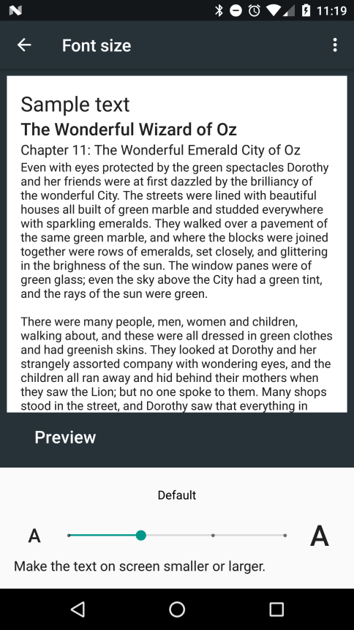
Scale Independent Pixel (sp)
Controlling text size
Scale according to screen density, not screen size
Also, scales according settings font settings

Slide 58
Fragment Code
Logic to fragment XML layout
onClick()

Slide 59
Show Fragment Code

Slide 60
Final Step
Reference Fragment in Activity

Slide 61
Questions

Slide 62
Links
My GitHub page:
https://github.com/Batch-xx/Android-Lunch-Learn
Activities in the Wild: Exploring the Activity Lifecycle by Kristin Marsicano
https://news.realm.io/news/activities-in-the-wild-exploring-the-activity-lifecycle-android/

