Slide 1

RANSOMWARE
Name of the Student :P.Vyshnavi
Registration No :154G1A05A9
Year & Sem :IV Year & II Sem
Srinivasa Ramanujan Institute of Technology
Department of Computer Science & Engineering

Slide 2
Abstract

Slide 3
Contents:
Introduction
What is Ransomware?
How do criminals install ransomware?
How Ransomware works
Types of Ransomwares
How to prevent Ransomware
Identify The Ransomware
Conclusion
References
Demo

Slide 4
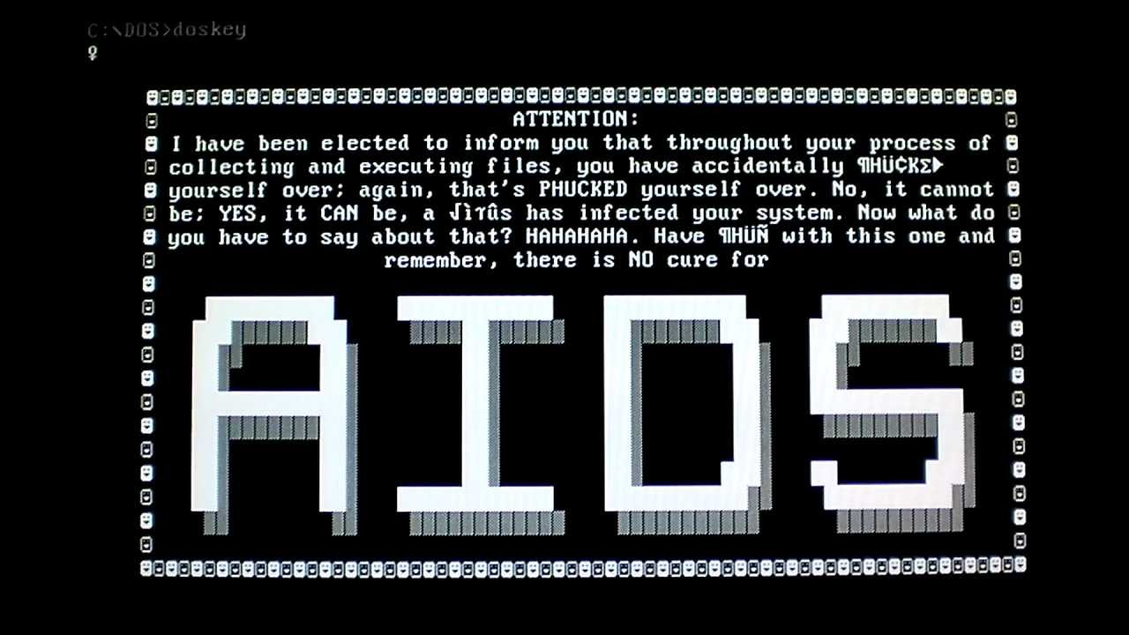
Introduction
The first known Ransomware was the 1989 ‘AIDS’ Trojan
This Trojan is also known as “PC Cyborg” written by Joseph Popp

Slide 5

What is Ransomware?
'Ransomware' is a type of malware that attempts to threat money from a computer user by infecting and taking control of the victim's machine or files or documents stored on it.

Slide 6

How do criminals install ransomware?
Ransomware generates a pop-up window,webpage, or email warning from what it looks like an official authority
Ransomware is usually installed when you open a malicious email attachment

Slide 7
Continued…
Click a malicious link in
an email message
an instant message
on social networking site
Ransomware can even be installed when you visit a malicious website

Slide 8
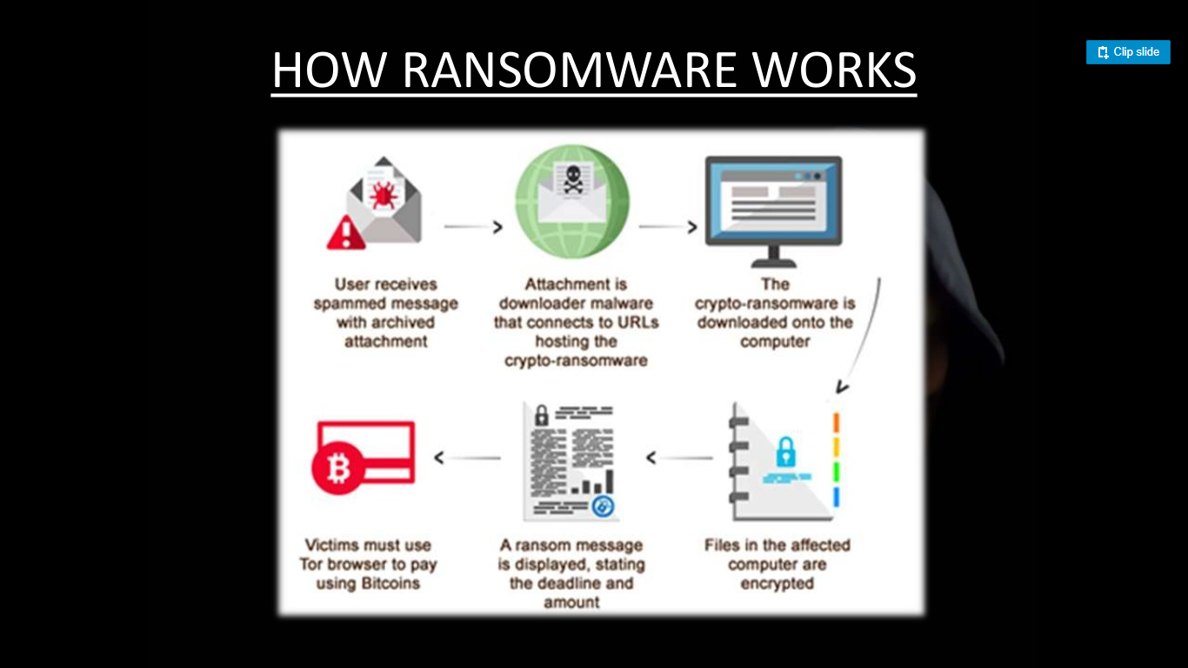
How Ransomware works

Slide 9
Types of Ransomware
Encryption Ransomware
Lock screen Ransomware
Mater Boot Record (MBR) Ransomware

Slide 10
Encryption Ransomware
Encrypts the personal files
Example:the contents of documents,spreadsheet pictures are encrypted
The user find a problem to open the file
This type is also called 'file encryptor' ransomware

Slide 11
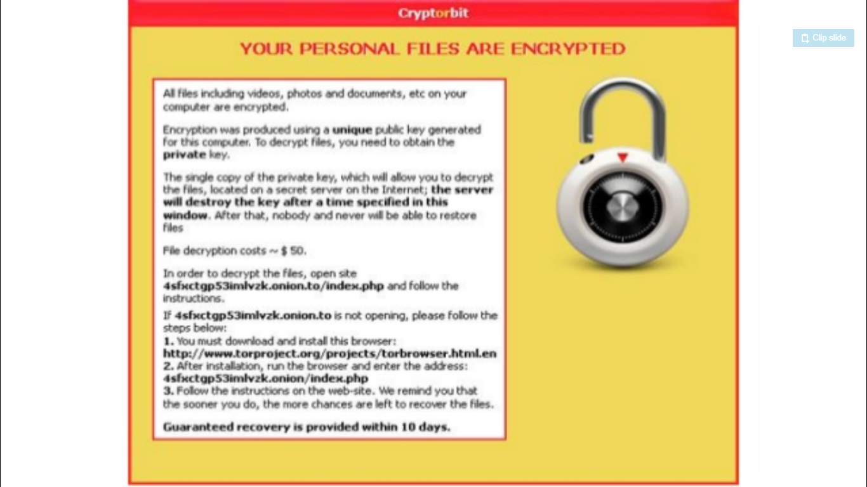

Slide 12
Lock Screen Ransomware
'Locks' the screen
It presents the full screen that blocks all other windows
This type is called 'WinLocker' ransomware
No personal files are encrypted

Slide 13
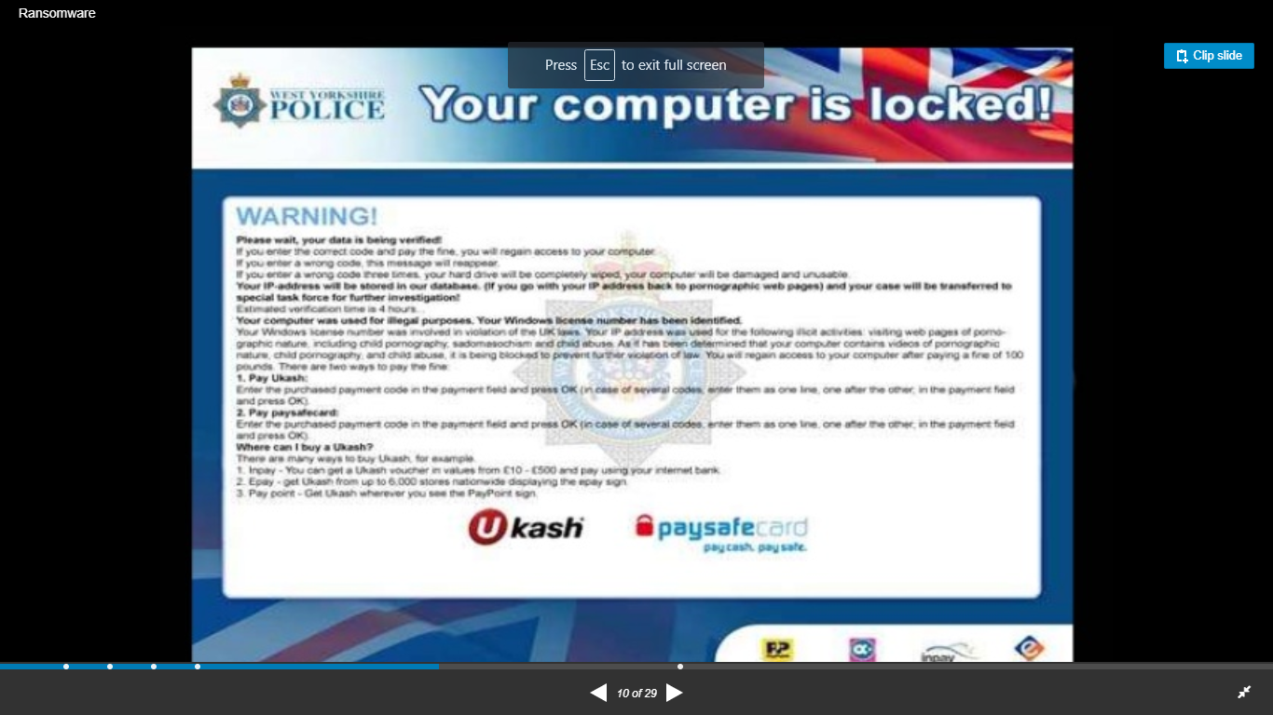

Slide 14
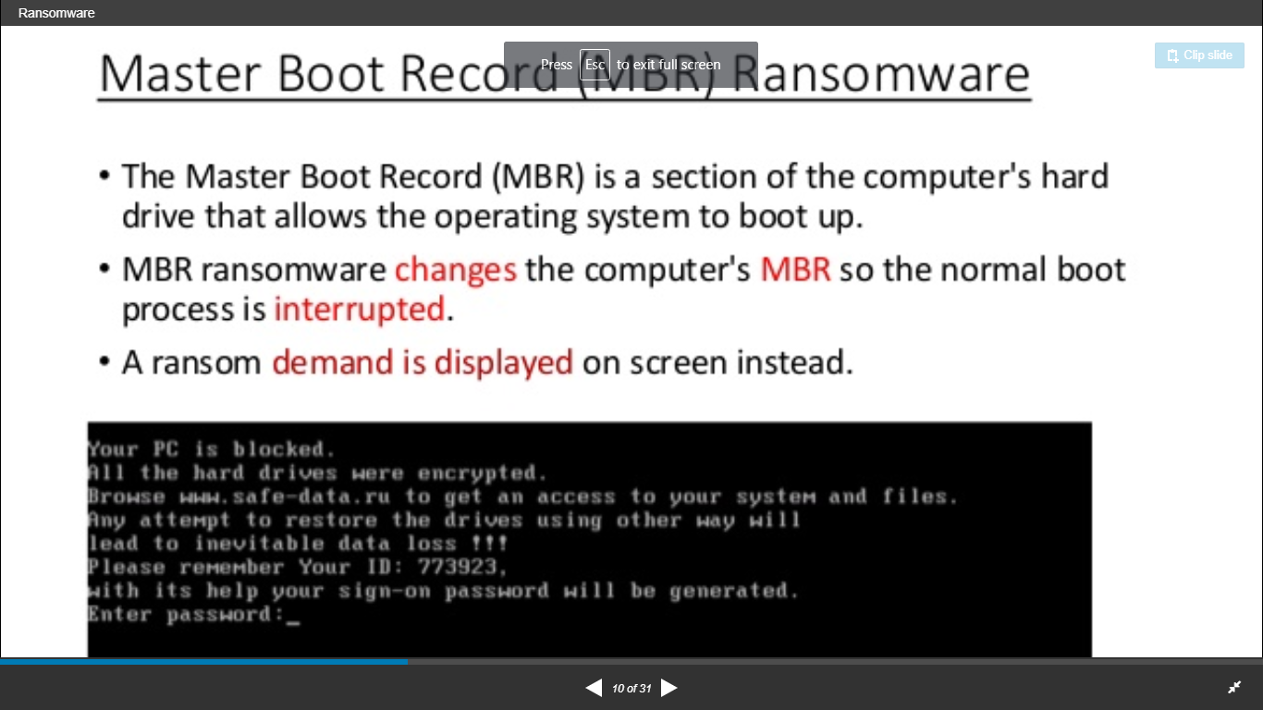
Master Boot Record Ransomware
MBR is a section of the computer's hard drive that allows the operating system to boot up
MBR ransomware changes the computer's MBR so the normal boot is interrupted

Slide 15
How to prevent ransomware?
Keep your firewall turned on
Keep all of the software update on your computer
Don't open spam email messages or click links
Keep your browser clean
Scan your computer with Microsoft Safety Scanner

Slide 16
Identify the Ransomware
Mostly Ransomware is saved to one of the locations:
C:\Users\(username)\0.(random numbers).exe
C:\Users\username\AppData\(random alpha numerics).exe

Slide 17
Conclusion
Knowledge is the best weapon to prevent malware attacks
BE CAREFUL WHAT YOU CLICK !!!

Slide 18
References:
http://en.wikipedia.org/wiki/Ransomware
http://www.trendmicro.com/vinfo/us/security/definition/Ransomware

Slide 19
Demo:
Example:
Playing Video
Presenting Results
Animations etc.,

Slide 20
Thank you
Queries
?

