Slide 1

CyberQuest
Team Members:
R.Abhilash-253
Y.Naveen-250
S.Munishwar-249
M.Praveen kumar-246
A Gamified Cybersecurity Learning Platform

Slide 2
Cybersecurity education faces critical challenges: students are disengaged, concepts feel abstract, and traditional methods fail to inspire learning.
Low Engagement:
Students spend more time on mobile apps and games than studying theoretical cybersecurity topics.
The Problem in Cybersecurity Education
Digital Distraction :
Gaming and social media compete for attention, leaving cybersecurity education feeling boring and outdated.
Passive Methods :
Traditional teaching approaches are lecture-based and ineffective, resulting in poor concept clarity and low exam scores.
Complex Concepts :
Students struggle to grasp key topics like encryption, networking security, and malware without hands-on practice.

Slide 3
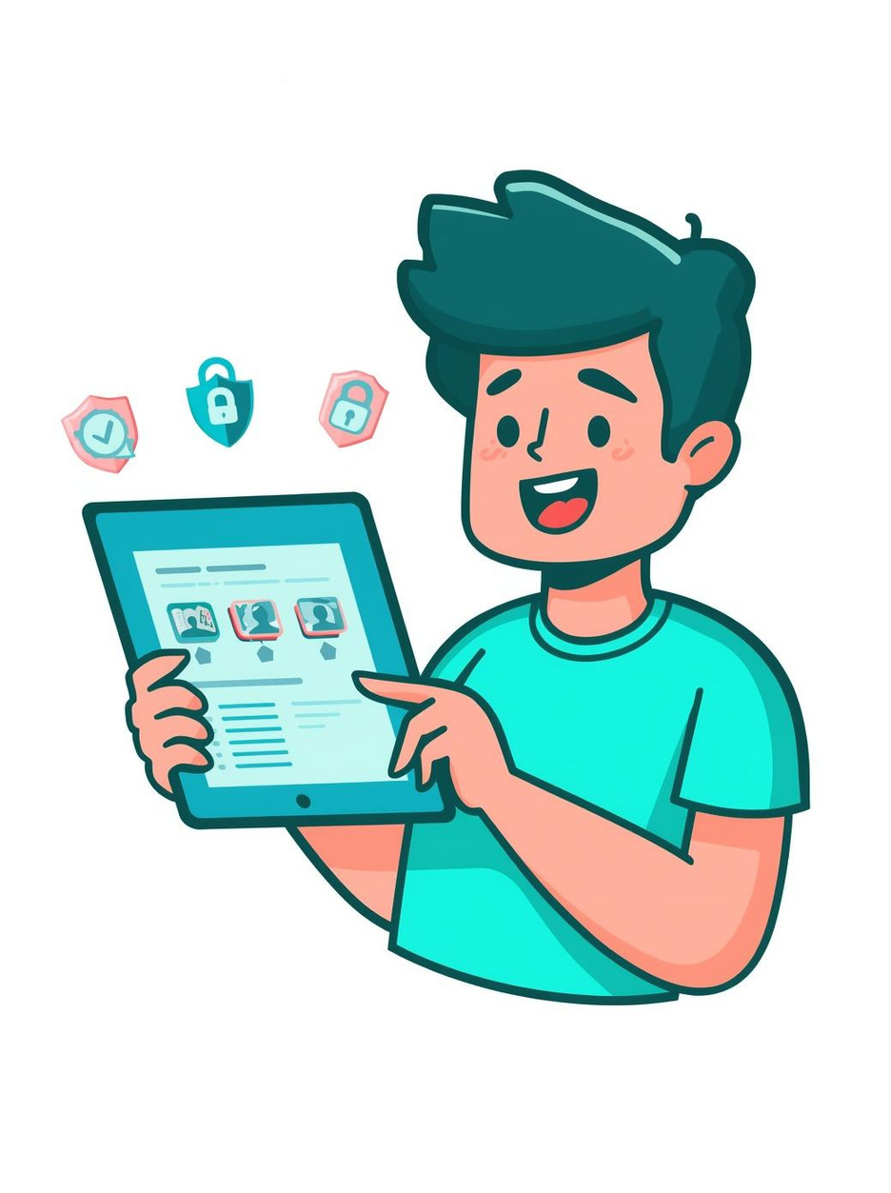
Solution: CyberQuest
Interactive MCQs :
WEB-BASED LEARNING PLATFORM
Learn through questions with instant feedback and detailed explanations.
Real-Time Features :
Timer-based challenges, live scoring, and competitive elements keep learners engaged.
Progressive Levels :
Advance from Basic to Intermediate to Advanced as you master concepts.

Slide 4
Game Mechanics
CORE GAME FEATURES :
Difficulty Levels :
Progress through Basic, Intermediate, and Advanced levels as your cybersecurity knowledge grows.
Speed Timer :
Answer quickly! Each question has 7-12 seconds to keep the challenge exciting and urgent.
Strike System :
Three wrong answers and you restart! Stay focused and learn from mistakes.
Score & Speed Bonus :
Earn points for correct answers plus bonus points for answering quickly.
Power-Up Bonuses :
Collect Double XP, Skip Question, and 50:50 power-ups to boost your gameplay!

Slide 5
Cybersecurity Topics Covered :
Phishing Attacks
Malware & Ransomware
Firewalls & Network Security
Encryption & Passwords
Social Engineering , etc. . ,

Slide 6
Usage Applications :
Self-Learning
Classroom Quizzes
Practice Tests
Tech Competitions
Skill Building

Slide 7
Student Benefits
Better Retention
Easy understanding of complex topics
Self-Directed Learning
Improves Logical and analytical Thinking
Enhances Digital Awareness
Boosts Creativity

Slide 8
FUTURE ENHANCEMENTS :
AI Personalization
Multiplayer Mode
Faculty Dashboard
Mobile Apps
Advanced Labs

Slide 9
SDG ALIGNMENT :
SDG 4
Quality Education
SDG 9
Innovation & Infrastructure
SDG 17
Partnerships for Goals
Promotes inclusive, gamified cybersecurity learning accessible to all students regardless of background.
Leverages technology-driven innovation to build digital security infrastructure skills for the future workforce.
Encourages academic-industry collaboration to strengthen global cybersecurity awareness and digital equity.
CyberQuest directly contributes to the UN Sustainable Development Goals through technology-enabled education.

Slide 10
CONCLUSION
CyberQuest transforms cybersecurity education by making it interactive, engaging, and effective.
Proven Engagement Model
Gamification bridges the gap between theory and practice in cybersecurity learning.
Scalable & Adaptive
Progressive levels and AI-powered enhancements ensure long-term learner growth.
Real-World Readiness
Topics like phishing, malware, and encryption prepare students for real industry challenges.
Multi-Purpose Platform
Suitable for self-study, classroom use, and competitive tech events alike.
CyberQuest is not just a quiz platform — it is a mission to make every student cyber-aware and career-ready.

Slide 11
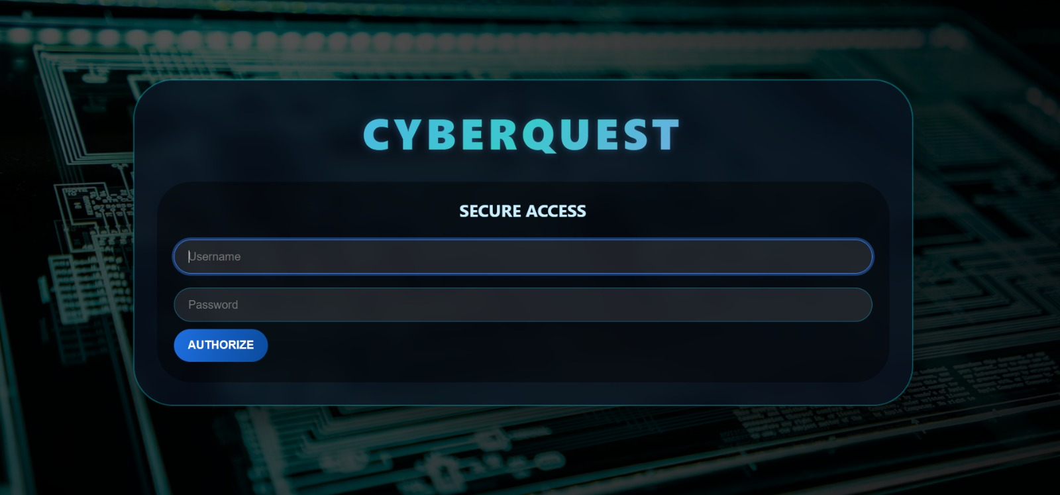

Slide 12
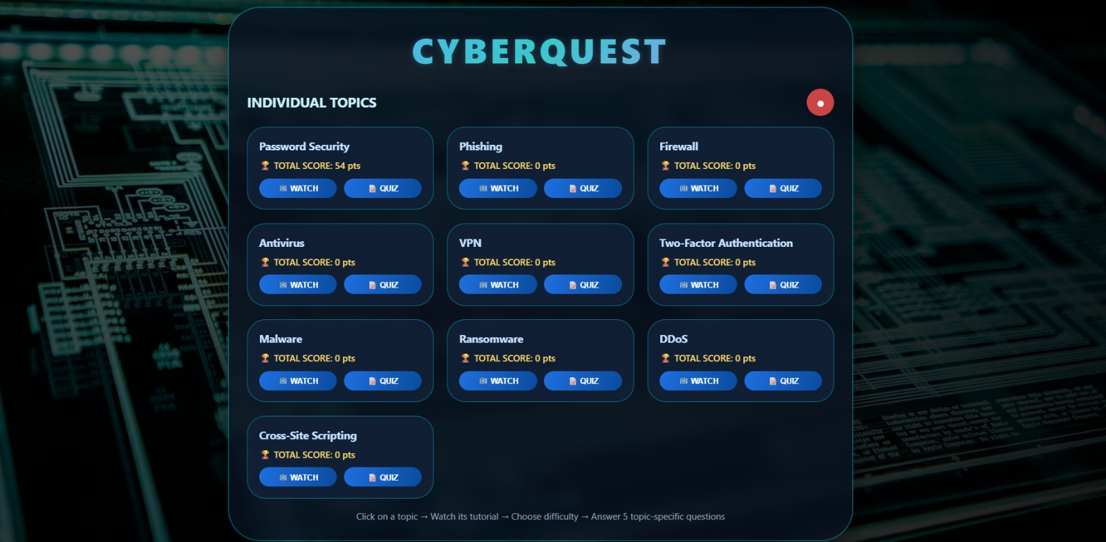

Slide 13

Thank You!

