Slide 1
PANIMALAR ENGINEERING COLLEGE DEPARTMENT OF CSE SECURE THE DRUG COMPONENTS USING NAÏVE BAYES AND SVM (DOMAIN: Cloud Computing)
Project Guide:
Mrs.M.S.Vinmathi(Associate Professor)
Team Members:
Bhagya Sree .C.R(211417104035)
Lavanya .T(211417104130)
Batch:A2

Slide 2
INTRODUCTION
Drug discovery is the process through which potential new therapeutic entities are identified, using a combination of computational, experimental, translational and clinical models.
Drug discovery is generally the process of identifying one or more active ingredients from traditional remedies, and includes the identification of screening hits, medicinal chemistry and optimization of these hits to increase the affinity, selectivity (to reduce the potential of side effects), bioavailability, and metabolic half-life.
Drug discovery and development is a long-term, competitive, expensive and complicated process. Bringing the drugs from the bench to the market, that is, from screening and identification of the drug to its introduction to the market, takes several years of efforts.
The process of discovering and developing a new drug involves an intricate interaction between investors, industry, academia, patent laws, regulatory authorities, marketing and the necessity to balance confidentiality with communication.
The complete process of presenting a drug to the patients involves four stages- drug discovery, drug development, regulatory review and approval, and marketing.

Slide 3
LITERATURE SURVEY
S.NO | TITLE | AUTHOR | YEAR | INFERENCE | DRAWBACKS
1. | Deep Learning in Drug Discovery and Medicine; Scratching the Surface | Dibyendu Dana , Satishkumar V. Gadhiya , Luce G. St. Surin , David Li , Farha Naaz ,Quaisar Ali | British journal of pharmacology, vol. 162, no. 6, pp. 1239–1249, 2018 | Drug discovery and medicine that started with Ayurveda in India are now benefiting from an altogether different artificial intelligence (AI)—one which is automating the invention of new chemical entities and the mining of large databases in health-privacy-protected vaults. Indeed, disciplines as diverse as language, chemistry, toxicology, biostatistics, medicine and computing have come together to harness algorithms based on transfer learning and recurrent neural networks to design novel drug candidates but only on demand. | 1)The molecular profile of an individual patient drives the selection of therapy. 2)Post-marketing surveillance data show that its benefit is not experienced by every patient.

Slide 4
S.NO | TITLE | AUTHOR | YEAR | INFERENCE | DRAWBACKS
2. | A Novel Neutrosophic Weighted Extreme Learning Machine for Imbalanced Data Set | Yaman Akbulut 1 ID , Abdulkadir ¸ Sengür 1,* ID , Yanhui Guo 2 and Florentin Smarandache | Journal of chemical information and computer sciences, vol. 44, no. 5, pp. 1630–1638, 2017 | It has advantages such as good generalization performance, fast learning speed, and low computational cost. Neutrosophic weighted extreme learning machine (NWELM), in which neutrosophic c-means (NCM) clustering algorithm is used for the approximation of the output weights of the ELM. | 1)Problems in the classification of imbalanced data sets. 2)ELM suffers from the presence of irrelevant variables in the large and high dimensional real data set
3. | Drug discovery and development: Role of basic biological research | Richard C. Mohsa, Nigel H. Greig | IEEE Journal of Biomedical and Health Informatics, vol. 20, pp. 655 – 668, 2017 | Better medicines that are iterative improvements on current medications are valuable as they may offer benefits over existing medications in terms of potency, safety, tolerability, or convenience. The drug discovery and development process and thereby support effective translation of preclinical research to humans. | The process is sufficiently long, complex, and expensive so that many biological targets must be considered for every new medicine eventually approved for clinical use and new research tools may be needed to investigate each new target.

Slide 5
S.NO | TITLE | AUTHOR | YEAR | INFERENCE | DRAWBACK
5. | Drug Design and Discovery: Principles and Applications | Shu-Feng Zhou , Wei-Zhu Zhong | Drug discovery today, vol. 17, no. 19, pp. 1088–1102, 2017 | Drug discovery is the process through which potential new therapeutic entities are identified, using a combination of computational, experimental, translational, and clinical models. Modern drug discovery involves the identification of screening hits, medicinal chemistry and optimization of those hits to increase the affinity, selectivity (to reduce the potential of side effects), efficacy/potency, metabolic stability (to increase the half-life), and oral bioavailability. | Despite advances in biotechnology and understanding of biological systems, drug discovery is still a lengthy, costly, difficult, and inefficient process with a high attrition rate of new therapeutic discovery.
6. | Privacy-Preserving Clinical Decision Support System Using Gaussian Kernel- Based Classification | Yogachandran Rahulamathavan, Suresh Veluru, Raphael | Biomedical and Health Informatics, IEEE Journal of, vol. 18, no. 1, pp. 56–66, 2015 | A clinical decision support system forms a critical capability to link health observations with health knowledge to influence choices by clinicians for improved healthcare. Remote outsourcing can be exploited to provide efficient and accurate clinical decision support in healthcare. | Servers are third party and therefore potentially not fully trusted raises possible privacy concerns.

Slide 6
S.NO | TITLE | AUTHOR | YEAR | INFERENCE | DRAWBACKS
7. | Machine Learning Classification over Encrypted Data | Raphael Bost, Raluca Ada Popa, Stephen Tu | 22nd Annual Network and Distributed System Security Symposium, NDSS 2015, San Diego, California, USA, February 8-11, 2015. | Machine learning classification is used for numerous tasks nowadays, such as medical or genomics predictions,spam detection, face recognition, and financial predictions. Due to privacy concerns, in some of these applications, it is important that the data and the classifier remain confidential.Three major classification protocols that satisfy this privacy constraint: hyperplane decision, Naïve Bayes, and decision trees. The basis of these constructions is a new library of building blocks, which enables constructing a wide range of privacy-preserving classifiers. | In the most basic sense, drug design involves the design of molecules that are complementary in shape and charge to the molecular target with which they interact and bind. No security for drug components while train the data set.

Slide 7
S.NO | TITLE | AUTHOR | YEAR | INFERENCE | DRAWBACKS
8. | Privacy-Preserving Multi-Class Support Vector Machine for Outsourcing the Data Classification in Cloud | Kanapathippillai Cumanan, Muttukrishnan Rajarajan | IEEE on Dependable and Secure Computing, vol. 11, no. 5, pp. 467–479, 2014 | Classifier built by the server can be utilized by clients in order to classify their own data samples over the cloud. A privacy-preserving (PP) data classification technique where the server is unable to learn any knowledge about clients’ input data samples while the server side classifier is also kept secret from the clients during the classification process | Emerging cloud computing infrastructure replaces traditional outsourcing techniques and provides flexible services to clients at different locations via Internet. This leads to the requirement for data classification to be performed by potentially untrusted servers in the cloud.Releasing the data samples owned by the clients to the cloud raises privacy concerns since the data processed in the cloud are often outsourced to untrusted-third-party-servers.

Slide 8
PROBLEM STATEMENT
Cloud plays a major role in our day to day organizational activities especially in this new normal.
The process of discovering and developing a new drug involves an intricate interaction between investors, industry, academia, patent laws, regulatory authorities, marketing and the necessity to balance confidentiality with communication.
Due to the significant investments and high commercial values involved in drug discovery, privacy is an important factor.
As privacy is prime,it is important to ensure that the potential new drug compounds will not be leaked to a third party, such as a competing pharmaceutical corporation.
Furthermore, to train the SVM, multiple pharmaceutical corporations may collaborate in order to increase the SVM decision rate. At the same time, these corporations do not wish to reveal their datasets.
How to achieve secure SVM training and decision under multiple data sources without compromising, the privacy of each individual party remains a research and operational challenge.
Thus in this project, we propose secure drug components using SVM and Naïve Bayes for Securing Drug discovery in the cloud environment.

Slide 9
Technology Stack
Software Requirements
Windows 7 and above(64 bit)
JDK 1.8
Python 3.6.3
Tomcat 9.0.26
MySQL
Hardware Requirements
Hard Disk: 80GB and Above
RAM : 4GB and Above
Processor:P IV and Above
Algorithms
Support Vector Machine
Naive Bayes

Slide 10









SYSTEM ARCHITECTURE
Drug Owner
Drug Tester
Registration & Login
Registration& Login
Upload Drug Dataset
Send Request to the owner if request has accepted tester can test the drug component
Store it into the cloud Server
Store it into the cloud server
Train dataset using dataming algorithms
Test the drug component
Admin
Sent the results to admin
Login
View Results

Slide 11
SYSTEM DESIGN ER DIAGRAM
password
contact no
Email-id
username
Lab name
services
gallery
contact
REGISTRATION FORM
name
Lab code
about
username
USER OPTIONS
has
LOGIN
typography
password
has
Drug name
username
has
File name
UPLOADED DRUG
Upload &train your document
Lab code
NB accuracy
Drug name
SVM accuracy
TESTER INFO.
Choose file
status
Drug id
Select date of upload
username
rating

Slide 12
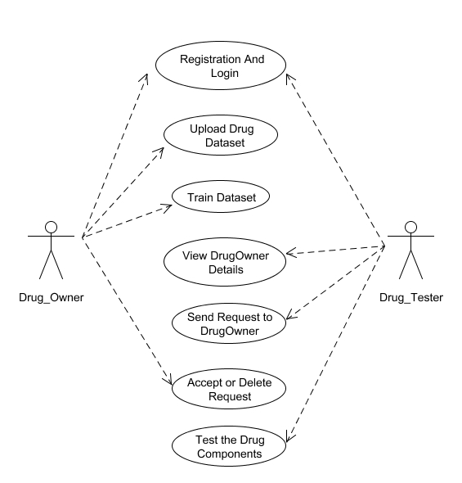
UML DIAGRAMS 1.USECASE DIAGRAM

Slide 13
2.CLASS DIAGRAM
Drug owner
Formula file
Upload & train your doc.
Username: string
Password: string
Email-id: string
Contact no: int
Lab name: string
Lab code: int
Id: int
Username: String
File: String
File name: String
File type: String
Username: string
Lab code: int
Drug id: int
Select date of upload: date
Choose file: string
getId(): int
setId(): int
getUsername(): String
SetUsername(): String
getFilename(): String
setFilename() String
getFiletype(): String
setFiletype(): String
Login(): string
Register(): string
Drug tester
Uploaded drug info(): string
Tester info(): string
Full name: string
Email-id: string
Username: string
Password: string
Contact no: int
Trained data
Train svm: String
Train nb: String
Status: String
Trained data result
Getsvm(): String
Setsvm(): String
Getnb(): String
Setnb(): String
Getstatus(): String
Setstatus(): String
Login(): string
Register(): string
Request():string
Test(): string
Train svm: String
Train nb: String
Status: String
Admin
Getsvm(): String
Setsvm(): String
Getnb(): String
Setnb(): String
Getstatus(): String
Setstatus(): String
Username: string
Password: string
Login(): string

Slide 14
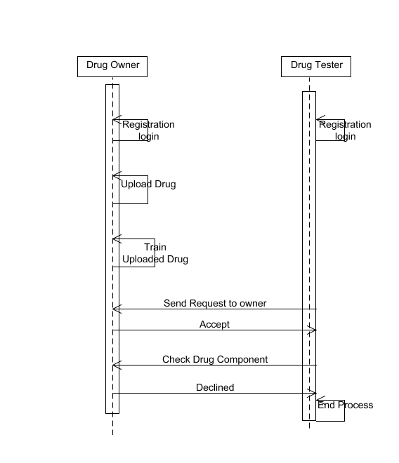
3.SEQUENCE DIAGRAM

Slide 15
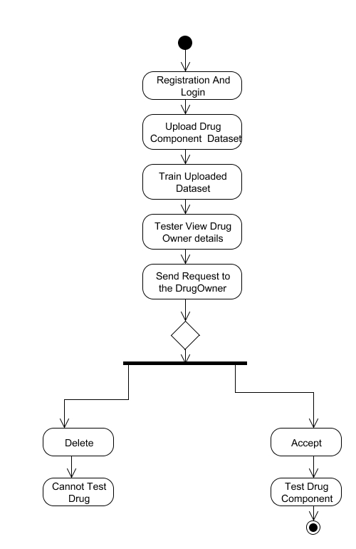
4.ACTIVITY DIAGRAM

Slide 16
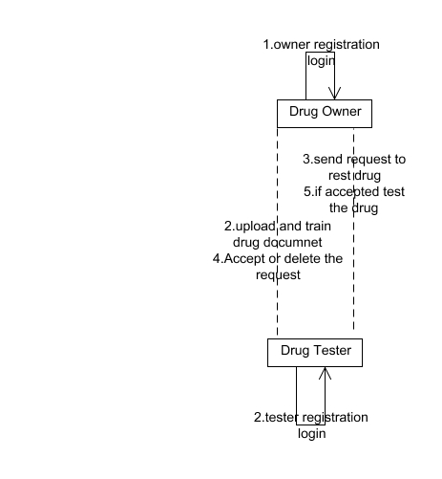
5.COLLABORATION DIAGRAM

Slide 17
DATABASE DESIGN
FIELD NAME | DATATYPE | LENGTH | PRIMARY KEY | CONSTRAINS
Username | varchar | 255 | Yes | Primary key
Password | varchar | 255 | No | Not null
Name | varchar | 255 | No | Not null
Email | varchar | 255 | Yes | Primary key
Phone | varchar | 255 | Yes | Primary Key
Status | varchar | 255 | No | Not null
Labname | varchar | 255 | No | Not null
Labcode | varchar | 255 | Yes | Primary Key
Drugname | varchar | 255 | No | Not null
Drugid | varchar | 255 | Yes | Primary Key

Slide 18
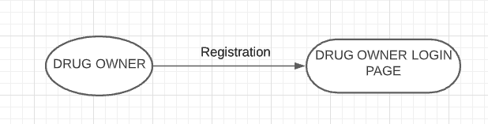
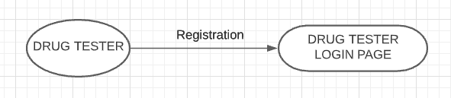
DFD DIAGRAM
DFD LEVEL 0

Slide 19
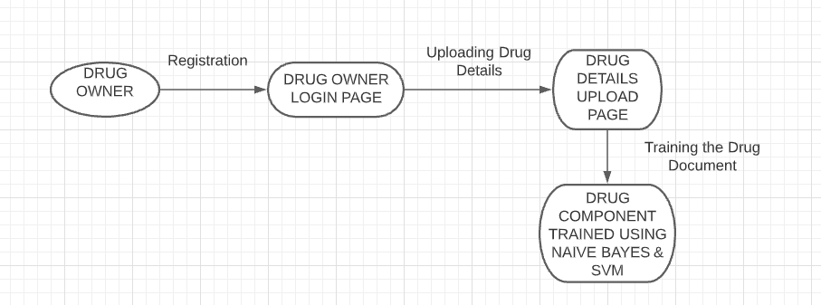
DFD LEVEL 1

Slide 20
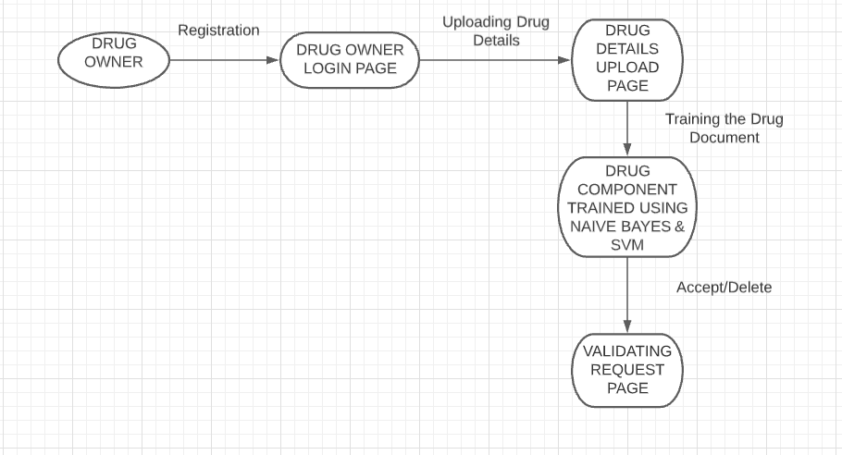
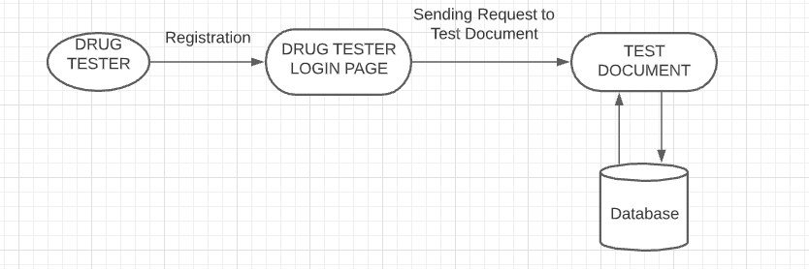
DFD LEVEL 2:

Slide 21
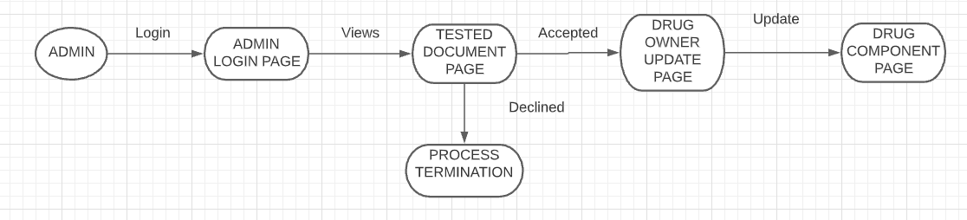
DFD LEVEL 3

Slide 22
MODULES
Drug Owner & Tester Registration
Drug Component Uploading
Train dataset
Drug Testing

Slide 23
Drug Owner & Tester Registration
Drug Owner will register in the service provider platform.
For storing the meta details about the drugs we use the MySQL data base.
This drug owner registration process will involves few entities such as
1)Name(drug owner’s) 2)Email(drug owner’s) 3)Contact number(drug owner’s)
4)lab name(where the drugs has been discovered) 5)lab code(unique number of lab)
for this process.
Likewise Drug Tester will also register in the service provider platform.
For storing the meta details about the drugs we use the MySQL data base.
This drug tester registration process will involves few entities such as
1.Name(drug tester’s) 3.Contact number(drug tester’s)
2.Email(drug tester’s) 4.TesterID( unique number of that tester)
for this process.

Slide 24
Drug Component Uploading
Once the Registration is completed, the drug owner should upload the drug component.
For uploading the drug component,the owner must provide the Drug Name,Drug Id and Date of Uploading.
Now we have to choose the file that contains the drug data sets and drug components.
That data set contains the formula and we have to mention the type of class (Class A, Class B).
While uploading the file we will read the content and store into the database and store that .csv file in cloud.

Slide 25
Train dataset
As the drug owner has successfully uploaded the drug components,now we will train the uploaded data using python.
For this part we will use two algorithms, SVM and Naïve Bayes.
The trained data and accuracy will be sent to the owner from python server.

Slide 26
Drug Testing
As the drug dataset has been trained and uploaded in the cloud , the drug tester now send request to the owner for testing.
Only after accepting the request, the tester can test the uploaded drug components.
Once the Testing is completed, the drug tester sends result to the admin.
If that particular drug component is still retained in the cloud then it is assumed that component is still active and passed the testing successfully.
If not,then the drug component gets removed from the cloud.

Slide 27
ALGORITHMS USED
Support Vector Machine(SVM)
Naïve Bayes

Slide 28
Algorithm SVM(Support Vector Machine)
Support Vector Machine or SVM is one of the most popular Supervised Learning algorithms, which is used for Classification as well as Regression problems.
However, primarily, it is used for Classification problems in Machine Learning.
The goal of the SVM algorithm is to create the best line or decision boundary that can segregate n-dimensional space into classes so that we can easily put the new data point in the correct category in the future. This best decision boundary is called a hyperplane.
SVM chooses the extreme points/vectors that help in creating the hyperplane.
These extreme cases are called as support vectors, and hence algorithm is termed as Support Vector Machine.

Slide 29
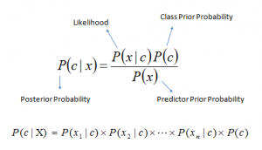
Naïve Bayes
It is a classification technique based on Bayes’ Theorem with an assumption of independence among predictors.
In simple terms, a Naive Bayes classifier assumes that the presence of a particular feature in a class is unrelated to the presence of any other feature.
Even if these features depend on each other or upon the existence of the other features, all of these properties independently contribute to the probability that this fruit is an apple and that is why it is known as ‘Naive’.
Bayes theorem:

Slide 30
TESTING AND PERFORMANCE ANALYSIS
UNIT TESTING
Unit Testing is a type of software testing where individual units or components of a software are tested. In this project, In the module of registration each input is denoted with specify constraint and the violation of these constraint will display error message. Thus it verify the unit testing.
Result:
All the test cases mentioned above passed successfully. No defects encountered

Slide 31
TABLE 1.1 DRUG OWNER LOGIN TEST REPORT
MODULE : DRUG OWNER AND TESTER REGISTRATION
SCREEN: (1) DRUG OWNER LOGIN
s.no | ACTION | INPUT | EXPECTED OUTPUT | ACTUAL OUTPUT | TEST RESULT
1. | Enter the username,password for registration. | Username:XXX Password: *** | XXX *** | XXX *** | passed
2. | Compare username and password with registered field | Username:XXX Password: *** | It Redirects to drug component uploading page. | It redirects to drug component uploading page. | passed
3. | Compare username and password with registered field | Username:XXy Password: *** | Invalid username and password. | Invalid username and password | passed

Slide 32
TABLE 1.2 DRUG OWNER REGISTRATION TEST REPORT
MODULE : DRUG OWNER AND TESTER REGISTRATION
SCREEN: (2) DRUG OWNER REGISTRATION
S.NO | ACTION | INPUT | EXPECTED OUTPUT | ACTUAL OUTPUT | TEST RESULT
1. | Drug Owner should provide name, mail id ,contact no,Lab Name and Lab Id. | Name:Jayalakshmi Mail id: jay@gmail.com Contact no:9876543210 Lab Name:ABC Lab ID:1234 | These details will be stored in drug Owner database. | These details will be stored in drug owner database. | Passed.
2. | Drug Owner should provide name, mail id ,contact no,Lab Name and Lab Id. | Name:Jayalakshmi Mail id: jaygmailcom Contact no:9876543210 Lab Name:ABC Lab ID:1234 | Please match the requested format for Mail Id. | Please match the requested format for Mail Id. | passed
3. | Drug Owner should provide name, mail id ,contact no,Lab Name and Lab Id. | Name:Jayalakshmi Mail id: jay@gmail.com Contact no:98765432 Lab Name:ABC Lab ID:1234 | Please match the requested format for Contact number. | Please match the requested format for Contact number. | passed

Slide 33
TABLE 1.3 DRUG TESTER REGISTRATION TEST REPORT
MODULE : DRUG OWNER AND TESTER REGISTRATION
SCREEN: (3) DRUG TESTER REGISTRATION
S.NO | ACTION | INPUT | EXPECTED OUTPUT | ACTUAL OUTPUT | TEST RESULT
1. | Drug Tester should provide name, mail id ,contact no and Tester Id. | Name:Saiveena Mail id: saiveena@gmail.com Contact no:9876543210 Tester ID:1234 | These details will be stored in drug Owner database. | These details will be stored in drug owner database. | Passed.
2. | Drug Owner should provide name, mail id ,contact no and Tester Id. | Name:Saiveena Mail id: saiveenagmailcom Contact no:9876543210 Tester ID:1234 | Please match the requested format for Mail Id. | Please match the requested format for Mail Id. | passed
3. | Drug Owner should provide name, mail id ,contact no and Tester Id. | Name:Saiveena Mail id: saiveena@gmail.com Contact no:98765432 Tester ID:1234 | Please match the requested format for Contact number. | Please match the requested format for Contact number. | passed

Slide 34
TABLE 1.3 UPLOADING DRUG COMPONENT TEST REPORT
MODULE : DRUG COMPONENT UPLOADING
SCREEN: (4) DRUG COMPONENT UPLOAD
S.NO | ACTION | INPUT | EXPECTED OUTPUT | ACTUAL OUTPUT | TEST RESULT
1. | Drug Owner should provide drug name, drug id, date of upload and drug component file. | Drug Name:XYZ Drug ID:12345 Date of Upload:MM-DD-YYYY File:drug1.csv | These details will be stored in drug Owner database. | These details will be stored in drug owner database. | Passed.
2. | Drug Owner should provide drug name, drug id , date of upload and drug component file. | Drug Name:Zincovit Drug ID:1234 Date of Upload:22-06-2020 File:drug1.csv | Please match the requested format for Date of upload. | Please match the requested format for Date of upload. | passed
3. | Drug Owner should provide drug name, drug id , date of upload and drug component file. | Drug Name:Zincovit Drug ID:1234 Date of Upload:22-06-2020 File:drug1.csv | Please match the requested format for File upload. | Please match the requested format for file upload. | Passed.

Slide 35
INTEGRATION TESTING
INTEGRATION TESTING is a level of software testing where individual units / components are combined and tested as a group. In this project, in the page of drug component uploading when we click submit it gets stored in the crowd similarly when we send request it gets notified to the drug owner to accept or decline the request. Thus the integration testing is done successfully and validated.
Result:
All the test cases mentioned above passed successfully. No defects encountered

Slide 36
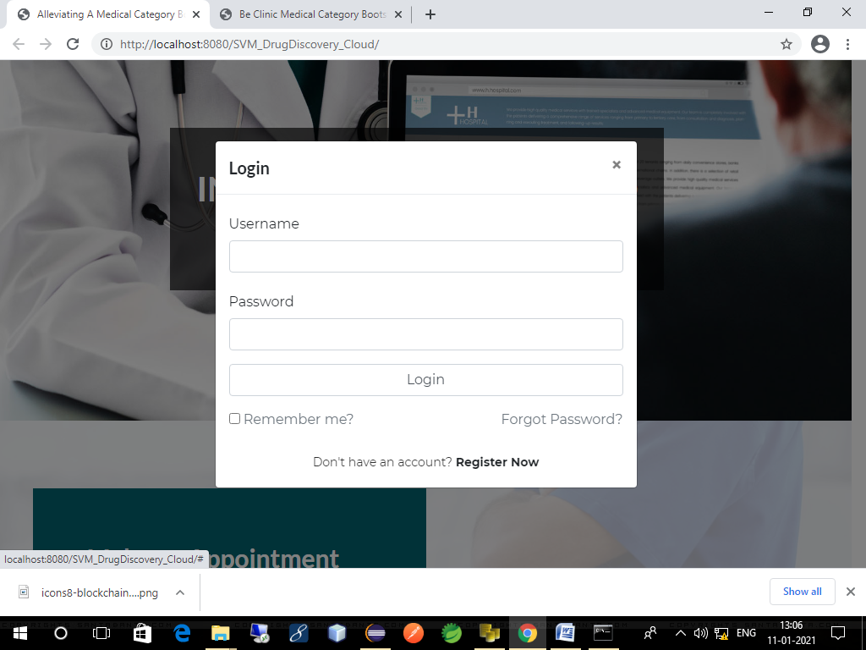
SCREENSHOTS
(1) DRUG OWNER LOGIN

Slide 37
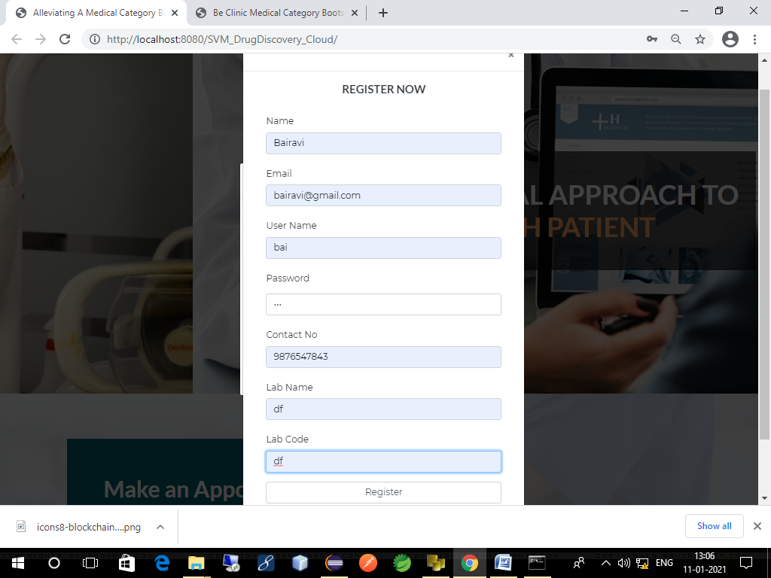
SCREENSHOTS
(2) DRUG OWNER REGISTRATION

Slide 38
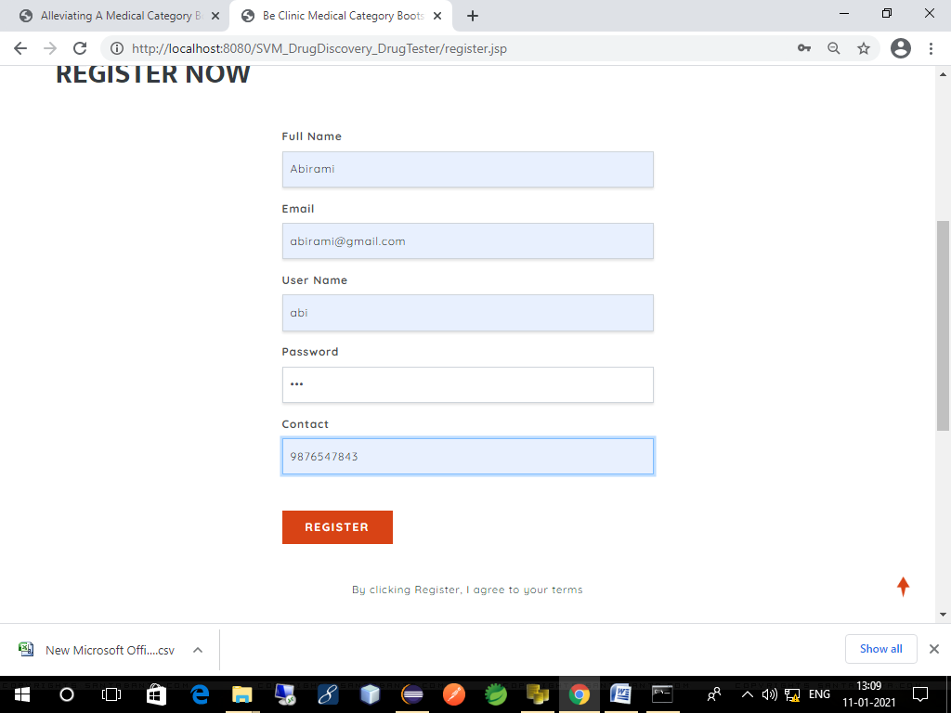
SCREENSHOTS
(3) DRUG TESTER REGISTRATION

Slide 39
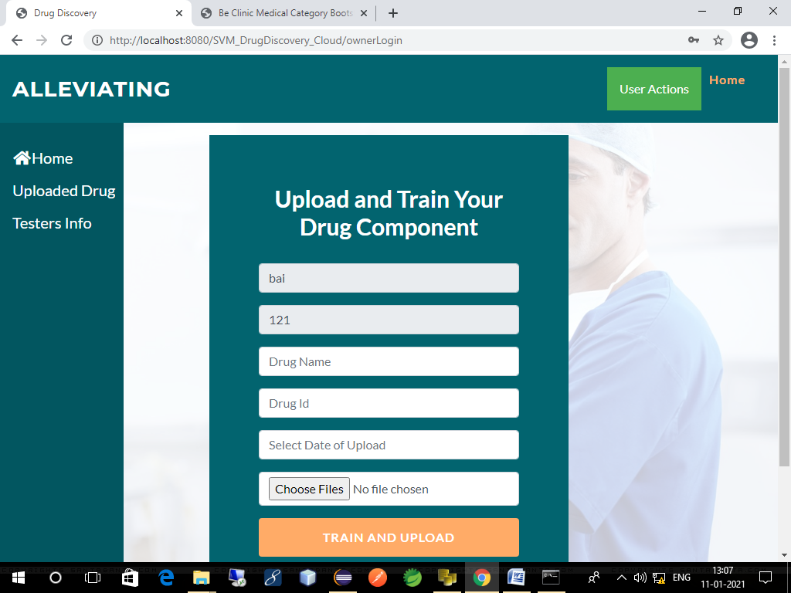
SCREENSHOTS
(4) DRUG COMPONENT UPLOAD

Slide 40
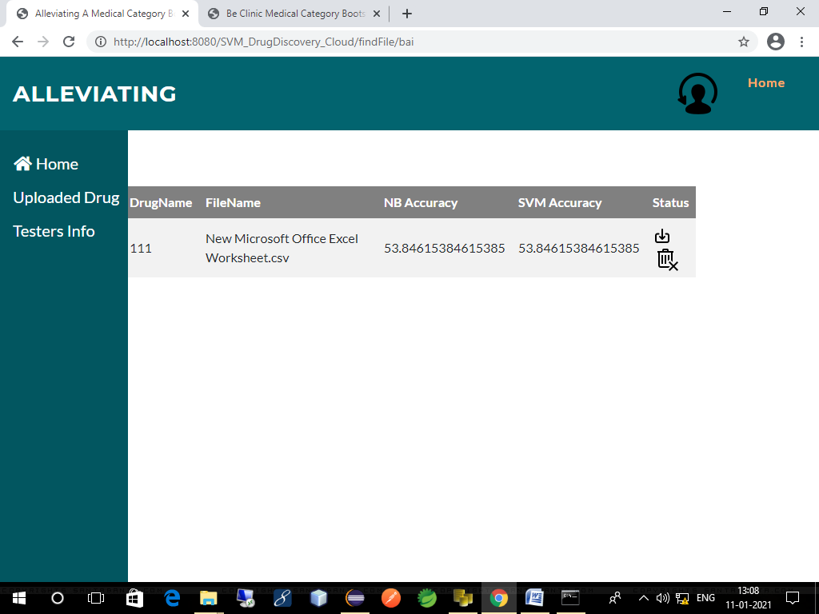
SCREENSHOTS
(5) UPLODED DRUG COMPONENT

Slide 41
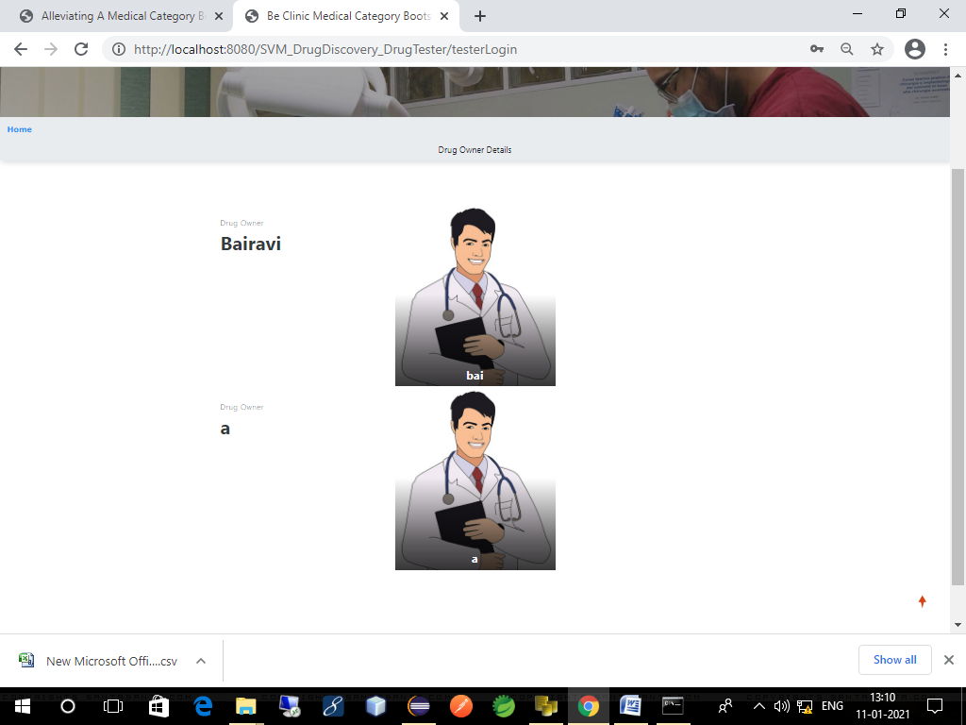
SCREENSHOTS
(6) LIST OF REGISTERED DRUG OWNERS

Slide 42
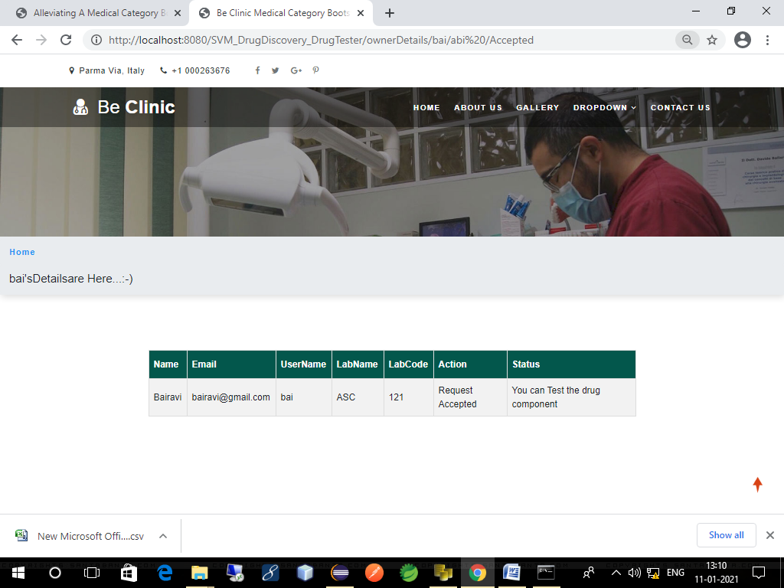
SCREENSHOTS
(7) DRUG TESTER SENDS REQUEST TO DRUG OWNER

Slide 43
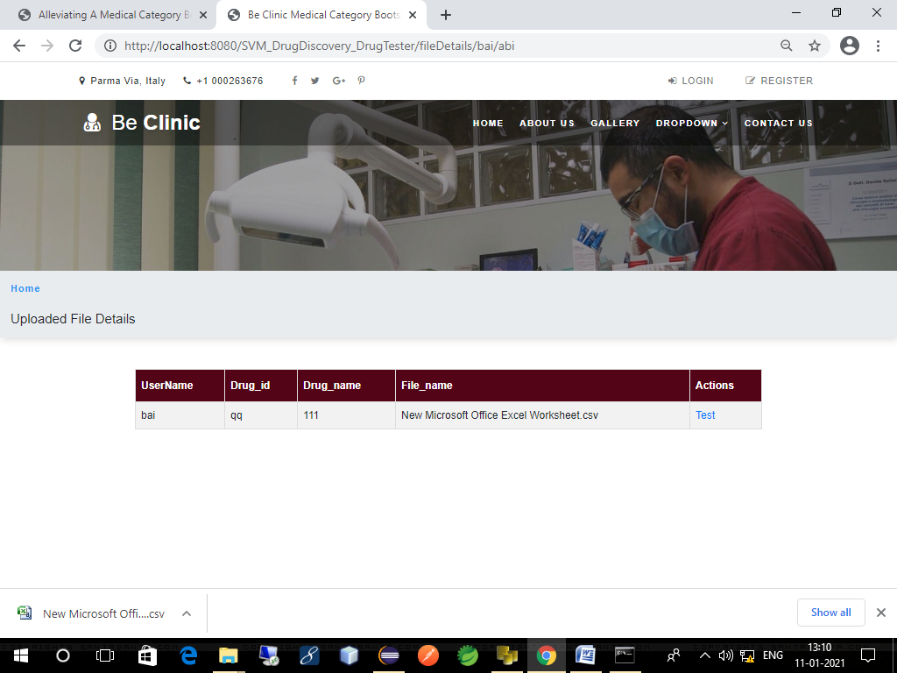
SCREENSHOTS
(8) DRUG COMPONENTS TESTING

Slide 44
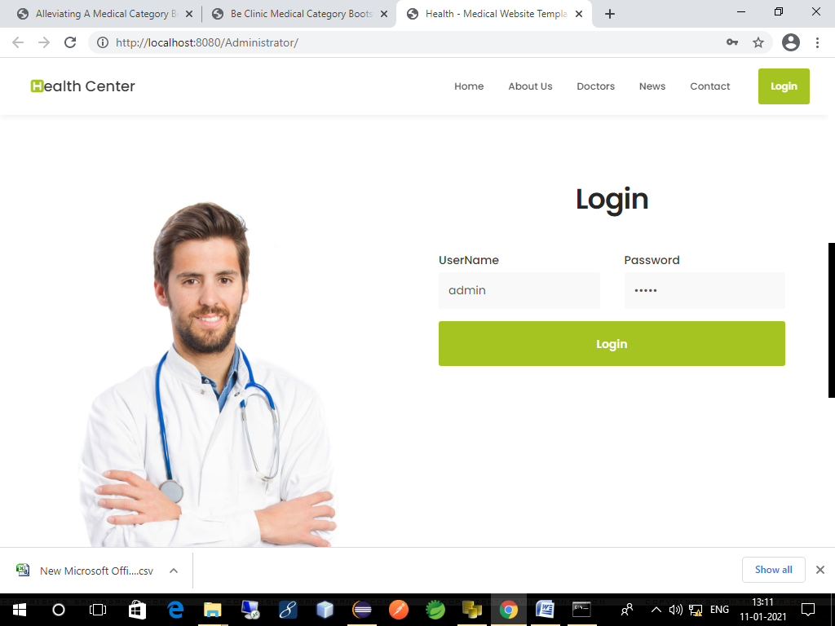
SCREENSHOTS
(9) ADMIN LOGIN

Slide 45
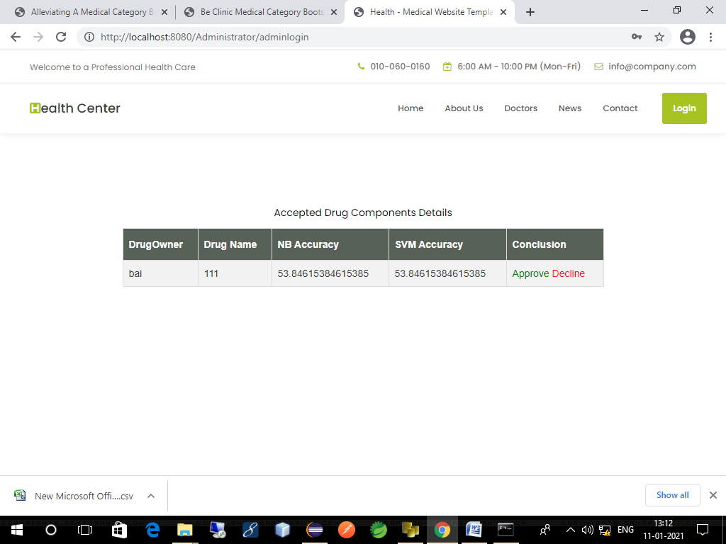
SCREENSHOTS
(10) NB AND SVM ACCURACY OF DRUG COMPONENT

Slide 46
CONCLUSION AND FUTURE ENHANCEMENT
Conclusion
We proposed POD, a new privacy preserving outsourced drug discovery in the cloud. POD is designed to facilitate drug manufacturers to securely outsource their formulas to the cloud for storage and SVM and NB training.
The trained model could be used for authorized client’s compound classification in a privacy-preserving way. Specifically, we designed a secure domain transformation protocol and several basic secure computation components for secure outsourced computation across different parties.
We also built two key secure components (i.e. secure parameter selection and secure sequential minimal optimization) to achieve privacy-preserving SVM and NB training in drug discovery.
Future Work
We will be extending our approach to support more sophisticated data mining method in order to support very large dataset in drug discovery.

Slide 47
REFERENCES
Dibyendu Dana , Satishkumar V. Gadhiya , Luce G. St. Surin , David Li , Farha Naaz ,Quaisar Ali,“Deep Learning in Drug Discovery and Medicine; Scratching the Surface”, The British journal of pharmacology, vol. 162, no. 6, pp. 1239–1249, 2018
Yaman Akbulut 1 ID , Abdulkadir ¸ Sengür 1,* ID , Yanhui Guo 2 and Florentin Smarandache, “A Novel Neutrosophic Weighted Extreme Learning Machine for Imbalanced Data Set ”,Journal of chemical information and computer sciences, vol. 44, no. 5, pp. 1630–1638, 2017
Richard C. Mohsa, Nigel H. Greig, “Drug discovery and development: Role of basic biological research,” IEEE Journal of Biomedical and Health Informatics, vol. 20, pp. 655 – 668, 2017
Aniket Sharma, “Needle Free Drug Delivery Devices Market Size, Industry Outlook and Opportunity Analysis Report 2018-2025 ”
Shu- Feng Zhou , Wei-Zhu Zhong,” Drug Design and Discovery: Principles and Applications ”, Drug discovery today, vol. 17, no. 19, pp. 1088–1102,2017.

Slide 48
REFERENCES
6. Y. Rahulamathavan, S. Veluru, R. C.-W. Phan, J. A. Chambers, and M. Rajarajan, “Privacy-preserving clinical decision support system using gaussian kernel-based classification,” Biomedical and Health Informatics, IEEE Journal of, vol. 18, no. 1, pp. 56–66, 2015.
7. R. Bost, R. A. Popa, S. Tu, and S. Goldwasser, “Machine learningclassification over encrypted data,” in 22nd Annual Network and Distributed System Security Symposium, NDSS 2015, San Diego, California, USA, February 8-11, 2015.
8. Y. Rahulamathavan, R. C.-W. Phan, S. Veluru, K. Cumanan, and M. Rajarajan, “Privacy-preserving multi-class support vector machine for outsourcing the data classification in cloud,” IEEE on Dependable and Secure Computing, vol. 11, no. 5, pp. 467–479, 2014.
9. J. B. Mitchell, “Machine learning methods in chemoinformatics,” Wiley Interdisciplinary Reviews: Computational Molecular Science, . 4, no. 5, pp. 468–481, 2014.
10. M. A. Lill and M. L. Danielson, “Computer-aided drug design platform using pymol,” Journal of computer-aided molecular design, vol. 25, no. 1, pp. 13–19, 2011.

Slide 49
THANK YOU

Slide 50
S.NO | TITLE | AUTHOR | YEAR | INFERENCE | DRAWBACKS
4. | Needle Free Drug Delivery Devices Market Size, Industry Outlook and Opportunity Analysis Report 2018-2025 | Aniket Sharma | 8th ACM SIGSAC symposium on Information, computer and communications security. ACM, 2013, pp. 541–546.2019 | The global Needle-Free Drug Delivery Devices Market report is a tailored made research service providing informative data and various critical aspects of the market such as market outlook, market share, growth, and trends.Moreover, the report also highlights the key strategy of top players. Additionally, this report covers a wide spectrum of services such as the latest technology trend, market opportunity analysis, and competitive landscape | This Needle free drug discovery is yet to be developed and to carry on this discovery we need advanced expensive technology.

Slide 51
S.NO | TITLE | AUTHOR | YEAR | INFERENCE | DRWBACKS
9 | Machine learning methods in chemoinformatics | J. B. Mitchell | Wiley Interdisciplinary Reviews: Computational Molecular Science, . 4, no. 5, pp. 468–481, 2014. | Machine learning algorithms are generally developed in computer science or adjacent disciplines and find their way into chemical modeling by a process of diffusion. This discussion is concentrate on methods for supervised learning, predicting the unknown property values of a test set of instances, usually molecules, based on the known values for a training set. Particularly relevant approaches include Artificial Neural Networks, Random Forest, Support Vector Machine, k‐Nearest Neighbors and naïve Bayes classifiers. | Although numerous articles cited herein have compared performances of the various machine‐learning algorithms used in chemoinformatics, there is no single best method for all problems. The relative abilities of methods will depend on the size and distribution in chemical space of the dataset, the linearity etc.

Slide 52
S.NO | TITLE | AUTHOR | YEAR | INFERENCE | DRAWBACKS
10 | Computer-aided drug design platform using pymol | M. A. Lill and M. L. Danielson | Journal of computer-aided molecular design, vol. 25, no. 1, pp. 13–19, 2011. | Over the decades, many powerful standalone tools for computer-aided drug discovery have been developed in academia providing insight into protein-ligand interactions. As programs are developed by various research groups, a consistent user-friendly graphical working environment combining computational techniques such as docking, scoring, molecular dynamics simulations, and free energy calculations is needed. | Despite advances in biotechnology and understanding of biological systems, drug discovery is still a lengthy, costly, difficult, and inefficient process with a high attrition rate of new therapeutic discovery.

Slide 53
REFERENCES
11. G. Cano, J. Garcia-Rodriguez, A. Garcia-Garcia, H. Perez-Sanchez, J. A. Benediktsson, A. Thapa, and A. Barr, “Automatic selection of descriptors using random forest: Application to drug discovery,” Expert Systems with Applications, vol. 72, pp. 151–159,
12. Liu, K.-K. R. Choo, R. H. Deng, R. Lu, and J. Weng, “Efficient and privacy-preserving outsourced computation of rational numbers,” IEEE Journal of Biomedical and Health Informatics, vol. 20, pp. 655 – 668, 2016.
13. X. Liu, R. Choo, R. Deng, R. Lu, and J. Weng, “Efficient and privacy-preserving outsourced calculation of rational numbers,” IEEE Transactions on Dependable and Secure Computing, 2016.
14 B. K. Samanthula, H. Chun, and W. Jiang, “An efficient and probabilisticbit decomposition,” in Proceedings of the 8th ACM SIGSAC symposium on Information, computer and communications security. ACM, 2013.
15 X. Liu, R. H. Deng, K.-K. R. Choo, and J. Weng, “An efficient privacy preserving outsourced calculation toolkit with multiple keys,” IEEE Transactions Information Forensics and Security, vol. 11, no. 11, pp. 2401–2414, 2016.

Slide 54
REFERENCE
16. J. Platt, “Sequential minimal optimization: A fast algorithm for training support vector machines,” 1998.
17. R. Todeschini and V. Consonni, Handbook of molecular descriptors. John Wiley & Sons, 2008, vol. 11.
18. S. Kamara, P. Mohassel, and M. Raykova, “Outsourcing multiparty ,” IACR Cryptology ePrint Archive, vol. 2011, p. , 2011. [Online]. Available: http://eprint.iacr.org/2011/272
19. A. Peter, E. Tews, and S. Katzenbeisser, “Efficiently outsourcing multiparty computation under multiple keys,” Information Forensics and Security, IEEE Transactions on, vol. 8, no. 12, pp. 2046–2058, 2013.
20. Y. Xue, Z.-R. Li, C. W. Yap, L. Z. Sun, X. Chen, and Y. Z. Chen, “Effect of molecular descriptor feature selection in support vector machine classification of pharmacokinetic and toxicological properties of chemical agents,” Journal of chemical information and computer sciences, vol. 44, no. 5, pp. 1630–1638, 2004.

Slide 55
REFERENCE
21. D. E. Knuth, “Seminumerical algorithm (arithmetic) the art of computer programming vol. 2,” 1981.
22. H. Yu, J. Vaidya, and X. Jiang, “Privacy-preserving SVM classification on vertically partitioned data,” in Advances in Knowledge and Data Mining, 10th Pacific-Asia Conference, PAKDD 2006, Singapore, April 9-12, 2006, Proceedings, 2006, pp. 647–656.
23. H. Yu, X. Jiang, and J. Vaidya, “Privacy-preserving SVM using nonlinear kernels on horizontally partitioned data,” in Proceedings of the 2006 ACM Symposium on Applied Computing (SAC), Dijon, France, April 23-27, 2006, 2006, pp. 603–610.
24. J. Vaidya, H. Yu, and X. Jiang, “Privacy-preserving SVM classification,” Knowl. Inf. Syst., vol. 14, no. 2, pp. 161–178, 2008.
25. T. Joachims, “Making large-scale svm learning practical,” Technical Report,SFB 475: Komplexit¨atsreduktion in Multivariaten Datenstrukturen, Universit¨at Dortmund, Tech. Rep., 1998.

Slide 56
REFERENCE
26. R. Burbidge, M. Trotter, B. Buxton, and S. Holden, “Drug design by machine learning: support vector machines for pharmaceuticaldata analysis,” Computers & chemistry, vol. 26, no. 1, pp. 5–14, 2001.

