Slide 1
A LIGHT WEIGHT CNN MODEL FOR FIRE DETECTION
GUIDE
P.DEEPA M.E.
Associate Prof .Dept of CSE
Panimalar Engineering College.
BY
SOWMIYA.S(211417104266)
SUSHMITHA.B(211417104279)

Slide 2
ABSTRACT
Vision based fire detection framework has lately picked up popularity when contrasted with customary fire recognition framework dependent on sensors. The need of video perception at private, Modern, business regions and woods areas has expanded the use of vision based fire acknowledgment system. Recently lots of fire related accidents has occurred due to improper Surveillance or unable to cover those uncertain regions like restricted areas in forest or any factory buildings. In order to overcome such accidents , this project provides a new method using Convolutional neural networks (RCNN).

Slide 3
LITERATURE SURVEY
S.NO | JOURNAL NAME AND YEAR | AUTHOR NAME | PAPER TITLE | MERITS | DEMERITS
1 | IEEE TRANSACTIONS ON CIRCUITS AND SYSTEMS FOR VIDEO TECHNOLOGY, VOL. 25, NO. 9, SEPTEMBER 2015 | Pasquale Foggia,Alessia saggese,and Mario Vento | Real-Time Fire Detection for Video-Surveillance Applications Using a Combination of Experts Based On Color, Shape, and Motion | The main advantage deriving from this approach lies in the fact that the overall performance of the system significantly increase with a relatively small effort made by the designer. We considered dataset; at the same time, although having a less true positive further reduces the false positive rate, conquering the best rank on this aspect | The thresholding of potential fire pixels is not based on a simple heuristics but instead on a support vector machine, able to provide a good generalization without requiring problem domain knowledge. Algorithm is less sensitive to variations in the luminance of the environment, its main drawback compared with other color based approaches.

Slide 4
LITERATURE SURVEY
S.NO | JOURNAL NAME AND YEAR | AUTHOR NAME | PAPER TITLE | MERITS | DEMERITS
2 | SIBGRAPI Conference on Graphics, Patterns and Images, 2015 -IEEE | Daniel Y. T. chino, Letricia P. S. Avalhais, Jose F. Rodrigues Jr.,Agma J.M. Traina | BoWFire: Detection of fire in Still Images by Integrating Pixel Color and Texture Analysis | Flames exhibit random behavior, and it is experimentally observed that the underlying random process can be considered as a wide-sense stationary process for a small video region. The method works very well when the fire is clearly visible and in close range, such that the flicker and irregular nature of flames are easily observable | The system does not use a background subtraction method to segment moving regions and can be used, to some extent, with non-stationary cameras. Using larger spatial block sizes decreases the resolution of the algorithm such that smaller fire regions cannot be detected.

Slide 5
LITERATURE SURVEY
S.NO | JOURNAL NAME AND YEAR | AUTHOR NAME | PAPER TITLE | MERITS | DEMERITS
3 | IEEE Transactions on Systems, Man, and Cybernetics: Systems 2018 | Khan Muhammad, Jamil Ahmad, Zhihan Lv, Paolo bellavista, Po yang, Sung Wook Baik. | Efficient Deep CNN-Based Fire Detection and Localization in Video Surveillance Applications | Various abnormal events such as accidents, medical emergencies, and fires can be detected using these smart cameras. Understanding the objects and scenes under observation. Future studies may focus on making challenging and specific scene understanding datasets for fire detection methods and detailed experiments. | These sensors are not well suited to critical environments and need human involvement to confirm a fire in the case of an alarm, involving a visit to the location of the fire. Such systems cannot usually provide information about the size, location, and burning degree of the fire.

Slide 6
PROBLEM STATEMENT
As we know, fire spreads very vastly and will cause a large destruction and ultimately there will be a huge loss to rescue.
In order to eliminate this kind of situation and to reduce the running rate, we have designed a light weight CNN model for fire detection which reduces the false alarm rates as well as overcomes the following listed problems in the traditional methods.
a) Dead battery Certain smokes alarms are not hardwired into home electrical system rely on battery power. So, it require regular checking and not function when battery dead.
b) Steam interference False alarm also will trigger when steam (maybe from bathroom or steam room) interrupt the light beams of electrical current inside smoke detector.
c) Dusty deception High dusty area or insects can trip sensor inside alarm and make false alarm.
d) Residual smoke from burned food (stoves, toasters or oven) also can trigger wrong alarm.
e) Delay trigger alarm Available smoke sometime will take long delay although already detect smoke before trigger alarm to people.

Slide 7
TECHNOLOGY STACK
Software Requirements:
Operating System : Windows 7 , 8, 10 (64 bit)
Software : Python 3.7
Tools : Anaconda (Jupyter Note Book IDE)
Hardware Requirements:
Hard Disk : 500GB and Above
RAM : 8GB
Processor : I3 and Above
Webcam 1

Slide 8
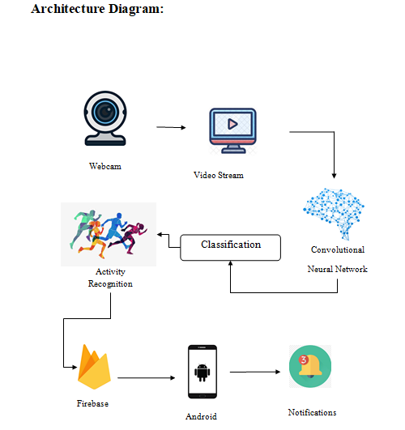
SYSTEM ARCHITECTURE

Slide 9
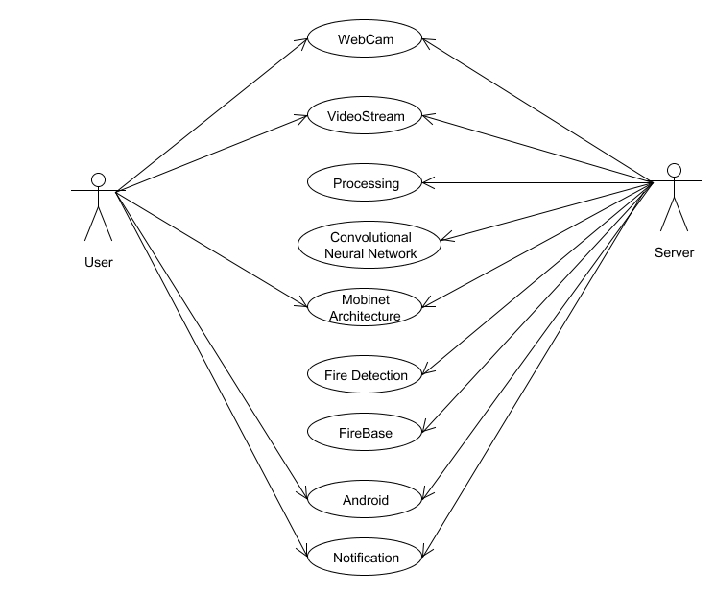
SYSTEM DESIGN
USECASE DIAGRAM

Slide 10
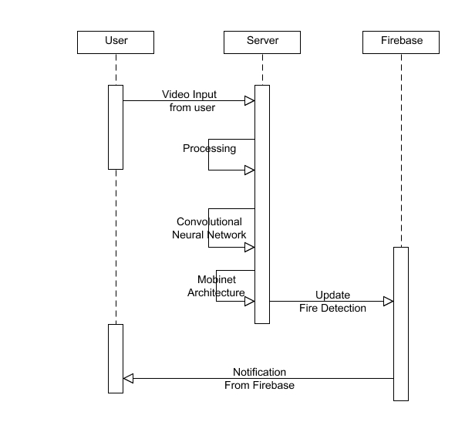
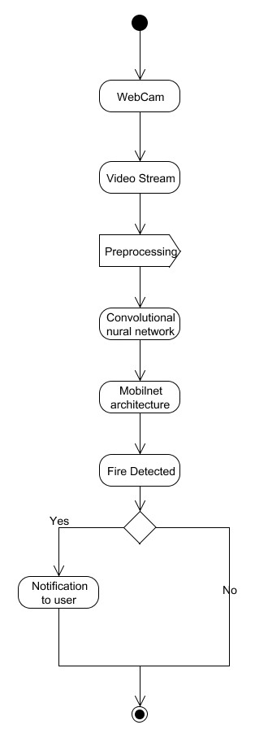
SYSTEM DESIGN
SEQUENCE DIAGRAM
ACTIVITY DIAGRAM

Slide 11
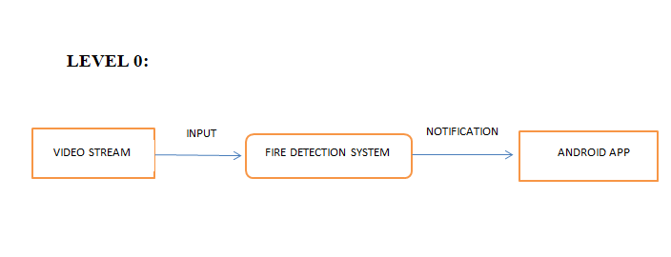
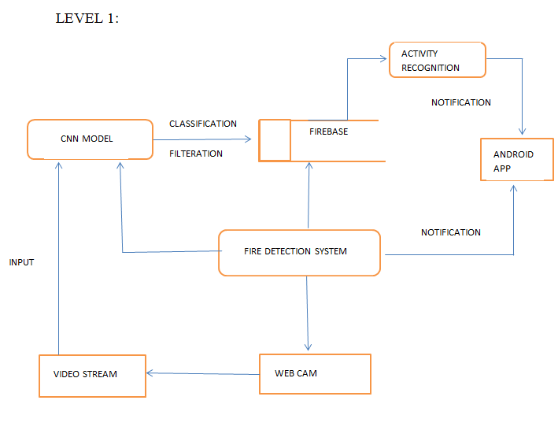
SYSTEM DESIGN
DATA FLOW DIAGRAM

Slide 12
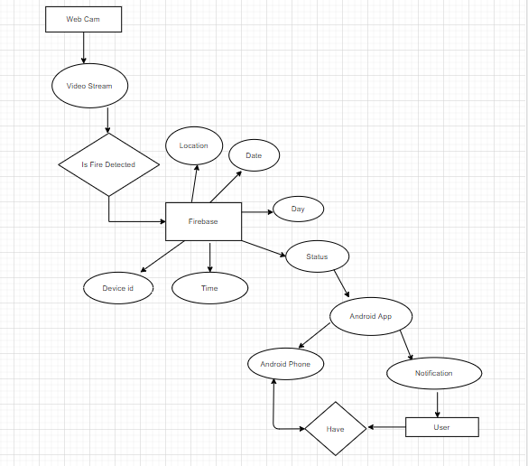
SYSTEM DESIGN
ER DIAGRAM

Slide 13
MODULES DESCRIPITION
DATASET CREATION
FRAME BY FRAME DETECTION
INPUT IDENTIFICATION
DATABASE CREATION
ANDROID APP FOR NOTIFICATIONS

Slide 14
MODULES
DATASET CREATION:
To Collect images of fire and non fire images and train both the fire and non fire images separately.
Now there created a trained dataset with well determined fire images which compares with the video sequence.

Slide 15
MODULES
FRAME BY FRAME DETECTION
The captured images are splitted into frame by frame and the frame is again splitted into pixels with the help of cnn algorithm from the surveillance

Slide 16
MODULES
INPUT IDENTIFICATION
Now a input data is given to the CNN model which identifies whether the input is fire or non fire.
Then indicates a red warning in the background for few seconds ,if the input is fire.
Else for a non fire it indicates a green in the background

Slide 17
MODULES
DATABASE CREATION
FIREBASE:
The Firebase Real-time Database is a cloud-hosted No-SQL database that allows to store and sync data between the users in real-time
Using a gmail account , signed up into a firebase and added our project
If the cnn model detects fire from the input data then, firebase will get updated.
It clearly shows the date , day , time once the fire detected and also the status as “FIRE”

Slide 18
MODULES
ANDROID APP FOR NOTIFICATION
The android app is created to get a notification if the fire is detected .
The Android App “Fire detection” can be installed in users Mobile devices using APK file.
Once fire is detected , firebase gets updated and the status will be send to the app .
The created Android app will give a notification message as “FIRE DETECTED”

Slide 19
ALGORITHM
CONVOLUTION NEURAL NETWORK:
Any neural network is divided into three layers. First layer being the input layer, the second as the hidden layer and the third layer is the output layer.
Each layer consists of several nodes and this number is generally in the power of 2 to maintain the symmetry of the entire model.
The nodes of one layer are connected to the nodes of another layer by means of an edge. And this edge is assigned with a weight which signifies the importance of that node in the outcome of the network.
At every node, the outcome is calculated by the summation of the product of the input nodes and the weights assigned to them.
When we are dealing with images, the data is generally huge and if it is fed as it is, the model becomes clumsy and the training will take a lot of time as well as the memory requirements will be huge. So, we will make use of a Convolutional neural network.
The pre-processed data is fed into the input layer of the Convolutional neural network. At the time of reading the pre-processed data, a filter is applied which helps in decreasing the dimensions of the input data.

Slide 20
TESTING
TEST CASES
S.NO | ACTION | INPUT | EXPECTED OUTPUT | ACTUAL OUTPUT | TEST RESULT | TEST COMMENTS
1. | Fire detection& notification | Test.mp4 | Fire detection& notification to app | Fire is detected& notification is sent to the app | Pass | Status will indicate as Fire detected
S.NO | ACTION | INPUT | EXPECTED OUTPUT | ACTUAL OUTPUT | TEST RESULT | TEST COMMENTS
2. | Fire detection& notification | Test1.mp4 | Fire detection & notification to app | No fire detected | Fail | Status will indicate as clear.

Slide 21
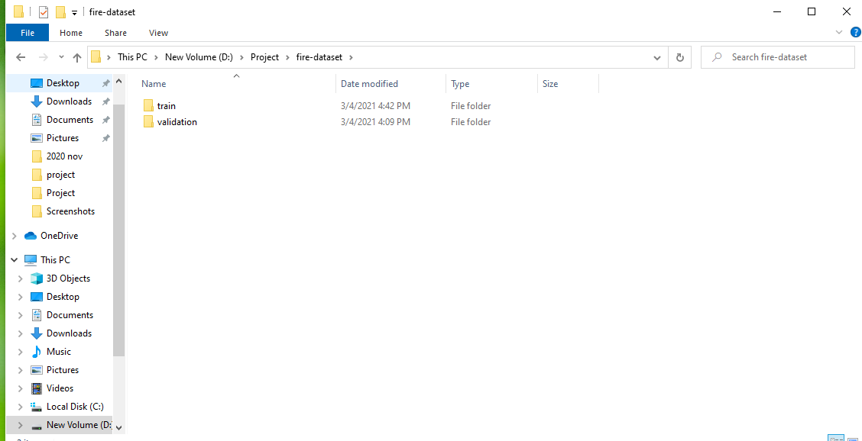
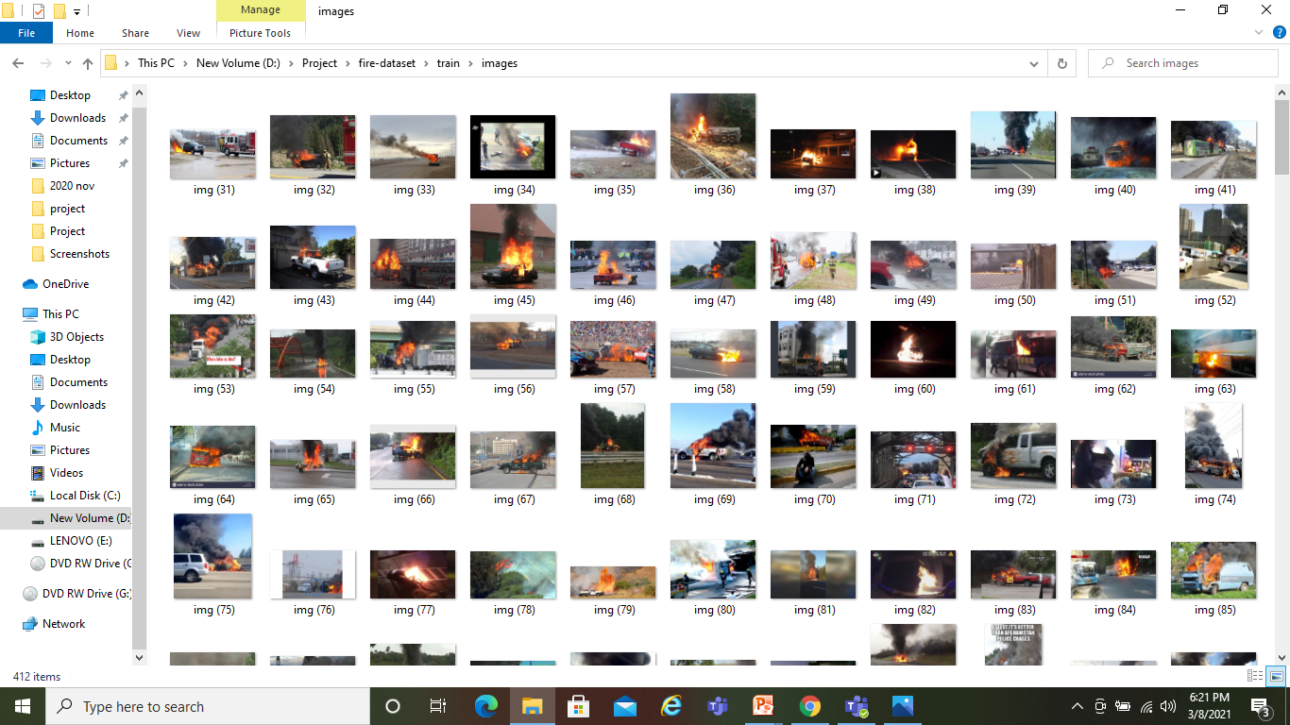
SCREENSHOTS

Slide 22
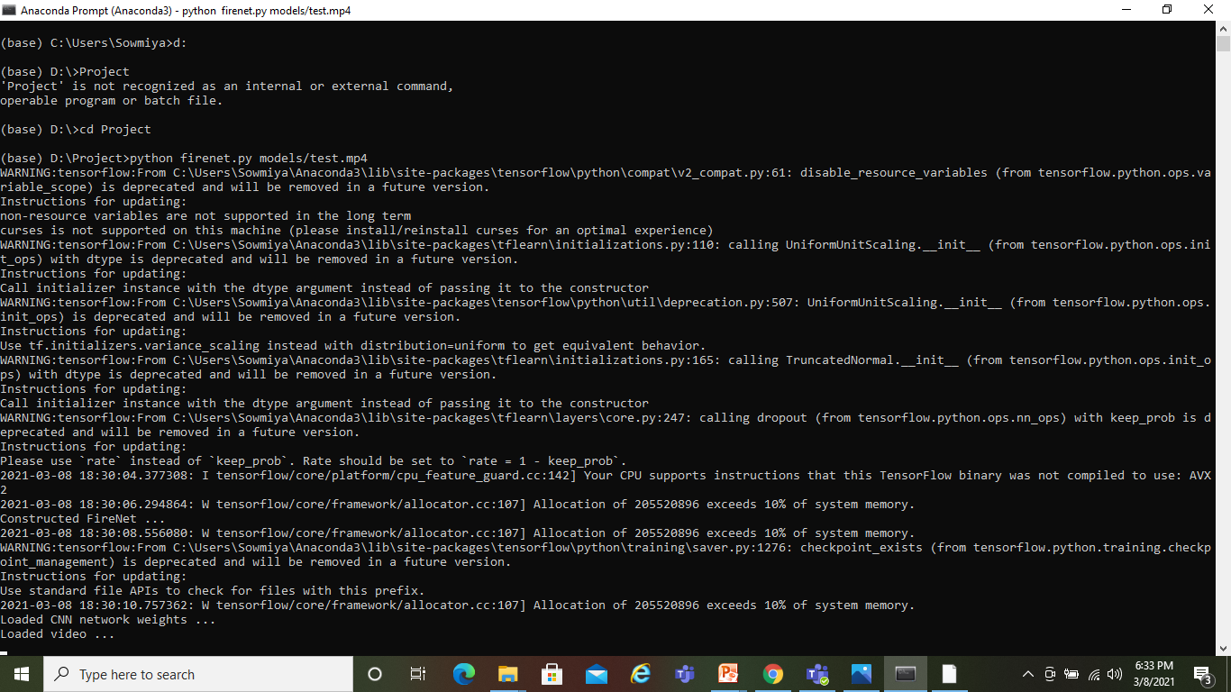
SCREENSHOTS

Slide 23
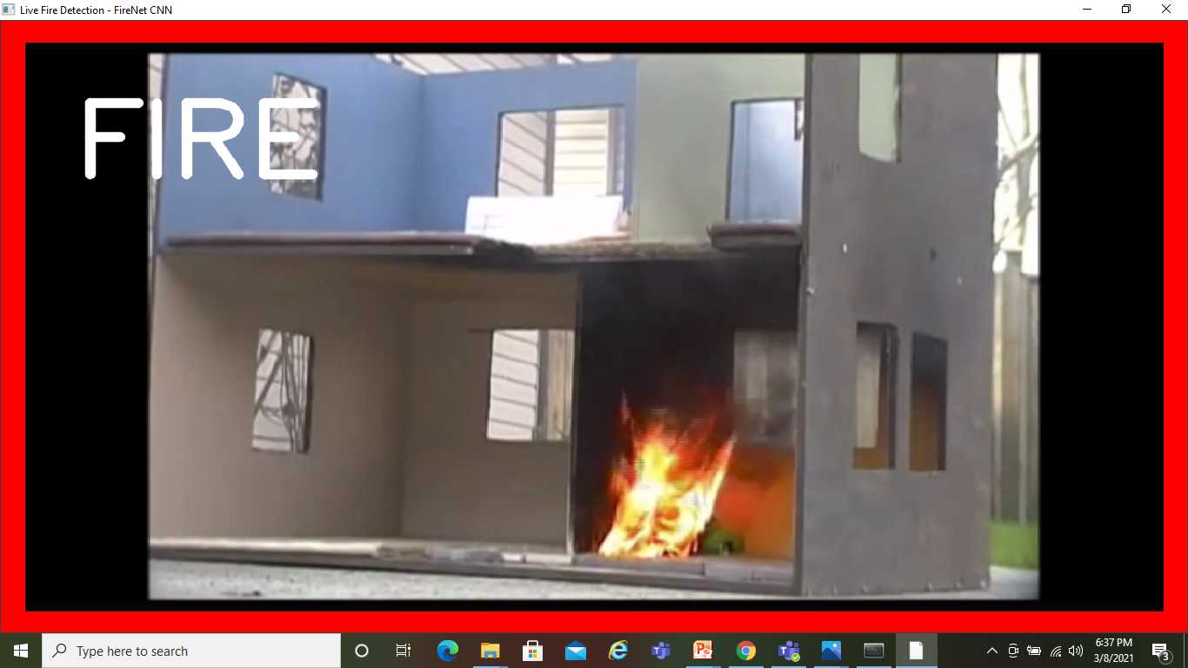
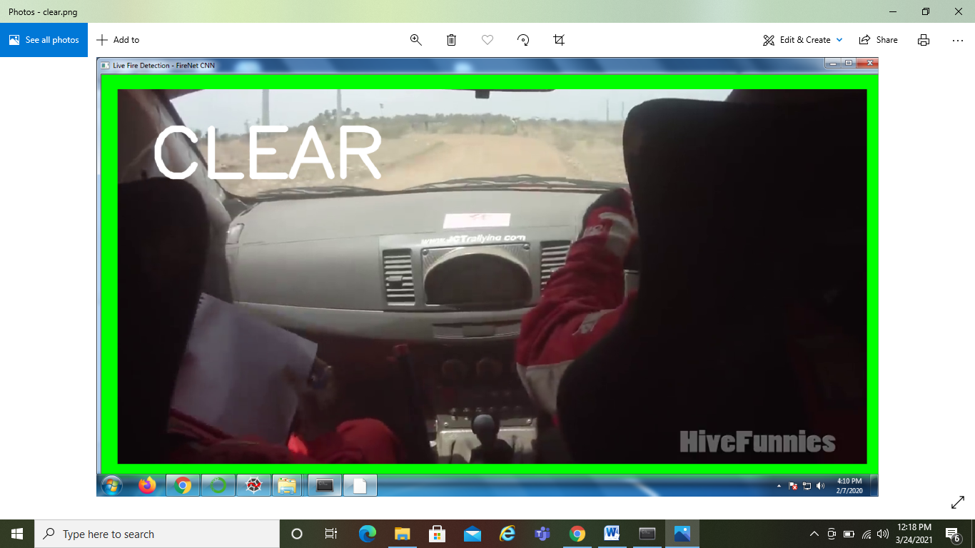
SCREENSHOTS

Slide 24
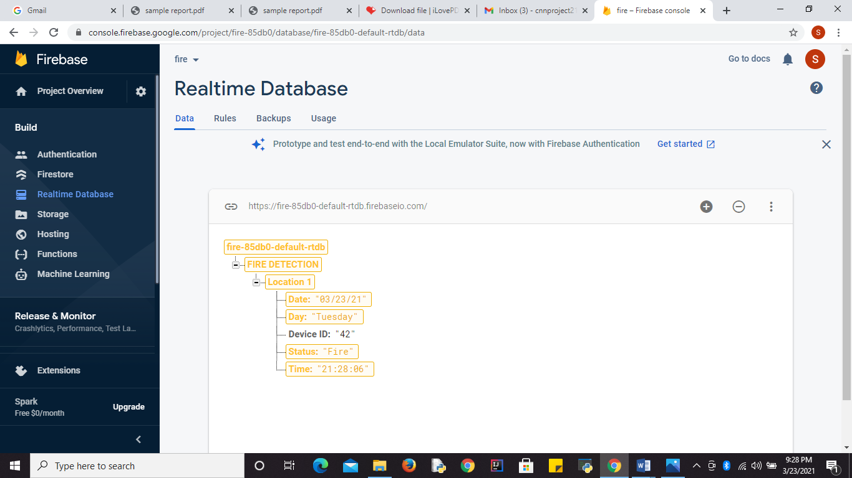

SCREENSHOTS

Slide 25

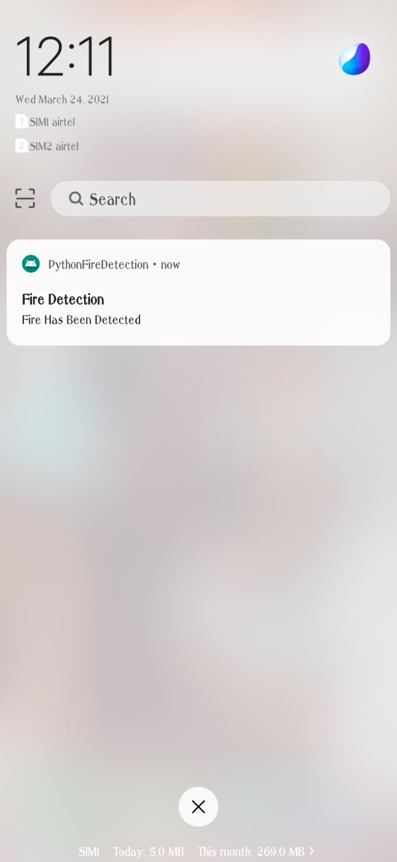
SCREENSHOTS

Slide 26
CONCLUSION
In this work ,our proposed CNN model balances the accuracy of fire detection and the size of the model using fine-tuning of datasets.
We have obtained an accuracy of 94%. This shows that the model gives a better prediction.
We conduct experiments using datasets collected from recording of fire and verified it to our proposed system.
Thus our CNN model’s has higher accuracy which not only reduces the running rate but also false alarms, this system can be helpful to disaster management teams in controlling fire disasters in a short time. Thus, avoiding huge losses.

Slide 27
REFERENCES
[1] R. Raina , A. Madhavan and A. Y. Ng, “Largescale deep un-supervised learning using graphics processors,”Computer Science Department, Stanford University, Stanford CA 94305 USA.
[2] K. Muhammad, R. Hamza, J. Ahmad, J. Lloret, H. H. Ge Wang,and S.W. Baik, “secure surveillance framework for IoT systemsusing probabilistic image encryption,”IEEE Trans. Ind.
[3] A. Krizhevsky, I. Sutskever, and G. E. Hinton, “ImageNet Classification with Deep Con-volutional Neural Networks,“ InNIPS, 2012.
[4] Y. LeCun et al., “Handwritten digit recognition with a back propagationnetwork,” inProc. Adv. Neural Inf. Process. Syst., 1990, pp.396–404
[5] A. Ullahet et al., “Action recognition in movie scenes using deep features of key frames,”J. Korean Inst. Next Generation Comput., vol. 13, pp.7–14,2017.

Slide 28
THANK YOU

