Slide 1
CREATING SECURED MULTI-CLOUDS BY CONTINUOUS AUTOMATED AUDITING USING TERNARY HASH TREE IN AWS
BATCH A1
TEAM
JAYALAKSHMI S(211417104089)
SAI VEENA K(211417104122)
HARINI A(211417104503)
GUIDE
Dr. Kavitha subramani

Slide 2
INTRODUCTION
There are lots of options for how to store and access your data. The main reason why cloud storage is appealing is that files can be accessed and edited with ease. All you need is an internet connection and you can access your files from any device, anywhere. A crucial component of cloud data security is data integrity — preventing unauthorized modification or deletion, and ensuring that data remains as it was when originally uploaded. This will be usually monitored by Third party auditor appointed by the organizations. But it may result in top risks related to data integrity which includes human errors(procrastination),insider threats(corruption of files),malicious intruders, compromised hardware and configuration error etc. Our solution aims at resolving the above mentioned problems. In this work, we proposed a novel integrity verification framework in multi-cloud environment for securing cloud storage using Ternary Hash Tree (THT) and Replica based Ternary Hash Tree (R-THT).This will be used to perform continuous data auditing at specified time intervals which will be set by the admin. Differing from existing work, the auditing will be done in three levels that is block- level, file-level and replica-level with tree block ordering, storage block ordering for verifying the data integrity and ensuring data availability in the cloud. The results show that the proposed secure cloud auditing framework is highly secure and efficient in storage, communication and computation costs.

Slide 3
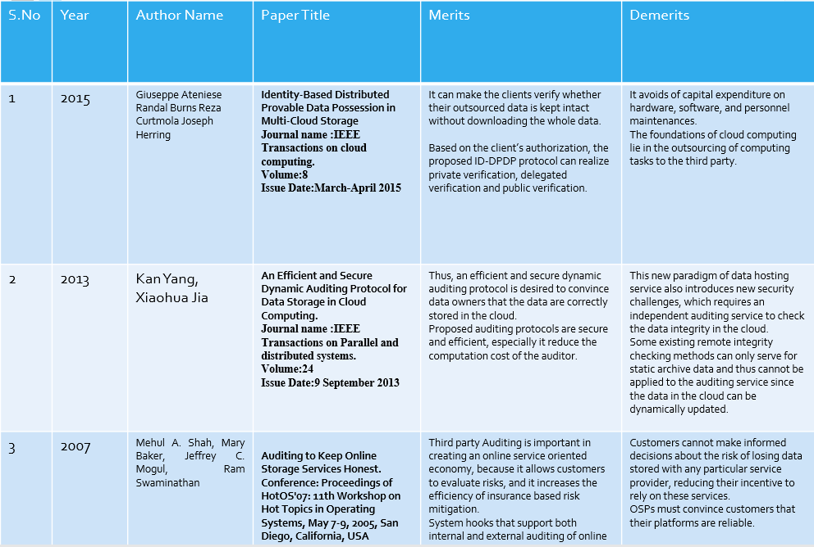
LITRATURE SURVEY

Slide 4
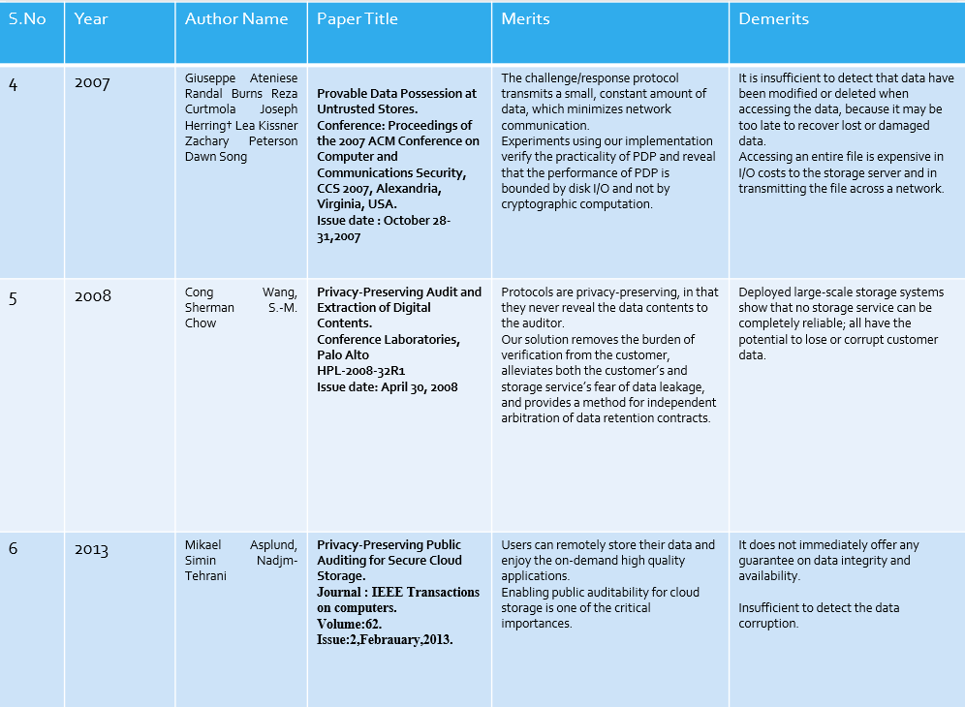

Slide 5
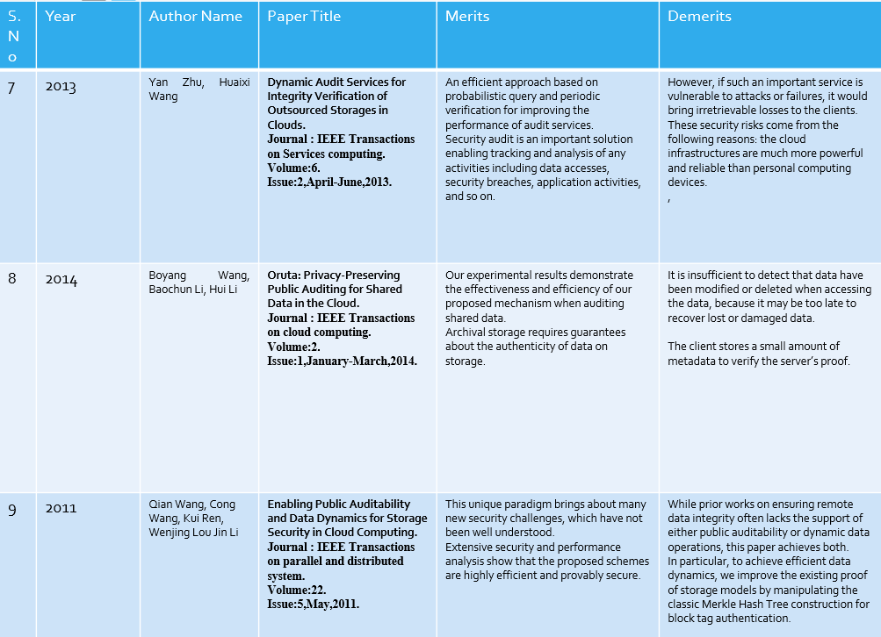

Slide 6
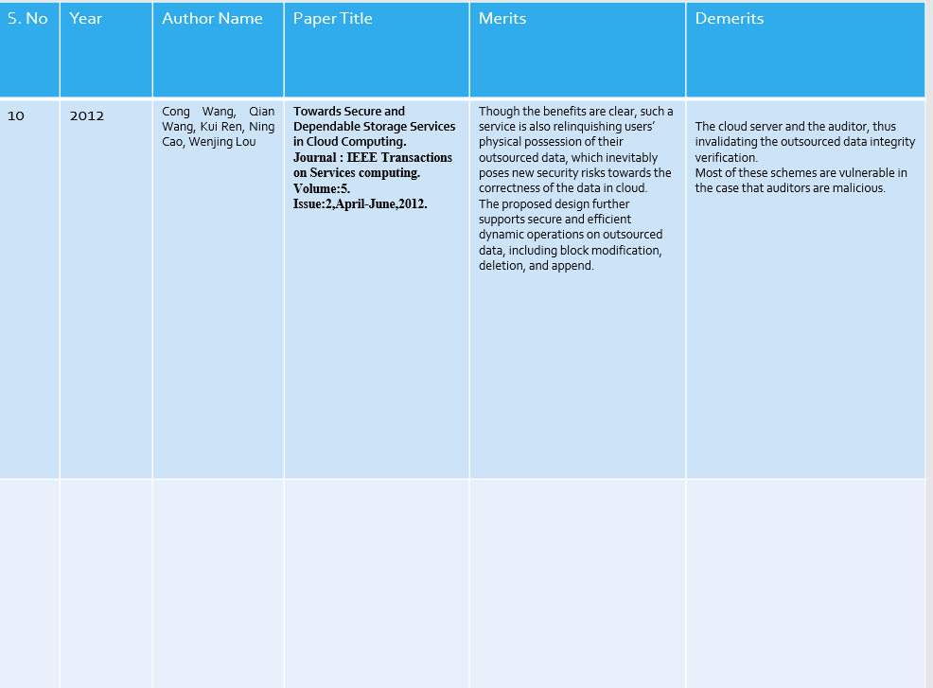

Slide 7
PROBLEM STATEMENT
In this new normal world, cloud storage is a boon for most of the organizations.
Work from home option is possible only because of cloud storage.
On the other hand, it is not easy for cloud users to identify whether Cloud Service Provider's (CSP) tag along with the data security legal expectations.
So, cloud users could not rely on CSP's in terms of trust. A crucial component of cloud data security is data integrity — preventing unauthorized modification or deletion, and ensuring that data remains as it was when originally uploaded.
This will be usually monitored by Third party auditor appointed by the organizations. But it may result in top risks related to data integrity which includes human errors(procrastination), insider threats (corruption of files), malicious intruders, compromised hardware and configuration error etc.
And reliability of certificate given by a Third-party auditor may put in doubt due to its long validity period.

Slide 8
TECHNOLOGY STACK
J2EE (JSP, Servlet)
Struts Framework
JavaScript , Ajax , HTML ,CSS, jquery
Web Services (JAX -WS), JSON.
Software Requirements:
Windows XP and above , JDK 1.7,Tomcat 6.0,Tomcat 7.0,MySql 5.0,eyeOS 2.5,XAMPP.
Hardware Requirements:
Hard Disk : 200GB and Above
RAM : 2GB and Above
Processor : i3 and Above

Slide 9
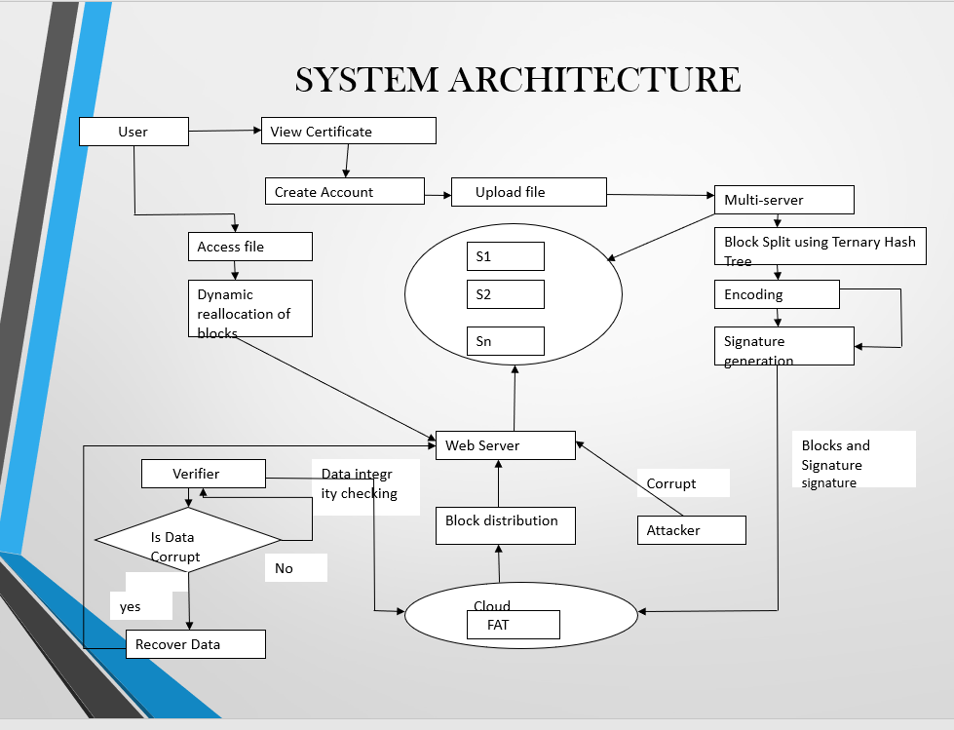
SYSTEM ARCHITECTURE

Slide 10
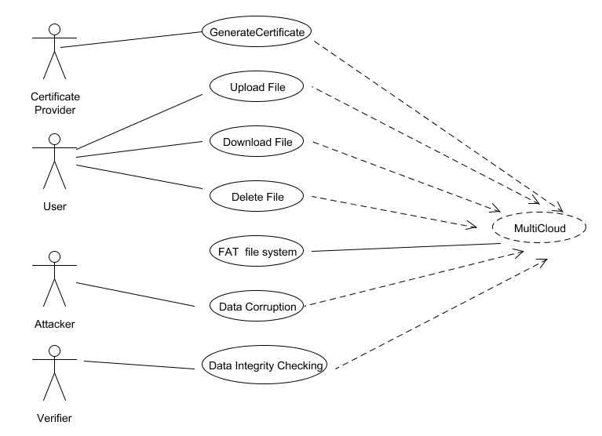
SYSTEM DESIGN UML DIAGRAMS USE CASE DIAGRAM

Slide 11
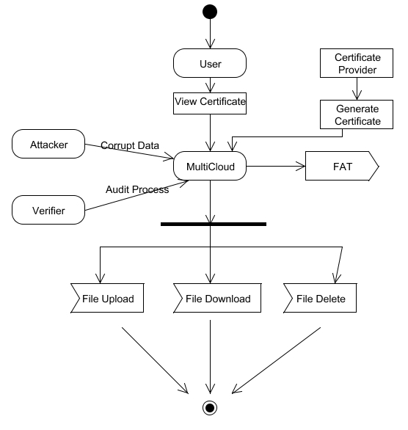
ACTIVITY DIAGRAM

Slide 12
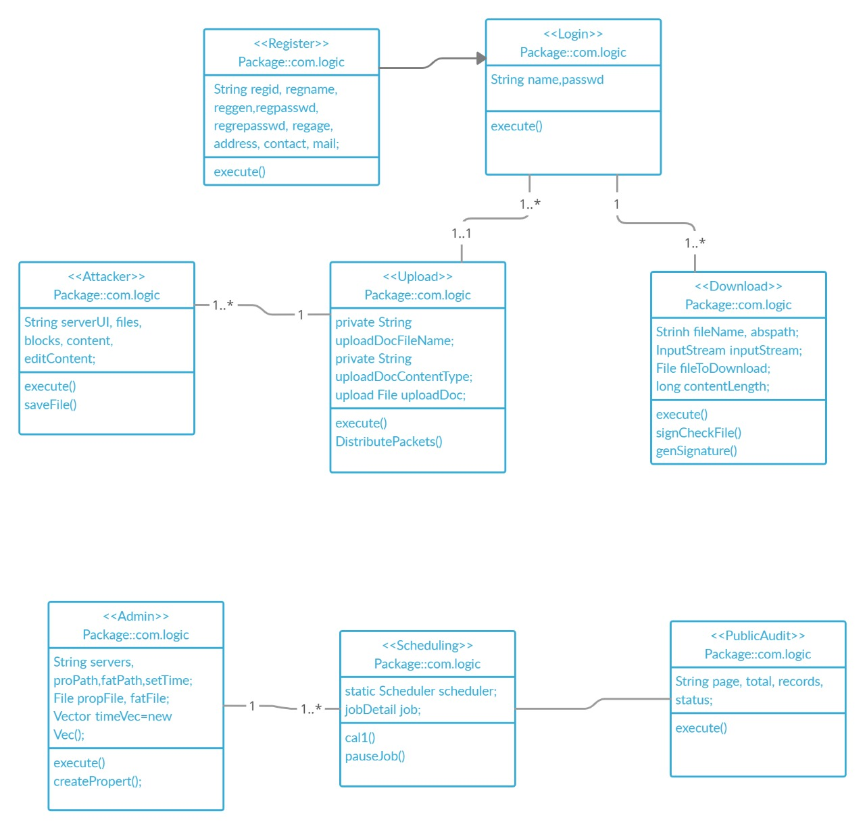
CLASS DIAGRAM

Slide 13
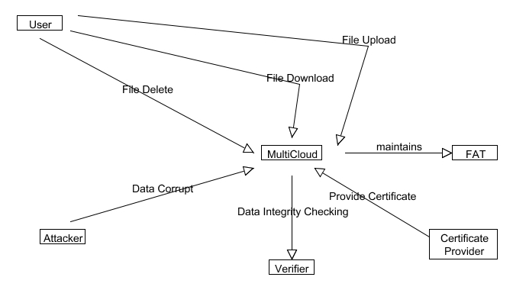
COLLABERATION DIAGRAM

Slide 14
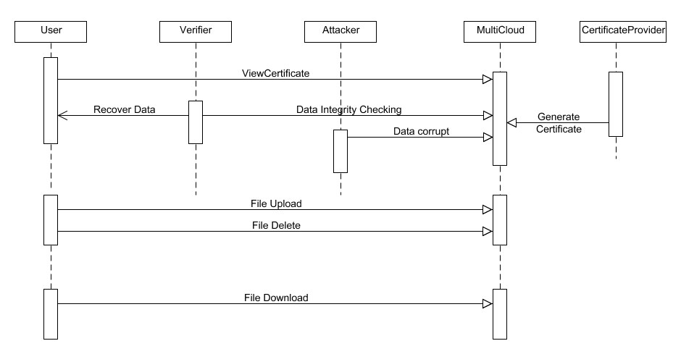
SEQUENCE DIAGRAM

Slide 15
DATABASE DESIGN
ADMIN LOGIN:
Field name | Datatype | Length | Primary key | Constraints
Username | Varchar | 255 | Yes | Primary Key
Password | Varchar | 255 | No | Not null
USER LOGIN:
Field name | Datatype | Length | Primary key | Constraints
Username | Varchar | 255 | Yes | Primary Key
Password | Varchar | 255 | No | Not null

Slide 16
MODULE DESCRIPTION
Server Configuration
Data Upload and Block Split
Data Integrity Checking and Update
File Recovery and Certificate Generation

Slide 17
Server Configuration
Admin configure Multi-Cloud server setup. Server IP Address and Port number is given by the admin for each Cloud. Now a Server Architecture is created for Multi-Cloud Storage.
If the admin has to reconfigure the old Multi-Cloud server setup, it can be done. For old server setup, FAT file can be modified or remain same.
Audit time will be set by the admin for Data Integrity checking process.

Slide 18
Data Upload and Block Split
User has an initial level Registration Process at the web end. The users provide their own personal information for this process.
The server in turn stores the information in its database. After Registration, user can upload files to the server.
Uploaded files will be stored in a Server. When the user upload the data to different cloud by the time it is splitted into different blocks using dynamic block generation Algorithm and each block will be appended with Signatures before storing the data in FATFS.
Signature generated using MD5 Algorithm. Also the data gets encoded using for Base64 Algorithm.

Slide 19
Data Integrity Checking and Update
FATFS has proper Indexing and Metadata’s for the different Chunks of the Data that is being uploaded by User. Verifier performs Remote Integrity Checking on Cloud Data.
Cloud allocates random combination of all the blocks to the Verifier, instead of the whole file is retrieved during integrity checking. This is to protect user privacy from a third party (Verifier).
Verifiable Data Integrity Checking Algorithm is done in two steps: Block Checking and File Checking. In Block Checking step: Three signatures are generated for Block level Checking.
A signature of a block retrieved from a FATFS
A new signature is generated for block to be checked
A Signature is retrieved from the block appended with the signature which is stored in the Cloud
The above three signatures are cross checked for Block level Integrity Checking. And the block contents are appended to verify with File level Integrity Checking.

Slide 20
File Recovery and Certificate Generation
Attacker can corrupt data in any one of the cloud servers. On Data Integrity Checking done by the Verifier, Verifier informs Corrupted blocks to the Cloud. Recovery Process will be done by the verifier automatically when data gets corrupted.
User can complaint to the Cloud if the user file get corrupted (Verifier doesn’t perform checking on this file).
Whenever user access file, Blocks will be reallocated dynamically to provide access confidentiality in cloud and FAT File System will get updated.
Auditor will monitor the cloud continuously and they provide the certificate based on the cloud performance.
When new user join in the cloud they will read the certificate and then they can create an account in the cloud.

Slide 21
ALGORITHMS
Base64 Algorithm
Message Digest(MD5)
Dynamic block generation

Slide 22
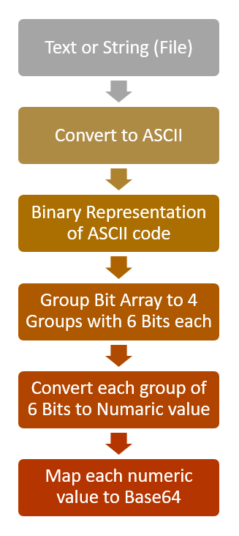
BASE 64 ALGORITHM

Slide 23
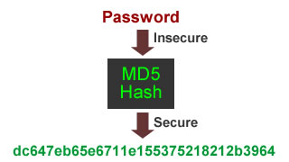
MESSAGE DIGEST(MD5)
MD5 Hash algorithm is a one-way cryptographic function that accepts a message of any length as input
and returns an output of fixed-length digest value(128-bits) to be used for authenticating the original message.

Slide 24
DYNAMIC BLOCK GENERATION ALGORITHM
This algorithm is used to split the data into different blocks using the Dynamic Block Generation algorithm.
The blocks are divided and stored in different servers in order to preserve security.
This algorithm comes into action again if the files get corrupted.
In this case the blocks will be redistributed and stored in different servers automatically.

Slide 25
TESTING AND PERFORMANCE ANALYSIS
ADMIN LOGIN
S.NO | ACTION | INPUT | EXPECTED OUTPUT | ACTUAL OUTPUT | TEST RESULTS
1 | Enter valid username | Username:Admin | Admin | Admin | PASSED
2 | Enter valid password | Password:***** | ***** | ***** | PASSED
3 | Check user name and password with the database | Username:Admin Password:***** | “Login successful "and Go to next page | “Login successful” and Configuration page displayed | PASSED

Slide 26
USER LOGIN
S.NO | ACTION | INPUT | EXPECTED OUTPUT | ACTUAL OUTPUT | TEST RESULTS
1 | (Registration page) Enter valid username,password, Retype password,Gender, Age,Address, Contact no,Email. | Username:XXXXX Password:******** Retype Password:******** Gender:Male/Female Age:25 Address:Chennai Contact no:9876543210 Email:xxx@gmail.com | “Registered successfully” | “Registered successfully” | PASSED
2 | (User login page) Enter valid username and password | Username:XXXXX Password:abcdefgh | “Password should contain one uppercase letter,one lowercase,one special character(@$*),one digit and should contain atleast of length 6” | “Password should contain one uppercase letter,one lowercase,one special character(@$*),one digit and should contain atleast of length 6” | PASSED

Slide 27
S.NO | ACTION | INPUT | EXPECTED OUTPUT | ACTUAL OUTPUT | TEST RESULTS
3 | (User login page) Enter valid username and password | Username:XXXXX Password:******** | Display “Login successful” and Go to File uploading page | Display “Login successful” and Go to File uploading page | PASSED

Slide 28
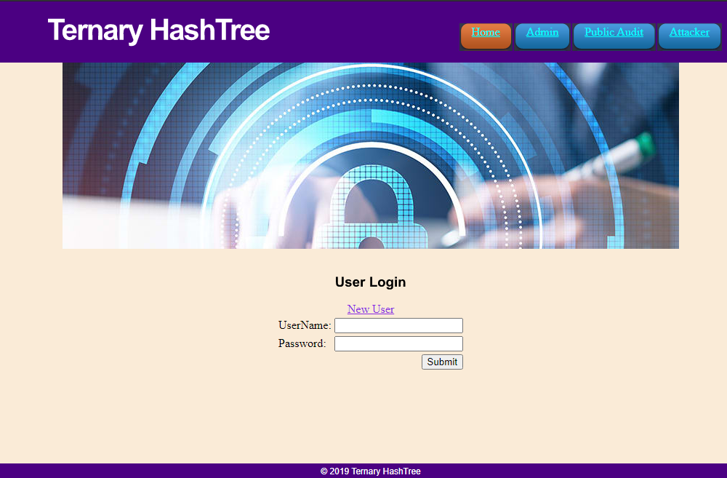
SCREENSHOTS
User Login:

Slide 29
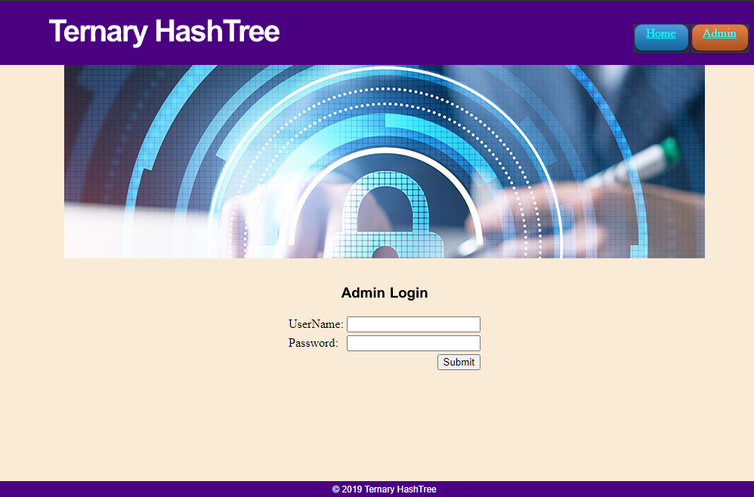
Admin Login:

Slide 30
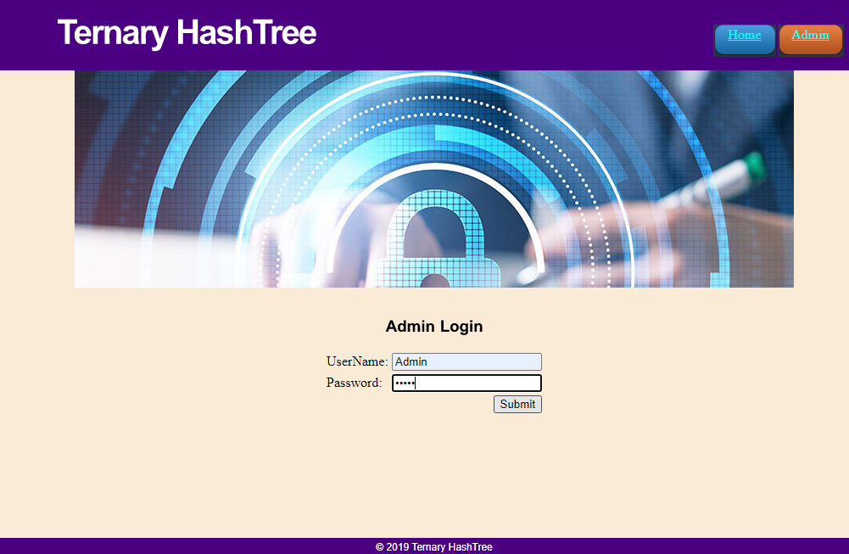

Slide 31
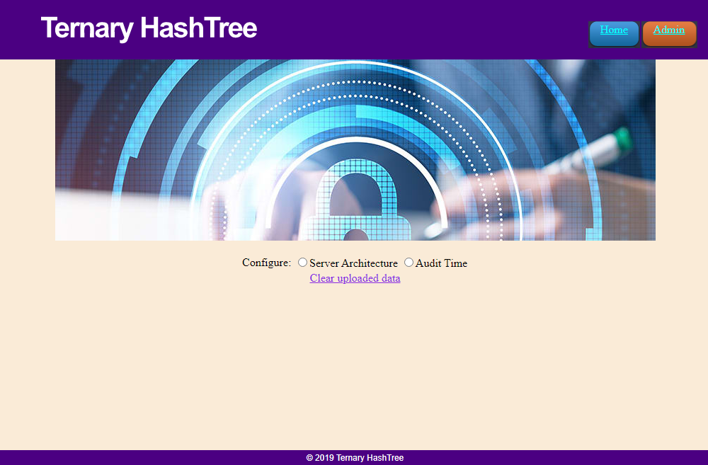
Configurations

Slide 32
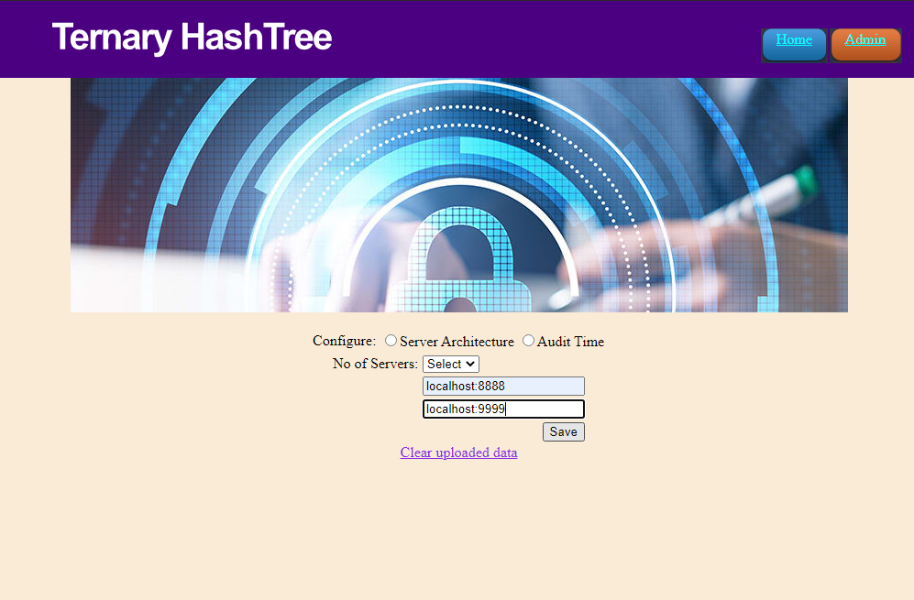
Server Configuration

Slide 33
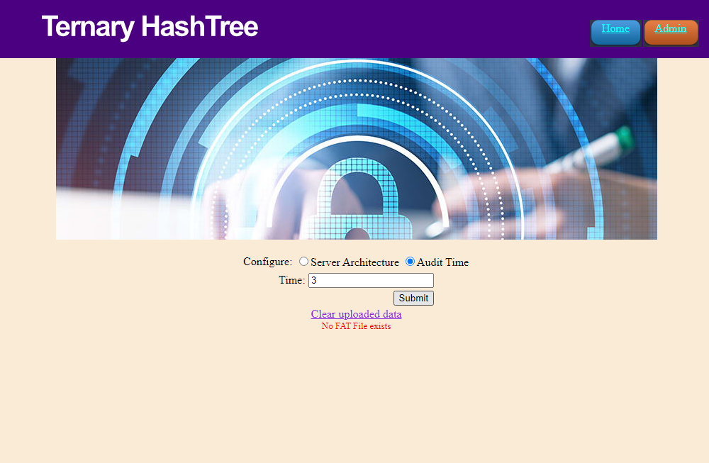
Audit time Configuration

Slide 34
CONCLUSION AND FUTURE ENHANCEMENT
The data auditing in file level, block level, and replica level are achieved for verifying data integrity of the entire file.
Few blocks for frequent audit tasks making it computationally efficient and replica level auditing to ensure data consistency across all the replicas in the cloud respectively.
Further, the corrupted blocks identified during auditing is localized and corrected to suit the need for real-time applications. Moreover, public auditing preserves the privacy of user data from TPA through the random ordering of the blocks being unknown to TPA and CS.
Further data dynamics is performed maintaining public verifiability on the same with reduced complexity which was better than the existing schemes.
FUTURE ENHANCEMENT:
The future work is to extend the framework for data sharing where data integrity is verified over the shared data across the user group.

Slide 35
REFERENCE
1.Identity-Based Distributed Provable Data Possession in Multi-Cloud Storage; Giuseppe Ateniese,Randal Burns,Reza Curtmola, Joseph Herring-2015.
2.An Efficient and Secure Dynamic Auditing Protocol for Data Storage in Cloud Computing; Kan Yang, Xiaohua Jia-2012.
3.Auditing to Keep Online Storage Services Honest; Mehul A. Shah, Mary Baker, Jeffrey C. Mogul, Ram Swaminathan-2007.
4.Provable Data Possession at Untrusted Stores; Giuseppe Ateniese Randal Burns Reza Curtmola Joseph Herring† Lea Kissner Zachary Peterson Dawn Song-2007

Slide 36
5. Privacy-Preserving Audit and Extraction of Digital Contents ; Cong Wang, Sherman S.-M. Chow-2010.
6. Privacy-Preserving Public Auditing for Secure Cloud Storage; Mikael Asplund, Simin Nadjm-Tehrani-2011.
7. Dynamic Audit Services for Integrity Verification of Outsourced Storages in Clouds; Yan Zhu, Huaixi Wang-2013.
8. Oruta: Privacy-Preserving Public Auditing for Shared Data in the Cloud;Boyang Wang, Baochun Li, Hui Li-2014.
9. Enabling Public Auditability and Data Dynamics for Storage Security in Cloud Computing; Qian Wang, Cong Wang, Kui Ren, Wenjing Lou Jin Li-2010.
10. Towards Secure and Dependable Storage Services in Cloud
Computing; Cong Wang, Qian Wang, Kui Ren, Ning Cao, Wenjing Lou-2014.

