Slide 1

SMART IRRIGATION SYSTEM USING IOT
BATCH NO: B11
SOWMYA. J(154G1A0584) Project Guide:
SAI SHARADA. G(154G1A0576) Mr.Y.Ramesh _{M.Tech}
SREEJA.L.S(154G1A0587) Assistant Professor
WASEEM AKRAM. M (154G1A05B0)
V.
Srinivasa Ramanujan Institute of Technology
Department of Computer Science & Engineering

Slide 2
Abstract
This project demonstrates the efficient use of Internet of Things for the traditional agriculture that result in a lot of wastage of water and can also promote disease such as fungus formation due to over moisture of soil.
The main objective of this project is to control the water supply and monitor the plants through a smart phone. To meet this demand we must adopt new techniques which will conserve need of water for irrigation process.
In automation system water availability to crop is monitored through sensors and as per need watering is done through the controlled irrigation.

Slide 3
Contents
Problem Statement
Objective
Existing System
Proposed Solution
A View of App
Process Flow
Working
Requirements
References

Slide 4
Problem Statement
Agricultural area receives power supply usually in non-peak hours; also frequent power cuts and low voltage supply creates a big problem to farmers. If farmer fails to attend the irrigation, there is a chance of wastage of water and electricity. Also, excess watering leads to soil damage.

Slide 5
Objective
Smart Irrigation System includes supplying only the sufficient amount of water to the plants which results in healthy crop and reduction of water wastage.
It reduces the human intervention in the agriculture field.

Slide 6
Existing System
In India most of the irrigation systems are operated manually.
Traditional methods that are used for irrigation, such as overhead sprinkler and flood type, is not that much efficient as it leads to wastage of water.
Incase of under irrigation, the plants get dried due to lack of sufficient amount of water.
Incase of over irrigation, the soil and roots are destroyed due to fungus formation.

Slide 7
Proposed Solution
In proposed solution, Smart Irrigation System uses Raspberry pi;where it monitors the amount of moisture content in the soil.
A threshold value of soil moisture is set and can be varied for different crops. In case the soil moisture of the soil deviates from the specified range, the watering system is turned ON/OFF. In case of dry soil, it will activate the irrigation system, pumping water for watering the plants and produce the result.

Slide 8
Requirements
Software Requirements:
Operating Systems - Windows, Linux
User Interface - Android
Programming language - Python
Hardware Requirements:
Sensors - Moisture Sensor
Raspberry pi 3
Smart Phone
DC Motor 5v,GSM module
Relay module
Connecting wires

Slide 9
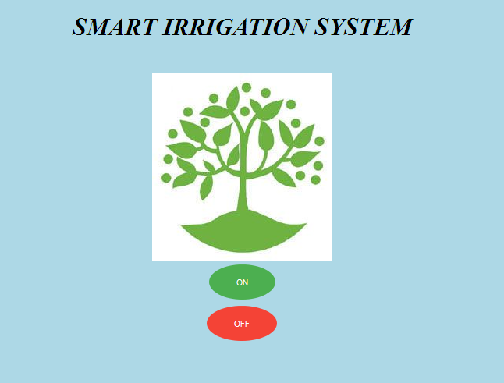
A View of App

Slide 10
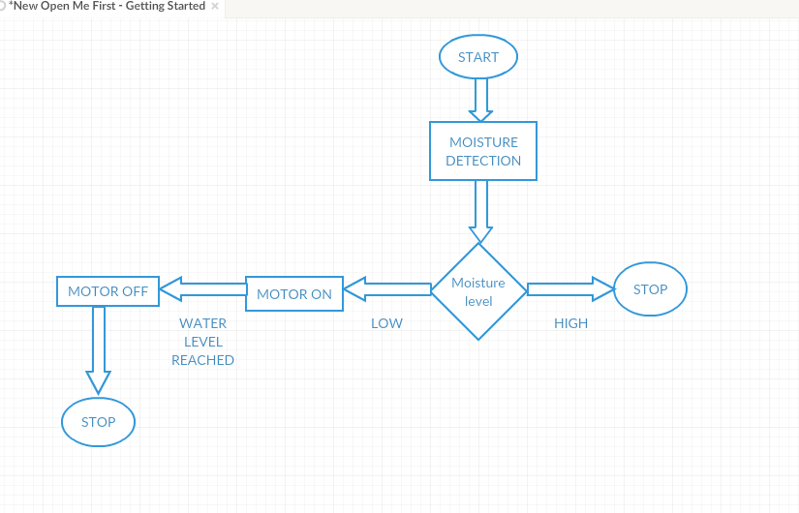
Process Flow

Slide 11
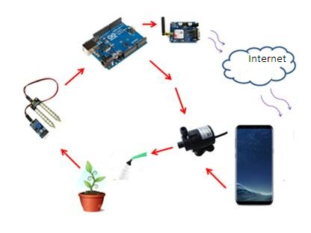
Working

Slide 12
References
http://www.ijirst.org/articles/IJIRSTV3I10005.pdf
https://ijarcce.com/upload/2017/july-17/IJARCCE%2027.pdf
https://observant.zendesk.com/hc/en-us/articles/208067926-Monitoring-Soil-Moisture-for-Optimal-Crop-Growth?mobile_site=true
https://www.pantechsolutions.net/smart-irrigation-system-using-iot-2381

Slide 13
Thank you “thousands live without love, none without water”
Queries
?

