Slide 1
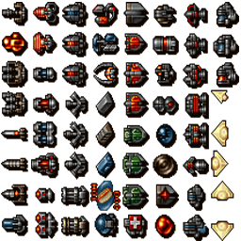


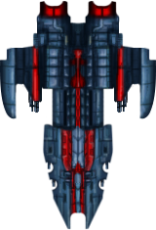

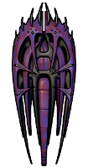
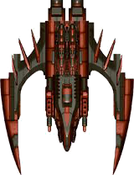

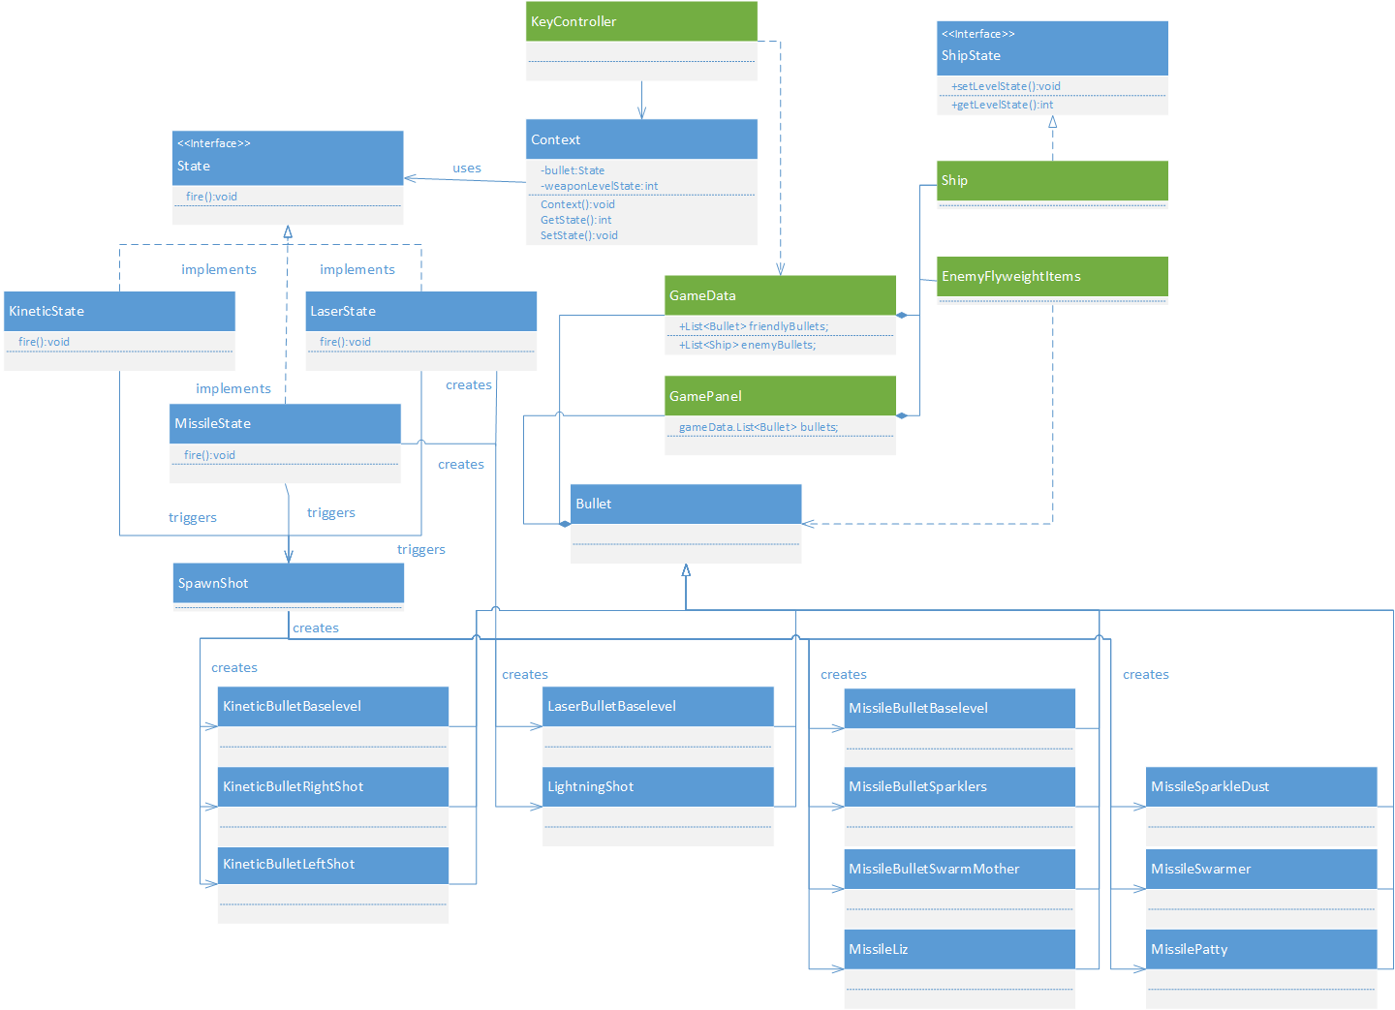
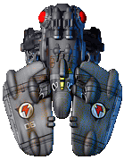





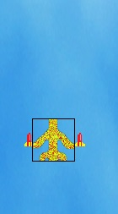
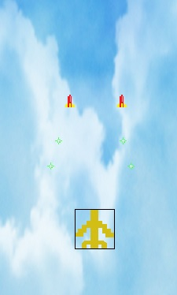
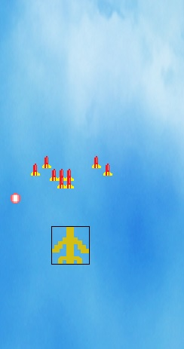
The Use of Design Patterns and Scrum Methodologies in Game Development Ryan Conyac, William McLain, Michael McGregor,
Yuchen Feng, Brian Davis - Dr. Hong K. Sung (Faculty Advisor)
1
PROBLEM AND MOTIVATION
3
SOLUTION
4
DESIGN PATTERN
Our team decided to make a 2D shooter like Raiden and Galaga. We were all familiar with and enjoyed these titles growing up so having the chance to create our own version seemed exciting.
We knew that our game needed to have the ability to offer a variety of ships. Also we need a range of weapons with the option for the player to choose not to acquire them if he or she did not want them. And finally the different types of weapons needed to have different types of sounds when used.
Change the ship’s appearance to show the user what he/she has selected.
Give the player an at the beginning of the game a choice of what ship to use..
Depending on the user’s choice change the ship’s appearance and attributes
Create different items for the user to pick up.
Change the bullet appearance from the initial image.
Add a different sound to play when in use.
Change the speed and other attribute of the bullet..
If the user collides with the item, change the state of the ship to correspond with the item
Game play is simple and redundant..
Use of different sounds
Create a class the holds all the sound files in the game along with functions to play, loop, and mute sounds.
When the game starts loop the background music.
When a shot is fired play the sound of each shot.
Have a different sound accompany each type of weapon for the ship.
The design pattern used in this project:
State pattern:
Intent is to add depth to the users ability to pick up items..
Using the state pattern when the user picks up multiple items of the same kind the effect of the weapon changes and becomes more powerful. Meaning the beam is able to cover more ground and the user will be able to destroy more ships with less shots.
These three things had to work in order to make the game feel complete. Since these aspects were all assigned to different team members. This required lots of team work to finally get it to work properly.
2
BACKGROUND
For the option to allow players to select different ships and weapons we need to use the state design pattern. This way when selecting different weapons the ship will obtain a new state to show that the player actually acquired the weapon. This is also used for the ship selection.
This choice makes it easier for our members to add and s=change current items in the game and lowers the chance of the changes effects other parts of the game.
As for sound differences there only needs to be a class to hold the different sound files. This way when a sound is needed in game the corresponding class will be able to call the Sound class and use the sound. Since there are not that many sounds needed this choice is easier for the entire team to understand and will cause less interference with the rest of the code.
5
RESULT
The second you select the missile pick you can fire 2 missile along with multiple energy spheres.
The result in using state design pattern and java applet for in game sounds was a success. The process went smoothly and all team members were satisfied with the decision. :
Natural and customizable game play.
Option of implementing different ships.
Game can easily be tweaked and sounds can easily be added and deleted if needed..
Item pick up example::
The first time you pick up the missile weapon you are able to shoot 2 missiles at once.
The third time you select the missile pick up you fire a barrage of missiles at once.

