Slide 1


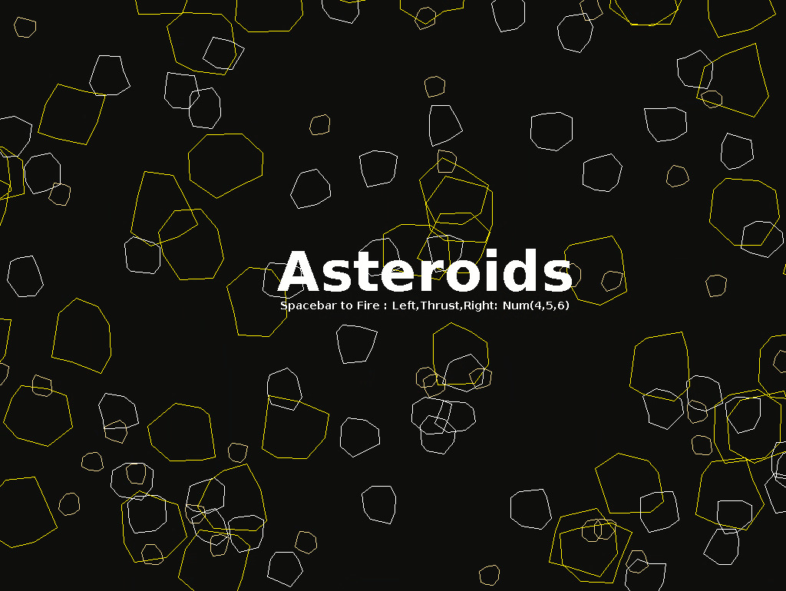
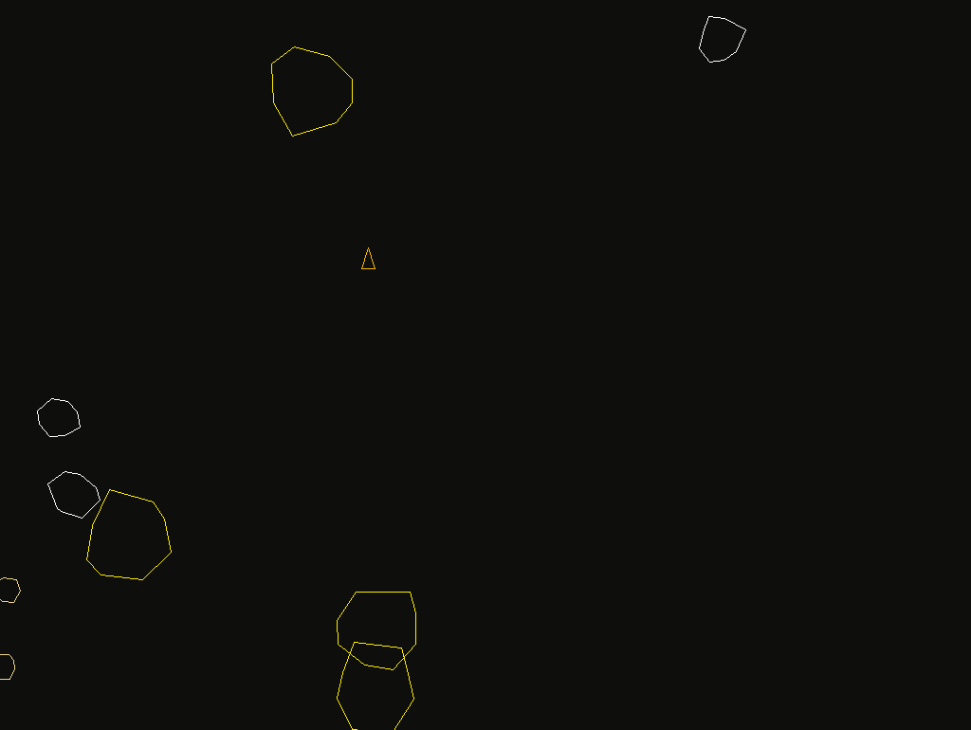
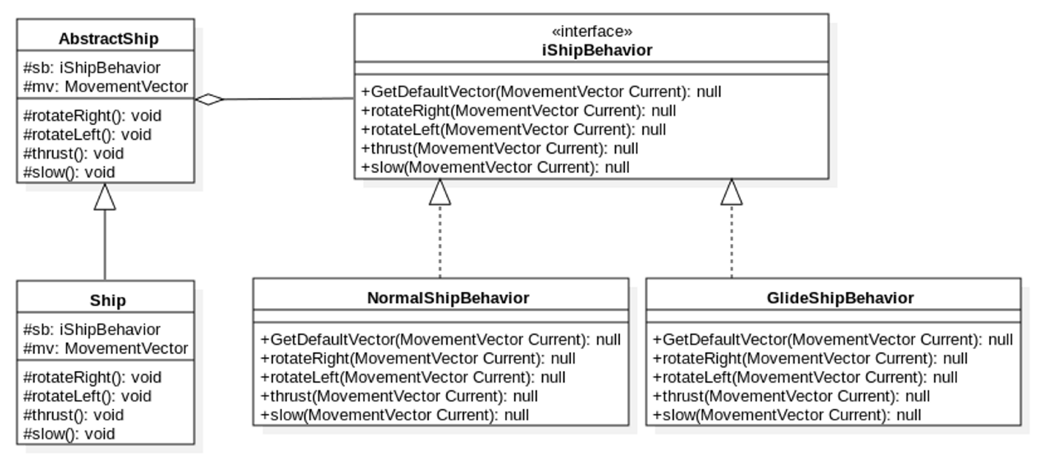
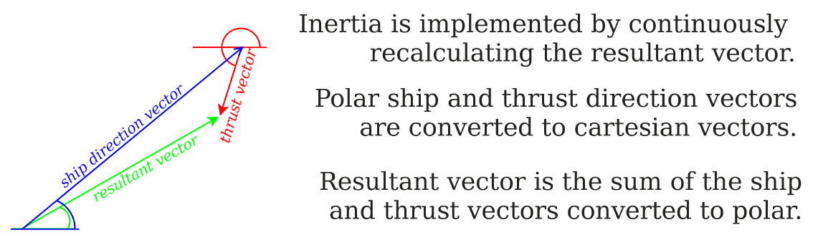
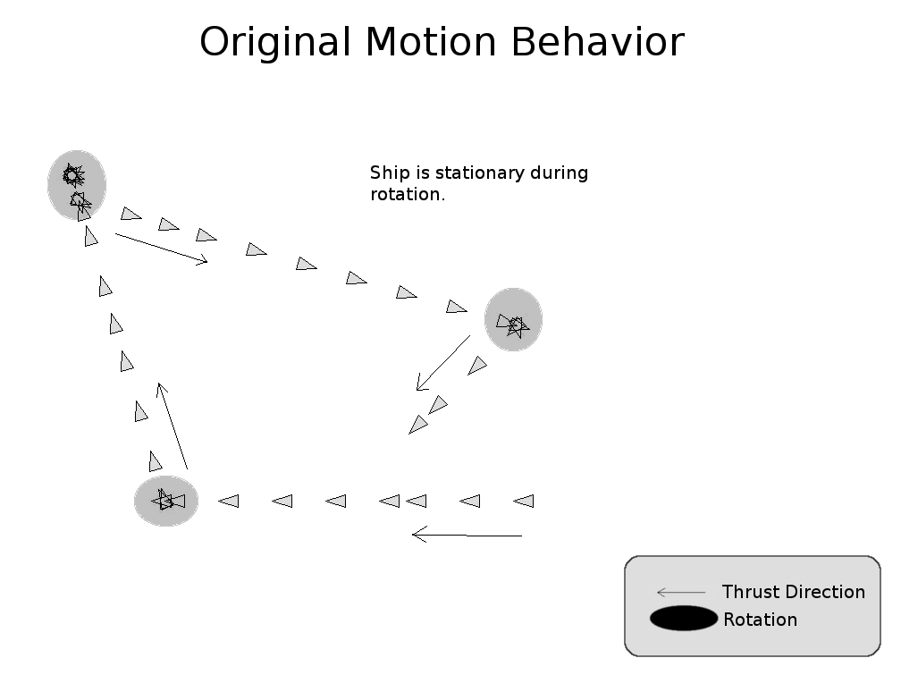
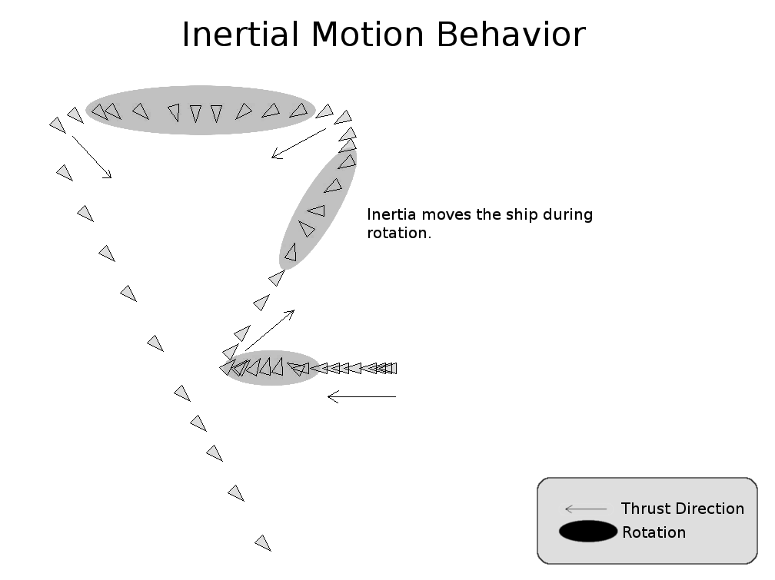
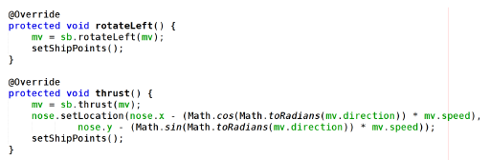
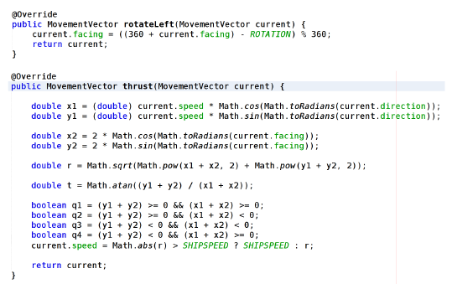
The Use of Design Patterns and Scrum Methodologies in Game Development Ryan Conyac, William McLain - Dr. Hong K. Sung (Faculty Advisor)
1
PROBLEM AND MOTIVATION
3
SOLUTION
4
DESIGN PATTERN
Our team decided to make a 2D shooter like Raiden and Galaga. We were all familiar with and enjoyed these titles growing up so having the chance to create our own version seemed exciting.
We knew that our game needed to have the ability to offer a variety of ships. Also we need a range of weapons with the option for the player to choose not to acquire them if he or she did not want them. And finally the different types of weapons needed to have different types of sounds when used.
Change the ship’s appearance to show the user what he/she has selected.
Give the player an at the beginning of the game of what ship to use..
Depending on the user’s choice change the ship’s appearance and attributes
Create different items for the user to pick up.
Change the bullet appearance from the initial image.
Add a different sound to play when in use.
Change the speed and other attribute of the bullet..
If the user collides with the item, change the state of the ship to correspond with the item
Game play is simple and redundant..
Use of different sounds
Create a class the holds all the sound files in the game along with functions to play, loop, and mute sounds.
When the game starts loop the background music.
When a shot is fired play the sound of each shot.
Have a different sound accompany each type of weapon for the ship.
The design pattern used in this project:
Bridge pattern:
Intent is to decouple an abstraction from its implementation for independent variation.
Applied in order to avoid permanent binding of the abstract ship to the ship’s behaviors.
These three things had to work in order to make the game feel complete. Since these aspects were all assigned to different team members. This required lots of team work to finally get it to work properly.
2
BACKGROUND
For the option to allow players to select different ships and weapons we need to use the state design pattern. This way when selecting different weapons the ship will obtain a new state to show that the player actually acquired the weapon. This is also used for the ship selection.
This choice makes it easier for our members to add and s=change current items in the game and lowers the chance of the changes effects other parts of the game.
As for sound differences there only needs to be a class to hold the different sound files. This way when a sound is needed in game the corresponding class will be able to call the Sound class and use the sound. Since there are not that many sounds needed this choice is easier for the entire team to understand and will cause less interference with the rest of the code.
Rotation sets the “facing” component.
Thrust is accelerated at a constant rate of 2 pixels per tick up to the maximum ship speed.
Result MovementVector direction is calculated for the appropriate quadrant.
5
RESULT
The result in using state design pattern and java applet for in game sounds was a success. The process went smoothly and all team members were satisfied with the decision. :
Natural and customizable game play.
Option of implementing different ships.
Game can easily be tweaked and sounds can easily be added and deleted if needed..

