Slide 1


Persuasive Strategies across Conversational Contexts:
Development of a natural language processing tool to detect benign and malicious persuasion in online dialogue
Kate Muir, Robert Thomas, Ekaterina Kochmar, Faye Walker, Nigel Dewdney, & Adam Joinson

Slide 2

Identifying malicious persuasion
Given a set of dialogues (forum interactions, messages, emails etc) how can we tell benign persuasion attempts (“Come to the pub tonight?”) from malicious persuasion attempts (“Take off all your clothes?”) without manually reading everything?
Project aims to develop automated computerized tool to analyse transcripts of conversations to identify the presence of malicious persuasion

Slide 3
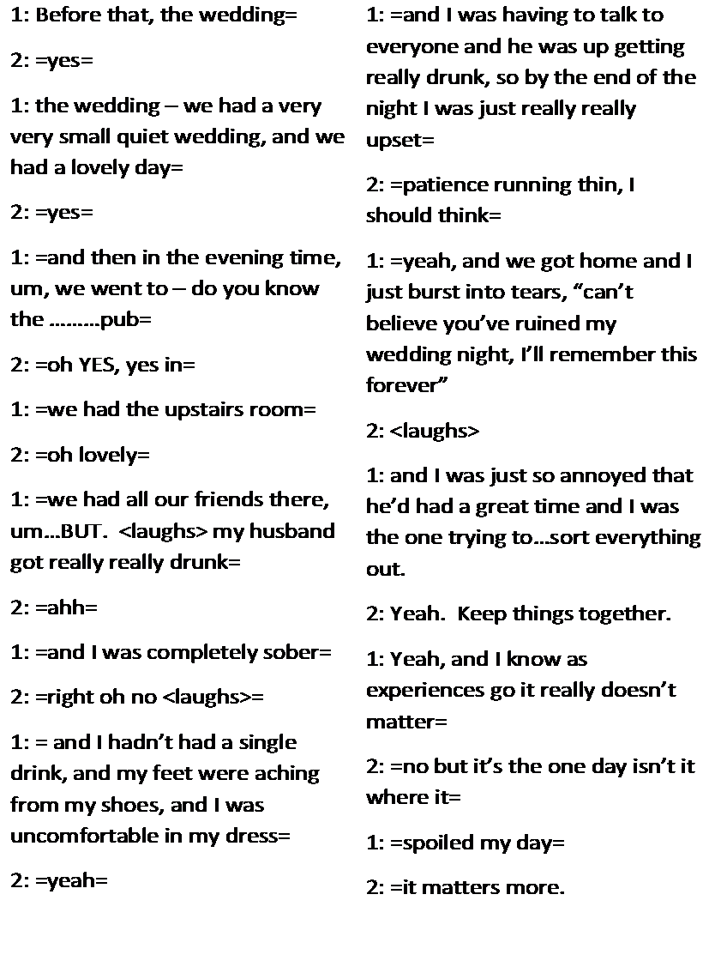
Conversational Moves in Persuasion
We use move analysis (Swales, 1981) as an overarching framework
Chiang and Grant (2017) identified moves that characterize online grooming conversations
E.g., building rapport; building sexual rapport; assessing likelihood and extent of engagement

Slide 4


“I like cats. I have a cat called fluffy.”
Build rapport
Personal Disclosure
“Me too! Cats are the best!”
“Cats are real pricy to keep though ☹”
“Yeah”
Assess target potential
Finance related question
“How do you pay for your cat? Do you have your own bank account??”
Conversational Move
Tactic
Linguistic technique

Slide 5

Building theoretical model of persuasion in dialogue
Systematic search of psychology, linguistics, and computational linguistics literature
List of moves assessed for those which appeared across multiple contexts and grouped into conceptually similar moves and strategies
Initial list of ten conversational moves which appeared across conversational contexts

Slide 6
Move | Contexts | Source
 |  | Data-driven | Theory-driven
Rapport and liking | Generic persuasion | Wang et al. (2019) | Marwell and Schmitt (1967)
 | Grooming | Chiang and Grant (2017); Chiang and Grant (2018) | Edwards and Leatherman (2009)
 | Negotiations | Young, Martell, Anand, Ortiz, and Gilbert (2011)
 | Argumentation | Bender et al. (2011)
 | Children and teen persuasion |  | Sinha, Zhao, and Cassell (2015)
 | Ideological | Prentice et al. (2011)
Negotiating | Generic persuasion | D'Zurilla (1966); Ho (2018)
 | Negotiations | Young et al. (2011) | Sokolova and Szpakowicz (2007)
 | Children and teen persuasion | Bartsch, Wright, and Estes (2010), Palan and Wilkes (1997)
Promising rewards | Generic persuasion | Barton and Eggly (2009); Scully and Moital (2016) | Adler, Iacobelli, and Gutstein (2016); Marwell and Schmitt (1967); Wilson (2003)
 | Children and teen persuasion | Bartsch et al. (2010)
 | Ideological | Prentice et al. (2011)
Appeals to emotion | Generic persuasion | Rocklage, Rucker, and Nordgren (2018); Scully & Moital (2016); Wang et al (2019) | Marwell & Schmitt (1967); Adler et al. (2016); Ferrari (2007)
 | Ideological | Prentice et al. (2011)
 | Children and teen persuasion | Palan & Wilkes (1997)
 | Logical Arguments | Hidey, Musi, Hwang, Muresan, and McKeown (2017)

Slide 7
Guilt tripping | Generic persuasion | Scully & Moital (2016); Vangelisti, Daly, and Rudnick (1991); Wang et al (2019) | Marwell & Schmitt (1967)
 | Ideological | Prentice et al. (2011)
 | Children and teen persuasion | Palan & Wilkes (1997)
Appeals to logic | Generic persuasion | Wang et al (2019) | Wilson (2003); Prakken (2006)
 | Ideological | Prentice et al. (2011)
 | Logical arguments | Felton, Garcia‐Mila, Villarroel, and Gilabert (2015); Hidey et al. (2017) | Habernal and Gurevych (2017)

Slide 8
Appeals to authority | Negotiations | Young et al. (2011)
 | Ideological | Prentice et al. (2011)
 | Child and teen persuasion | Bartsch et al. (2010)
 | Logical Arguments | Bender et al. (2011); Hidey et al. (2017)
Moral proof | Generic persuasion |  | Marwell & Schmitt (1967)
 | Ideological | Prentice et al. (2011)

Slide 9
Social proof | Generic persuasion |  | Marwell & Schmitt (1967)
 | Negotiations | Young et al. (2011)
 | Ideological | Prentice et al. (2011)
 | Child and teen persuasion | Palan & Wilkes (1997)
 | Argumentation | Bender et al. (2011)
Overt persuasion and pressure | Generic persuasion | Scully & Moital (2016); D’Zurilla (1966) | Wilson (2003); Marwell & Schmitt (1967)
 | Ideological | Prentice et al. (2011)
 | Grooming | Chiang & Grant (2018); Schneevogt, Chiang, and Grant (2018)
 | Children and teen persuasion | Bartsch et al. (2010); Palan & Wilkes (1997)

Slide 11
Moves, Strategies and Techniques
Rapport and Liking
Negotiating
Appeals to emotion
Appeals to logic
Appeals to authority
Social proof
Overt persuasion and pressure

Slide 12

Automating Persuasion Detection With Computer Science!
Notes:
Hello, My name is Rob and I am a research assistant on the project. I specialise in Computational Linguistics which is the convergence of Linguistics and Computer Science. It has been my task to collect the data, analyse the data and model the data.

Slide 13
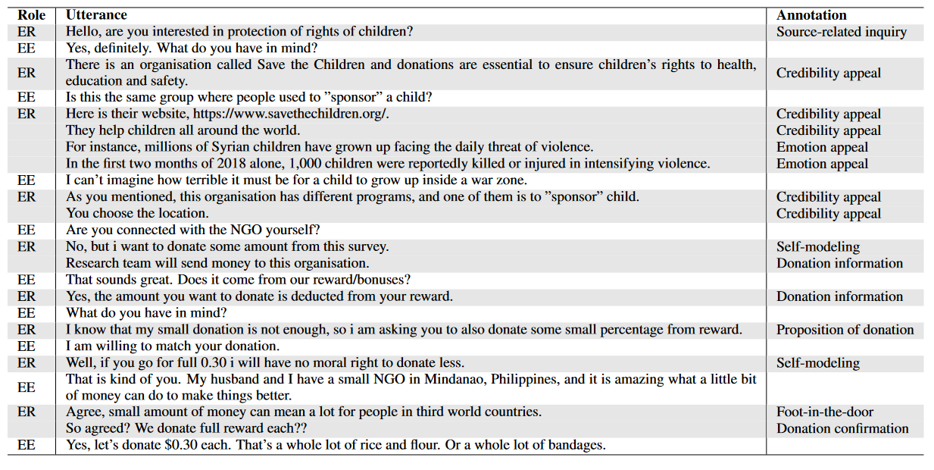
Building a Dataset
Persuasion For Good
Generated online using Amazon Mechanical Turk
Persader tasked with persuading a persuadee to donate to charity, persuasively
Notes:
The first step of the project was to create a dataset that contains persuasive strategies that can be distinguishable by human annotators. The framework developed at Bath Spa aims to account for all types of persuasion strategies and importantly across domains.
The data we used is from a paper called Persuasion for Good, developed by researchers at the university of x and y. They aimed to see if a model be developed to find a connection between personality types and persuasion strategies, whether or not certain strategies work better on certain personality types.
The data was collected using Amazon’s Mechanical Turk platform. Users were tasked with convincing over users to donate the fee for taking part in the experiment to the charity Save the Children. Annotators then marked up the data, identifying the strategies. We have taken the data but are now applying a new persuasive strategy taxonomy.

Slide 14
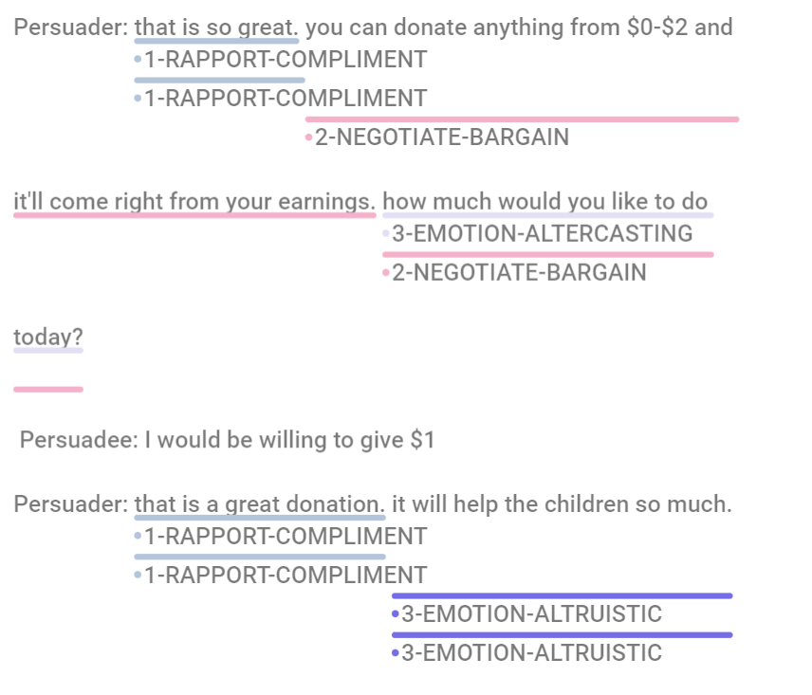
The Experiment
Open Source - Doccano
8 PhD Students
Instructions
Annotate only Persuader utterances
Full Sentences
More than one tag if necessary
Mark as no persuasion if none present
Notes:
To annotate the data we hired 8 PhD students from between the university of Bath and university of Bristol. We chose students as we wanted to be able to have training sessions and get feedback about the task.
The data was uploaded to an open source webapp named Doccano. The students were given the following instructions
Annotate only the persuader’s utterances
Annotate full sentences
Use more than one label if necessary
If no persuasion is present mark it so
For the initial data mark up we aimed to provide the annotators with as few as 25 transcripts so we could get an idea of what language was present in the data and if the annotators agree

Slide 15
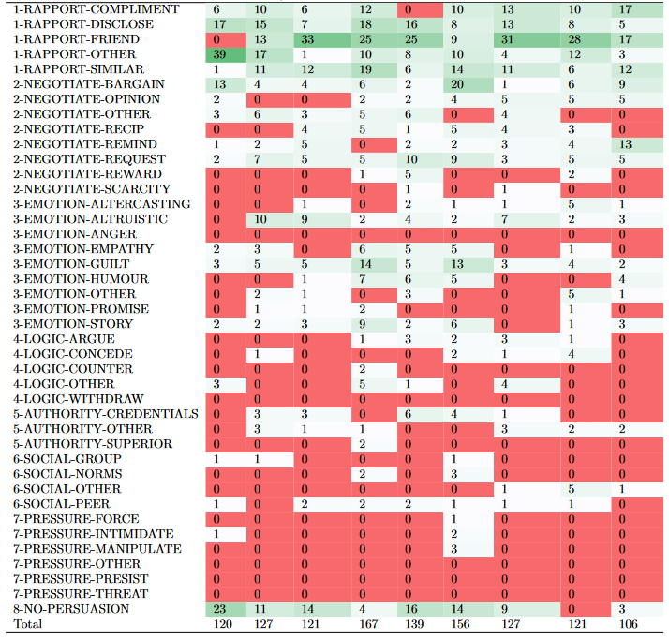
Distilling the Taxonomy
Which tags can be merged?
How many is too much?
Can a human tell the difference between persuasion strategies?
If a human struggles an AI will probably also struggle
Notes:
We originally gave the annotators 41 tags that included 8 top level tags, each top level tag having further branches. We wanted to make a compromise between capturing enough types of persuasion and having a realistic amount that annotators would be able to identify. We made the decision to merge the mid layer tags to only consider the top level when it comes to modelling persuasion. To capture the more deeper levels of persuasion would require much more data markup which is very expensive and time consuming.
The graph on the right gives an indicitaiton of what types of persuasion of more common in this dataset, obviously we would like to equal tags present across the dataset as this would allow our model to generalise better.

Slide 16
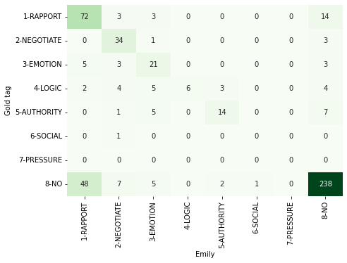
Measuring Agreement
Observed Agreement
Total agreed out of total annotations
Cohen’s kappa
Measures agreement taking into account chance encounters
Can be interpreted as consistent agreement and not just by accident
Confusion matrix
Visualise tags that are agreed on and which cause disagreement
Training session to discuss agreement
Tags can overlap
Language can be ambiguous
Minimise the disagreement
Notes:
After marking up an initial batch of transcripts for the purpose of training the annotators, we looked at how the annotators agreed on the tags. Measuring the agreement can give an idea of the complexitiy of the task and the framework. To measure the agreement we looked at the observed agreement and a metric named Cohen’s kappa. The kappa score gives us an indication if the annotators are agreeing consistently or rather just by chance.
We can also look at a confusion matrix, shown on the right, which can show us which tags are more agreed than others and if there are tags that are consistently disagreed. We can use this data to discuss whether there are further tweaks to be made to the framework or further training to be done with the annotators before we mark up the large bulk of the data which is around 1000 transcripts.

Slide 17

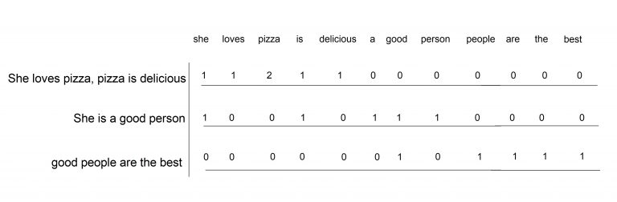
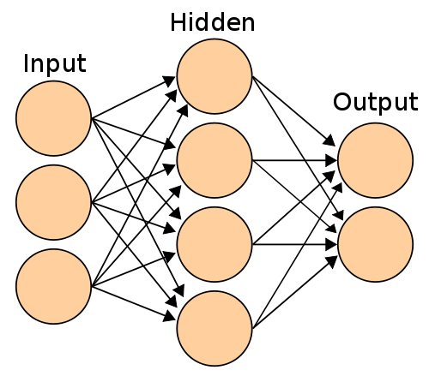
Training a Classifier
Bag of Words representation
Build vocabulary from training data
Generate vectors representing the sentence
Doesn’t include context or relationship between words
Trained using a feedforward neural network
Hidden layer learns latent features of the language
Aims to learn relationship between words and output labels
Notes:
Now that we have created a dataset we can use a statistical model to try and model the data. Essentially we would like an algorithm to look at the text and the labels given by a human evaluator and accurately predict the label. The steps to achieve this is as follows –
The features of the data is extracted, in this case we are using a bag of words representation. Each sentence is turned into a vector which is as long as the amount of unique words in the training data. The index of each word present is incremented by one for everytime they are present in the utterance.
This is a rather naïve way of representing language as it does not take any context or word relationships into account, it is however a rather good baseline to build off.
The baseline model is a multilayer perceptron or feedforward neural network. The input data is fed from layer to layer with different functions being acted upon it at each point. The hidden layer aims to learn the latent features of the language and it’s connection to the output which is the persasive strategy given by a human annotator.
The model learns by adjusting weights and biases, these essentially tells the mode which features have a greater or lesser effect on an output label. A loss function tells the model how right or wrong it’s prediction is and a clever algorithm called back propagation updates the weights/biases to try and get the model in the right direction for predicting the right label.
Once the model is trained it should be able to take unseen data and predict, accuractely, a persuasion strategy.

Slide 18
Future steps
Deeper Models
Include context
More complex representation of language
More Data to learn from
Identify further sources of persuasive language
Open source web app
Notes:
This experiment is our jumping off point to try and develop a tool that can generalise over all persuasion strategies in any domain. We aim to expand the tool by exploring other sources of data, deeper and more complex representations of the linguistic data with the gradual aim of enabling a tool that will be able to detect persuasion.
You can see in the little demo in the corner there the model is trying to predict persuasion strategies, I’ll let you decide if it is predicting accurately.
Thanks for listening
:D

Slide 19
Thank you for listening!

