Slide 1
GRAPHS

Slide 2
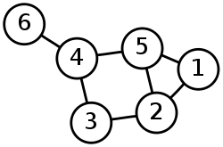
INTRODUCTION
A graph G = (V, E) is a set of vertices (or nodes) V and a set of edges E, assumed finite i.e. |V| = n and |E| = m.
Example

Slide 3
INTRODUCTION
V(G) = {1, 2, 3, 4, 5, 6}
E(G) = {(1,2), (1,5), (2,3), (2,5), (3,4), (4,5), (4,6)}

Slide 4
TYPES OF GRAPHS
Two types of graphs:
Directed graphs: G=(V,E) where E is composed of ordered pairs of vertices; i.e. the edges have direction and point from one vertex to another.
Undirected graphs: G=(V,E) where E is composed of unordered pairs of vertices; i.e. the edges are bidirectional.

Slide 5
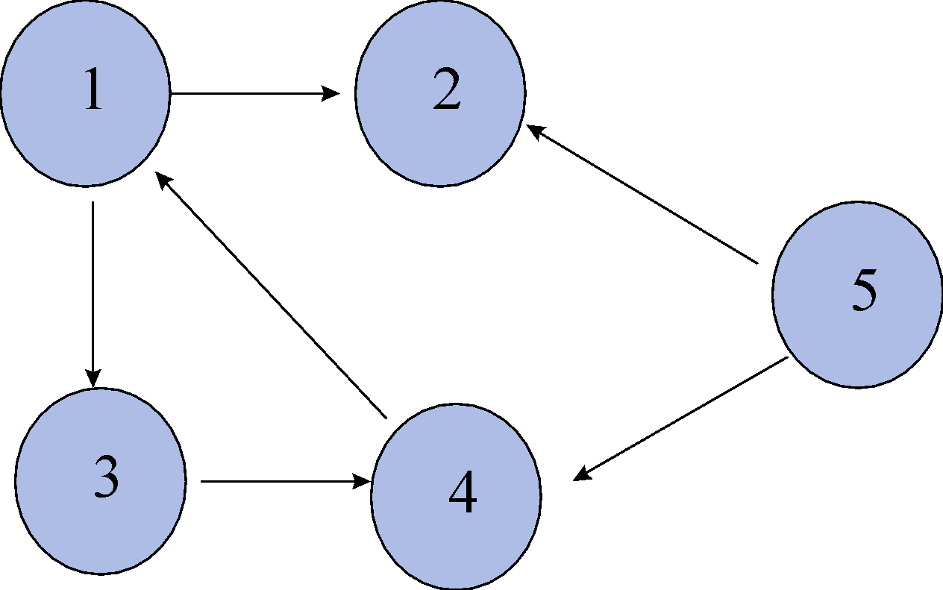
DIRECTED GRAPH

Slide 6

UNDIRECTED GRAPH

Slide 7
IMPLEMENTING A GRAPH
Implement a graph in two ways:
Adjacency List
Adjacency Matrix

Slide 8
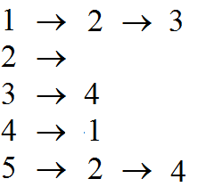
ADJACENCY LIST
Directed Graph

Slide 9
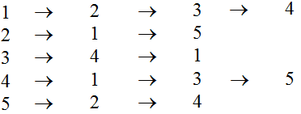
ADJACENCY LIST
Undirected Graph

Slide 10
ADJACENCY LIST
The sum of the lengths of the adjacency lists is 2|E| in an undirected graph, and |E| in a directed graph.
The amount of memory to store the array for the adjacency list is O(V+E).

Slide 11
ADJACENCY MATRIX
Directed Graph
1 2 3 4 5
1 0 1 1 0 0
2 0 0 0 0 0
3 0 0 0 1 0
4 1 0 0 0 0
5 0 1 0 1 0

Slide 12
ADJACENCY MATRIX
Undirected Graph
1 2 3 4 5
1 0 1 1 1 0
2 1 0 0 0 1
3 1 0 0 1 0
4 1 0 1 0 1
5 0 1 0 1 0

Slide 13
ADJACENCY MATRIX
The matrix always uses Θ(v^2) memory.
Usually easier to implement and perform lookup than an adjacency list.

Slide 14
ADJACENCY MATRIX VS. LIST?
Sparse graph: very few edges.
Dense graph: lots of edges. Up to O(v^2) edges if fully connected.
The adjacency matrix is a good way to represent a weighted graph. In a weighted graph, the edges have weights associated with them.

Slide 15
PATHS
Path in a graph G = (V, E) to be a sequence P of nodes V1, V2, . . . . Vk-1, Vk with the property that each consecutive pair Vi, Vi+1 is joined by an edge in G.
P is often called a path from V1 to Vk, or a V1-Vk path.

Slide 16
CYCLES
A cycle is a path that begins and ends on the same vertex.
We call a sequence of nodes a cycle if V1 = Vk. In other words, the sequence “cycles back" to where it began.
A path is called simple if all its vertices are distinct.
A path is called a simple cycle if V1, V2, . . . Vk are all distinct, and V1 = Vk.

Slide 17
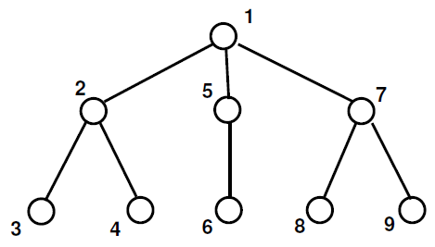
TREES
We say that a graph is connected if for every pair of nodes u and v, there is a path from u to v.
A tree is a connected graph with no cycles.

Slide 18
TREES
We say that a graph is connected if for every pair of nodes u and v, there is a path from u to v.
A tree is a connected graph with no cycles.

Slide 19
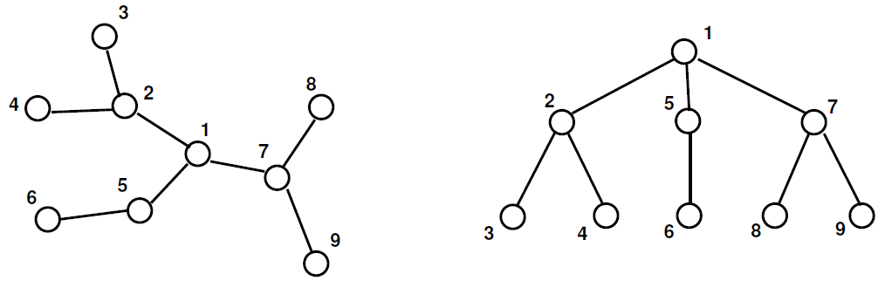
TREES
Same Trees or Different Trees?

Slide 20
APPLICATIONS OF GRAPHS
Social Network Graphs
Transportation Networks.
Web links.
Robot Planning
Etc

Slide 21
ALGORITHMS ON GRAPHS
Searching Graphs
Detecting Cycles in Graphs
Shortest Path algorithms

Slide 22
SEARCHING A GRAPH
Search:
The goal is to methodically explore every vertex and every edge; perhaps to do some processing on each.
For the most part in our algorithms we will assume an adjacency-list representation of the input graph.

Slide 23
GRAPH CONNECTIVITY
node-to-node connectivity.
Suppose we are given a graph G = (V, E), and two particular nodes s and t.
We'd like to find an efficient algorithm that answers the question: Is there a path from s to t in G?

Slide 24
GRAPH CONNECTIVITY
Easy to find the connectivity for small graphs.
Tough to find for very large graphs.
Design an efficient algorithm for finding the connectivity.

Slide 25
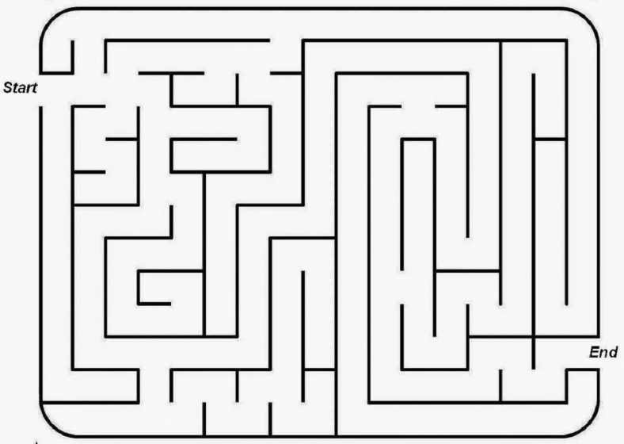
GRAPH CONNECTIVITY

Slide 26
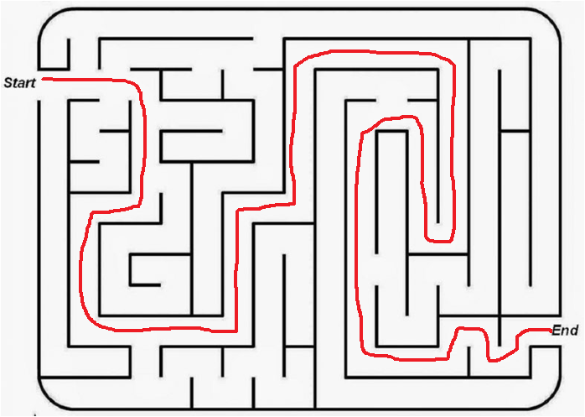
GRAPH CONNECTIVITY

Slide 27
GRAPH CONNECTIVITY
The basic idea in searching for a path is to “explore" the graph G starting from s, maintaining a set R consisting of all nodes that s can reach.
Initially, we set R = {s}.
If at any point in time, there is an edge (u, v) where u Є R and v ₡ R, then we claim it is safe to add v to R.

Slide 28
GRAPH CONNECTIVITY
Indeed, if there is a path P from s to u, then there is a path from s to v obtained by first following P and then following the edge (u,v).
Suppose we continue this of growing the set R until there are no more edges leading out of R.

Slide 29
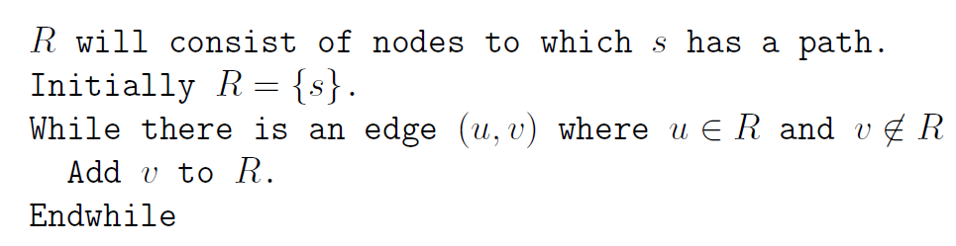
GRAPH CONNECTIVITY

Slide 30
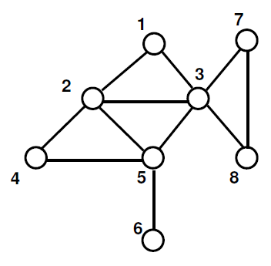
GRAPH CONNECTIVITY

Slide 31
GRAPH TRAVERSALS
Graph traversal means visiting every vertex and edge exactly once in a well-defined order.
While using certain graph algorithms, you must ensure that each vertex of the graph is visited exactly once.
The order in which the vertices are visited are important and may depend upon the algorithm or the problem.

Slide 32
GRAPH TRAVERSALS
During a traversal, it is important that you track which vertices have been visited.
The most common way of tracking vertices is to mark them.
2 Types
Breadth First Search (BFS)
Depth First Search (DFS)

Slide 33
BREADTH-FIRST SEARCH

Slide 34
BREADTH-FIRST SEARCH
BFS is a traversing algorithm where you should start traversing from a source node and traverse the graph layer-wise thus exploring the neighbor nodes.
Then move towards the next-level neighbor nodes.

Slide 35
BREADTH-FIRST SEARCH
As the name BFS suggests, you are required to traverse the graph breadth wise as follows:
First move horizontally and visit all the nodes of the current layer
Move to the next layer

Slide 36
BREADTH-FIRST SEARCH

Slide 37
WORKING OF BREADTH-FIRST SEARCH

Slide 38
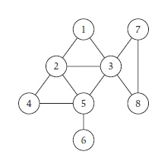
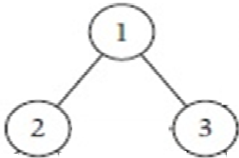
In this algorithm, given a graph G= (V, E) and a source vertex S, we explore from S in all possible directions, adding nodes one “layer” at a time.
Example 1
Consider the source vertex S=1. Add to BFS tree T @ Layer 0.
We discover nodes {2,3} from node 1 check if {2,3} are in T
Layer L1

Slide 39
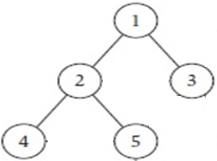
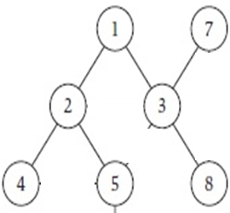
We now discover nodes {3,4,5} from node 2 in L1
3 is already present in T
Add 4,5 to T
Layer 2
We now discover the nodes {2,5,7,8} from the node 3 in L1.
2 is already present in T L2
5 is already present in T
Add 7,8 to T
L2

Slide 40
Now we consider each node in L2
From 4 we discover node 5.
5 is already there in T.
From 5 we discover nodes {4,6}
4 is already there in T
Add 6 to T
From 7 we discover {3,8} and 8 we discover {3,7} which are already in T.

Slide 41
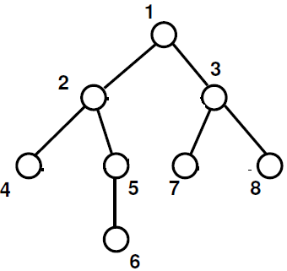
For new node 6 added in L3, there are no more further nodes to be explored.
The full BFS tree is as depicted below.
L0
L1 L1
L2 L2
L3

Slide 42
APPLYING THE BFS ALGORITHM
2
4
1
6
3
5
Discovered |  |  |  |  |  | List | Edge | Tree
T | F | F | F | F | F | L[0] = 1 I=0 |  | Ø
T | T | F | F | F | F | L[1] =2 I=1 | U=1, V=2
T | T | T | F | F | F | L[1] =2, 3 I=1 | U=1, V=3
T | T | T | T | F | F | L[2]= 4 I=2 | U=2, V=1, V=3, V=4
T | T | T | T | T | F | L[2] = 5 I=2 | U=3, V=1, V=2, V=5
T | T | T | T | T | T | L[3] = 6 I=3 | U=4, V=2, V=5, V=6
1
2
1
3
2
4
1
3
2
4
1
3
5
Now L[i] is empty. So the BFS Tree.

Slide 43
APPLYING THE BFS ALGORITHM
2
4
1
6
3
5

Slide 44
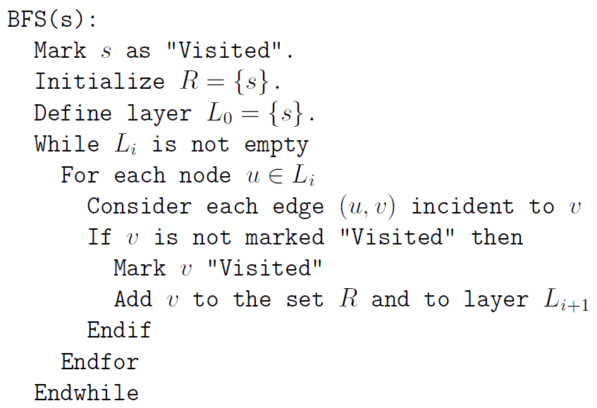
BREADTH-FIRST SEARCH

Slide 45
BREADTH-FIRST SEARCH
If we store each layer Li as a queue, then inserting nodes into layers and subsequently accessing them takes constant time per node.
Furthermore, if we represent G using an adjacency list, then we spend constant time per edge over the course of the whole algorithm, since we consider each edge e at most once from each end.
Thus, the overall time spent by the algorithm is O(m + n).

Slide 46
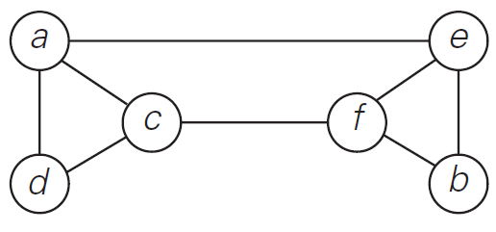
BREADTH-FIRST SEARCH
Find the BFS Traversal for the following graph.

Slide 47
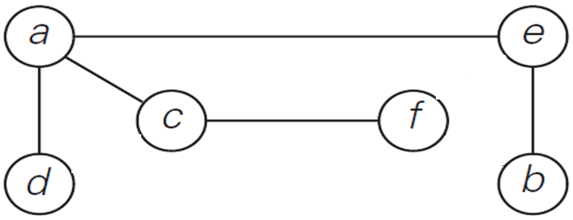
BREADTH-FIRST SEARCH
BFS Tree

Slide 48
BFS CLAIMS
For each j ≥ 1, layer Lj produced by BFS consists of all nodes at distance exactly j from s. There is a path from s to t if and only if t appears in some layer.

Slide 49
BFS CLAIMS
Let T be a breadth-first search tree, let x and y be nodes in T belonging to layers Li and Lj respectively, and let (x, y) be an edge of G. Then i and j differ by at most 1.

Slide 50
BFS CLAIMS
Proof:
Suppose by way of contradiction that i and j differed by more than 1; in particular, suppose i < j − 1.
Now consider the point in the BFS algorithm when the edges incident to x were being examined.

Slide 51
BFS CLAIMS
Since x belongs to layer Li, the only nodes discovered from x belong to layers Li+1 and earlier.
If y is a neighbor of x, then it should have been discovered by this point at the latest and hence should belong to layer Li+1 or earlier.

Slide 52
BFS CLAIMS
The implementation of the BFS algorithm runs in time O(m + n) (i.e., linear in the input size), if the graph is given by the adjacency list representation.
Proof:
We need to observe that the For loop processing a node u can take less than O(n) time if u has only a few neighbors.

Slide 53
BFS CLAIMS
As before, let nu denote the degree of node u, the number of edges incident to u.
Now, the time spent in the For loop considering edges incident to node u is O(nu), so the total over all nodes is O(∑ u∈V nu).

Slide 54
BFS CLAIMS
Recall that ∑u∈V nu = 2m, and so the total time spent considering edges over the whole algorithm is O(m).
We need O(n) additional time to set up lists and manage the array Discovered.
So the total time spent is O(m + n) as claimed.

Slide 55
TESTING BIPARTITENESS: AN APPLICATION OF BFS
The Problem
Triangle is not bipartite, since we can color one node red, another one blue, and then we can’t do anything with the third node.
If a graph G simply contains an odd cycle, then we can apply an argument; thus
If a graph G is bipartite, then it cannot contain an odd cycle.

Slide 56
TESTING BIPARTITENESS: AN APPLICATION OF BFS
Designing the Algorithm
We can implement this on top of BFS, by simply taking the implementation of BFS and adding an extra array Color over the nodes.
Whenever we get to a step in BFS where we are adding a node v to a list L[i + 1], we assign
Color[v]= red if i + 1 is an even number
Color[v]= blue if i + 1 is an odd number.

Slide 57
TESTING BIPARTITENESS: AN APPLICATION OF BFS
Designing the Algorithm
At the end of this procedure, we simply scan all the edges and determine whether there is any edge for which both ends received the same color.
Thus, the total running time for the coloring algorithm is O(m + n), just as it is for BFS.

Slide 58
TESTING BIPARTITENESS: AN APPLICATION OF BFS
Analyzing the Algorithm
Let G be a connected graph, and let L1, L2, . . . be the layers produced by BFS starting at node s. Then exactly one of the following two things must hold.
(i) There is no edge of G joining two nodes of the same layer. In this case G is a bipartite graph in which the nodes in even-numbered layers can be colored red, and the nodes in odd-numbered layers can be colored blue.

Slide 59
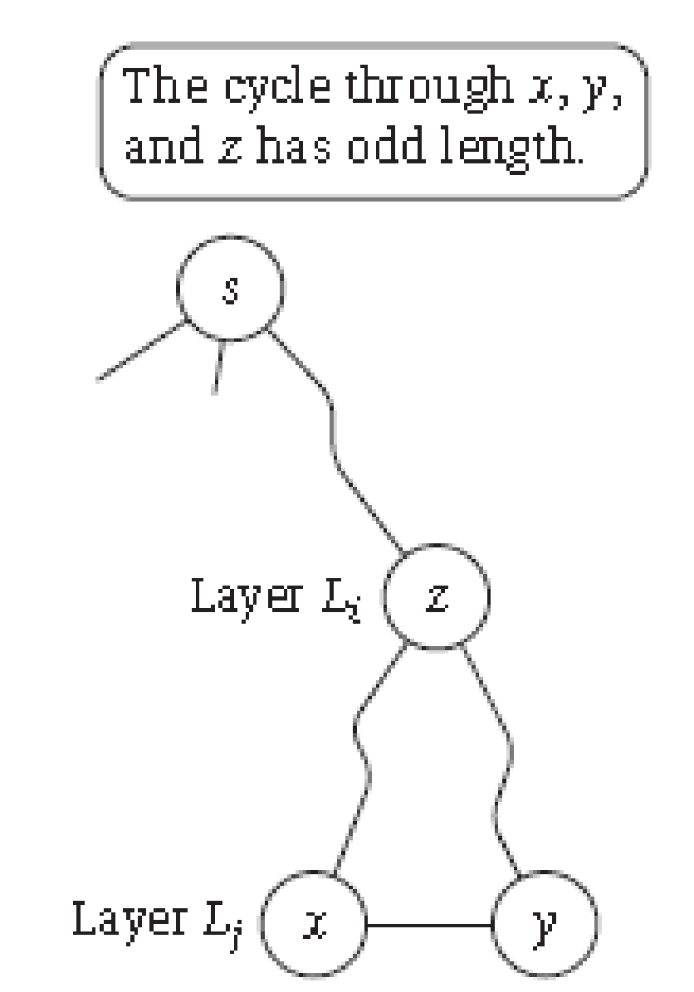
TESTING BIPARTITENESS: AN APPLICATION OF BFS
Analyzing the Algorithm
(ii) There is an edge of G joining two nodes of the same layer. In this case, G contains an odd-length cycle, and so it cannot be bipartite.

Slide 60
TESTING BIPARTITENESS: AN APPLICATION OF BFS
Proof:
First consider case (i), where we suppose that there is no edge joining two nodes of the same layer.
We know that every edge of G joins nodes either in the same layer or in adjacent layers.
Our assumption for case (i) is precisely that the first of these two alternatives never happens, so this means that every edge joins two nodes in adjacent layers.
But our coloring procedure gives nodes in adjacent layers the opposite colors, and so every edge has ends with opposite colors.
Thus this coloring establishes that G is bipartite.

Slide 61
TESTING BIPARTITENESS: AN APPLICATION OF BFS
Now suppose we are in case (ii); why must G contain an odd cycle?
We are told that G contains an edge joining two nodes of the same layer.
Suppose this is the edge e = (x, y), with x, y ∈ Lj.
Also, for notational reasons, recall that L0 (“layer 0”) is the set consisting of just s.
Now consider the BFS tree T produced by our algorithm, and let z be the node whose layer number is as large as possible, subject to the condition that z is an ancestor of both x and y in T;

Slide 62
TESTING BIPARTITENESS: AN APPLICATION OF BFS
Now suppose we are in case (ii); why must G contain an odd cycle?
Suppose z ∈ Li, where i < j.
We consider the cycle C defined by following the z-x path in T, then the edge e and then y-z path in T.
The length of this cycle is (j − i) + 1+ (j − i), adding the length of its three parts separately; this is equal to 2(j − i) + 1, which is an odd number.

Slide 63
DEPTH-FIRST SEARCH

Slide 64
DEPTH-FIRST SEARCH
Another method to find the nodes reachable from S.
Start from S and try the first edge leading out of it, to a node v.
Follow the first edge leading out of v, and continue in this way until you reached a “dead end“.

Slide 65
DEPTH-FIRST SEARCH
Then back-track till you got to a node with an unvisited neighbor, and resume from there.
Called Depth-First Search (DFS) as it explores G by going as deeply as possible, and only retreating when necessary.

Slide 66
DEPTH-FIRST SEARCH

Slide 67
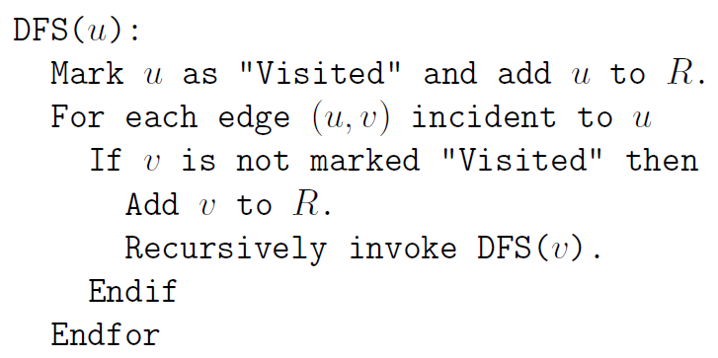
DEPTH-FIRST SEARCH

Slide 68
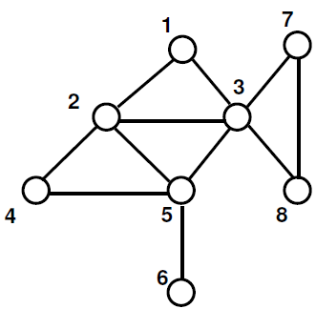
DEPTH-FIRST SEARCH

Slide 69
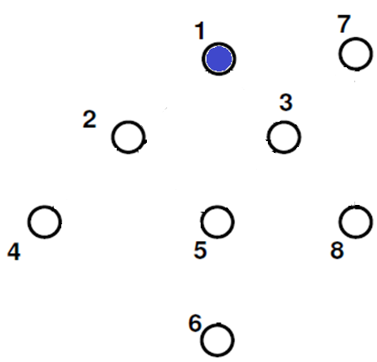
DEPTH-FIRST SEARCH
STACK
1
OUTPUT: 1

Slide 70
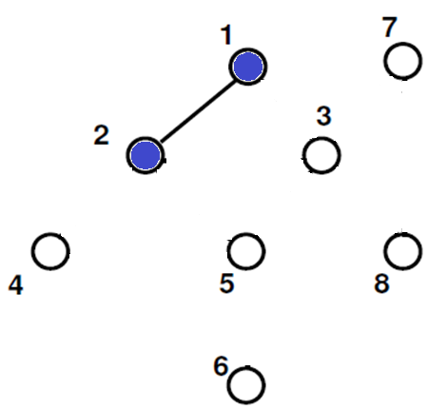
DEPTH-FIRST SEARCH
STACK
2
1
OUTPUT: 1 2

Slide 71
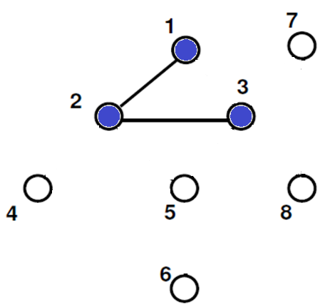
DEPTH-FIRST SEARCH
STACK
3
2
1
OUTPUT: 1 2 3

Slide 72
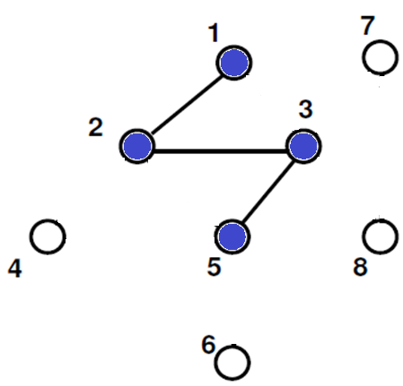
DEPTH-FIRST SEARCH
STACK
5
3
2
1
OUTPUT: 1 2 3 5

Slide 73
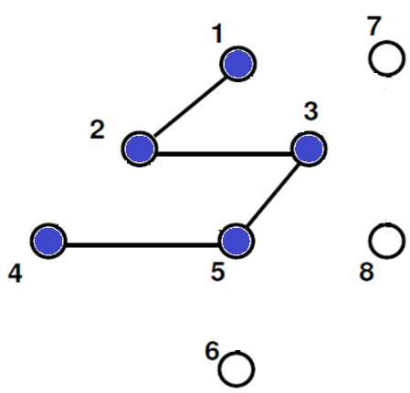
DEPTH-FIRST SEARCH
STACK
4
5
3
2
1
OUTPUT: 1 2 3 5 4

Slide 74
DEPTH-FIRST SEARCH
STACK
5
3
2
1
POP
4
OUTPUT: 1 2 3 5 4

Slide 75
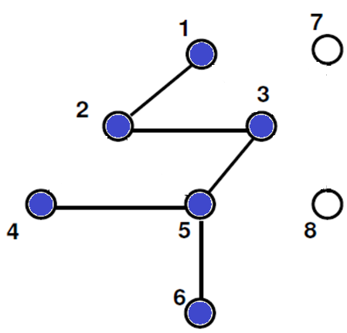
DEPTH-FIRST SEARCH
STACK
6
5
3
2
1
OUTPUT: 1 2 3 5 4 6

Slide 76
DEPTH-FIRST SEARCH
STACK
5
3
2
1
POP
6
OUTPUT: 1 2 3 5 4 6

Slide 77
DEPTH-FIRST SEARCH
STACK
3
2
1
POP
5
OUTPUT: 1 2 3 5 4 6

Slide 78
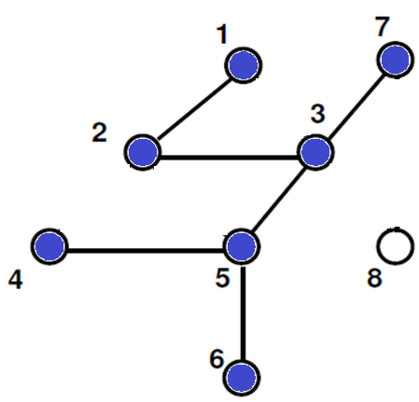
DEPTH-FIRST SEARCH
STACK
7
3
2
1
OUTPUT: 1 2 3 5 4 6 7

Slide 79
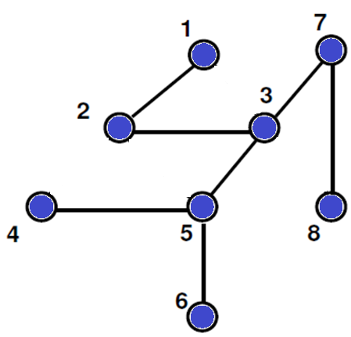
DEPTH-FIRST SEARCH
STACK
8
7
3
2
1
OUTPUT: 1 2 3 5 4 6 7 8

Slide 80
DEPTH-FIRST SEARCH
STACK EMPTY
OUTPUT: 1 2 3 5 4 6 7 8

Slide 81
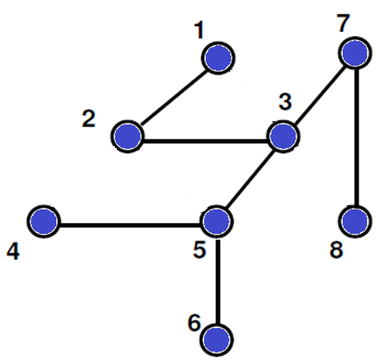
DEPTH-FIRST SEARCH
OUTPUT: 1 2 3 5 4 6 7 8

Slide 82
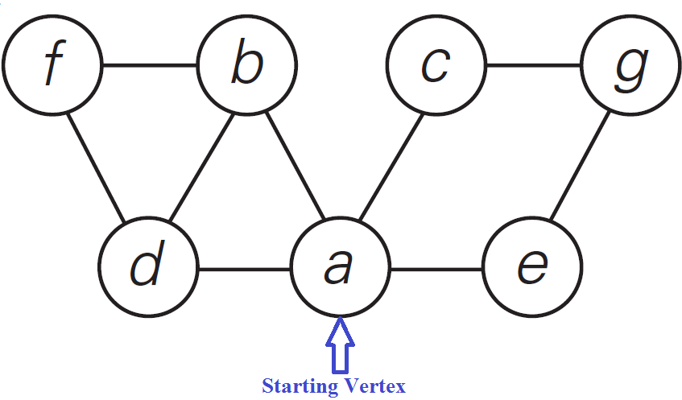
DEPTH-FIRST SEARCH

Slide 83
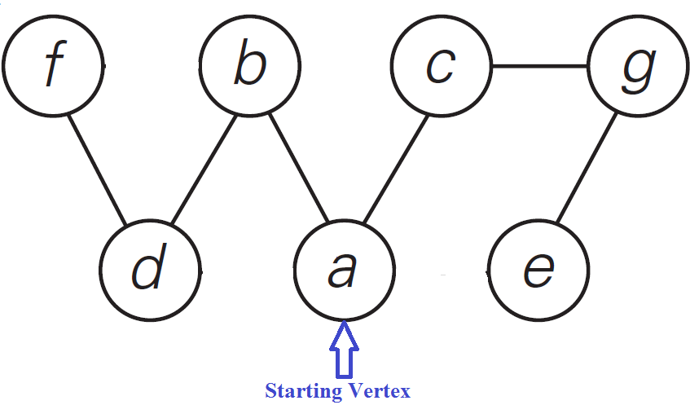
DEPTH-FIRST SEARCH

Slide 84
APPLICATIONS OF GRAPH TRAVERSALS
Testing Whether a Graph is Bipartite
Finding Cut-Points in a Graph

Slide 85
APPLICATIONS OF GRAPH TRAVERSALS
Finding Cut-Points in a Graph
A Connected graph G = (V, E), we say that u Є V is a cut-point if deleting u disconnects G.
In other words, if G – {u} is not connected.
We can think of the cut-points as the " weak points" of G, the destruction of a single cut-point separates the graph into multiple pieces.

Slide 86
DIRECTED ACYCLIC GRAPHS AND TOPOLOGICAL ORDERING

Slide 87
DIRECTED ACYCLIC GRAPHS AND TOPOLOGICAL ORDERING
If an undirected graph has no cycles, then it has an extremely simple structure.
Each of its connected components is a tree.
But it is possible for a directed graph to have no (directed) cycles and still have a very rich structure.
If a directed graph has no cycles, we call it as a directed acyclic graph, or a DAG for short.

Slide 88
THE PROBLEM
DAGs can be used to encode precedence relations or dependencies in a natural way.
Suppose we have a set of tasks labeled {1, 2, ….. , n} that need to be performed.
There are dependencies among them stipulating, for certain pairs i and j, that i must be performed before j.

Slide 89
THE PROBLEM
We can represent such an interdependent set of tasks by introducing a node for each task, and a directed edge (i, j) whenever i must be done before j.
If the precedence relation is to be at all meaningful, the resulting graph G must be a DAG.

Slide 90
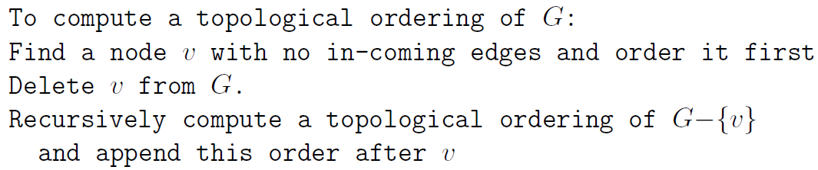
TOPOLOGICAL ORDERING
SOURCE – REMOVAL ALGORITHM

Slide 91
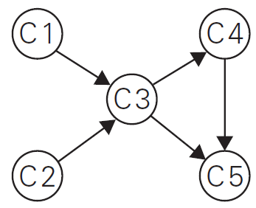
TOPOLOGICAL ORDERING

Slide 92
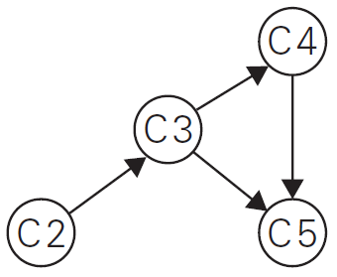
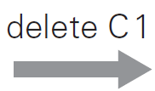
TOPOLOGICAL ORDERING
Method 1: Source – Removal Algorithm

Slide 93
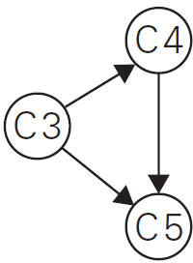

TOPOLOGICAL ORDERING

Slide 94

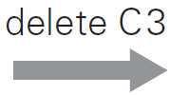
TOPOLOGICAL ORDERING

Slide 95
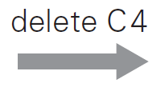
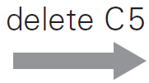

TOPOLOGICAL ORDERING

Slide 96
TOPOLOGICAL ORDERING
Method 2: Using DFS Traversal

Slide 97
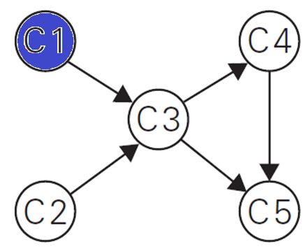
TOPOLOGICAL ORDERING
STACK
C1

Slide 98
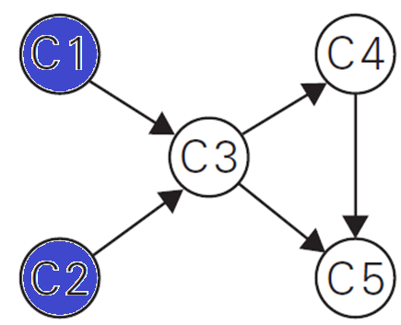
TOPOLOGICAL ORDERING
STACK
C2
C1

Slide 99
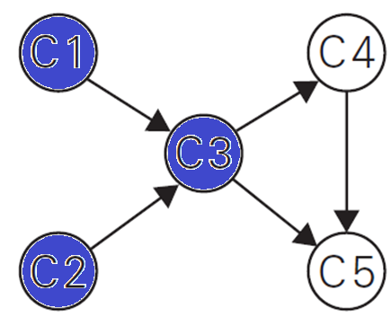
TOPOLOGICAL ORDERING
STACK
C3
C2
C1

Slide 100
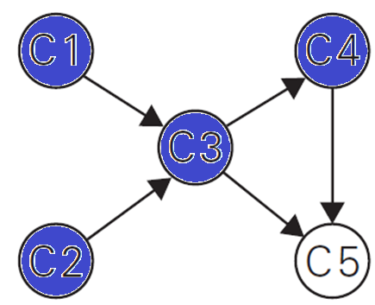
TOPOLOGICAL ORDERING
STACK
C4
C3
C2
C1

Slide 101
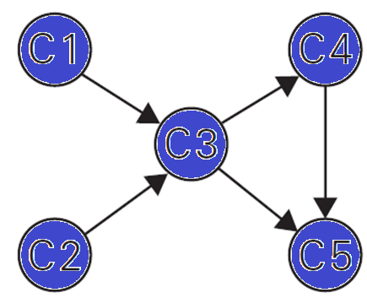
TOPOLOGICAL ORDERING
STACK
C5
C4
C3
C2
C1

Slide 102
TOPOLOGICAL ORDERING
STACK
C5
C4
C3
C2
C1
POP C5

Slide 103
TOPOLOGICAL ORDERING
STACK
C4
C3
C2
C1
POP C4

Slide 104
TOPOLOGICAL ORDERING
STACK
C3
C2
C1
POP C3

Slide 105
TOPOLOGICAL ORDERING
STACK
C2
C1
POP C2

Slide 106
TOPOLOGICAL ORDERING
STACK
C1
POP C1

Slide 107
TOPOLOGICAL ORDERING
POPPING OFF ORDER
C5
C4
C3
C2
C1
Topologically Sorted List:
C1 🡪 C2 🡪 C3 🡪 C4 🡪 C5

Slide 108
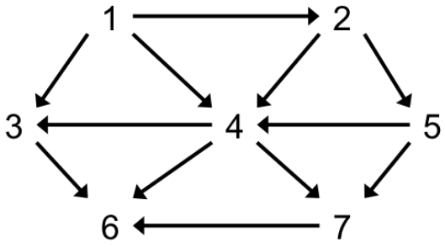
TOPOLOGICAL ORDERING
Method 1: Using Source - Removal

Slide 109
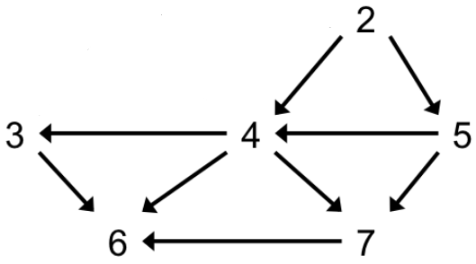
TOPOLOGICAL ORDERING
Delete Vertex 1

Slide 110
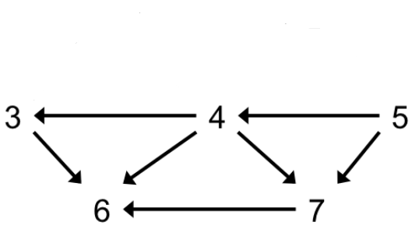
TOPOLOGICAL ORDERING
Delete Vertex 2

Slide 111
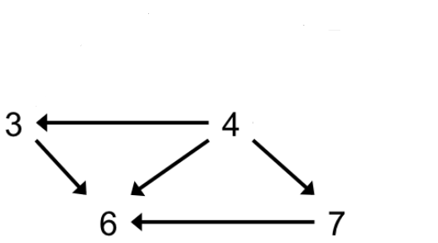
TOPOLOGICAL ORDERING
Delete Vertex 5

Slide 112
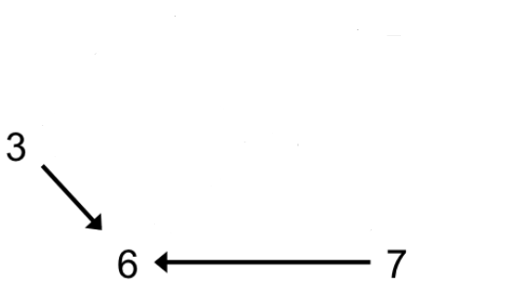
TOPOLOGICAL ORDERING
Delete Vertex 4

Slide 113

TOPOLOGICAL ORDERING
Delete Vertex 3

Slide 114

TOPOLOGICAL ORDERING
Delete Vertex 7
Delete Vertex 6
Solution: 1 2 5 4 3 7 6

Slide 115
ANALYSIS OF TOPOLOGICAL ORDERING

Slide 116
ANALYSIS
If G has a topological ordering, then G is a DAG.
Proof
Suppose, by way of contradiction, that G has a topological ordering v1, v2, . . . , vn, and also has a cycle C.
Let vi be the lowest-indexed node on C, and let vj be the node on C just before vi—thus (vj , vi) is an edge.
But by our choice of i, we have j > i, which contradicts the assumption that v1, v2, . . . , vn was a topological ordering.

Slide 117
ANALYSIS
If G is a DAG, then G has a topological ordering.
Proof
Since G is a DAG, there is a node v with no incoming edges.
We place v first in the topological ordering; this is safe, since all edges out of v will point forward.

Slide 118
ANALYSIS
Now G−{v} is a DAG, since deleting v cannot create any cycles that weren’t there previously.
Also, G−{v} has n nodes, so we can apply the induction hypothesis to obtain a topological ordering of G−{v}.
We append the nodes of G−{v} in this order after v; this is an ordering of G in which all edges point forward, and hence it is a topological ordering.

Slide 119
THANK YOU

