Slide 1

Dr.Mahalingam College of Engineering & Technology
Department of Artificial Intelligence & Data Science
Team Number : A12
Domain : Artificial Intelligence and Machine Learning
Title :Nova Notes: An Adaptive Placement Preparation and Readiness Platform
Faculty Supervisor : Mr.A.VishnuPrasath, AP(SS)/AI&DS
Team Members : Bathri Narayanan S (727624BAD067) ,
Neeraj k (727624BAD001) ,
Bruthivi Raj J (727624BAD107)

Slide 2
Contents
Problem Statement
Existing System
Abstract
Research Gap
Objectives
Proposed System
Dataset Collection
Assessment Structure
Methodology
Model Explanation
Prototype – 90% Demo
Expected Output
Tools & Technologies

Slide 3
Problem Statement
Students use multiple platforms for placement preparation, coding practice, assessments and interview preparation.
• Existing platforms often provide practice and assessments separately without continuous personalization.
• Students may know their assessment score but cannot clearly identify their weak topics.
• Repeated assessments may contain previously attempted questions, reducing the effectiveness of reattempts.
• There is no continuous connection between assessment performance, weak-topic identification, adaptive reattempt and interview preparation.
Need:
A unified platform for adaptive, role-specific placement preparation and readiness tracking.

Slide 4
Existing System
Existing System – Leetcode,HackerRank,ScholarPlace
ScholarPlace is a campus placement preparation platform for engineering colleges.
It provides DSA and aptitude preparation, weekly tests, mock assessments and performance analytics.
Colleges can monitor student performance through a placement dashboard.
Limitations :
Mainly focuses on structured preparation, tests and performance tracking.
It does not specifically implement our role-specific adaptive assessment and reattempt workflow.
It does not connect weak-topic detection → different-question reattempt → qualification → AI HR interview as one continuous process.

Slide 5
Abstract
Nova Notes is an adaptive placement preparation and readiness platform designed for students.
Students select a specific placement role and access role-based practice and assessments.
Assessment performance is analyzed to identify weak topics and skill gaps.
Students scoring below the qualification threshold receive an adaptive reattempt with different questions focused on their weak areas.
Students who qualify can proceed to an AI-based HR mock interview.
Interview responses are evaluated based on relevance, correctness, clarity, completeness and professionalism.
The platform combines practice, assessment, interview and activity data to provide an internal placement readiness indicator.

Slide 6
Research Gap
Existing placement platforms provide combinations of practice, assessments, adaptive learning and mock interviews.
However, these features are often provided as separate modules rather than one continuous workflow.
There is limited focus on connecting individual assessment history with weak-topic-based remediation.
Reattempt mechanisms do not always explicitly exclude the student's previously attempted questions.
There is a gap in connecting adaptive assessment → qualification → interview unlocking → readiness tracking as a single state-driven process.
Research Gap Identified:
A need exists for a closed-loop placement preparation system that uses individual assessment performance and question history to continuously personalize the student's next preparation stage.

Slide 7
Objectives
Develop a centralized platform for role-specific placement preparation.
Provide technical practice using different question formats.
Conduct role-specific assessments and calculate student performance.
Identify weak topics and skill gaps from assessment results.
Generate adaptive reattempts using different questions based on weak areas.
Provide an AI-based HR mock interview for qualified students.
Track practice, assessment, interview and activity performance.
Provide an internal placement readiness indicator.

Slide 8
Proposed System
Role Selection – Python Developer, Java Developer, Data Analyst, Data Scientist, ML Engineer, Web Developer, Full Stack Developer and Software Developer.
Practice – MCQ, MSQ, Output/Pseudocode and Coding.
Role-Based Assessment – Questions selected according to role, topic and difficulty.
Weak Topic Analysis – Identifies topics where the student performs poorly.
Adaptive Reattempt – Generates a new assessment focused on weak topics while excluding previously attempted questions.
Qualification – Students achieving 70% or above qualify.
AI HR Interview – Unlocked after qualifying in the selected role.
Progress & Readiness – Tracks performance and provides an internal readiness indicator.

Slide 9
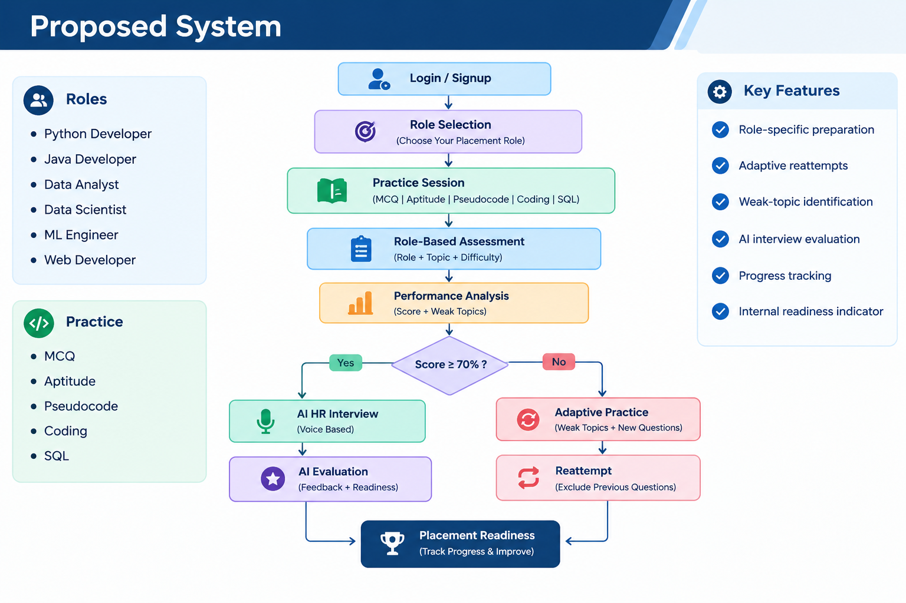
Proposed System (conts)

Slide 10
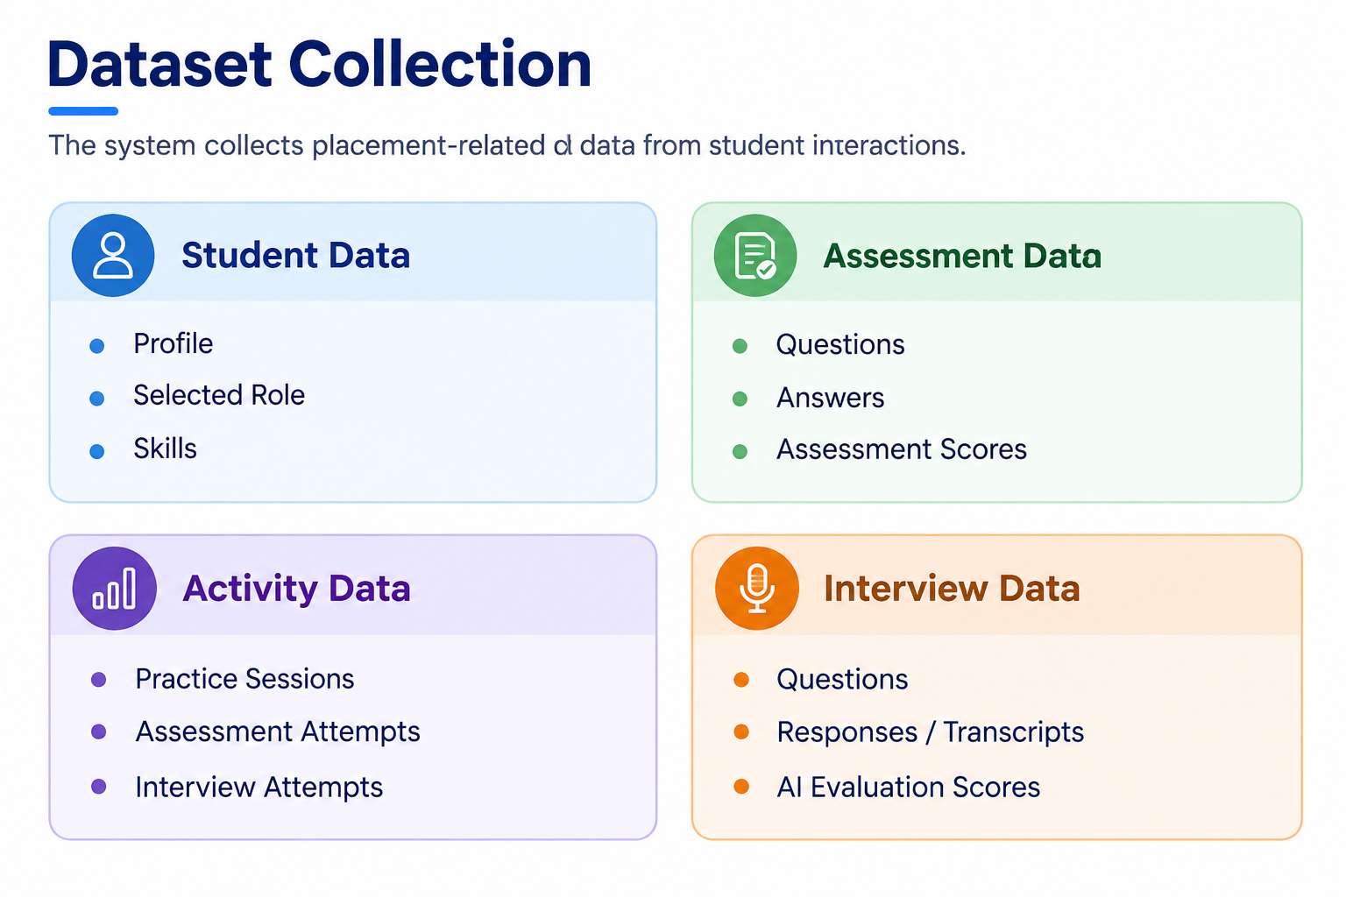
Dataset Collection

Slide 11
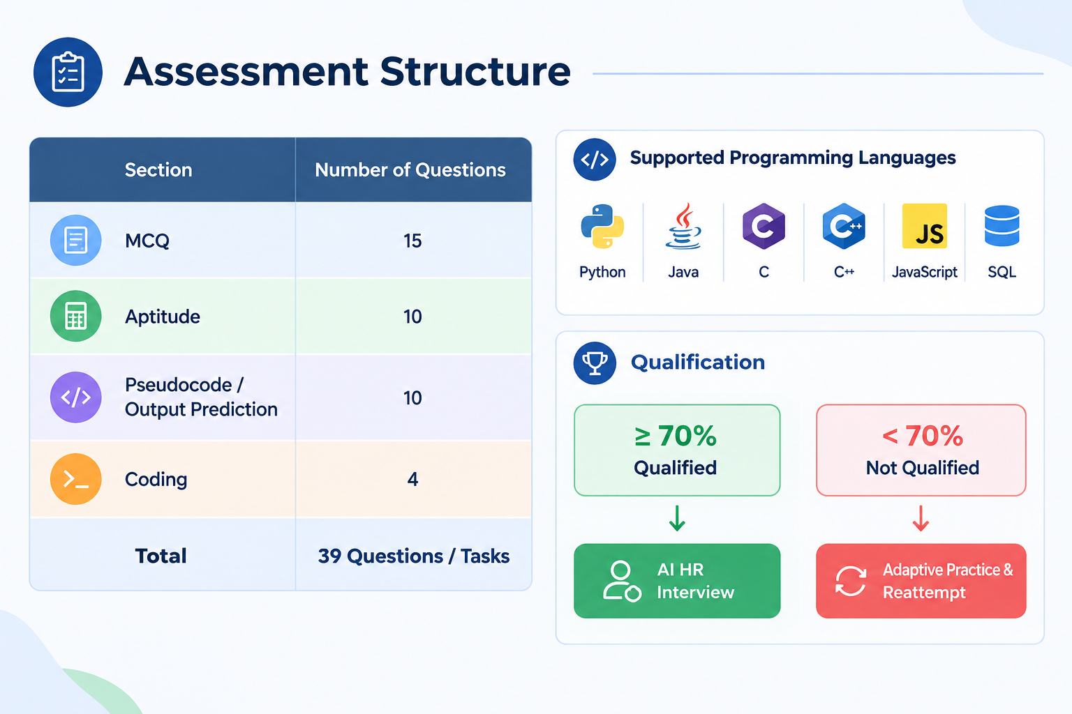
Assessment Structure

Slide 12
Methodology
Login → Role Selection → Practice → Assessment → Performance Analysis → Adaptive Reattempt → AI Interview
Techniques Used :
Question Randomization — Role, topic and difficulty-based question selection
Assessment Evaluation — Answer comparison and score calculation
Weak Topic Analysis — Identifies low-performing topics
Adaptive Recommendation — Generates targeted practice based on weak topics
State Management — Controls assessment and interview access based on qualification

Slide 13
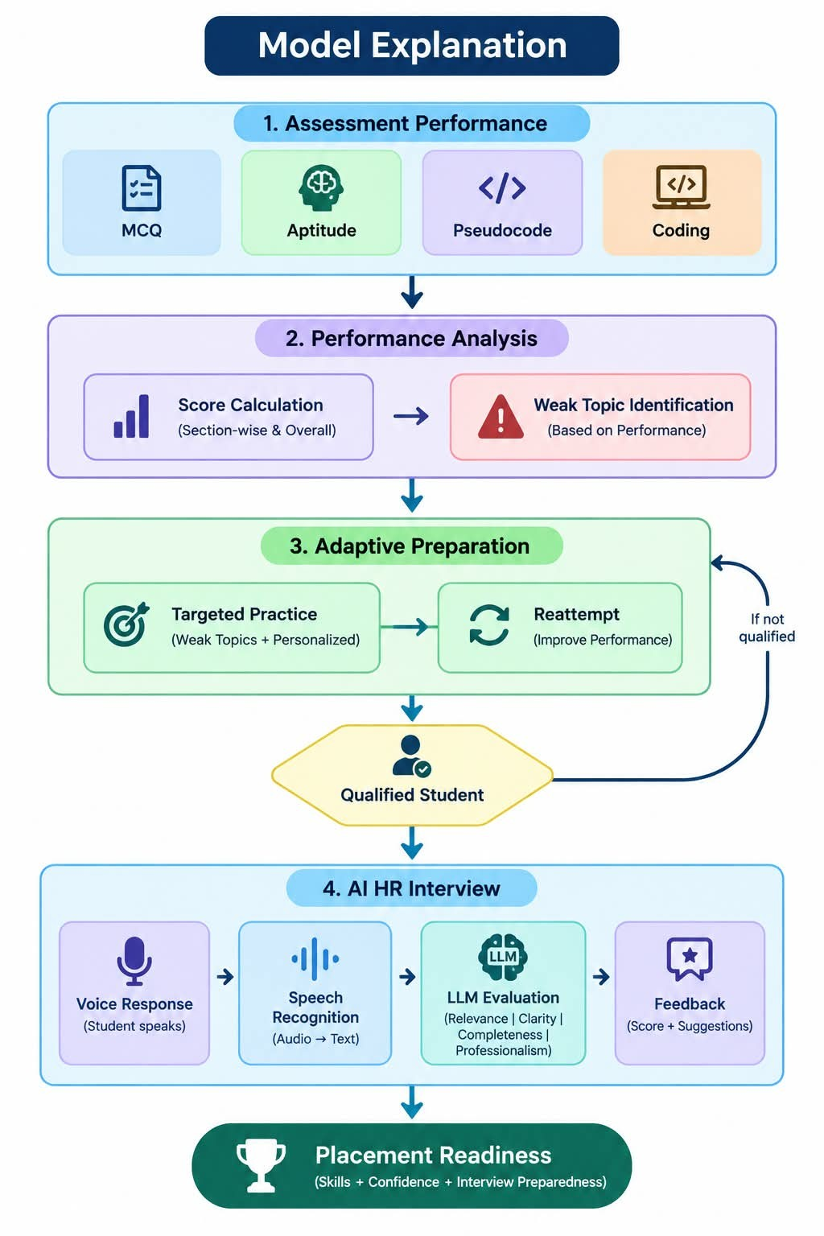
Model Explanation
1. Performance Analysis
Assessment → Scores → Weak Topics
2. Adaptive Recommendation
Weak Topics → Targeted Practice → Reattempt
3. AI Interview Evaluation
Voice → Speech Recognition → LLM →
Feedback
Evaluation Factors:
Relevance | Correctness | Clarity | Completeness | Professionalism

Slide 14
Prototype
User Signup & Login
Profile Management
Role Selection
Skill Practice & Topic-wise Practice
Role-Based Assessment
Result & Progress Tracking
Demo Flow:
Login → Dashboard → Role Selection → Practice → Assessment → Result

Slide 15
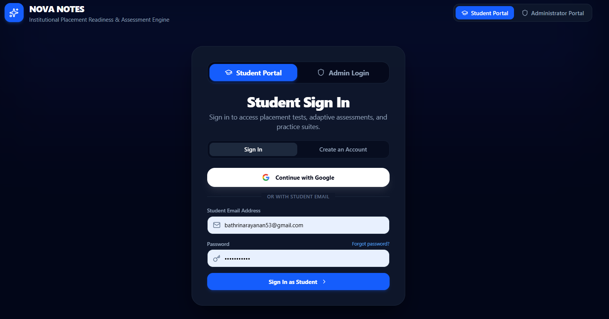
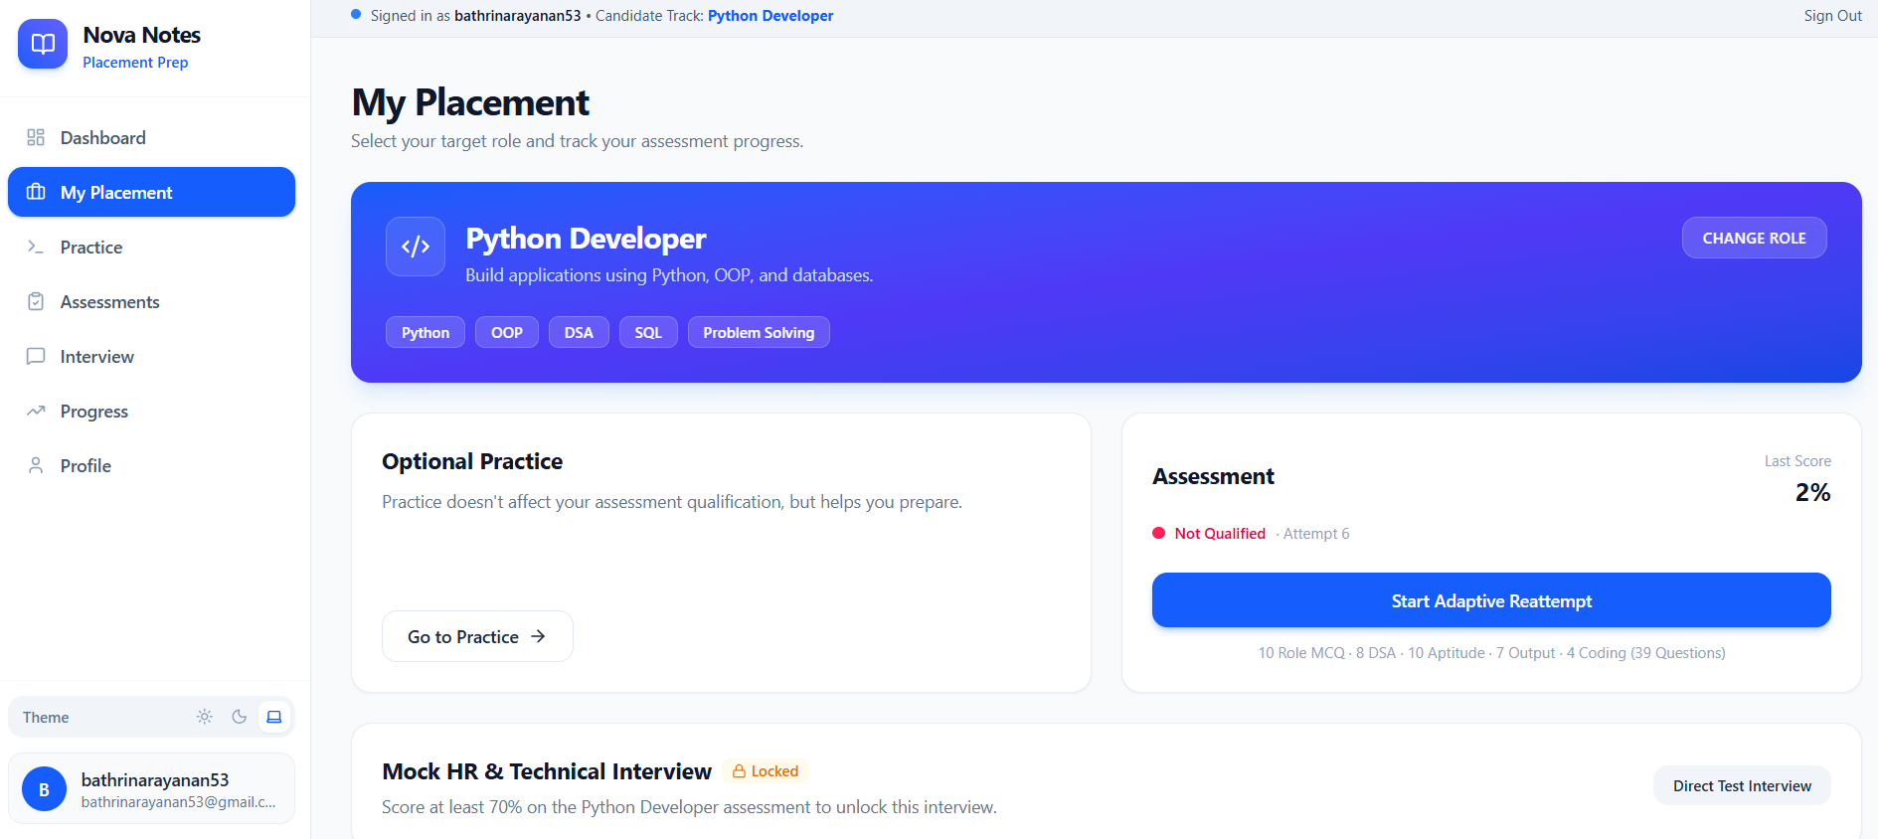
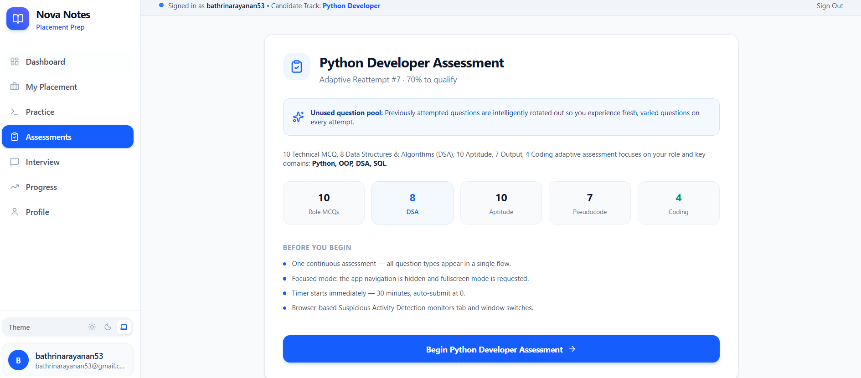
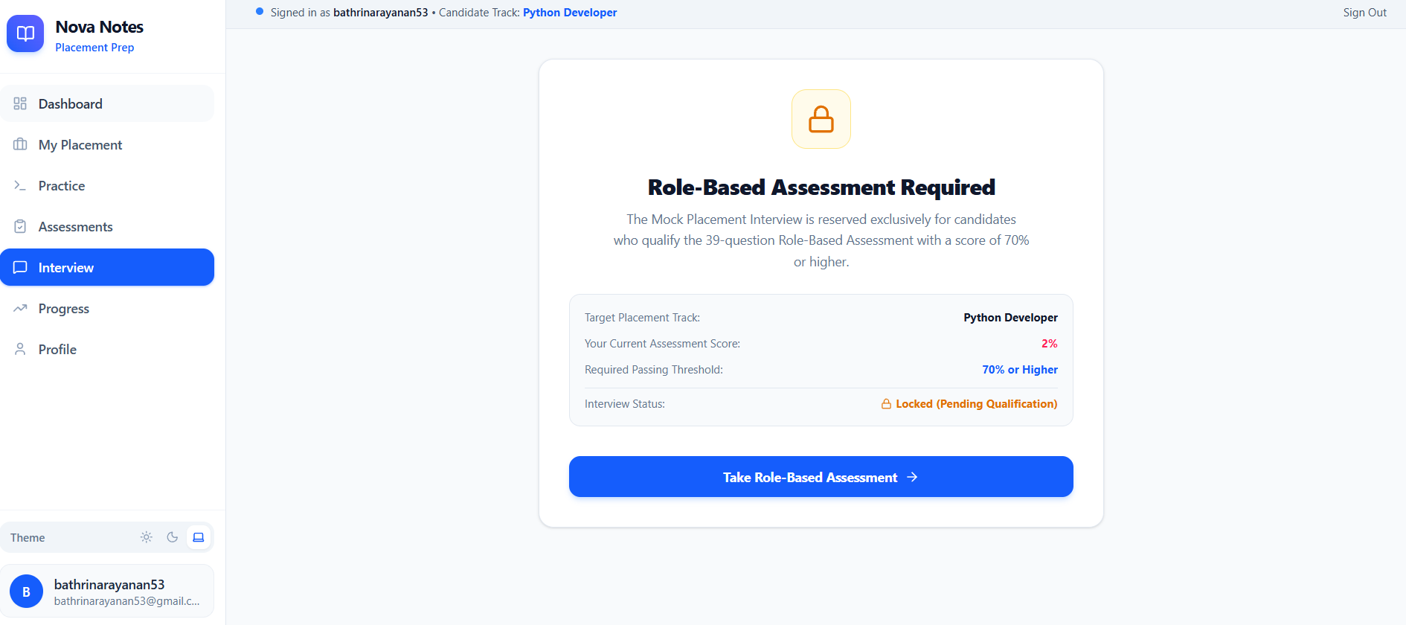
Prototype

Slide 16
Expected Output
Assessment Evaluation
Overall Score | Section Scores | Qualification Status
Performance Analysis
Weak Topics | Skill Gaps | Attempt History
Adaptive Preparation
Targeted Practice | Different Questions | Reattempt
AI HR Interview
Voice Response | AI Evaluation | Feedback
Final Output
Placement Readiness Indicator

Slide 17
Tools & Technologies
Frontend : Backend & Database :
Next.js Supabase
TypeScript PostgreSQL
Tailwind CSS
Authentication & Storage : Development :
Supabase Auth VS Code
Supabase Storage Git / GitHub

Slide 18
System Architecture
STUDENT
↓
Next.js Frontend
↓
Supabase Authentication
↓
┌─────────────┴─────────────┐
↓ ↓
PostgreSQL AI Services
↓ ↓
Users / Questions LLM Evaluation
Assessments / Attempts Speech Recognition
Scores / Progress Speech Synthesis
↓ ↓
Performance Data Interview Data
↓ ↓
Progress Tracking AI Interview Evaluation

Slide 19
Conclusion
Nova Notes provides a unified placement preparation environment.
Role-specific practice and assessment are integrated.
Student performance is analyzed to identify weak topics.
Adaptive practice supports targeted reattempts.
AI-based HR interview evaluation extends the preparation workflow.
Assessment, practice and interview activities contribute to placement readiness.
Future Scope :
More Roles | Larger Question Bank | Advanced Recommendations | Interview Analytics

Slide 20
References
Al-Karaki, J. N., et al. (2022). AI-Based Personalized E-Learning Systems: Issues, Challenges, and Solutions. IEEE Access, 10, 81323–81342.
https://ieeexplore.ieee.org/document/9840390/
Artificial Intelligence-Based Personalised Learning in Education: A Systematic Literature Review (2025). Discover Artificial Intelligence.
https://link.springer.com/article/10.1007/s44163-025-00598-x

Slide 21
THANK YOU

