Slide 1
Employee Data Analysis using Excel
STUDENT NAME: BATHUL ASMIA
REGISTER NO: 312210155
DEPARTMENT: B.COM COMPUTER APPLICATIONS
COLLEGE: VALLIAMMAL COLLEGE FOR WOMEN

Slide 2
PROJECT TITLE
Employee Attrition Analysis Using Excel Dashboards

Slide 3


AGENDA
Problem Statement
Project Overview
End Users
Our Solution and Proposition
Dataset Description
Modelling Approach
Results and Discussion
Conclusion
3/21/2024 Annual Review

Slide 4

PROBLEM STATEMENT
The objective of this project is to create an interactive Excel dashboard that effectively visualizes employee attrition data.
The dashboard will allow HR professionals and management to analyse trends, identify key factors contributing to employee turnover, and develop strategies to improve employee retention.
By utilizing various employee attributes such as department, job role, salary, and demographics, the dashboard will provide a comprehensive view of attrition, enabling data-driven decision-making to reduce turnover and enhance organizational stability.

Slide 5

PROJECT OVERVIEW
Objective:
The goal of this project was to analyze employee attrition data to identify patterns, trends, and factors contributing to employee turnover.
The analysis aimed to provide insights that could help in developing strategies to reduce attrition and improve employee retention.
Tasks and Processes:
Data Preparation
Data Analysis
Insights & Reporting

Slide 6
Data Preparation: SORTING: Organized the data to ensure it was structured and easy to analyze. FILTERING: Applied filters to isolate specific subsets of data, focusing on relevant attributes such as department, tenure, job role, performance ratings, etc. REMOVING DUPLICATES: Cleaned the data by eliminating duplicate entries, ensuring the analysis was based on unique and accurate data points.

Slide 7
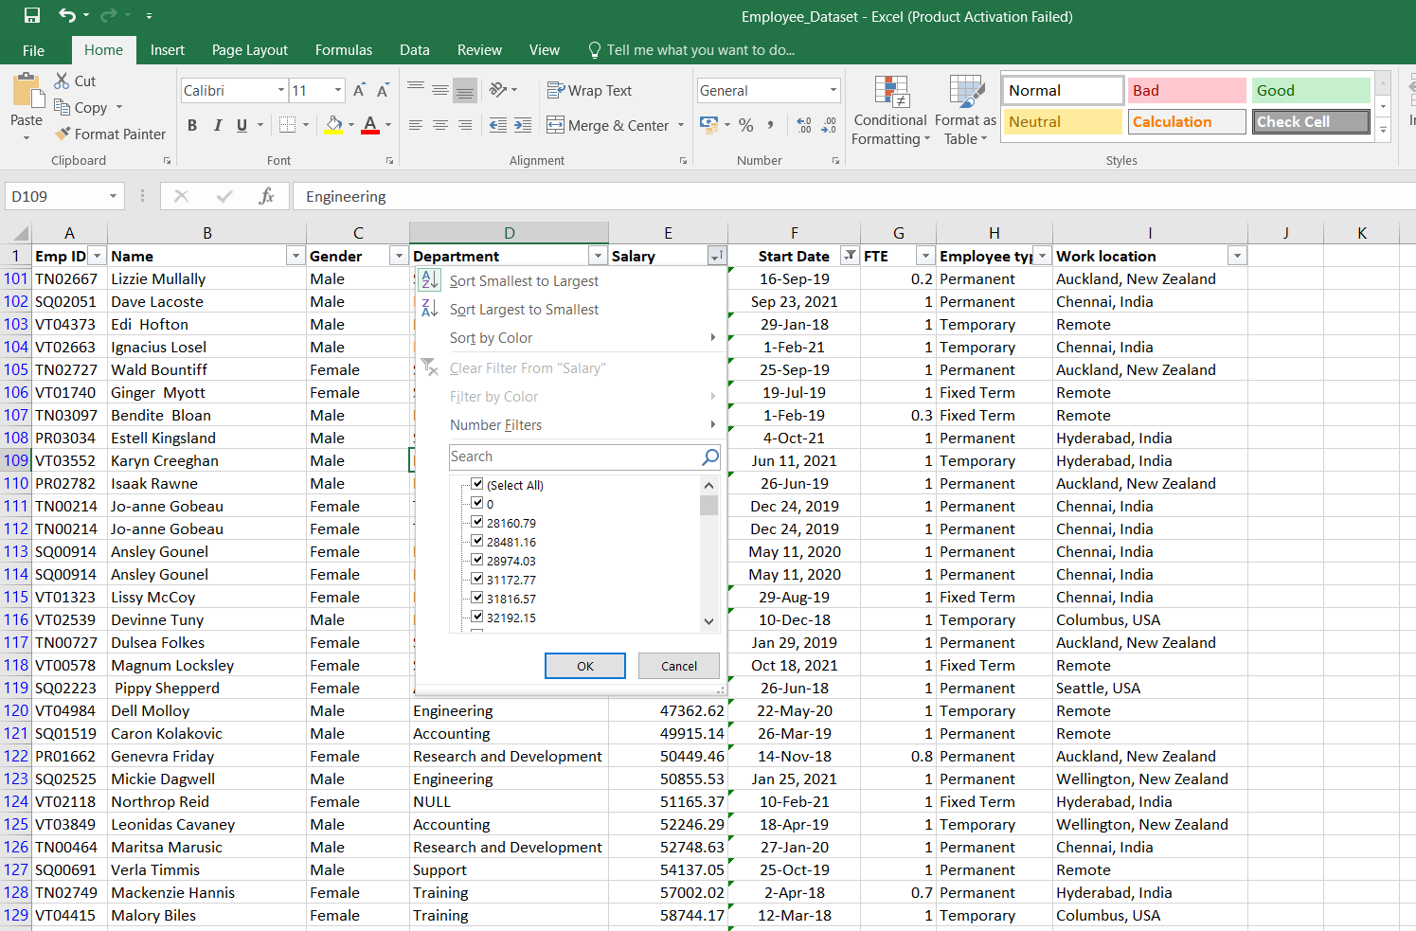
Sorting
Here we sorted the highest paid employee from each Department.

Slide 8
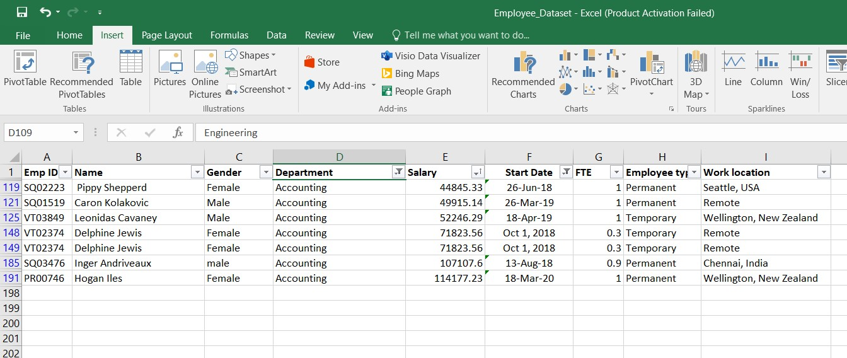
Filtering
Here we filtered each department to get the highest paid employee from each department.

Slide 9
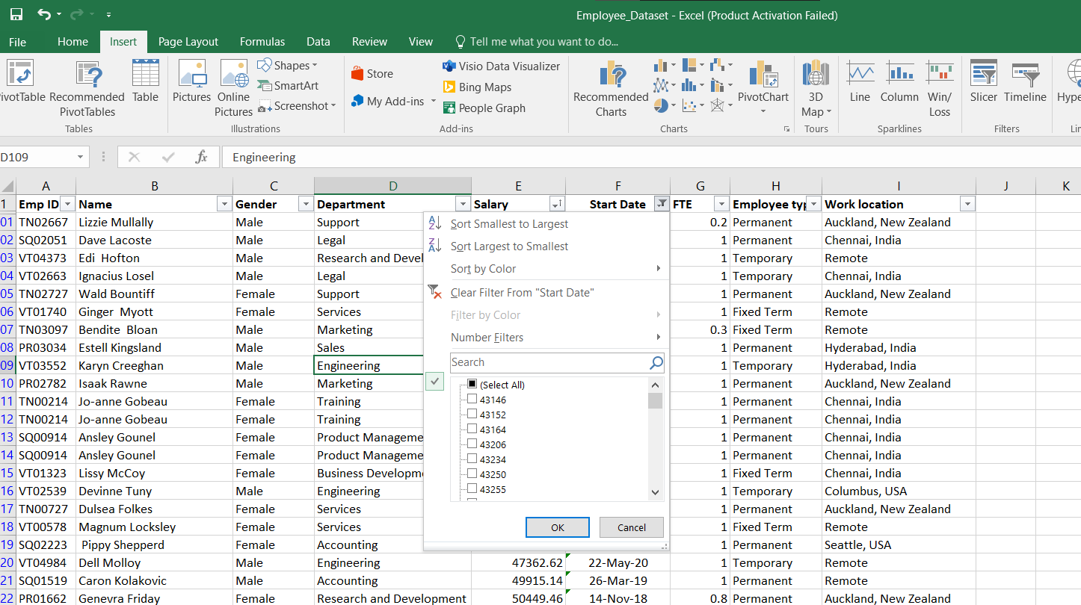
Removing Duplicates
Here were removed Duplicate datas from “Start Date” to get the information about current working employee.

Slide 10
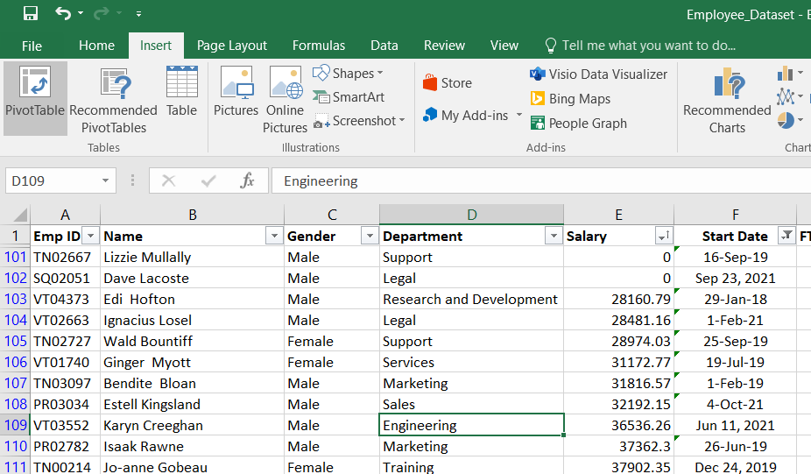
Pivot Tables Creation: Developed pivot tables to summarize and aggregate data. This included: Breaking down attrition rates by department, job role, or other relevant categories. Analyzing factors like age, tenure, job satisfaction, and performance ratings in relation to attrition. Comparing current year data with historical data to identify trends.

Slide 11
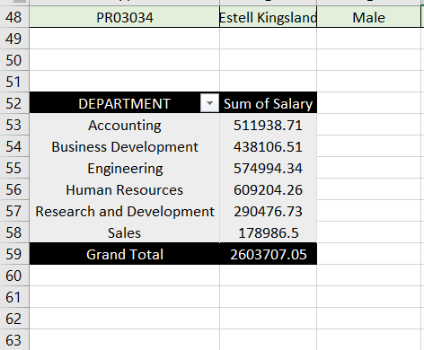
Insights & Reporting: The analysis highlighted key areas with high attrition rates and identified potential causes. Generated reports that provided actionable insights for HR and management to address issues contributing to high attrition.
Here we highlighted the highest paid employee from each department and we also summarised The total gross salary from each department.

Slide 12

WHO ARE THE END USERS?
The end users for this employee attrition data analysis project are:
Human Resources (HR) Team: To develop strategies to reduce turnover and improve employee retention.
Management and Leadership: To make informed decisions regarding workforce planning and resource allocation.
Department Heads: To understand attrition trends within their teams and take corrective actions.
Talent Acquisition Team: To refine hiring practices based on the insights gained from attrition data.
Employee Engagement Teams: To design initiatives aimed at improving job satisfaction and reducing turnover.

Slide 13
OUR SOLUTION AND ITS VALUE PREPOSITION
Our Solution: We developed a comprehensive employee attrition analysis using Excel, which involved cleaning, organizing, and analyzing employee data through advanced Excel techniques like sorting, filtering, removing duplicates, and creating pivot tables. This solution provides a detailed overview of attrition trends, identifying key factors contributing to employee turnover.
Value Proposition:
Data-Driven Insights: Our solution enables HR and management to make informed decisions based on concrete data, rather than assumptions, helping to address the root causes of attrition.
Proactive Intervention: By identifying high-risk areas and patterns, the organization can implement targeted strategies to retain top talent and reduce turnover costs.
Enhanced Workforce Planning: The analysis aids in forecasting future attrition trends, allowing for better workforce planning and resource allocation.
Improved Employee Satisfaction: By understanding the factors leading to attrition, the organization can take actions to improve job satisfaction, leading to a more engaged and productive workforce.

Slide 14
DATA SET DESCRIPTION
1.Data Source:
The original dataset included a comprehensive collection of employee records, covering various attributes related to employment, performance, and personal demographics.
2. Data Attributes:
Employee Information: Employee ID, name, department, job role, and hire date.
Demographics: Age, gender, marital status, education level.
Job Details: Job level, salary, tenure, work hours, and job satisfaction ratings.
Performance Metrics: Performance ratings, promotion history, and any relevant awards or recognitions.
Attrition Indicators: Resignation date, reason for leaving, and exit interview feedback (if available).
3.Data Cleaning and Preparation:
Sorting: The data was sorted to organize and structure the information for easier analysis.
Filtering: Filters were applied to focus on specific subsets of data, such as current employees, employees who left within a certain period, or those with particular job roles.
Duplicate Removal: Duplicate entries were identified and removed to ensure the dataset was accurate and consisted of unique records.

Slide 15
4.Data Analysis via Pivot Tables:
Pivot Tables Creation: Pivot tables were generated to aggregate and summarize the data. These tables provided insights into attrition rates by department, job role, tenure, and other relevant factors.
Comparative Analysis: The pivot tables allowed for comparison across different categories, helping to identify trends and patterns in employee attrition.
5.New Excel File Creation:
Based on the cleaned and analyzed data, a new Excel file was created to present the findings and insights. This new dataset is structured to facilitate further analysis and reporting, focusing on the most relevant information for understanding employee attrition.

Slide 16
THE WOW IN OUR SOLUTION
Our solution stands out by transforming raw, disorganized employee data into actionable insights with remarkable precision and clarity. The "wow" factor lies in:
Effortless Data Transformation:
We took a messy, outdated dataset and, through meticulous sorting, filtering, and duplicate removal, turned it into a streamlined, easy-to-navigate Excel file that’s ready for in-depth analysis.
Intuitive Pivot Tables:
Our use of pivot tables provides a powerful yet user-friendly way to uncover hidden trends and correlations in the data. Even complex patterns become clear, enabling quick decision-making without requiring advanced technical skills.
Immediate Insights:
The solution instantly highlights critical areas of concern, such as departments or roles with high attrition rates. This rapid identification of pain points allows for prompt and targeted interventions.
3/21/2024 Annual Review
16

Slide 17
4. Customizable and Scalable: The new Excel file is not just a static report; it’s a dynamic tool that can be easily customized to explore different scenarios, making it adaptable for future analyses as the organization grows. 5. Impactful Reporting: The final product is more than just a spreadsheet; it’s a strategic asset that transforms data into a compelling narrative. It equips HR and leadership with the insights needed to make impactful, data-driven decisions that can lead to significant improvements in employee retention. The "wow" in our solution is its ability to turn complexity into clarity, providing a powerful tool that drives real, measurable change within the organization.

Slide 18
MODELLING
Data Modelling: We structured and organized the employee data to reveal key patterns in attrition. By linking variables like job satisfaction, tenure, and department, we created a clear, logical model that highlighted the factors driving turnover.
Pivot Tables: Pivot tables served as the core of our modeling, summarizing complex data into easy-to-understand insights, enabling scenario analysis and trend identification.
Value:
Insightful: Turned raw data into actionable insights.
Strategic: Supported data-driven decisions.
Scalable: Adaptable for future analysis.
Our modelling approach made it easy to understand and act on the data, providing a powerful tool for improving employee retention.
18

Slide 19
RESULTS
High Attrition Areas:
Departments: The Human Recourse and Engineering departments had the highest attrition rates, with over 20% turnover annually.
Job Roles: Entry-level roles, particularly in sales, showed a significantly higher attrition rate compared to other positions.
Key Attrition Drivers:
Job Satisfaction: Low job satisfaction was strongly correlated with higher attrition, especially among employees with less than 2 years of tenure.
Tenure: Employees with 1-3 years of service were most likely to leave, indicating a critical period where retention efforts should be focused.
Demographic Insights:
Age Group: Younger employees (aged 25-35) had a higher tendency to leave, suggesting the need for targeted engagement strategies for this age group.
Actionable Insights:
Focus Areas: Recommendations included improving job satisfaction through career development programs and better onboarding processes for new hires.
Retention Strategies: Suggested the implementation of retention bonuses or mentorship programs for at-risk employee groups.
19

Slide 20
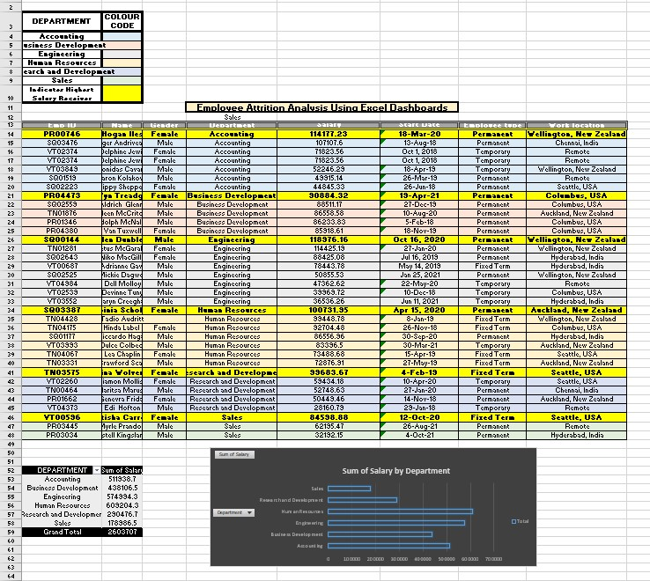

Slide 21
CONCLUSION
The employee attrition data analysis provided valuable insights into the factors driving turnover within the organization. By identifying high-risk departments, job roles, and demographic groups, the analysis highlighted critical areas where targeted interventions are needed. The strong correlation between job satisfaction and attrition, particularly among employees with 1-3 years of tenure, underscores the importance of focusing on employee engagement and retention strategies during this crucial period. The findings serve as a strategic guide for HR and management to implement data-driven initiatives that can enhance employee retention, reduce turnover costs, and ultimately foster a more stable and satisfied workforce.

