Slide 1
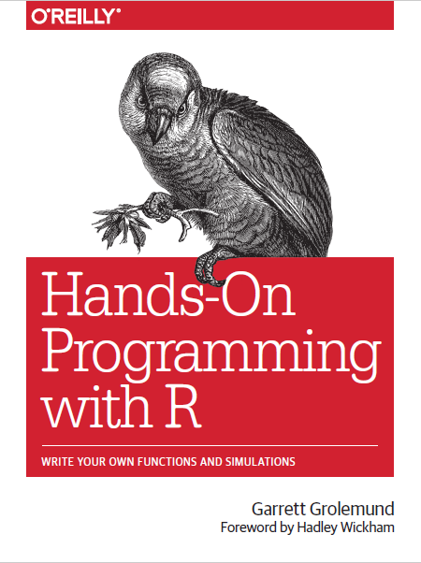
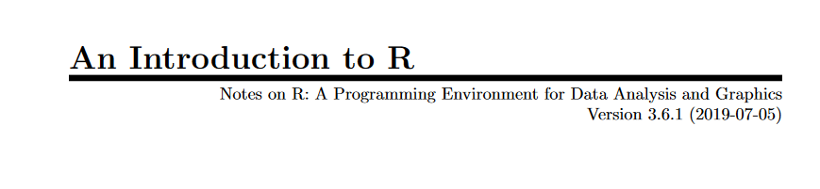
Objects and operations in R
Or one of the most common sources of frustration in R
By W. N. Venables, D. M. Smithand the R Core Team

Slide 2
Download the script and files
https://github.com/Batis007/R_Course_UA_2020

Slide 3
Data types vs Data structures
R has 6 basic data types.
Character
Numeric (real or decimal)
Integer
Logical
Complex
Raw
And what about data structures in R?

Slide 4
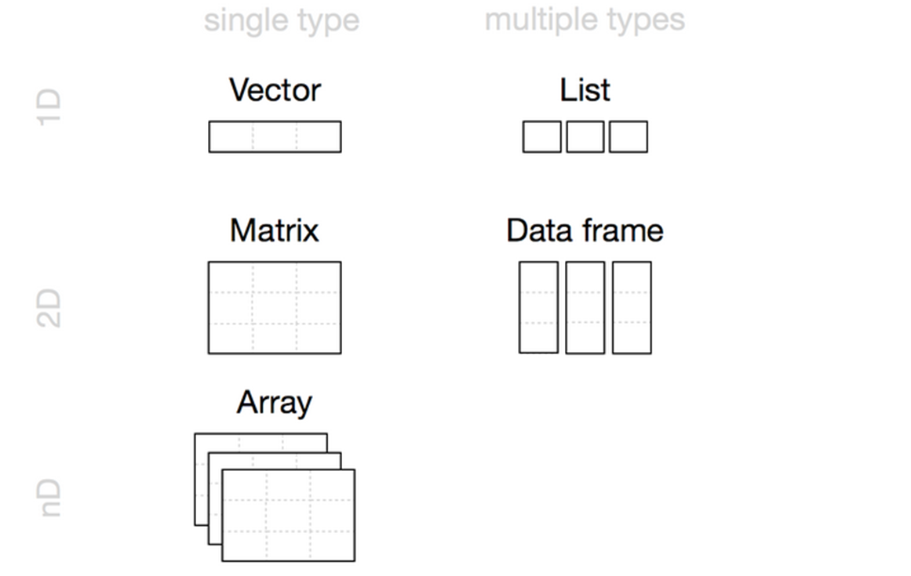
Data structures
Vector
Matrix
Array
Lists
Data Frames

Slide 5
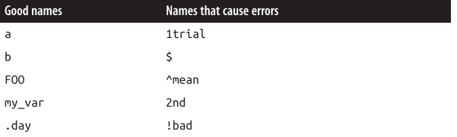
Let’s create some objects!

Slide 6
Vector
Each atomic vector stores its values as a one-dimensional vector, and each atomic vector can only store one type of data.
There are six common types of R Atomic Vectors:
Doubles
Integers
Characters
Logicals
Complex (Bonus lecture – extra fee)
Raw (Bonus lecture – extra fee)
Operator | Description
< | Less than
> | Greater than
<= | Less than or equal to
>= | Greater than or equal to
== | Equal to
!= | Not equal to

Slide 7
Matrix
Matrices store values in a two-dimensional array, just like a matrix from linear algebra.
Array
The array function creates an n-dimensional array. For example, you could use array to sort values into a cube of three dimensions or a hypercube in 4, 5, or n dimensions
Lists
Lists are like atomic vectors because they group data into a one-dimensional set. How‐ ever, lists do not group together individual values; lists group together R objects, such as atomic vectors and other lists.
Data frames
Data frames are the two-dimensional version of a list. They are far and away the most useful storage structure for data analysis, and they provide an ideal way to store an entire deck of cards. You can think of a data frame as R’s equivalent to the Excel spreadsheet because it stores data in a similar format.

